Slide 1
Census statistics – ensuring quality in a time of major change
David Thorogood
Eurostat

Slide 2
Census statistics – ensuring quality in a time of major change
Role of the census at the heart of the statistical system
How are censuses changing?
Pressures for change
Use of administrative data
Maintaining the quality of the census
Management and planning
Concepts and definitions
Accuracy
European census frameworks

Slide 3
A very public need for a high quality statistical operation
Key source of statistics on size, structure and conditions of the population
Budget allocation
Political/electoral representation
Foundation for other statistical activities
High political and media profile
Often controversial, often challenged
Large and expensive exercise
Important it is done well
– and can be shown to be reliable

Slide 4
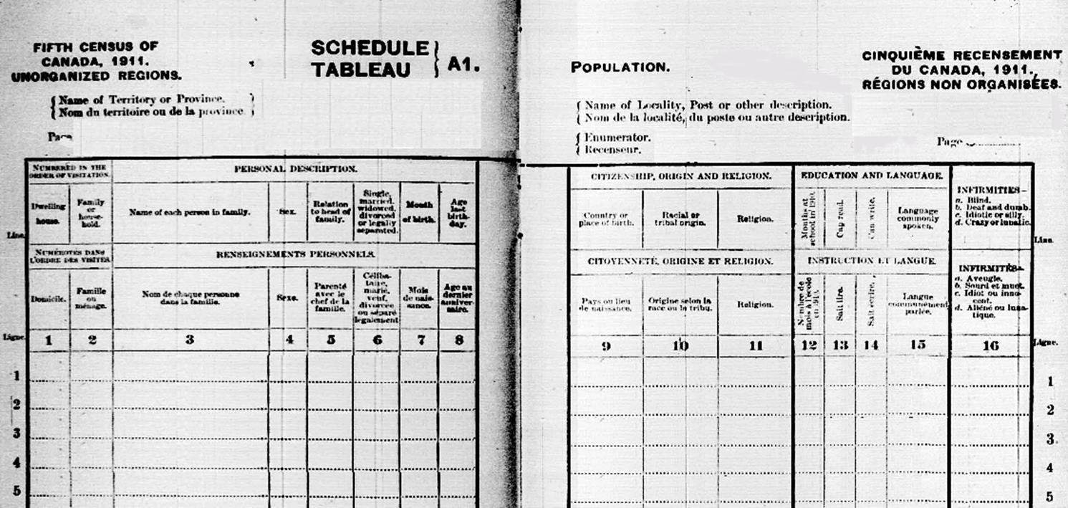

Slide 5
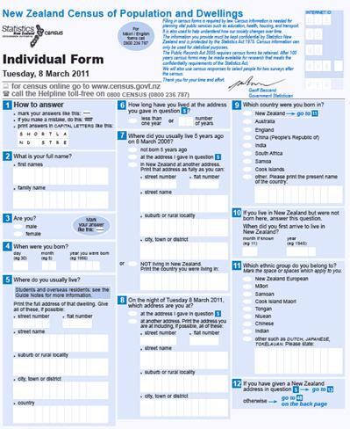

Slide 6
A generalised view of changes to census methods and data sources
1800s – 1970s
Door-to-door enumeration
1980s -1990s
A few countries moving to administrative data censuses
2001 -2011
Around half of European countries using ‘non-traditional’ census methods
2021 …
Evidence that many more countries will abandon the census enumeration

Slide 7
Main new census methods
Administrative sources
Often multiple sources
Ideally linked using common ID numbers – personal numbers, building reference numbers etc.
Combined administrative and sample survey sources
Simplified 100% enumeration and sample sources

Slide 8
Quality issues of using administrative data: planning and management considerations
Lack of corporate knowledge in the NSI
Loss of experience of census taking
Lack of direct control over design, content and management of the data sources
Holders of the data have different aims and priorities
Quality for administrative purposes may differ from statistical quality
Long-term availability of the data

Slide 9
Quality issues of using administrative data: concepts and definitions
Who should be covered? ‘Population’ or ‘registered population’?
Is this what users want? Do they understand the difference?
Impact of administrative sources on concepts and definitions
Place of residence
Household and family definitions

Slide 10
Quality issues of using administrative data: accuracy
How well does the administrative source reflect ‘realty’?
Register inflation
Ensuring data items are up-to-date

Slide 11
Successful adoption of new census methods and data sources
User consultation – understanding the real needs for census statistics
In-depth review of the strengths and weaknesses of the administrative sources that are available
Understanding the underlying administrative process
Long-term working relationship with data holders
Legal and political framework
Time
Resources

Slide 12
Developing the European programme of census statistics – a two stage approach
2021
Retain existing basic framework for the collection of harmonised census data at European level
Adapt the detailed requirements (tabulation programme, classifications)
experience from 2011
facilitate the use of administrative sources in those countries that wish to do so

Slide 13
Developing the European programme of census statistics – a two stage approach
Beyond 2021
In-depth consultation on the census-type statistics on population and housing that could be supplied to Eurostat
Content, frequency, level of geographical detail
Relevance to user needs

Slide 14
Thank you

