Slide 1
The challenge of a mixed-mode design survey and new IT tools application: the case of the Italian Structure Earning Surveys Fabiana Rocci Stefania Cardinleschi Stefanio De Santis ISTAT

Slide 2
Presentation
Description of the survey SES
Introduction to the re-engeneering of the flow
Focus on the direct survey flow:
Edititng and Imputation process (E&I)
Selective editing
imputation by administrative data
Results of the direct survey: quality indicators and analysis of by mode

Slide 3
Description of the survey SES
Final aim: to gather micro-data about individual and economic characteristics of a representative sample of employees
to obtain detailed and comparable information on relationships between the level of remuneration and individual characteristics of employees and their employer
Observation unit: the enterprise, through which the data are obtained on a representative sample of their employees
Coverage: economic activities from B to S of NACE Rev. 2
on business with 10 or more employees (the section O and units with less than 10 employees are optional)
Sample design: two stage sampling design - a sample of employees nested in a sample of enterprises. The size of the second stage sample varies according to the enterprise size, from 10 – 19 employees a module for every employee, till 200 modules required to the biggest size-class (more than 10000 employees)
Collected variables: sex, age, occupation (ISCO08), education (ISCED 97), full time/part time, mean monthly gross earnings in the reference month, mean annual gross earnings, number of hours paid includes all normal and overtime hours worked and remunerated by the employer during the reference month

Slide 4
Description of the survey SES
Starting frame:
Private sector: the official register of active enterprises defined by Istat (Asia). From this frame a random stratified sample is drawn on business with 10 till 249 employees, it has been stratified according to the size class, Nace Rev. 2 groups and macro geographical area (NUTS1). On the other side a census is done on units with more than 250 employees
Public sector (school excluded): the starting frame is the official Istat list of the Institutional units belonging to the PA sector, it is supplied with several information about every units but the number of employees. On this list a census is drawn
Public School: the universe representing the starting frame has been elaborated on the basis of an integration of administrative data sources. Hence, the sample design of employers and employees belonging to the public Education sector has been realized through the integration of statistical archives provided by LFS and EU-SILC as well as cross linking techniques with administrative and fiscal data.

Slide 5
Re-engeneering of the flow
The process has been re-engeneerized in order to improve the results
in terms of:
coverage
response rate
quality of the microdata and fo the final estimates

Slide 6
Re-engeneering of the flow
Private sector
Public sector \ school
Public School
Direct Survey
Integration of Administrative, Fiscal and Statistical archives
Statistical matching
Imputation of partial missing data
Final sata set edited and imputed data

Slide 7
Direct survey
sample
RESPONDENTS
NON RESPONDENTS
web
ad hoc file
paper
si
Online interactive editing :
Is there any problem?
back office registration
no
status
check ok
check not ok
paper
selection of non response
in critical strata
Estimation of basic variable
by admisnitrative
no
Selective editing
Tested for being potential influential error
yes
Automatic editing
interactive editing
Edited data

Slide 8
Direct survey: coverage
Questionnaire by sector and mode
42%
51%
in most cases the full answer were gain about the sample of employees resulting in a very huge amount of microdata : about 240.000, compared to the 160.000 of the previous session of the survey

Slide 9
final coverage by imputaion
Imputed enterprises by administrative data by size class and geographical area

Slide 10
E&I process: first step – selective editing
selective editing: to detect influential errors
i.e. to search for those units particularly abnormal and dangerous, according to the values ​​of some variables of interest, which may affect the final estimates
selected enterprise by size

Slide 11
Direct survey and E&I:
quality indicators of the raw data and analysis by mode
To evaluate the efficiency of the interactive editing developed to be used on the web questionnaire
To asses whether the mode used implies different quality of data

Slide 12
Frequency table of mode by…
enterprises by economic activity and mode
enterprises by size and mode
enterprises by geographical area and mode

Slide 13
Chi squared on …
Test of Chi squared has been run, in order to test whether there is association between the chosen mode and given characteristics. For each of the previous table the test has been calculated and the results are in the following table:
Because the null hypothesis is lack of association, the diagnostic give us results to reject it in any model has been tested.

Slide 14
Quality of data according the mode
Synthetic table of percentage of fails by mode
17 edits out of the number 87, the most common failed edits

Slide 15
Classification regression tree
a classification method has been used to identify which are the main components to determine the difference in recording fails in edits
basic idea:
to model as dependent variable the number of failed explained by the independent variables size geographical area, economic activity and mode
y ~ mode + geographical area + size + economic activity
a classification regression tree method has been used: it divide the units of the starting dataset into groups in a recursive way to reach a final tree with nodes and attributes
the tree: to describe which are the variables that mainly determine those differences

Slide 16
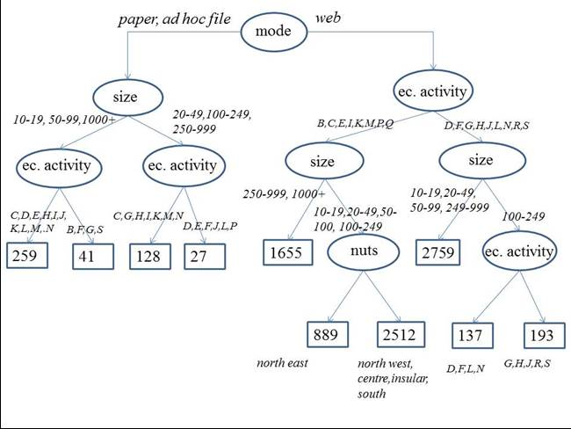
Classification regression tree

Slide 17
conclusion and comments at first glance…
The use of the web and the interaction it allows give a good instrument to the statistical manager to handle the needs and problem of the respondents, resulting in a better quality and quantity of data
The use of the web does not resolve the problem of the total non response!
The use of administrative data as auxiliary information is becoming essential to assure a good coverage for the final estimates
An efficient editing design that would take into account different tool and method could guarantee a good quality data into budget constraints

Slide 18
…and development
1. to optimize the use of IT tools for the direct survey with the web questionnaire
2. to extend the use of administrative data in order to fully integrate them with survey data only were necessary, it means for the not available data from the administrative sources
3. to optimize the use of selective editing also for other, using as auxiliary variable also the ones from the administrative data
4. in the case there the will to give possibility to choose between different modes, the information about how it interact with the enterprise characteristics can be used in a very innovative way to better study a proper sample

Slide 19
thank you for your attention

