Slide 1

The Calibration of Weights Using Calmar2 and Calif in the Practice of the Statistical Office of the Slovak Republic
Helena Glaser-Opitzová, Ľudmila Ivančíková, Boris Frankovič
European conference on quality in official statistics 2014
Vienna
2 – 5 June 2014

Slide 2
Outline
calibration estimator
calibration in SO SR
aspects of Calif
EU-SILC

Slide 3
Introduction
sampling estimates
design weights
auxiliary variables and totals
modified weights
enhanced precision and consistence
smaller variance
Deville and Särndal (1992)

Slide 4
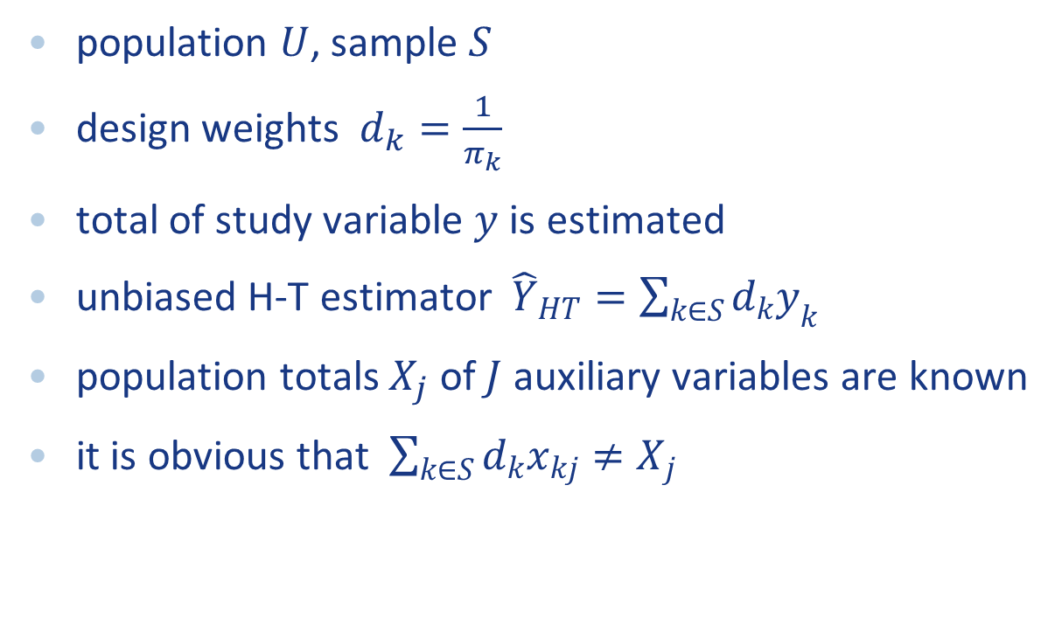
Calibration estimator
population $U$, sample $S$
design weights $d_{k}=\frac{1}{π_{k}}$
total of study variable $y$ is estimated
unbiased H-T estimator ${\hat{Y}}_{HT}=\sum_{k∈S}{d_{k}y_{k}}$
population totals $X_{j}$ of $J$ auxiliary variables are known
it is obvious that $\sum_{k∈S}{d_{k}x_{kj}}≠X_{j}$

Slide 5
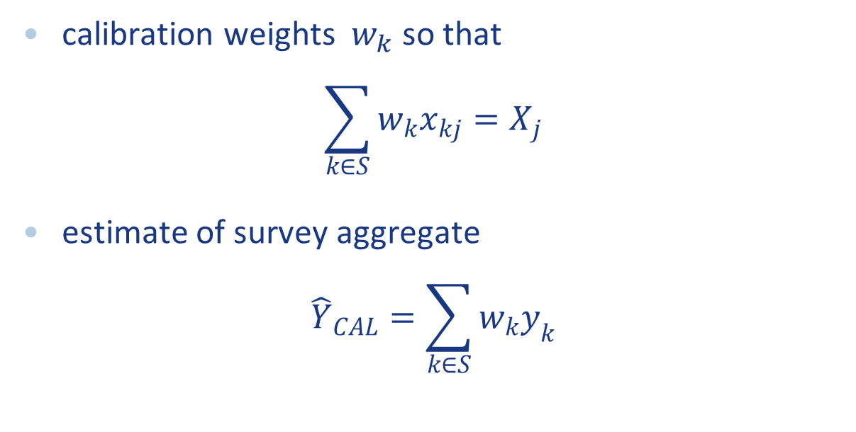
Calibration estimator
calibration weights $w_{k}$ so that
$$\sum_{k∈S}{w_{k}x_{kj}}=X_{j}$$
estimate of survey aggregate
$${\hat{Y}}_{CAL}=\sum_{k∈S}{w_{k}y_{k}}$$

Slide 6
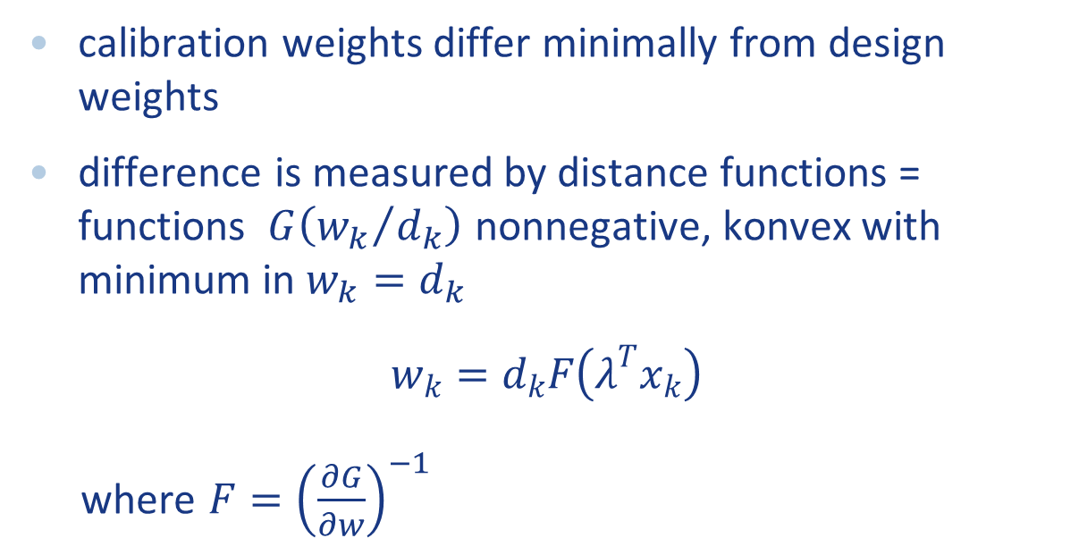
Calibration estimator
calibration weights differ minimally from design weights
difference is measured by distance functions = functions $G\left({w_{k}}/{d_{k}}\right)$ nonnegative, konvex with minimum in $w_{k}=d_{k}$
$$w_{k}=d_{k}F\left(λ^{T}x_{k}\right)$$
where $F={\left(\frac{∂G}{∂w}\right)}^{−1}$

Slide 7
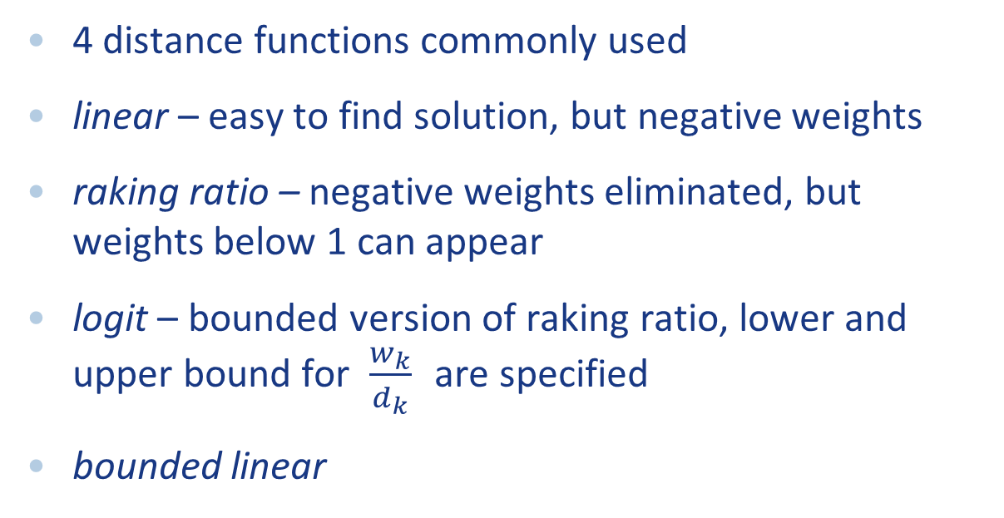
Calibration estimator
4 distance functions commonly used
linear – easy to find solution, but negative weights
raking ratio – negative weights eliminated, but weights below 1 can appear
logit – bounded version of raking ratio, lower and upper bound for $\frac{w_{k}}{d_{k}}$ are specified
bounded linear

Slide 8
Software
CALMAR2 – SAS macro, INSEE
g-Calib 2 – written in SPSS, Statistics Belgium
GES – SAS application, Statistics Canada
Bascula – Delphi tool by Statistics Netherlands
Caljack – extension of Calmar, Statistics Canada
CALWGT – free program in S-Plus for Unix by Li-Chun Zhang
CLAN97 – Statistics Sweden
calib – function in R package sampling
calibrate – function in R package survey

Slide 9
Timeline of calibration at SO SR
in the distant past
no calibration

Slide 10
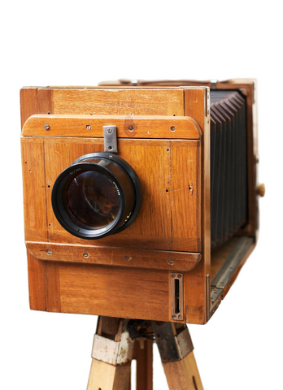
Timeline of calibration at SO SR
in the past
heuristic and simple procedures

Slide 11
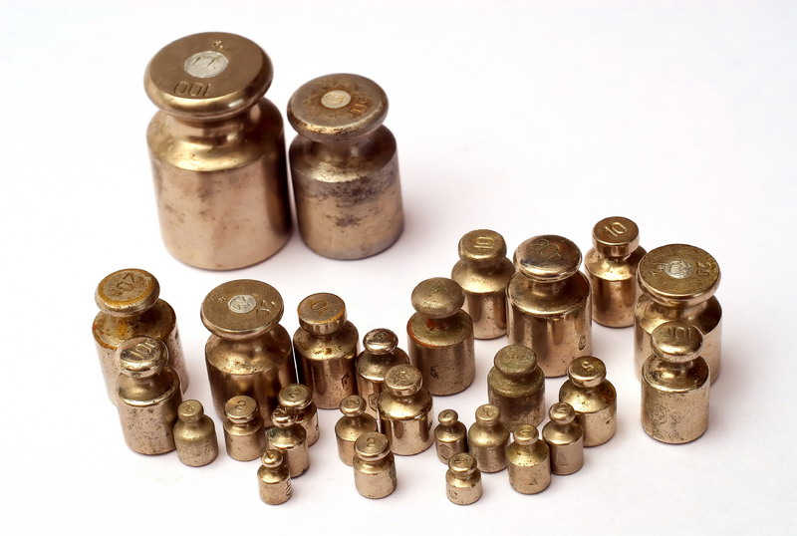
Timeline of calibration at SO SR
up to now
calibration of weights in CALMAR2

Slide 12

Timeline of calibration at SO SR
in the future
Calif (?)

Slide 13
Calif
free R based code for calibration of weights
written by SO SR
motivations
  SAS/IML needed – just 2 licences
  user-friendly tool
  more precise estimates

Slide 14
Features of Calif
GUI
4 distance functions
stratification
approximate solutions
several optimization functions implemented
nice outputs

Slide 15
Features of Calif
package fgui was used for creating the GUI
nonlinear equation system solvers
  functions BBsolve and dfsane from package BB
  function nleqslv from package nleqslv
function calib from package sampling also implemented

Slide 16
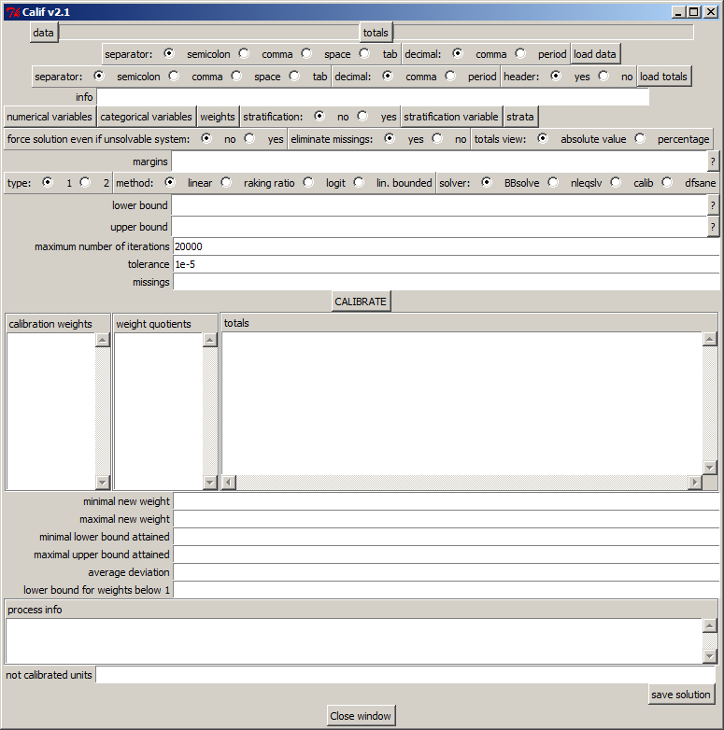

Slide 17
Calif pros and cons
Pros
  free environment
  GUI
  free data structure
  stratification
  approximate solutions
  large tables with many auxiliary variables are solvable

Slide 18
Calif pros and cons
Cons
  no GREG estimator
  no multi-stage calibration
  only .csv and .txt formats are supported
  extended computational time when using BBsolve
yet

Slide 19
Calibration of EU-SILC
calibrated at two levels – households and individuals
sample of individuals is turned into a sample of households – auxiliary variables are summed within particular households
EU-SILC 2012 – 15463 members within 5291 households
NUTS3 stratification (8 strata)

Slide 20
Calibration of EU-SILC
auxiliary variables
  households by members (5 categories)
  sex + age groups (2*6 categories)
  5 additional variables related to economic activity
  22 variables all together
calibration with CALMAR2 a little bit exhausting

Slide 21
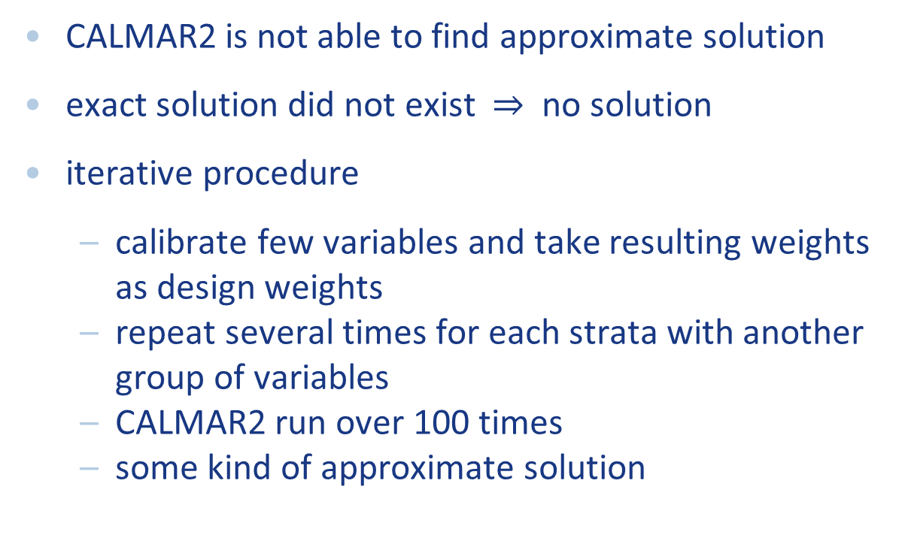
Calibration of EU-SILC
CALMAR2 is not able to find approximate solution
exact solution did not exist $⇒$ no solution
iterative procedure
  calibrate few variables and take resulting weights as design weights
  repeat several times for each strata with another group of variables
  CALMAR2 run over 100 times
  some kind of approximate solution

Slide 22
Calibration of EU-SILC
results by CALMAR2 and Calif were the same for small tables (about 3 auxiliary variables)
for the whole EU-SILC, the solution by CALMAR was within bounds 0,34 and 2,72
just 24 totals calibrated exactly
others varied between 75,4% and 126,9%

Slide 23
Calibration of EU-SILC
Calif gave result directly in 3 minutes
function calib from package sampling was used
solution within bounds 0,3 and 3
153 out of 176 totals calibrated exactly
others varied between 96,3% and 101,3%
totals matched on both individual and household level

Slide 24
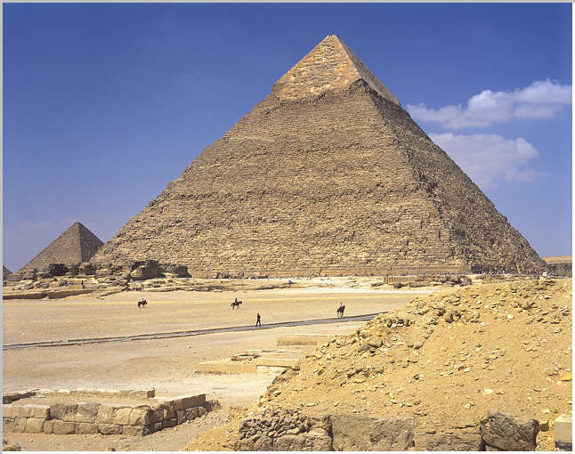
Appropriate word for Calif
great?
probably not

Slide 25
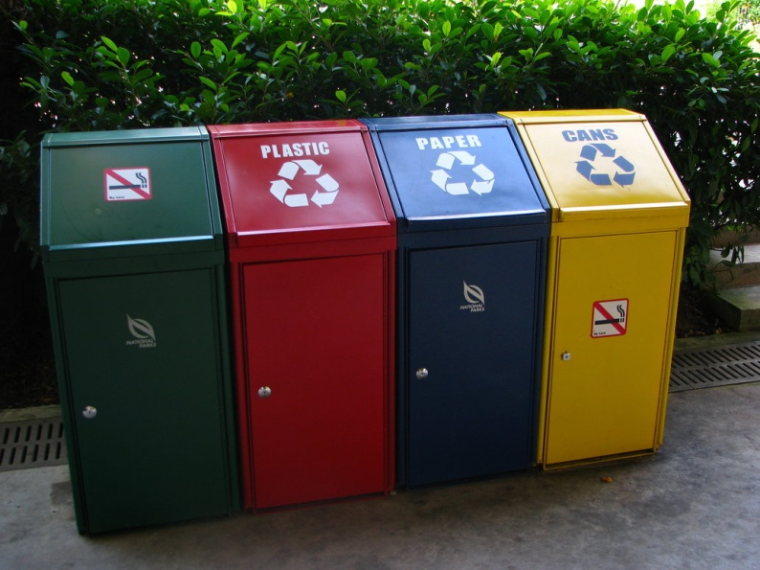
Appropriate word for Calif
useless?
hope not

Slide 26

Appropriate word for Calif
promising?
maybe

Slide 27
What do you think?
Thank you for your attention

