Slide 1
Quality assessment for register-based statistics
Eva-Maria Asamer
Statistics Austria
Registers, Classifications and Methods Division
4th June 2014
Results for the Austrian census 2011

Slide 2
Quality assessment for register-based statistics
Authors:
Eva-Maria Asamer, Manuela Lenk, Henrik Rechta
Statistics Austria, Unit Register-based Census
Franz Astleithner, Predrag Ćetković, Stefan Humer, Mathias Moser
Vienna University of Economics and Business, Department of Economics

Slide 3
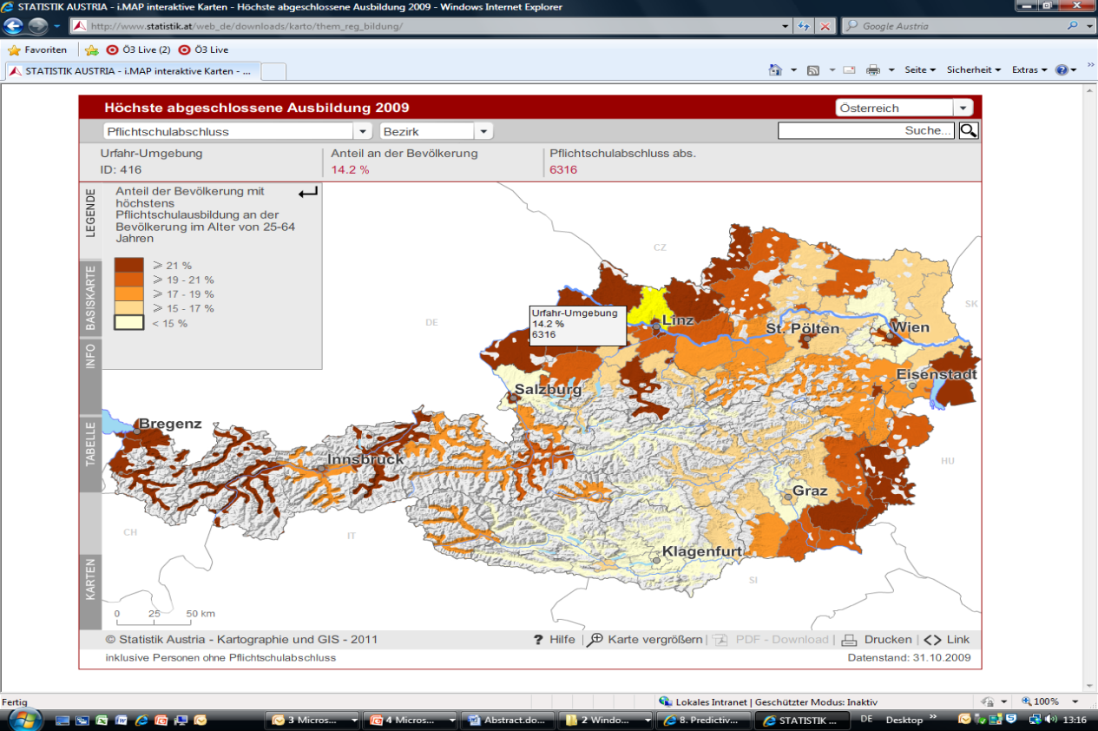
Census 2011
Register based
More than 50 data holders
Integrated Data Base
Persons, Families, Households, Buildings and Dwellings, Locations of Work
Data availability
Municipalities, Geo-Information
Statistical Database
Interactive Maps

Slide 4
Motivation for quality framework
Initial considerations
Contemporary statistics based on administrative data take use of the principle of redundancy
The required information is collected from several data sources (e.g. base registers and comparison registers)
How are we able to assess the quality of all data sources and evaluate the process of combining the different sources as well?
6 Quality Dimensions
Our focus on measuring Accuracy and Reliability

Slide 5
Quality assessment
Application of a quality framework
The framework is independent from data processing, allowing the application on all statistical projects based on administrative data
Data processes can be evaluated without influencing them
Three stages of quality evaluation
Raw data
Registers provided by the data holders
Central Database (CDB)
Combined information from the registers
Data is merged by a unique key
Final Data Pool (FDP)
Final data including imputations
RAW
CDB
FDP

Slide 6
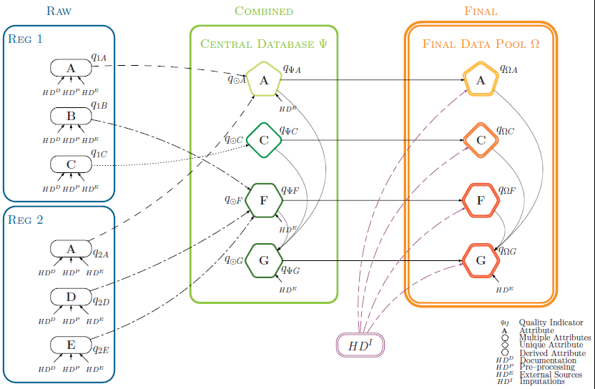
Quality framework - Overview

Slide 7
Quality assessment
Calculation of quality indicators for each stage
Each attribute obtains a quality between 0 and 1 in the stages
Raw data - in a certain register
Central Database (CDB)
Final Data Pool (FDP)
Quality calculation is based on 4 so-called hyperdimensions
HD Documentation
HD Pre-processing
HD External Source
HD Imputations

Slide 8
Raw data level

Slide 9
Hyperdimension Documentation (HD^{D})
Focuses on factors which possibly predetermine data quality
Realized by a questionnaire which is filled out in accordance with the data authority
How reliable is the register authority?
How good is the data management at the register authority?
Can we trace changes in the data (are reference dates available)?
For which purpose is the attribute recorded?
Do the attribute definitions match those of Statistics Austria?
Questions are weighted by their impact on data quality
Quality indicator:
obtained score
maximum obtainable score

Slide 10
Hyperdimension Documentation
Data base contains information on date of delivery, contact person, attributes, and quality related information
Information from phone interviews with experts at administrative data holders

Slide 11
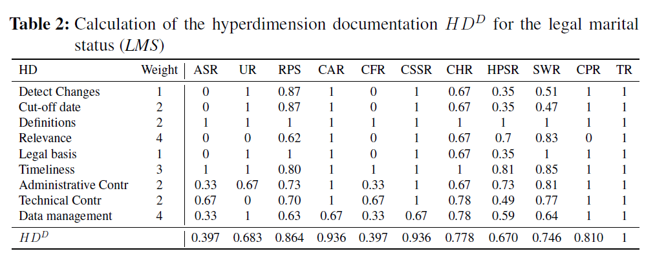
Hyperdimension Documentation LMS

Slide 12
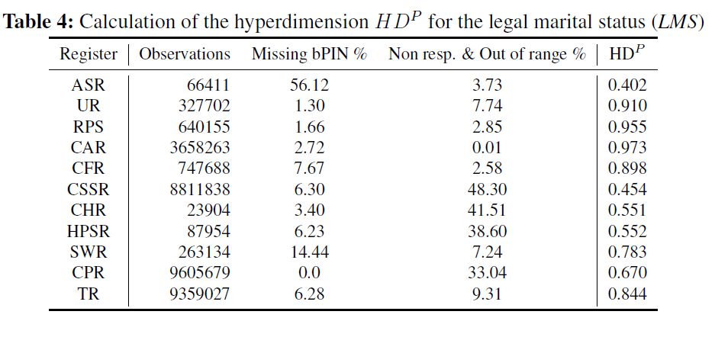
Hyperdimension Pre-processing (HD^{P})
Detection of formal errors, like missing primary keys, out-of-range values and item non-response
Quality indicator:
usable records
total number of records

Slide 13
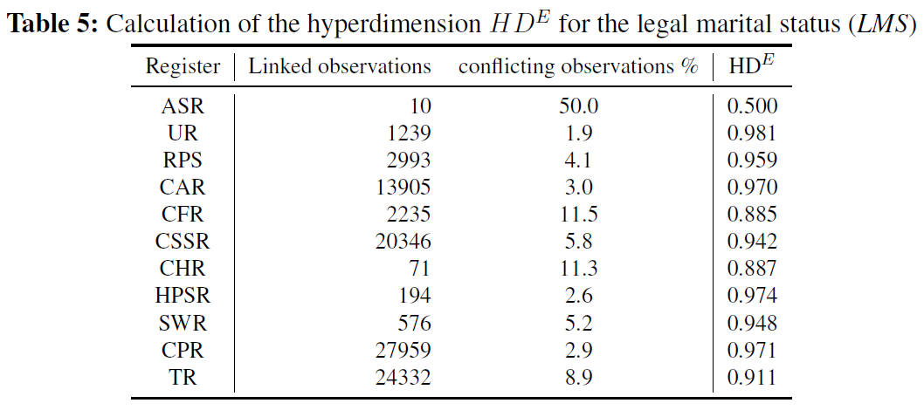
Hyperdimension External Source (HDE)
The accuracy of the data is checked, by a comparison with existing representative surveys
Quality indicator:
number of consistent values
total number of linked records

Slide 14
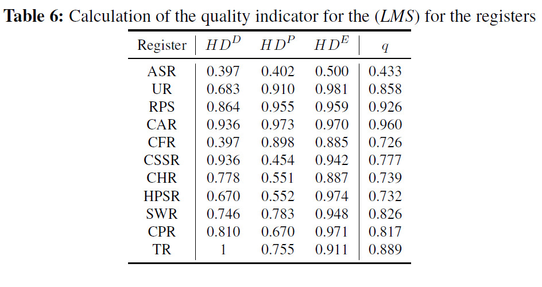
Raw data level results LMS

Slide 15
Central Data Base

Slide 16
Quality assessment of the CDB
Unique Attributes
Attribute exists in only one register, directly transferred to the CDB (e.g. highest level of education)
Multiple Attributes
Attribute exists in more than one register, combined in the CDB using certain decision rules (e.g. demographic attributes)
Derived Attributes
Attribute is created based on other attributes (e.g. type of commuter)
SEX_Reg1
SEX_Reg2
SEX_Reg3
Multiple Attribute
Attrib1
Attrib2
Derived Attribute

Slide 17
Quality Central Database LMS
Multiple Attribute
Quality Assessment using Dempster-Shafer Theory for the Combination of Evidence

Slide 18
Final Data Pool

Slide 19
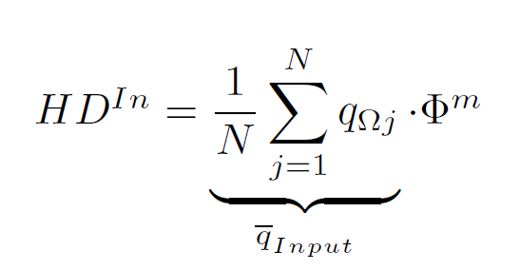
Hyperdimension Imputation (HD^{I})
Classification rate measures the „hit ratio“
The imputation model is applied on already existing data
How many estimated values match with the true data?
Classification rate for categorical variables
Combined with qualtity of input variables

Slide 20
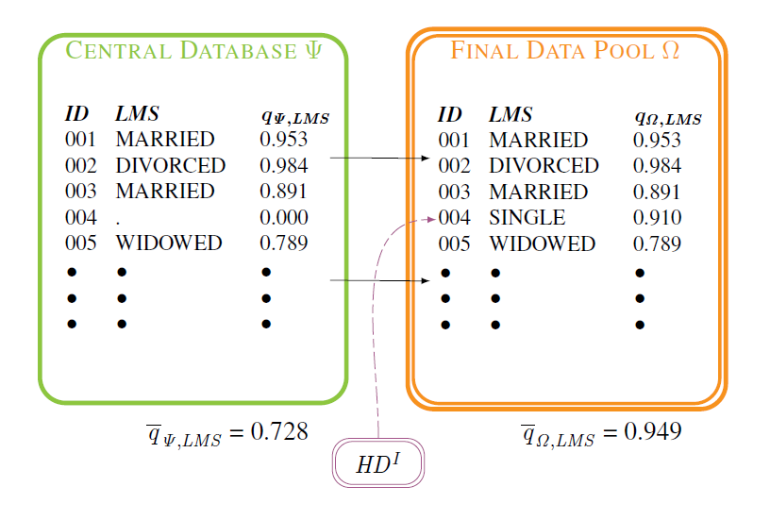
Quality in Final data pool LMS
After the process of imputation the overall-quality is higher .
In the CDB the quality of missing values (ID004) is zero.

Slide 21
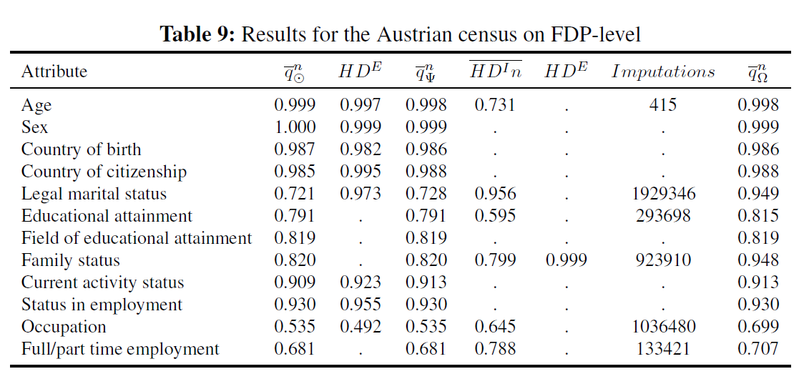
Final Results Census 2011
Imputations contain also deterministic editing due to evaluation parallel to the process flow (for LMS 220.823 are real estimations)

Slide 22
Usability of the results
Raw data
Which register delivers a certain attribute with the highest quality indicator?
Is there a register with a below-average quality for all delivered attributes?
Is the quality indicator of a certain attribute worse than in the last delivery?
Results of the hyperdimensions on this level for quality reports
Central Database
Is there any advancement of data quality by the use of multiple data sources?
Comparison with prior data on this stage – plausibility checks
Final Data Pool
Quality reports
Comparison of attributes for further advancement
Comparison of results over time
Quality assessment for subgroups
RAW
CDB
FDP

Slide 23
Further Information
Journal of Official Statistics (in press) – Quality measurement in administrative statistics and the assessment of imputations
Austrian Journal of Statistics, Volume 39 (2010), Number 4
http://www.stat.tugraz.at/AJS/ausg104/104Berka.pdf
Statistica Neerlandica, Volume 66 (2012), Issue 1
http://onlinelibrary.wiley.com/doi/10.1111/j.1467-9574.2011.00506.x/pdf
UNECE Work Session on Statistical Data Editing 2012, Oslo
http://www.unece.org/fileadmin/DAM/stats/documents/ece/ces/ge.44/2012/41_Austria_Kausl.pdf
ESSnet on Data Integration 2011, Madrid
http://www.ine.es/e/essnetdi_ws2011/ppts/Lenk.pdf
ISI World Statistics Congress STS50 - Methods and quality of administrative data used in a census 2011, Dublin
http://isi2011.congressplanner.eu/pdfs/650199.pdf
NTTS Conference 2011, Brussels
http://www.cros-portal.eu/sites/default/files/S13P1.pdf
UNECE/Eurostat Expert Group Meeting on Register-Based Censuses 2010, The Hague
http://live.unece.org/fileadmin/DAM/stats/documents/ece/ces/ge.41/2010/wp.4.e.pdf
European Conference on Quality in Official Statistics 2010, Helsinki
http://q2010.stat.fi/media//presentations/session-26/fiedler_quality-in-official-statistics_statisticsaustria_paper.pdf
European Conference on Quality in Official Statistics, June 2012
http://www.q2012.gr/articlefiles/sessions/21.2_Manuela%20Lenk%20_A%20quality%20monitoring%20system.pdf

Slide 24
Please address queries to:
Eva-Maria Asamer
Registers, Classifications and Methods Division
Contact information:
Guglgasse 13, 1110 Vienna
phone: +43 (1) 71128-7922
fax: +43 (1) 71128-7445
Eva-maria.asamer@statistik.gv.at
Quality assessment for register-based statistics
Results for the Austrian census 2011

