Slide 1
Does mixed-mode data collection have influence to the quality of data of LFS?
The web pilot study of LFS in Statistics Finland
Q2014 Vienna 2‒5 June 2014
Kirsti Pohjanpää
Head of Statistics
Statistics Finland

Slide 2
Labor Force Survey in Finland
Telephone interview (CATI)
The sample of 12,000 by month
  A random sample of 15 to 74 year-olds Finns
  Questions about the whole household are presented in the last (5th) interview
There are five waves in 1,5 years
The response rate is about 70‒75%

Slide 3
The Web Pilot Study of LFS
One aim of the pilot is to find out if there is some mode effect between telephone interview (official LFS) and web data collection (the pilot data)
LFS normal data as a comparison data
  data collection at the same time
  different data collection mode (telephone – web)
Data collection at October 2013
There were some split plot tests in the pilot
ESSnet Data Collection for Social Surveys using Multi Modes

Slide 4
The Web Pilot Study of LFS
Sample size n=8,000
A random sample of 15 to 74 year-olds
Data collection at October 2013
  Four fixed reference weeks
The questionnaire is coded by Blaise IS
  Only in Finnish
Response rate 30%, data n=2,366
Respondents found the questionnaire quite good

Slide 5
Data Collection of One Reference Week
Data collection
total 18 days

Slide 6
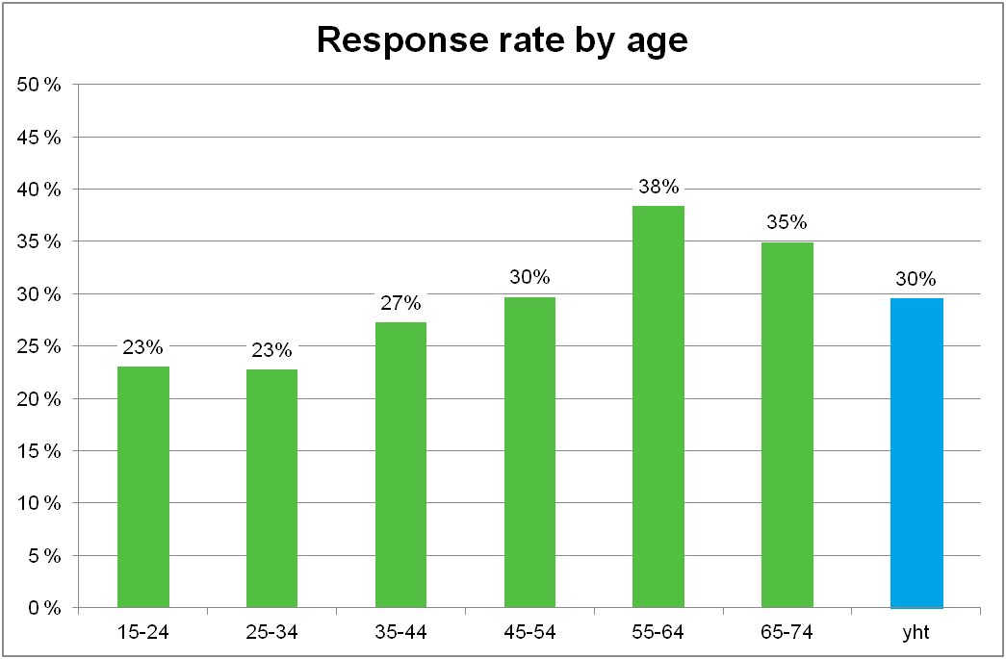

Slide 7
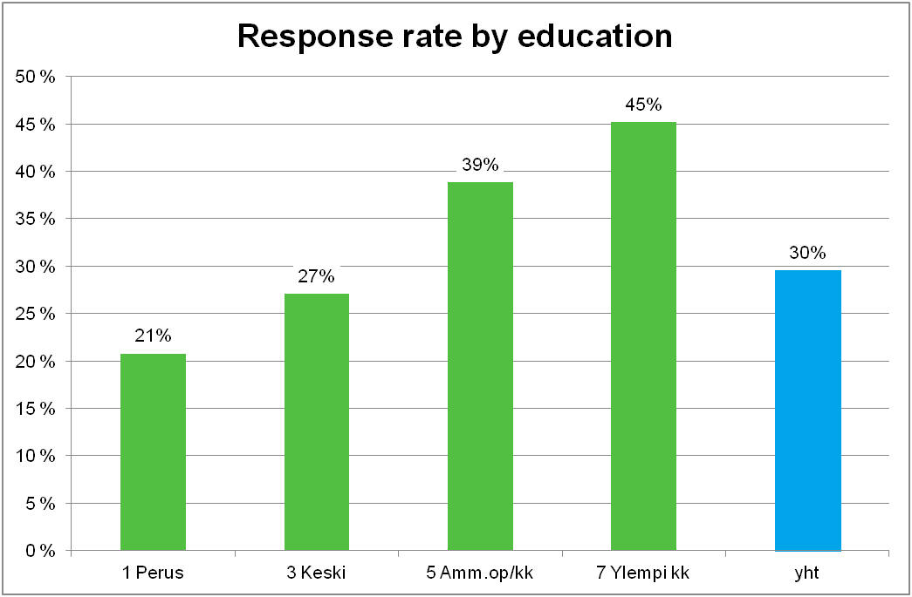
primary upper secondary tertiary university ALL
education education education degree

Slide 8
The main indicators of LFS

Slide 9
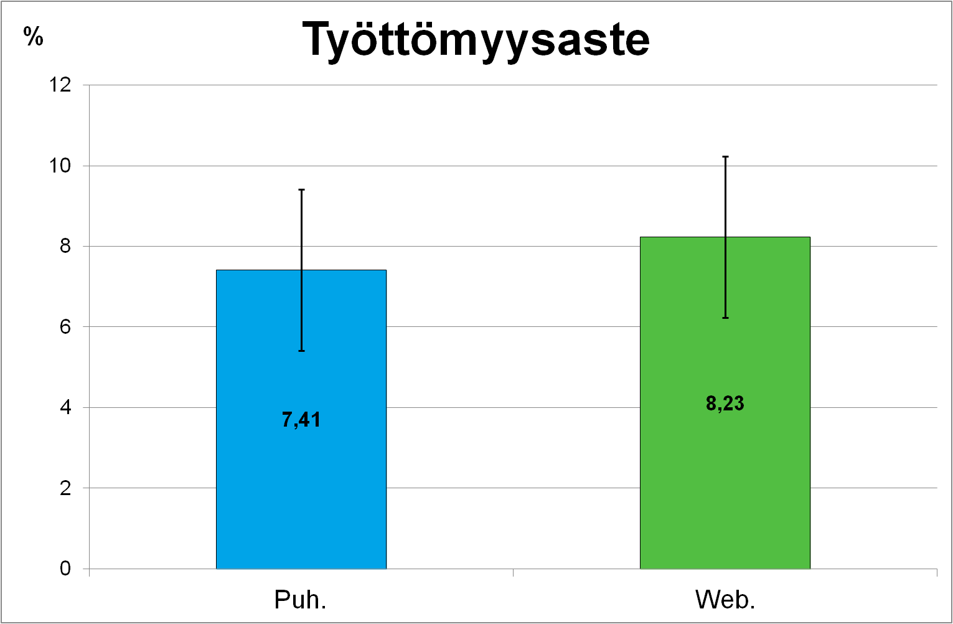
Unemployment rate
LFS

Slide 10
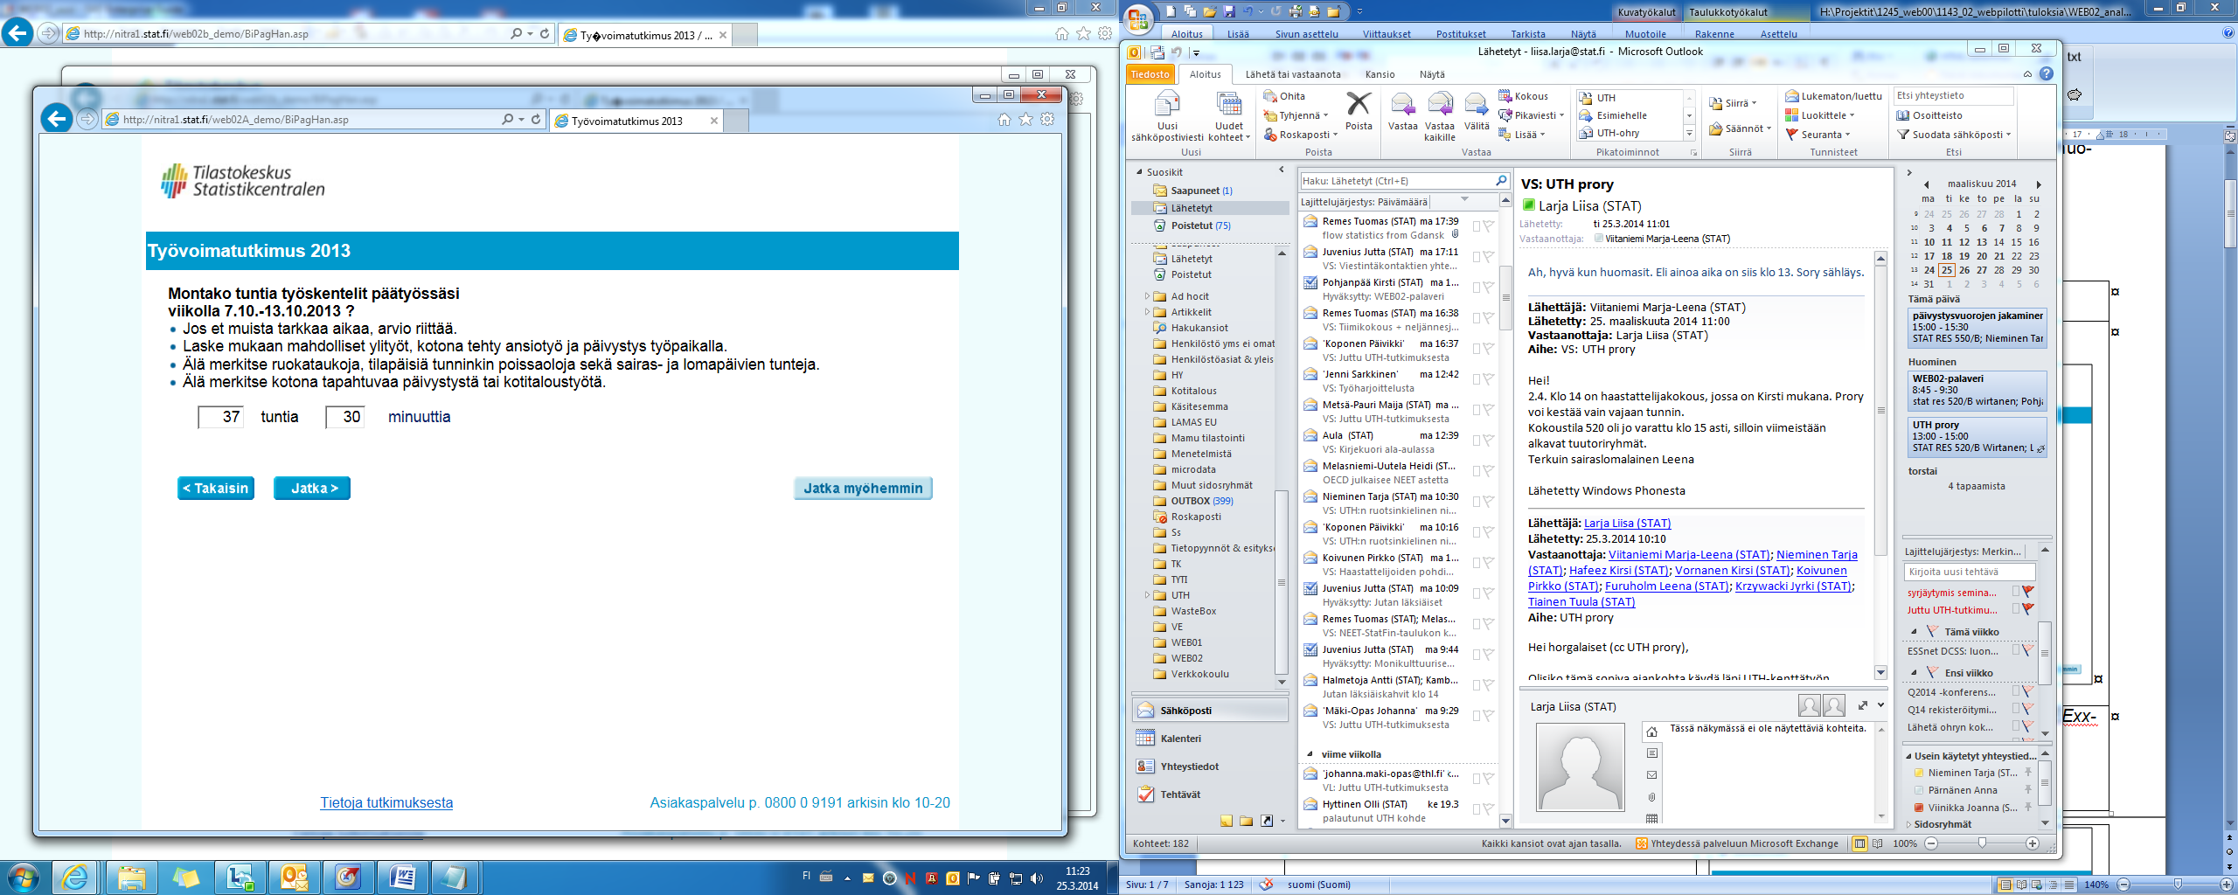
Number of Hours Worked, Group A
“How many hours did you work in your main job during the week 7.10.-13.10.2013?”
___ hours ___ minutes

Slide 11
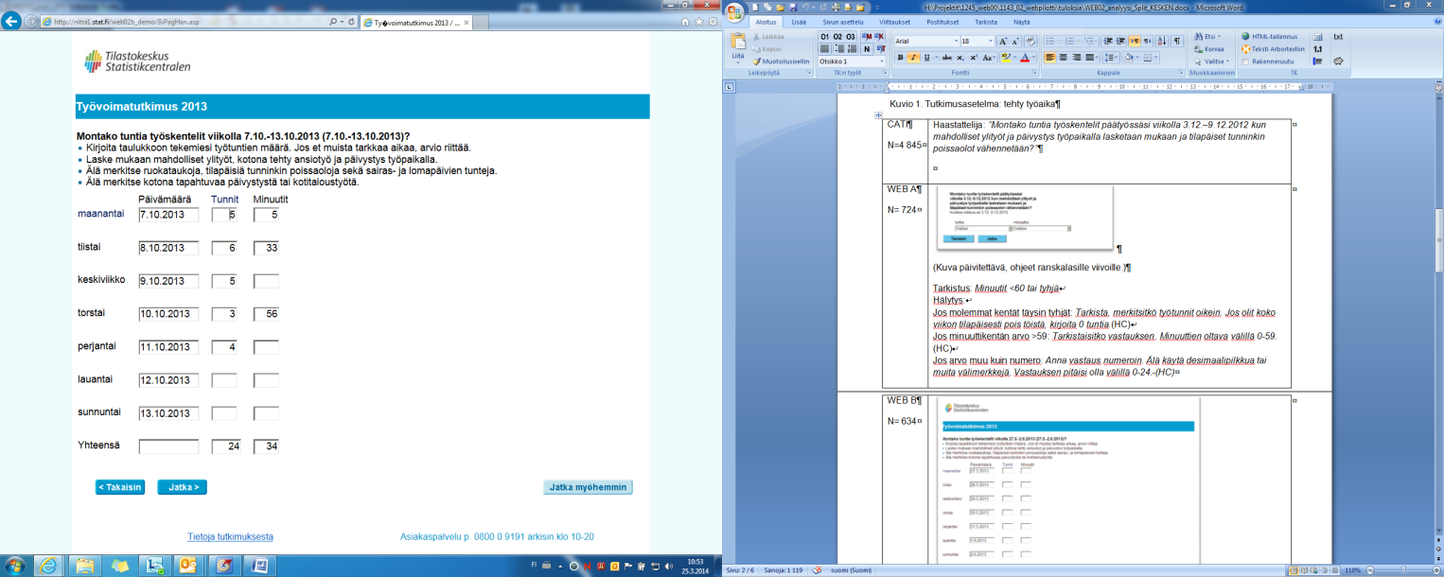
Number of Hours Worked, Group B
“How many hours did you work in your main job during the week 7.10.-13.10.2013?”
Date Hours Minutes
Monday 7.10.2013 ___ ___
Tuesday 8.10.2013 ___ ___
Wednesday 9.10.2013 ___ ___
Thursday 10.10.2013 ___ ___
Friday 11.10.2013 ___ ___
Saturday 12.10.2103 ___ ___
Sunday 13.10.29013 ___ ___
Total ___ ___

Slide 12
Number of Hours Worked

Slide 13
Conclusions
The design, and testing of questionnaire is very important, and has power to the quality of data
The grid form of asking working hours recommended
No (statistical significant) mode effects in main indicators
More studies needed to confirm the best quality of LFS data when mixing data collection modes
Web and mixed mode data collection will be a normal part of statistical process of LFS in future

