Slide 1

Improving the Quality Management System: Projects at Hungarian Central Statistical Office
Bernadett Szekeres
Quality management, Methodology Department, HCSO
and Annamária Nagy, Csaba Ábry, Kornélia Mag, Zoltán Vereczkei
June 4th 2014
Q2014, Vienna

Slide 2

Outline
Quality-related internal development programme of HCSO
3 projects:
  Process management improvement in 3 stages: (1) HCSO statistical process model, (2) process documentation, (3) IT tool supporting workflow and process monitoring
  Revision of process quality guidelines
  Creation of a methodology handbook
Conclusions, next steps
Aspects:
current state-of-the-art
reason for change and differences between past and present/future plans
implementation process and issues emerged
critical success factors
present status of the projects
the way forward

Slide 3
Quality-related internal development programme of HCSO
3 projects
Preparation for 2014/2015 ESS Code of Practice (CoP) Peer Review
Three projects managed by Methodology Department
Goals:
  Improve the quality management system
  Improve efficiency and transparency
  Better harmonization with international/national standards, CoP principles
Planned timing of the projects from launch to completion
3 projects | 2013 | 2014 |  |  |  |  |  |  |  |  |  |  |  | 2015 |  |  |  |  |  |  |  |  |  |  |  | 2016
 | 12 | 1 | 2 | 3 | 4 | 5 | 6 | 7 | 8 | 9 | 10 | 11 | 12 | 1 | 2 | 3 | 4 | 5 | 6 | 7 | 8 | 9 | 10 | 11 | 12 | …
ESTFM
Quality guidelines
Methodology handbook

Slide 4
3 related projects
3 projects
ESTFM
Quality guidelines
Methodology handbook
 | Most practical and detailed output: process descriptions reflecting HCSO practice and checkpoints | Set the basic aspects of process documentation and monitoring + Directions on how to use methodologies in practice | Detailed methodological documentation, rather theoretical
 | Frame of the 3 projects
 | process documentation | basic requirements | recommended and applied methods
 |  | Guidelines are built in the process documentation and monitoring system | Process documentations reflect HCSO practice, will be a part of the handbook
 |  |  | Quality guidelines influence applied methods
Objectives
Level of detail
Process model (ESTFM)
…for each process stages
ESTFM
Quality guidelines
Methodology handbook

Slide 5
ESTFM project: 3 stages
ESTFM
Process model (ESTFM)
Process documentation
IT tool
 | Establish a process-driven approach in HCSO
 | Transparency and comparability of processes increases + identifiable responsibilities + visible interactions among sub-processes
 | Frame structure for operating the statistical production | Standardized structure for each process phase/statistical domain | IT tool supporting process management, workflow, process monitoring
 | Unified, generic statistical business process structure has not been implemented in HCSO till now Past: specific purposes (IT, methodology,…), multiple solutions, less transparent processes | Past: standard, unified, user-oriented process decsriptions + producer-oriented descriptions, but not standard Pilot studies for creating a final template for documentations for some statistical domains Flow-charts
 | GSBPM v.4 adaptation HCSO practice Operation model of IT | GSIM (input, output,…) | Process model Process documentation Quality guidelines
 |  | Finalising process documentation template Developing an IT tool for automatising the maintenance Integration of this sub-system to our Metainformation system | Developing metainformation-driven IT solution (foreseen for 2015-2016)
Ultimate purpose
Benefits
Objective
Details
Basis
Next steps

Slide 6
ESTFM process model
ESTFM
Separated sub-processes
Merged sub-processes
New process phases
Relocations
ESTFM vs. GSBPM

Slide 7
Revision of process quality guidelines project
Quality guidelines
Goals
  Revise current (2009) quality guidelines
  Alignment with the latest HCSO methodological and IT solutions
  Reflecting the newest international guidelines and methodological solutions
  Harmonization with GSBPM and ESTFM
Reasonable, because…
  4 years passed, the operating environment changed (e.g. internal regulations, quality improvement actions in HCSO, GSBPM)
  + needed to reconsider the former guidelines because of some deficiencies → all are reflected in new guidelines

Slide 8
Former quality guidelines
Quality guidelines
Chapter structure: not in full harmony with GSBPM → value chain for statistical processes
Chapters’ internal structure:
  Definition
  Principles
  Quality guidelines
  References
  Overlapping principles + quality guidelines
  Quality guidelines not tangible enough, essence difficult to catch
  Interrelations among process stages and/or IT systems difficult to follow
  Lacking concrete measurement tools, process quality indicators were in a separete document
  Guidelines not conrete/detailed enough to check the realization
  Only Hungarian version

Slide 9
Principles of the new quality guidelines
Quality guidelines
Quality guidelines for each ESTFM model process + sub-process phase (overarching as well)
Chapters’ internal structure:
  Short process description from ESTFM
  Quality guidelines: like a checklist
  Possible process quality indicators
  Related sub-processes
  IT system linkages
  References
  List of related concepts
New structures

Slide 10
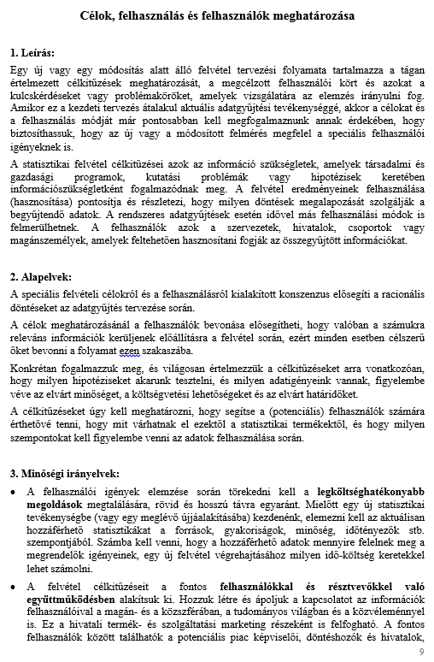
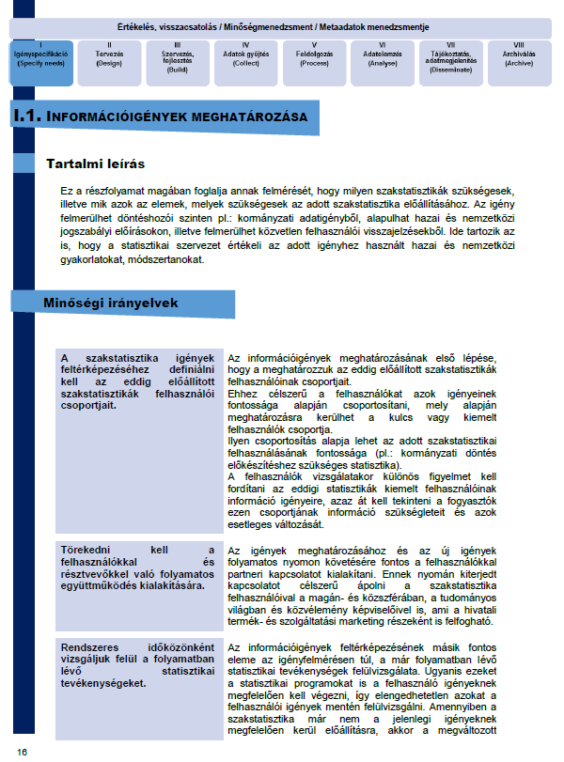
Outlook: former vs. current guidelines
Quality guidelines

Slide 11
Lessons learned and the way forward
Quality guidelines
Elaboration
Challenges in writing guidelines for each sub-processes of the ESTFM model
  various level of detail of sub-processes → shorter / longer chapters
  closely related sub-processes + under different processes in the model → difficult to write guidelines separately → in practice managed together
Consultation
Wide consultation needed with stakeholders (subject matter, IT, dissemination, external experts) → higher commitment
Implementation
Revised quality guidelines will be used in practice
  Guidelines will be adopted into the daily work
  Quality of the processes will be monitored with process monitoring IT tools established in ESTFM project
Support for the adaptation
  Further educated in HCSO School Quality course

Slide 12
Methodology Handbook project
…foreseen for 2015-2016
Methodology handbook
When?
Following the finalisation of ESTFM and quality guidelines
What aim?
  Twofold:
  Internal version
  Public version
How?
Follow the structure of the ESTFM model and connected to quality guidelines
Cover all relevant methodological areas + reflect on the latest methodological developments, international practices, guidelines of ESS, UN, OECD
Experts of Methodology Department, subject-matter domains, National Statistical Service, academic sphere
Cooperative work

Slide 13
Conclusions + future plans for further developments
Sum up
Conclusion
Adaptation of an international standard for business processes (ESTFM model)
→ more efficiently compare/integrate international best practices/standards in methodology, quality, IT fields
Next steps
Elaboration of the detailed assessment procedure of the compliance with quality guidelines
Development of the Methodology handbook

Slide 14


Bernadett Szekeres
Quality management, Methodology Department
Hungarian Central Statistical Office http://www.ksh.hu/?lang=en
Thank you for your attention
Bernadett.Szekeres@ksh.hu
+36 (1) 345 1215

