Slide 1
The dilemma of International organizations in using non-official statistics

Slide 2
The role of international statistics
Statistical programmes in international organizations: an “accounting” function or the generation of knowledge?
Presenting statistics or using statistics to explain regional or global phenomena?

Slide 3
 | “Accounting” Framework | Presenting statistics | Generating knowledge
Re-publication of data provided by Member States (no change) | ✓ | ✓ | ✓
Adjustments applied to national data to ensure comparability |  | ✓ | ✓
Production of national estimates (the organization becomes the primary source of national data) |  |  | ✓
Production of forecasts |  |  | ✓
Production of global/regional estimates |  |  | ✓
International Organizations with statistics as core business
International Organizations with thematic focus

Slide 4

When the drive is to only present statistics at global level
Quality standards are set by the statistical communities (national and international)
Official statistics is typically understood as the statistics produced by national statistical systems
Non official sources are not explored unless approved by NSS

Slide 5

When the drive is to provide knowledge…..
Statistics is a tool not an end by itself
To play a significant role it needs to be comprehensive
National officials are not from NSS and do not have the same sensitivity to quality standards
What does official statistics mean?

Slide 6
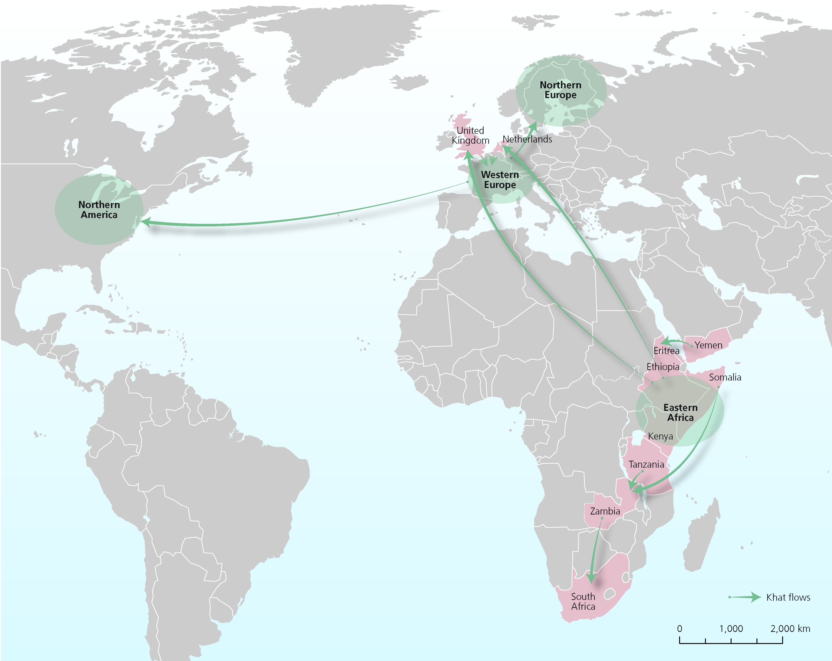
Transnational nature of statistics: Example Khat flows 2008-2012

Slide 7
Statistics typically produced outside NSS:
Annual prevalence of cannabis use among adult population (2011 World Drug Report)
Type of data | N. countries
“Official” data provided by countries | 61
UNODC estimates or use of “non-official” sources | 77
No data | 94
Total | 232
Use of modelling, any non-official source with solid pre-defined methodology

Slide 8
Does the “Official” label matter when defining quality in international statistics?
Quality standards are defined according to HOW statistics are produced and not by WHOM
Why does the international community discuss the dichotomy of official and non-official sources? Shouldn’t it focus on Quality?
Usually statistics produced by NSS = Good quality, but not always…

Slide 9

In international organizations where the core business is statistics, Member States and IO have the same criteria to define quality and have a common vision on the need to strive to the highest data quality

Slide 10

In IOs where the core business is not statistics MS representatives do not have the same statistical sensitivity and statistical quality sometimes come after national interest
In international contexts, the more statistics become visible the more countries want to control them

Slide 11
What to do when data quality and national interest diverge?
Quality
National interest
Can our role as statisticians and international civil servants be made compatible?

Slide 12


Slide 13

But we need help……

Slide 14
National and international statisticians to move the international debate from the use of official statistics to the use of good quality statistics
National statisticians to support the professional independence of international statisticians (the same that they claim for them selves)
UN Statistical Commission (UNSC) to focus more on developing standards for statistical areas which are more at risk of political interference (outside of UNSD mandate)
UNSC to promote the notion of quality standards in other inter-governamental fora (outside of the “comfort zone”)

Slide 15

Together the international statistical programmes can be stronger
Define a UN data quality framework to be approved by the UNSC
Peer reviews
Ask highest managers to sign the Principles for International Statistics
Promote the Principles outside of the statistical community

Slide 16
Each single international statistical programme
To define and promote standard methodology to assess data provided by MS
Ask countries to review data before publishing
Gain statistical authority

Slide 17

Thank you!

