Slide 1
The Final Steps of the Journey towards an ISO-certification
Implementing ISO 20252 for Market, Opinion and Social Research
at Statistics Sweden
Q2014

Slide 2
Background
ES Code of Practice – means of implementing
Swedish government – quality reporting
Call for tenders – quality statement on adherence to common business standard
Standardisation work on methods and tools

Slide 3
ISO 20252 - requirements
Client focus
General order in planning and documentation
Transparency and traceability
Checklists
Validation of results
Testing of questionaires

Slide 4
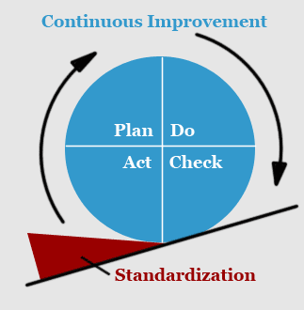
A six year process!
Training of staff
Setting up network of quality coaches
Screening of 200 statistical products
Supplementing Process Support System
Setting up organisation of internal quality auditors
Establishing a Quality Manual
Completing 5 major development projects

Slide 5
Major Projects – development and implementation
Disclosure control – methods and tools
Validation of coding process – common tool and working routines
System for Telephone Interview Monitoring
Estimation of Variance where lacking
Pretesting of questionaires – clear strategy and structure

Slide 6
Follow-up of degree of product adherence to standard
2009 5 % (at screening)
2010 46 %
2011 84 %
2012 - 2013 final steps in cooperation with department heads
2014 Certification!

Slide 7
Experiences gained and lessons learned
Useful with an existing standard to lean on
Importance of top management focus aided by the Swedish government
Could have been better to have standardisation in place beforehand
Easy to be too optimistic about the timeline

Slide 8
Benefits
Important projects completed and long term deficiencies addressed
Illumination of certain areas with clear needs for improvement
Higher degree of general order in production
Staff involvement and their increasing awareness of the need for quality assurance

Slide 9
Conclusions and future work
Valuable accomplishment for Statistics Sweden
Need to maintain the standard
Need to development more formal approach for continuous improvement
Further implementation needed within standardisation
More focus on product quality

Slide 10
Thank-you!
Contact: kvalitetsledning@scb.se

