Slide 1
Harmonising Standard Questions, Classifications and Concepts at the ONS
Palvi Shah and Becki Aquilina

Slide 2
Overview
ONS Quality Goals and Harmonisation
The Harmonisation Vision and Strategy
Harmonisation Planning and Process
Benefits of Harmonisation
Issues and Considerations
Harmonisation versus Standardisation
Progress to Date
The Variable and Question Bank (VQB)
Forward Work Programme

Slide 3
ONS Quality Goals and Harmonisation
“To use Quality Management to encourage and promote a culture of continuous improvement through self-assessment and quality reviews”
“To produce relevant outputs with up-to-date metadata”
“To produce standardised outputs”

Slide 4
The Harmonisation Vision
“All inputs, processing and outputs for the Census and surveys and all data from administrative records will be harmonised, so that users can compare data from different sources with confidence and can merge and match data more easily, taking account of international implications”.

Slide 5
Harmonisation Strategy
Role of Harmonisation
Work Priorities
Communication Strategy
Stakeholder Engagement
Research Projects

Slide 6
Planning and Process
Planning Stage
Process Stage
Plans for new/revised harmonised principles agreed by GSS SPSC
Costs / Benefits of developing new / revised principles reviewed
Topic Group
Harmonisation Plans
User Requirements
Consultation Plans
Development Plan
Timetable
Key Issues
Cost / Benefits
UK Nations
Stakeholder
Principles tested and further consultation with stakeholders
Consider issues and potential principles with stakeholders
Other Groups
Endorsement Requested from NSHG
Proposals for principles formally produced
Endorsement requested from the NSHG
Agreement Requested from GSS SPSC
Ratification requested from HoPs
Approval requested from GSS SPSC
Further Development of Principles
Agreed Principles Published

Slide 7
Benefits
Compliance with UK Statistics and Registration Service Act 2007 and Code of Practice
Comparability, Consistency and Integration of Datasets and Data Sources
Data Quality
Cost Savings and Efficiencies
Knowledge Management

Slide 8
Issues and Considerations
‘Encouragement’ rather than ‘enforcement’
Conflicting priorities across Govt
Resource constraints
Harmonisation across UK/Europe/Other bodies
Lack of understanding of bigger picture
Difficult to access data for research
Inadequate evidence of failure and success
Confusion between ‘harmonisation’ and ‘standardisation’

Slide 9
Harmonisation Versus Standardisation
Definitions:
Harmonisation: “the adjustment of differences and inconsistencies between different measurements, methods, procedures, schedules, specifications or systems to make them uniform or mutually compatible. Harmonisation also aims to avoid duplication of effort or place an undue burden on respondents.”
Standardisation: “the adoption of generally accepted uniform technical specifications, criteria, methods, processes or practices to measure an item.”

Slide 10
Harmonisation Progress to Date…….
Harmonised social questions (13K Variables)
Cross Government Topic Groups
Revised Strategy
Quarterly NSHG meetings
Quarterly Newsletters
Harmonisation Roadshows
StatsUserNet Page and Community
A-Z of Harmonised Principles
Data Markers/Symbols in Tables

Slide 11
Variable and Question Bank (VQB)
The benefits to survey commissioners include:
Promotion and re-use of questions and instruments.
The benefits to users include:
An aid for researchers who already hold data.
An aid for data collectors.
Innovations – individual questions are mapped to wider instruments; questions are tagged by ownership; tagging of questions by intent.
State of the art searching experience.

Slide 12
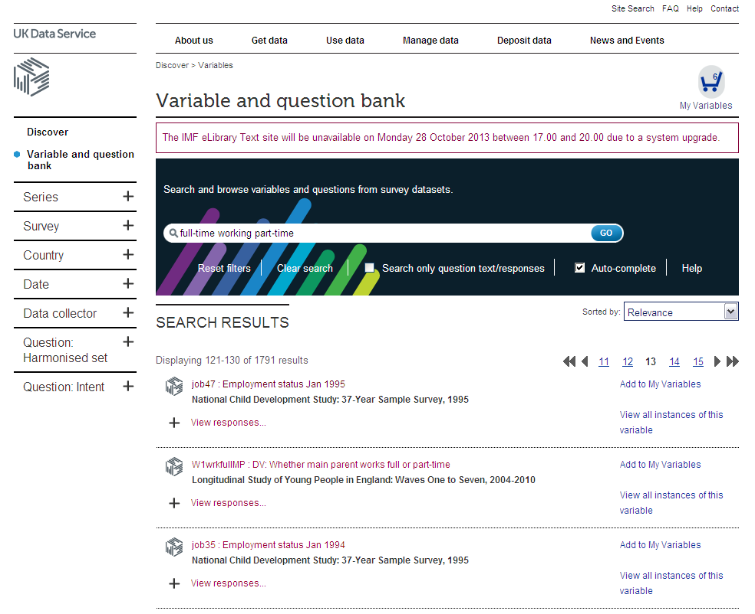
Variable search

Slide 13
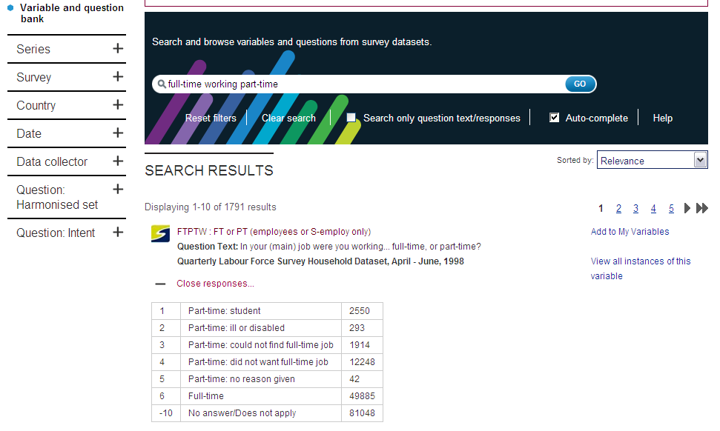

Slide 14
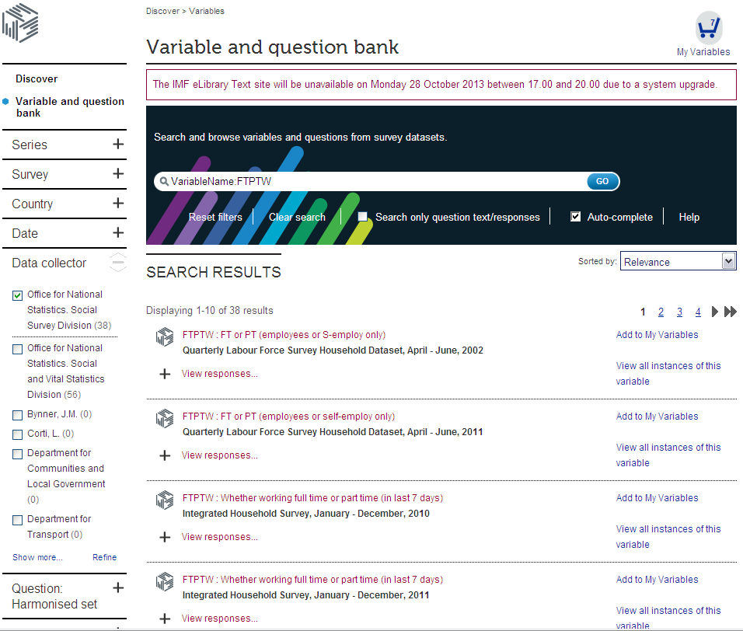

Slide 15
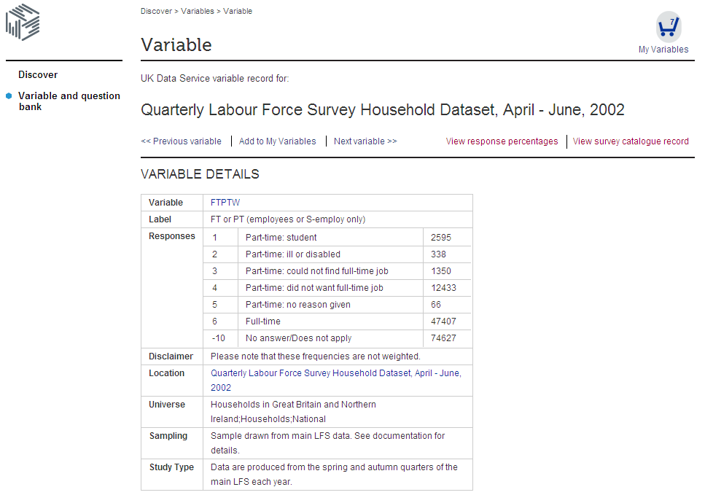

Slide 16
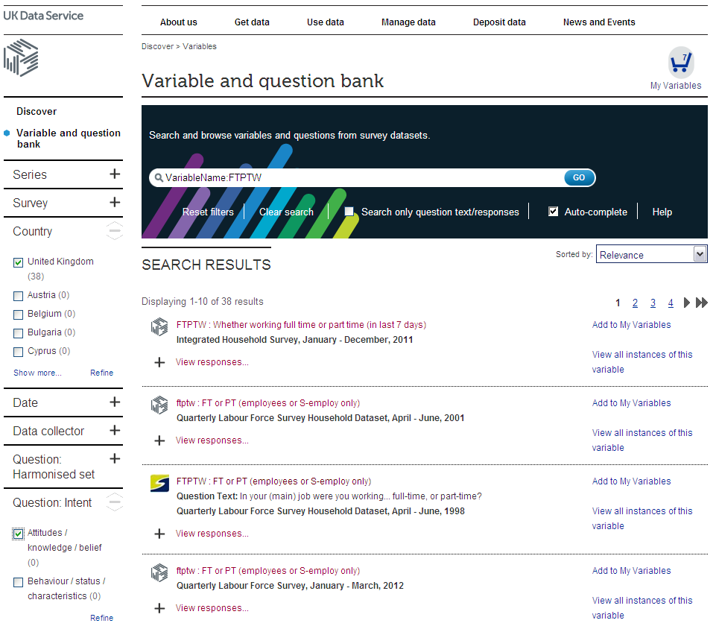

Slide 17
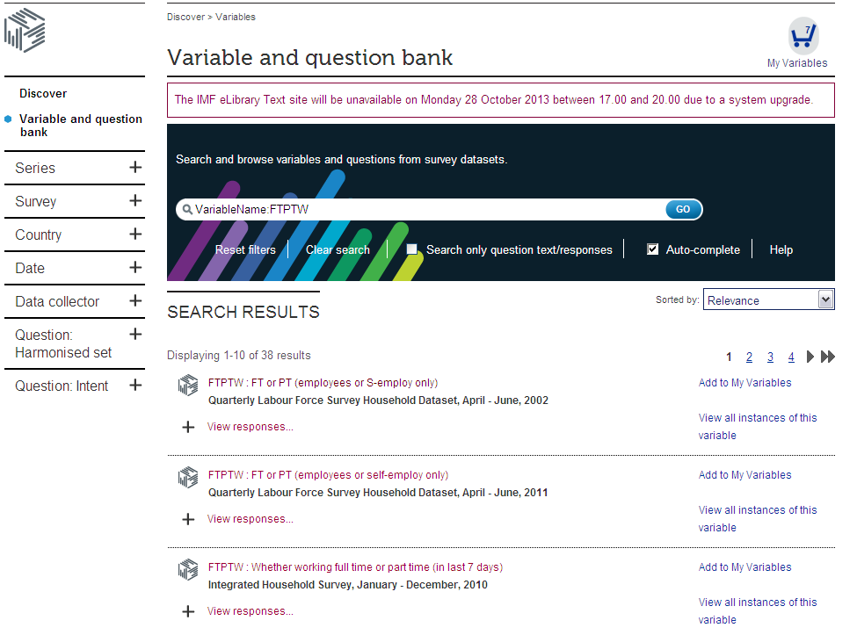

Slide 18
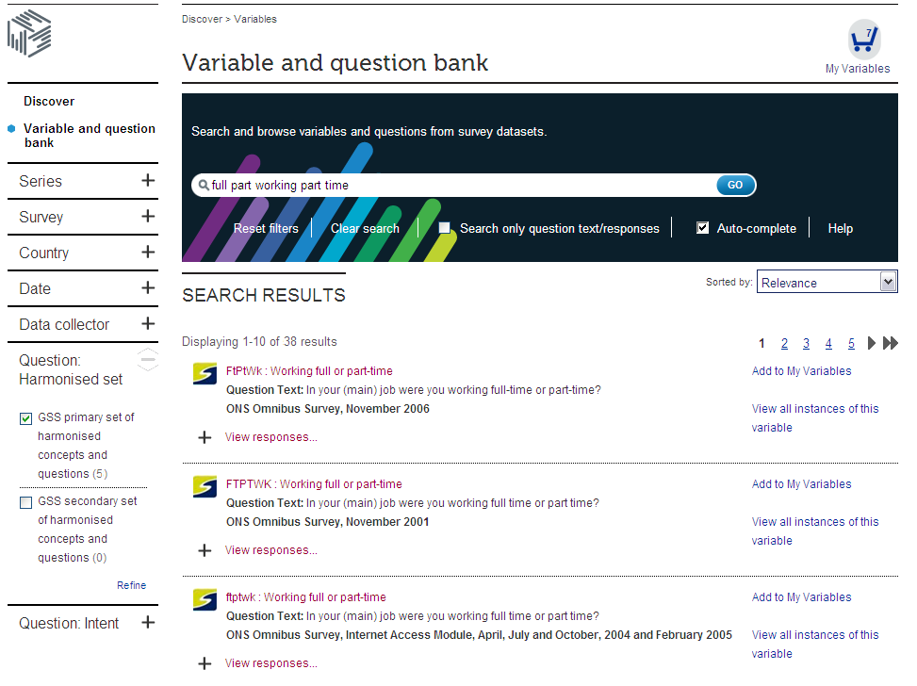
Question search

Slide 19
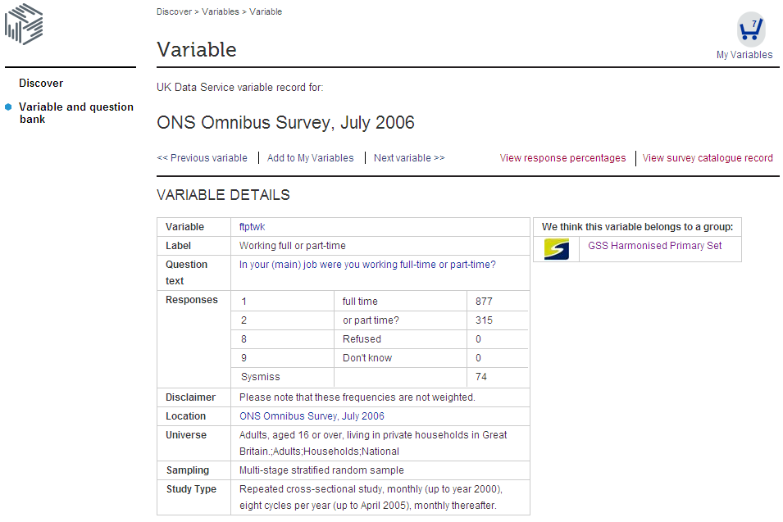

Slide 20
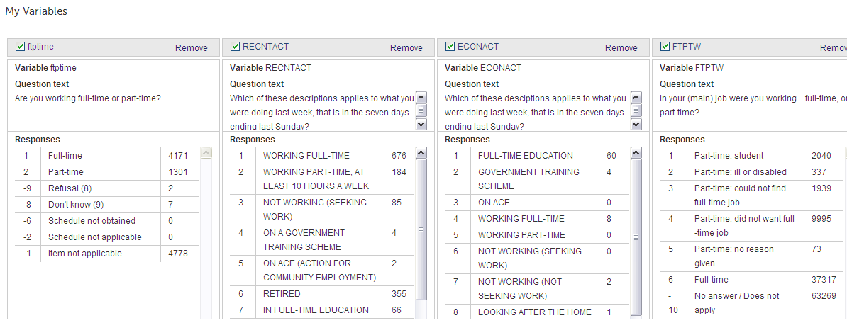
Add to basket…..

Slide 21
Forward Work Programme
Implementation Plan, Stakeholder Analysis and Communication Plan
Roadshows
Collaboration with business and admin data colleagues
Phase 2 ESSnet on Standardisation

Slide 22
Thank you !
Any Questions?
Palvi.Shah@ons.gsi.gov.uk
Becki.Aquilina@ons.gsi.gov.uk
Harmonisation@ons.gsi.gov.uk
discover.ukdataservice.ac.uk/variables

