Slide 1

Statistical literacy
Statistics Portugal approach to improve it
Q2014 - European Conference on Quality in Official Statistics
4 june 2014
Francisco Correia | Statistics Portugal/Dissemination Unit
Magda Ribeiro | Statistics Portugal/Planning Control and Quality Unit
Maria João Zilhão | Statistics Portugal/Planning Control and Quality Unit

Slide 2
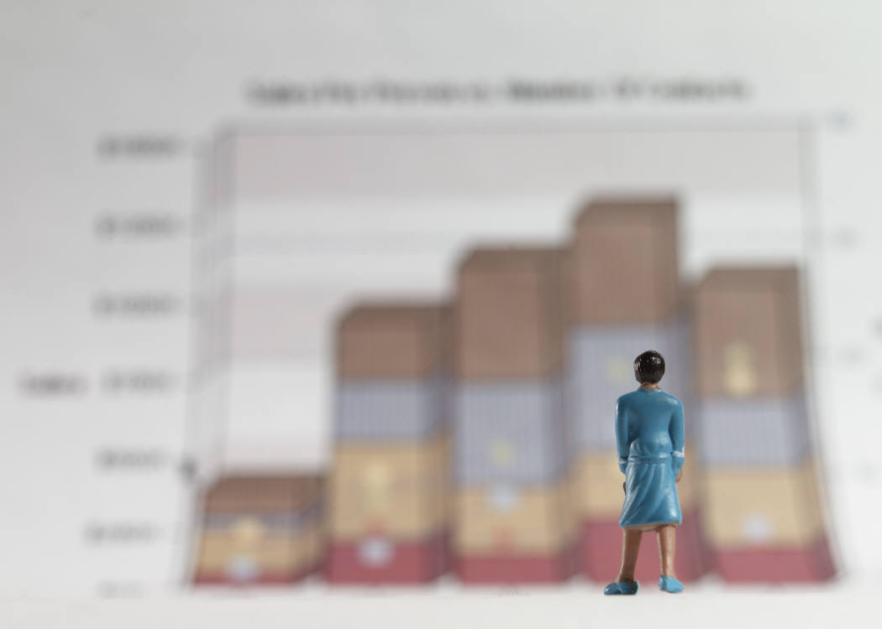



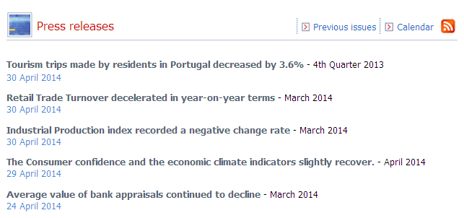

Introduction
Statistical information became a current need for most people in professional and personal activities, as it is essential to their active participation in society

Slide 3
Statistical literacy
Statistical literacy is the ability to handle
situations involving statistical knowledge
Use
Be critical
Understand/
interpret
Skills
Comunicate
The development of these skills enables citizens to solve consciously the challenges that arise in their daily live which involve statistical knowledge, enabling them to understand the reality, to have and express opinions, to make decisions, to criticize and to be intervenient in society.

Slide 4
Statistics Portugal approach to improve Statistical literacy
Vision of Statistics Portugal
Statistics Portugal is acknowledged at an internal and external level as a reference statistical institution:
as a producer and provider of high-quality official statistical information;
as an independent and reliable organization;
as an entity stimulating statistical literacy in society;
as a committed and efficient entity in international cooperation.

Slide 5
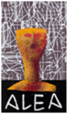



Statistics Portugal approach to improve Statistical literacy
Statistics Portugal
ALEA
Network in Higher Education Institutions Libraries
Schools Library Network
Study visits

Slide 6




Challenges
Target
teachers
Keys:
Partnership
Network
students
ALEA | Basic/Secondary level | Teachers
Statistics Portugal Information Network in Higher Education Institutions Libraries | Higher level | Teachers and students
Schools Library Network | Basic/Secondary level | Teachers
Study visits | Basic/Secondary level and Higher level | Teachers and students

Slide 7
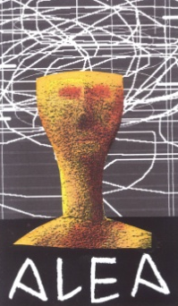
ALEA
Entertainment
ALEA - Local Action of Applied Statistics
Fun with Statistics
Names & Dates
Q: What is ALEA?
A: A (web) place to understand numbers…
Challenges
Your Surroundings
Calculator
Interesting Numbers
It aims at providing both teachers and students of basic and secondary education with teaching/learning materials for the study of Statistics.
Edutainment
Statistics
Data
Dossiers & Resources
Glossary
Probability Concepts
Statistical Concepts

Slide 8

ALEA
Ex: Challenges
Statistical challenges put to pupils in order to develop their liking for statistics
Challenges are based on news (on daily life issues) containing statistical information in the text but also in graphics, published in newspapers and magazines
Each challenge has two levels of difficulty: Level 1 - up to 9th grade and Level 2 – up to 12th grade
3 challenges/year
39 challenges (up to now!)
Average number of participants by Challenge each year
2006 | 2007 | 2008 | 2009 | 2010 | 2011 | 2012 | 2013
248 | 549 | 840 | 1 087 | 1 250 | 1 467 | 1 289 | 934

Slide 9

ALEA
Ex: Challenges
Participants in ALEA Challenges (No.)

Slide 10
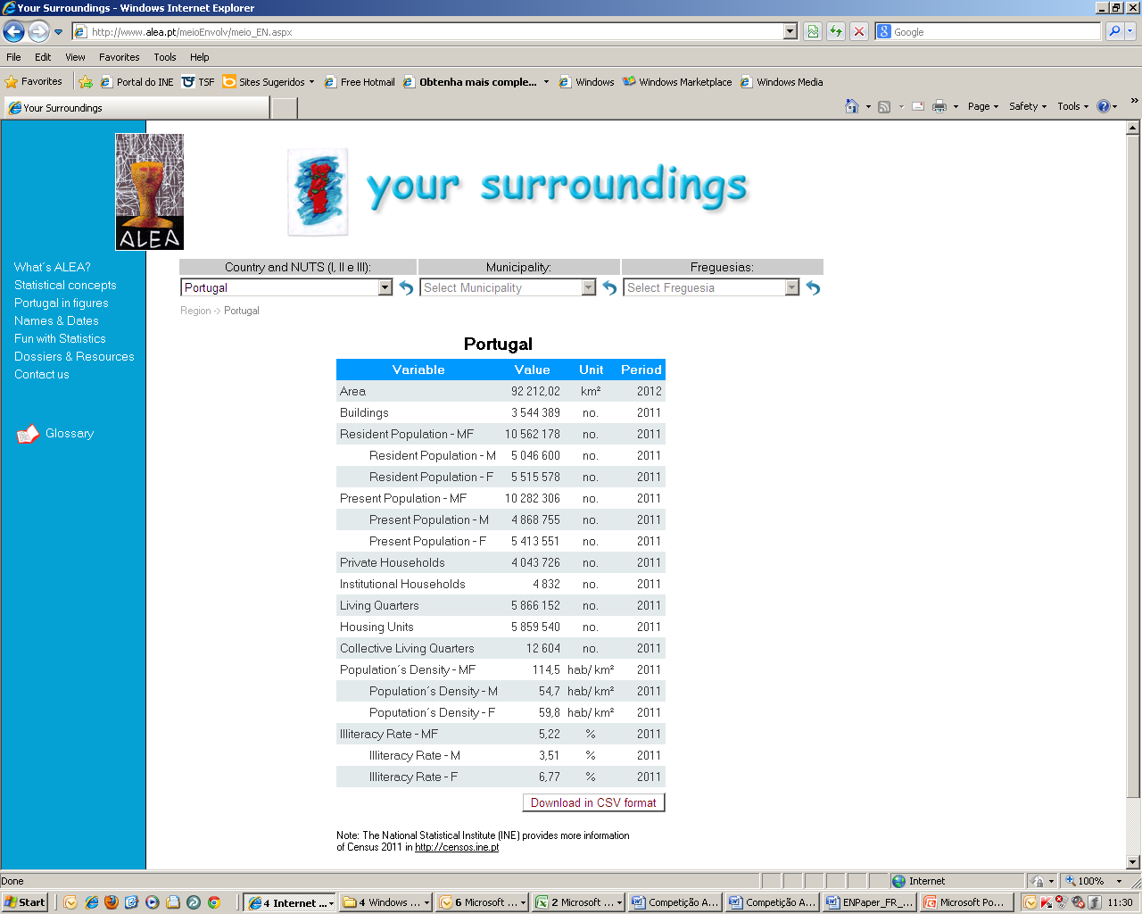
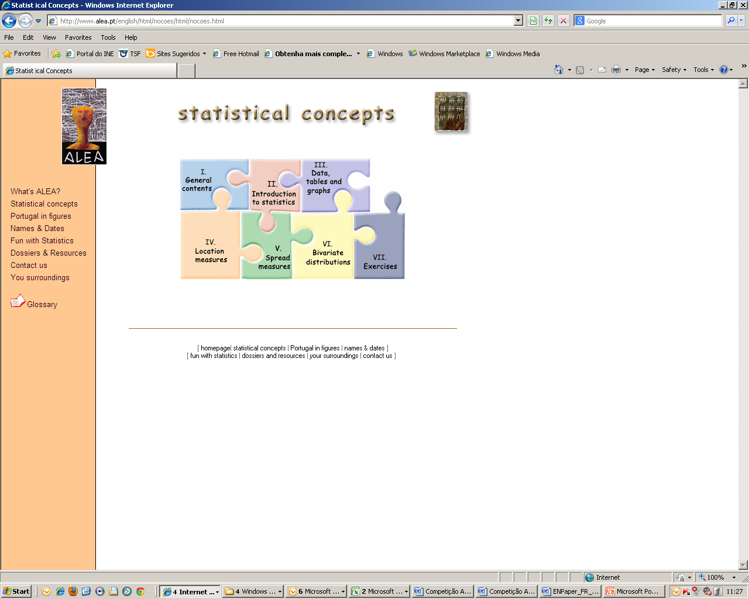
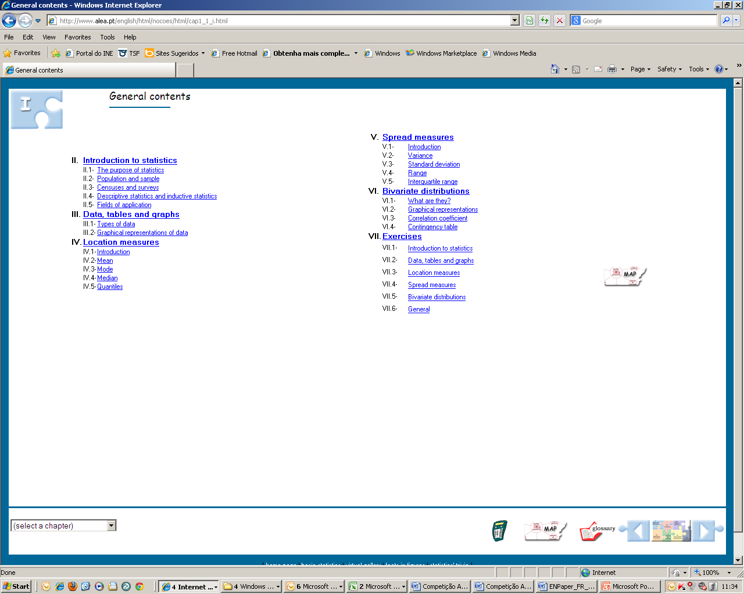
ALEA
(Satistical information)
(Handbook)
«

Slide 11
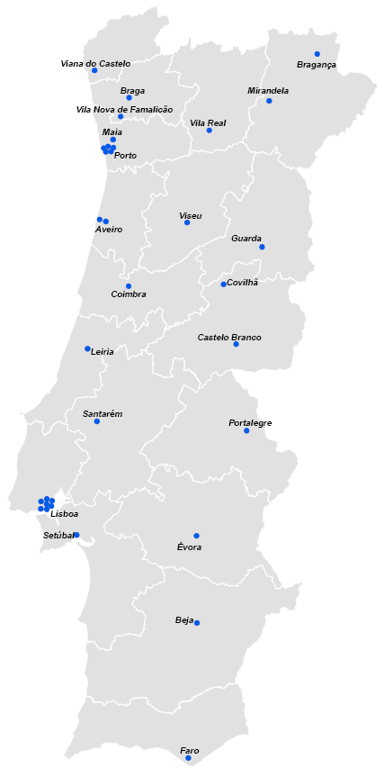
Statistics Portugal Information Network in Higher Education Institutions Libraries
Statistics Portugal Information Network in Higher Education Institutions Libraries (RIIBES)
34 Access points across the country (mainland)
All SP’s publications available
Specific technical training to local support staff + users
Direct helpline (User’s support contact centre)
Specific promotion activities
E-news about the network
A bridge to universities

Slide 12
Statistics Portugal Information Network in Higher Education Institutions Libraries
Training sessions to users assured by SP staff in partners facilities
Year | Sessions | Participants
2010 | 16 | 344
2011 | 15 | 273
2012 | 28 | 346
2013 | 43 | 738
Total | 105 | 1 701
16 participants
per session

Slide 13
Training sessions
Training sessions to basic and secondary school teachers
A protocol was established in 2010 between Statistics Portugal and the (basic and secondary) School Libraries Network (RBE) intended to reach through these libraries the educational communities and thus promoting statistical literacy at this level.
Training was provided first to librarian teachers and soon after to teachers from any curriculum area. These training sessions are a first approach to Statistics Portugal and ALEA websites contents and they are strongly practical.
Year | Sessions | Participants
2010 | 22 | 346
2011 | 29 | 454
2012 | 165 | 2 675
2013 | 64 | 999
Total | 280 | 4 474
16 participants
per session

Slide 14
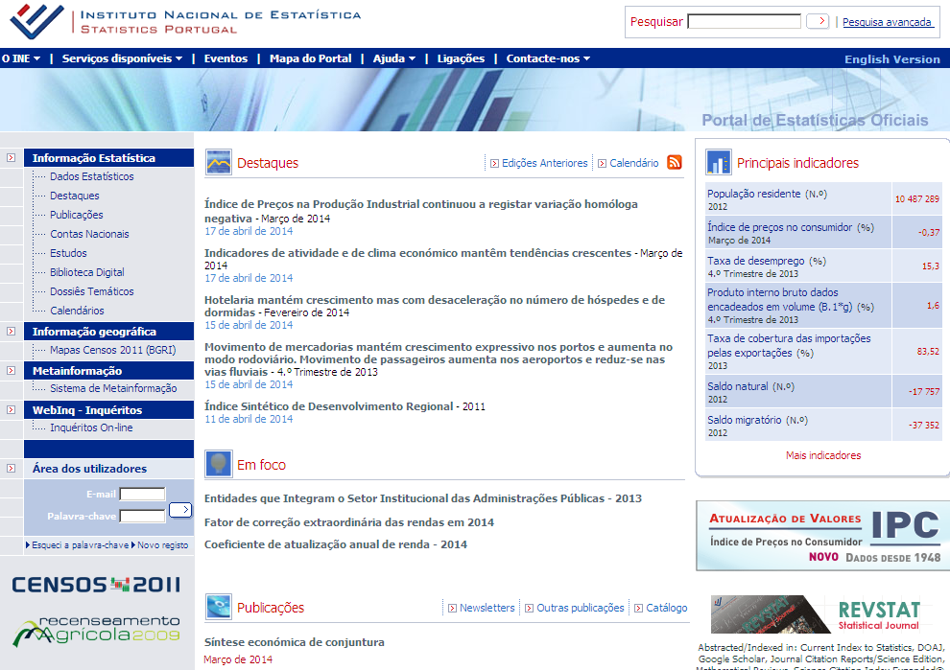
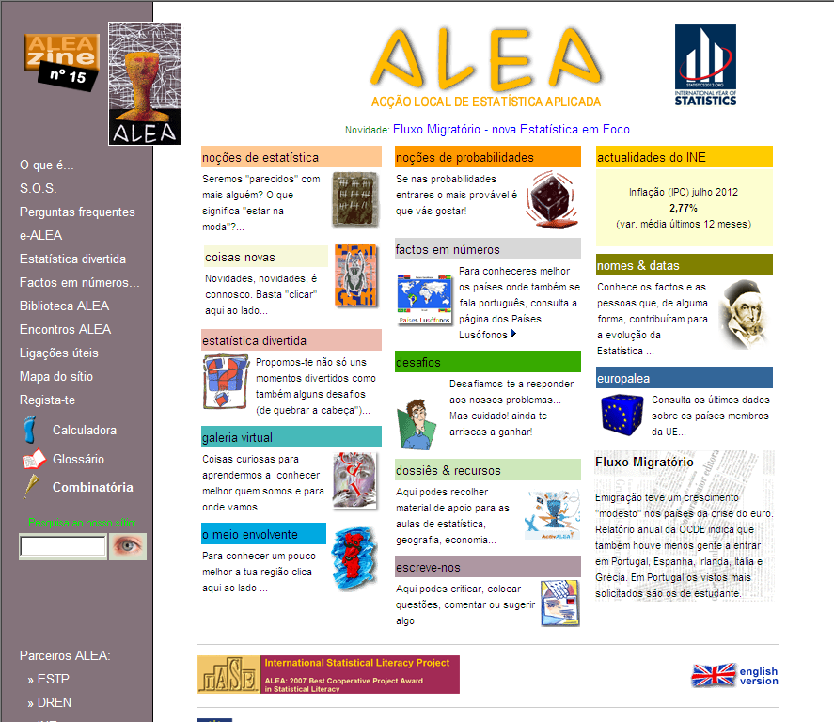
Training sessions
Training sessions on:
Statistics Portugal: www.ine.pt
ALEA: www.alea.pt

Slide 15
Study visits
Statistical theme selected by teachers
Presentation of the theme
Presentation of SP Portal and ALEA website
Practical activities with the purpose to raise students/teachers awareness about the importance of statistics, their knowledge on concepts and also the potentialities on the use of what is available on SP Portal
Duration: 1,5 hours
Study visits
40 visitors
per visit

Slide 16
Study visits
Requested statistical themes
Institutional activity and the phases of the statistical process
Census
Demography
Geographic infrastructure
Labour force
National accounts
Consumer price index
Tourism
Demography contents (example)
Importance of demographic studies Statistical information sources of demography Main phases of the statistical information process applied to demography Statistical information (such as resident population, population density, population change, birth and mortality rates, migration and net migration; natural and migratory growth) Demography changes
Statistics Portugal: www.ine.pt
ALEA:www.alea.pt

Slide 17
Conclusions
Statistics Portugal is succeeding in its activities towards the promotion of Statistical Literacy
The continuous growing of participation on ALEA Challenges
The increasing number of Access Points in Statistics Portugal Information Network in Higher Education Institutions Libraries
The increasing number of training sessions and of its participants (at the different levels) since these activities were put in place
The consistent good results obtained with the customer satisfaction surveys
The bridge established between the educational community and SP in different levels of statistical competencies

Slide 18

Challenges
 | ALEA | Redesign and broaden the scope of the website (contents and its coverage) Increase its dissemination at national and international level
 | Statistics Portugal Information Network in Higher Education Institutions Libraries | Broaden the scope of Statistics Portugal Information Network in Higher Education Institutions Libraries Diversify the existent training models Continue the improvement of training courses models Start training courses for teachers’ certification on the use of official statistics to produce teaching materials
 | Schools Library Network
 | Study visits | Broaden the contents of the study visits and adapt them to different audiences and needs Increase and adapt these model to school facilities
 | Open sessions | Start the implementation of open sessions in SP facilities to the public in general covering different themes

Slide 19
Challenges
The approach to improve statistics literacy is a never ending story, that as to be constantly aligned with society needs and expectations.
Lets’ improve
statistical literacy!

