Slide 1
Quality assurance for Consumer Prices and MIP Statistics
Berthold Feldmann, Aleš Čapek
Eurostat

Slide 2
Chapter 1
Quality Assurance Framework for Consumer Price Statistics

Slide 3
Quality Assurance System for HICP

Slide 4
The legal framework
Since 1995 a Regulation on Harmonised Indices of Consumer Prices (HICP)
Revision of the HICP Regulation foreseen
  Core Regulation
  Implementing Act
  Delegated Act
Targets:
  Incorporate modern compilation methods
  Assure full comparability of the HICP

Slide 5
Methodological Manual
Recommendations, explanations and examples for producing HICP
Not legally binding
Transparency: the NSI informs Eurostat of the reasons for a different approach and quantifies the consequences
Developed in close cooperation with NSIs
Planned to be endorsed in 2016

Slide 6
Inventory
More than hundred categories on
  data collection in all its forms
  treatment of confidentiality
  handling of specific product groups
  weights used
  process of quality assurance in the NSIs
  Accuracy, timeliness, comparability and coherence
Updated at annual frequency

Slide 7
Compliance Monitoring Visits
Eurostat experts visit at regular intervals (about every four to five years) each NSI
Check if the production process for HICP and HPS is fully compliant with
  the rules of the legal framework
  the recommendations laid down in the Methodological Manual
Weak points are identified and recommendations how to improve are developed

Slide 8
Task Force Quality Improvement
'Task Force Quality Improvement' with experts from
  Eurostat
  the NSIs
  the ECB
  National Central Banks
Meets several times per year
TF discusses outstanding methodological issues and develops recommendations for further harmonisation
Published on a Wiki website

Slide 9
Chapter 2
Quality Management and Monitoring for MIP statistics

Slide 10
MIP Scoreboard Indicators
3 year moving average of the current account balance in % of GDP
net international investment position in % of GDP
3 years percentage change of the real effective exchange rate
5 years percentage change of export market share
3 years percentage change in nominal unit labour cost.
year-on-year change in deflated house prices
private sector credit flow in % of GDP
private sector debt in % of GDP
general government sector debt in % of GDP
3 year backward moving average of unemployment rate
year-on-year change of total financial sector liabilities

Slide 11
Specificities of quality assurance for MIP statistics
New policy framework – quality assurance to be set up
Build on existing domain specific quality frameworks + harmonise and standardise
Focus on fitness for purpose
(comparability, reliability)
MIP statistics in the form of set of indicators: additional quality aspects (coherence, parsimony)

Slide 12
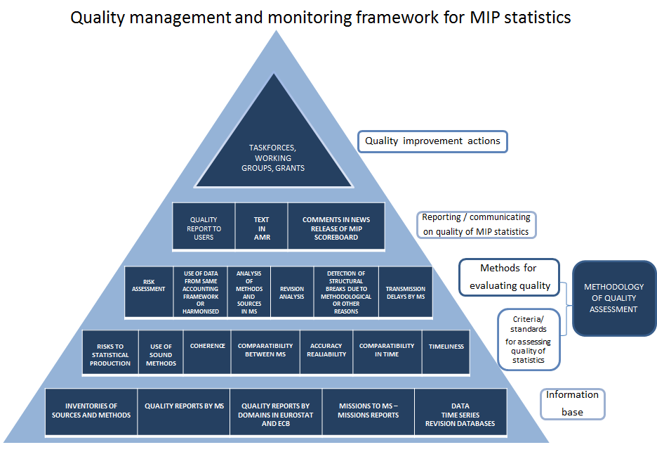

Slide 13
Thank you for
your attention!
Any Questions ?

