Slide 1
Quality assurance framework applications in Turkish Statistical System
Nezihat KERET
Gülhan Eminkahyagil
Metadata and Standards Department
Turkish Statistical Institute (TurkStat)
Notes:
1

Slide 2
Vision of Turkish Statistical Institute (Turkstat) (2012-2016)
User Oriented
Sustainable Statistics System
International Standards

Slide 3
Continuous improvement cycle
Ministry of Justice
Ministry of Family and Social Policies
Banking Regulation and Supervision Agency
Information and Communication Technologies Association
Ministry of Science, Industry and Technology
Ministry of Labour and Social Security
Ministry of Environment and The City
Presidency of Religious Affairs
Ministry of Economic Affairs
Energy Market Regulatory Authority
Ministry of Energy and Natural Resources
Ministry of Youth and Sports
Ministry of Food, Agriculture and Livestock
Undersecretariat of Treasury
H.U. Institute of Population Studies
Ministry of Development
Public Procurement Authority
Ministry of Culture and Tourism
Ministry of Finance
Ministry of National Education
Ministry of Forest and Water Affairs
Ministry of Health
Capital Markets Board
Central Bank
Turkish Cooperation and Development Agency
TOBB
Association of the Insurance and Reinsurance Companies
Information and Communication Technologies Authority
Turkstat
Banks Association of Turkey
Ministry of Transport, Maritime Affairs and Communication
Council of Higher Education
Savings Deposit Insurance Fund
Turkish Statistical
System (TSS)
=
Official Statistics Programme
A chain is only as strong as its weakest link

Slide 4
The role of TurkStat in Turkish Statistical System
Determining standards
Monitoring the performance of tasks assigned by the Official Statistics Program to the institutions and organizations in relation to official statistics.
Performing quality controls and providing technical support
Managing the Turkish Statistical System
Ensuring the cooperation and coordination
Turkish Statistics Law defines the quality principles indicated in CoP

Slide 5
Process-oriented reorganization and developments
2010
2012
2013
2014
Sub-strategy
Policy papers
Directives
Regulations
Reorganization/
New departments established
Quality assessment studies for official statistics in Turkish Statistical System
Metadata, quality and
process standardization studies
Official Statistics Program II &
Strategic Plan II
(2012-2016)
Quality Assurance Framework Pilot Applications
Studies on GSBPM initiated
Controlling
mechanisms

Slide 6
TurkStat’s Statistical Business Process Model
Quality Management / Metadata Management
1.Specify Needs
2.Design
3.Build
4.Collect
5.Process
6.Analyse
7.Disseminate
1.1.Determine needs for information
2.1.Design statistical products and outputs
3.1.Build and develop production system components
4.1.Establish frame and registers, select sample
5.1.Clasify and code
6.1.Evaluate the information for its effect
7.1.Update dissemination systems
1.2.Consult and confirm needs
2.2.Design frame and sample methodology
3.2.Integrate production system with other systems
4.2.Set up collection
5.2.Micro-edit
6.2.Produce statistics
7.2.Produce dissemination products
1.3.Establish output objectives
2.3.Design data collection methodology
3.3.Test production system
4.3.Run collection
5.3.Macro-control
6.3. Ensure statistical quality
7.3.Manage release of dissemination products
1.4.Check data availabilty
2.4.Design statistical processing and analysis metodology
3.4. Finalize production system
4.4.Finalize collection
5.4.Impute
6.4.Examine and evaluate statistics
7.4.Manage user queries
1.5.Prepare business plan
2.5.Design production systems and workflows
5.5.Calculate weights and derive variables
6.5.Prepare statistics for dissemination
6.6.Finalize content

Slide 7
Process oriented structure
Specify needs
Dissemination of Information and Communication Department
Design
Metadata and Standards Department
Build
Data Collection Coordination Department
Collect
Process
Register Systems Department
Analyse
Sampling and Analysis Techniques Department
Disseminate

Slide 8
Process-oriented reorganization and developments
2010
2012
2013
2014
Sub-strategy
Policy papers
Directives
Regulations
Reorganization/
New departments established
Quality assessment studies for official statistics in Turkish Statistical System
Metadata, quality and
process standardization studies
Official Statistics Program II &
Strategic Plan II
(2012-2016)
Quality Assurance Framework Pilot Applications
Studies on GSBPM initiated
Controlling
mechanisms

Slide 9
QAF
in TSS
Specific
Measurable
Achievable
Relevant
Timely

Slide 10
Pillars of SMART
National
quality
standards
Monitor &
Control
Continuous
improvement
Sustainable statistical system

Slide 11
Quality Assurance Framework in TSS
Structural
quality
Adequacy of resources
Statistical confidentility
Impartiality and
objectivity
Process quality
4. Sound methodology
5. Appropriate statistical
procedures
Product quality
User orientation
Accuracy and reliability
Timeliness
Coherence and comparablility
Accessiblility and clarity
Integrated quality
approach/
Trust to
official statistics
Perceived quality

Slide 12
Quality Accreditation Process for Official Statistics
Quality re-assessment process
Quality improvement plans
Quality accreditation
every 3 years
Quality assessment process

Slide 13
Objectives of quality assessment process
to prepare a "Data Source Inventory"
to determine cooperation activities
to specify the current situation of “to what extent” the user needs taken into account
to obtain the documentation of statistical production processes
to determine the level of compliance with quality principles and standards
to specify quality improvement actions
to prepare a "Quality Assessment Report”

Slide 14
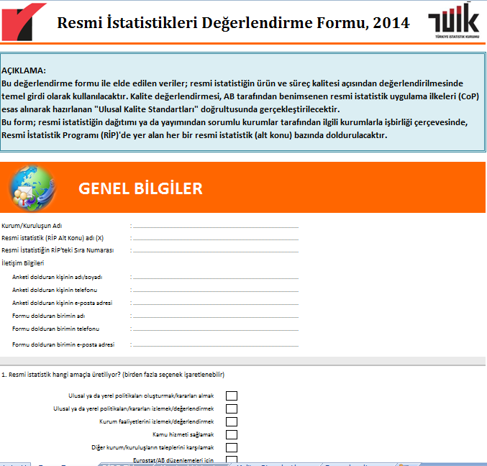
Quality Evaluation Questionnaire
General information
Data sources and cooperation
Specifying user needs
Data collection
Classifications
Data process and analysis
Dissemination of official statistics
Opinions and recommendations

Slide 15
Quality Evaluation Checklist
Checklist
strategies/ objectives
formal meeting decisions
Other
flow diagram of statistical production processes
metadata

Slide 16
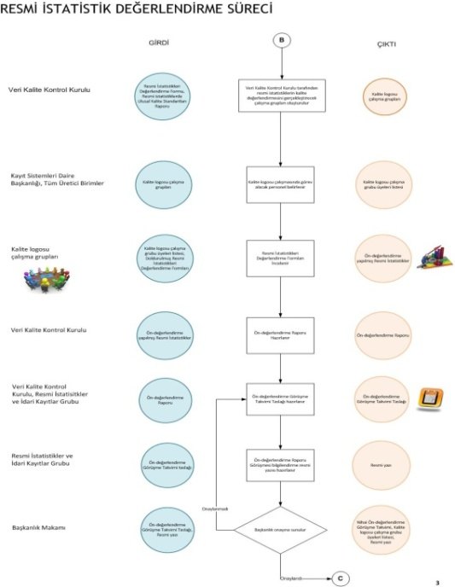
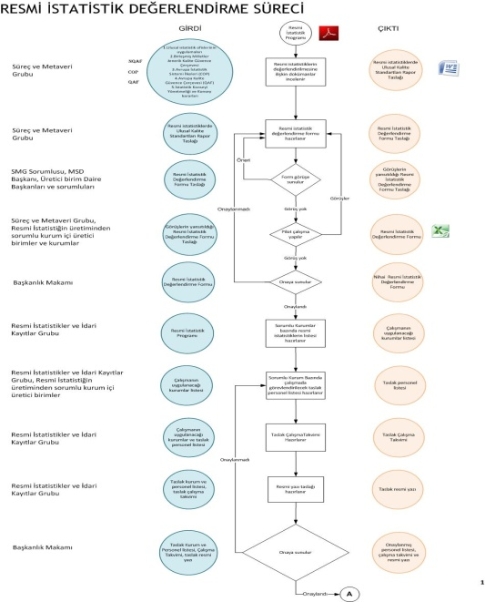
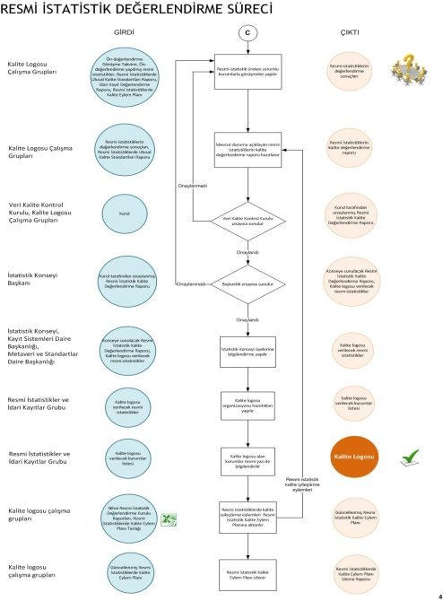
Quality Assessment Process
Responsible department
Input
Process
Output

Slide 17
Major requirements for quality accreditation
a separate statistical unit and adequate staff graduated from statistics
metadata standards and publishing/updating
internal consistency of administrative data
accuracy and reliability
international definitions, methodology and classifications in the production of official statistics
appropriate statistical procedures

Slide 18
Pilot Applications
In-house pilots
Quality Assessment
Undersecretariat of Treasuary
Ministry of Forest and Water Affairs

Slide 19
“The journey of a thousand miles begins with one step” Lao-Tzu
Sustainable Statistics
System
Quality management
Quality Assurance Framework
Thank you
Standards

