Slide 1
Assessing and improving the quality, analytic potential and accessibility of data by linking administrative, survey and open data
European Conference on Quality in Official Statistics (Q2014)
Vienna, 5 June 2014
Manfred Antoni
Alexandra Schmucker

Slide 2
Motivation
Starting point:
Increasing demand of comprehensive (particularly longitudinal) data in social sciences
Rising problems with surveys (declining reachability and cooperation of respondents, increasing costs)
More and more new (big data) or uncommon (administrative data) sources are examined regarding their value for research
Different shortcomings of these different data sources
Remedy:
Balancing the disadvantages of these data sources by combining their advantages
Implementation:
Creating more comprehensive datasets using data linkage

Slide 3
Advantages and disadvantages: Survey data
Advantages:
Specifically gathered for certain research questions
Subjective information on behaviours, attitudes etc.
Disadvantages:
Missing data (unit-nonresponse, item-nonresponse, panel attrition)
Misreporting (e.g. recall errors in retrospective interviews)
Time restrictions
High costs

Slide 4
Advantages and disadvantages: Administrative data
Advantages:
Covering long time periods
Precise and reliable information
Complete target population
Disadvantages:
Data collected for administrative purposes (research as secondary use)
Changes in the data collection method and the recorded information
Time lag

Slide 5
Remedy: Data linkage
Potential data sources:
Survey data (e.g. on individuals, household or establishments) [S]
Administrative data [A]
Open data [O]
Advantages:
Higher analytic potential
Reduced respondent burden
Higher cost efficiency
Measuring and improving data quality
Challenges:
Error-prone and non-unique matching variables for record linkage
Legal restrictions for linkage and data access

Slide 6
Implementation at Research Data Centre (FDZ)
Tasks of the FDZ:
preparation, standardization and documentation of research data
secure data access
advisory service on analytic potential, scope, validity and handling of data
Several projects on data linkage using different sources since the FDZ’s establishment in 2004
Provision of (linked) data to external researchers

Slide 7
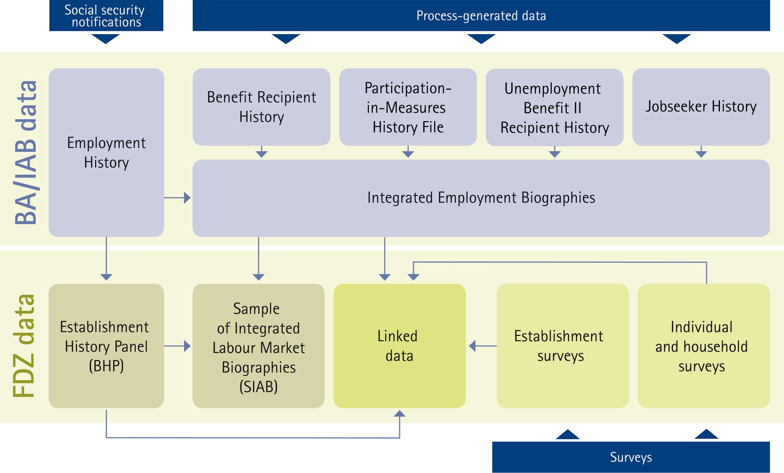
Data sources of the Research Data Centre
7

Slide 8
German Record Linkage Center (GRLC): Activities
FDZ Nuremberg | University of Duisburg-Essen
Focus: Service facility | Focus: Research unit
Project advisory center | Development and evaluation of linkage methods
Conducting (privacy preserving) record linkage | Development of free linkage software
Secure access to linked data | Dissemination of current research results
Tutorials on record linkage

Slide 9
Exemplary project I: WeLL-ADIAB (I)
Data sources:
Employee survey (project ‘Further Training as Part of Lifelong Learning’) [S]
IAB Establishment Panel [S]
Employment biographies [A]
Establishment histories [A]
Data linkage:
Using the social security number and the establishment number
Informed consent for linkage
Analytic potential:
Innovative linked employer-employee dataset to analyse determinants and consequences of further training in Germany
Research on data quality and selectivity (unit-nonresponse or refusal of allowance)
Data access:
On-site use at the Research Data Centre

Slide 10
Exemplary project I: WeLL-ADIAB (II)
Survey data
WeLL Employee Panel
IAB Establishment Panel
Employment Biographies
Establishment Histories
Employment Biographies
Establishment Histories
Administrative data
10

Slide 11
Exemplary project II: MPI-IC-IAB-Inventor Data
Data sources:
Patent and inventor data (German Patent and Trademark Office and PATSTAT - EPO Worldwide Patent Statistical Database) [O]
Employment biographies [A]
Establishment histories [A]
Data linkage:
Record linkage using names and addresses of inventors
Analytic potential:
Research at the intersection of labour market processes and patenting activities of individuals
Topics: Socio-demographic profiles of inventors, team composition, employment careers of inventors and their co-workers (e.g. mobility)
Data access:
Currently only for project members of IAB and Max Planck Institute for Innovation and Competition (MPI-IC)
Access via the Research Data Centre planned in the future

Slide 12
Exemplary project III: Geocoding of German Administrative Data
Data sources:
Geocoded addresses from the Federal Agency for Cartography and Geodesy [A]
Addresses of individuals and establishments from administrative employment biographies of the IAB [A]
Data linkage:
Record linkage using addresses of establishments and individuals
Aggregation to 2,280,864 small-area regions and grid cells (1,000 meter edge length)
Analytic potential:
Analyses below the municipality level
Neighbourhood effects
Data access:
So far only feasibility study on data access via the FDZ

Slide 13
Practice-oriented hints for data linkage
Linkage with survey data:
Early consideration in the survey design
Reduction of the questionnaire
But: Simultaneous collection of interesting variables in both sources ➔ Assessing data quality
Consider the national legal norms regarding the linkage of micro data
If necessary: asking for consent in surveys
Gathering unique (e.g. social security number) and non-unique (e.g. names, addresses, birth dates) identifiers ➔ Unique identifiers preferable to error-prone and non-unique ones ➔ Iterative process possible if both types are collected

Slide 14
Contact:
Manfred.Antoni@iab.de
Alexandra.Schmucker@iab.de
Information on the Research Data Centre:
http://fdz.iab.de
Information on the German Record Linkage Center:
http://www.record-linkage.de
Assessing and improving data by linking administrative, survey and open data

Slide 15
References:
Bender, Stefan; Dorner, Matthias; Harhoff, Dietmar; Hoisl, Karin; Scioch, Patrycja (2014): The MPI-IC-IAB-Inventor Data (MIID): Record-Linkage of Patent Register Data with Labor Market Data of the IAB. FDZ-Methodenreport, xx/2014 (forthcoming), Nuremberg.
Bender, Stefan; Fertig, Michael; Görlitz, Katja; Huber, Martina; Schmucker, Alexandra (2009): WeLL - unique linked employer-employee data on further training in Germany. In: Schmollers Jahrbuch. Zeitschrift für Wirtschafts- und Sozialwissenschaften, Jg. 129, H. 4, S. 637-643.
Scholz, Theresa; Rauscher, Cerstin; Reiher, Jörg; Bachteler, Tobias (2012): Geocoding of German Administrative Data. The Case of the Institute for Employment Research. FDZ-Methodenreport, 09/2012 (en), Nuremberg.

