Slide 1
QM Implementation Based on CoP, PDCA, and GSBPM
Statistics Iceland

Slide 2
Statistics Iceland
Small statistical office with ca 100 employees
Still it requires a substantial statistical and technical infrastructure
No board – the Director-General is directly responsible to the relevant ministry or minister
Statistics Iceland is the main producer and coordinator of statistics in Iceland

Slide 3
Statistics Iceland
Four divisions
Economic Statistics
Social Statistics
Business Statistics
Resources and Services
Quality manager hired in a full time position 2012
First as part of Resources and Services
Now directly under the Director-General

Slide 4
Quality Policy
Quality Policy of Statistics Iceland
Statistics Iceland is a professionally independent institution which develops, produces and disseminates statistics about society. Statistics Iceland’s policy is to work according to sound methodology and appropriate statistical procedures and with impartiality, objectivity and statistical confidentiality. The statistics are accurate and reliable, coherent and comparable. The statistics are according to users’ needs, released in a timely and punctual manner and presented in a clear and understandable form. In order to realize this, Statistics Iceland‘s professional independence is specified in law and it is ensured that staff has adequate training and experience to meet current statistical needs. Statistics Iceland is responsible for official statistics in Iceland and needs to ensure that statistics are internally coherent and comparable, processing of data collecting is simplified, business and administrative sources used when possible with a sound methodology to avoid excessive burden on respondents. Statistics Iceland puts emphasis on good service, efficiency and cost effectiveness to meet increasing domestic and international demands. Statistics Iceland takes part in international cooperation and is fully compliant with the demands of the European Statistical System. Statistics Iceland operates within well-designed processes and according to plan. Quality indicators and other important factors regarding the operation and its outputs are well defined and results are checked accordingly. If quality indicators are not met changes will be carried out and improvements made on processes and procedures. The quality system of Statistics Iceland is based on the 15 principles of the European Statistics Code of Practice (CoP) published by the European Statistical System (ESS): 1. Professional independence 2. Mandate for data collection 3. Adequacy of resources 4. Commitment to quality 5. Statistical confidentiality 6. Impartiality and objectivity 7. Sound methodology 8. Appropriate statistical procedures 9. Non-excessive burden on respondents 10. Cost effectiveness 11. Relevance 12. Accuracy and reliability 13. Timeliness and punctuality 14. Coherence and comparability 15. Accessibility and clarity

Slide 5
Quality Policy
Quality Policy of Statistics Iceland
Statistics Iceland is a professionally independent institution which develops, produces and disseminates statistics about society. Statistics Iceland’s policy is to work according to sound methodology and appropriate statistical procedures and with impartiality, objectivity and statistical confidentiality. The statistics are accurate and reliable, coherent and comparable. The statistics are according to users’ needs, released in a timely and punctual manner and presented in a clear and understandable form. In order to realize this, Statistics Iceland‘s professional independence is specified in law and it is ensured that staff has adequate training and experience to meet current statistical needs. Statistics Iceland is responsible for official statistics in Iceland and needs to ensure that statistics are internally coherent and comparable, processing of data collecting is simplified, business and administrative sources used when possible with a sound methodology to avoid excessive burden on respondents. Statistics Iceland puts emphasis on good service, efficiency and cost effectiveness to meet increasing domestic and international demands. Statistics Iceland takes part in international cooperation and is fully compliant with the demands of the European Statistical System. Statistics Iceland operates within well-designed processes and according to plan. Quality indicators and other important factors regarding the operation and its outputs are well defined and results are checked accordingly. If quality indicators are not met changes will be carried out and improvements made on processes and procedures. The quality system of Statistics Iceland is based on the 15 principles of the European Statistics Code of Practice (CoP) published by the European Statistical System (ESS): 1. Professional independence 2. Mandate for data collection 3. Adequacy of resources 4. Commitment to quality 5. Statistical confidentiality 6. Impartiality and objectivity 7. Sound methodology 8. Appropriate statistical procedures 9. Non-excessive burden on respondents 10. Cost effectiveness 11. Relevance 12. Accuracy and reliability 13. Timeliness and punctuality 14. Coherence and comparability 15. Accessibility and clarity
CoP
Plan – Do – Check – Act (PDCA)
CoP

Slide 6
Improvement System
Quality Audits
(ESS per review)
Internal Audits
User Surveys
Process Model and Performance Indicators
Visual Management System
Program Management
User Groups
Improvement Ideas from Employees
Methods for Problem Solving and Improvement
Process for Suggestions and Complaints

Slide 7
Process Model
Current condition
High Level Process Map
Three core processes, produce products and services for customers
Do research and forecasts
Four enabling processes, service the core processes (and each other)
Design products and services
Create and disseminate statistics
Ensure secure supervision of finance
Maintain good human resources
Maintain housing
and control access
Ensure data security and provide suitable computer systems
One management process called Get the right things done
Get the right things done

Slide 8
High Level Process Map - the highest level of the Process Model -
Do research and forecasts
Design products and services
Create and disseminate statistics
Ensure secure supervision of finance
Maintain good human resources
Maintain housing
and control access
Ensure data security and provide suitable computer systems
Get the right things done

Slide 9
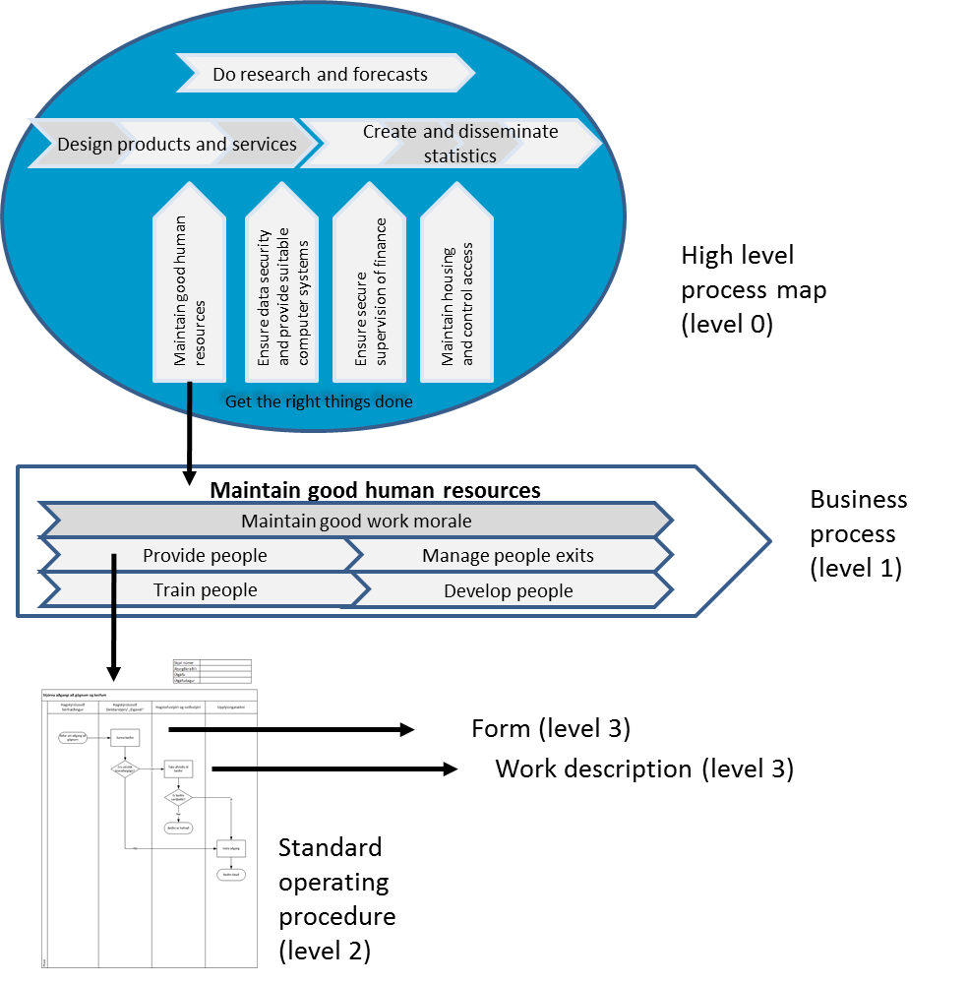
Process Model
Drill-down structure from each of the business processes on the High Level Process Map
Four levels
High Level Process Map (Level 0)
Business Processes (Level 1)
Standard Operating Procedures (Level 2)
Work Descriptions, Forms, Checklists, etc. (Level 3)

Slide 10
Process Model
Operating procedures answer essentially two questions:
What is done?
Who does it?
Work descriptions answer the question:
How is it done?

Slide 11
Statistical Business Process
Many different products with different processes
We started to map the statistical business processes just like all the other business processes, that is to say, on a blank piece of paper
The same processes for different products were not comparable to each other
We decided to start mapping the statistical business process using the GSBPM as a reference frame

Slide 12
GSBPM
To make the GSBPM usable for us
Translate to Icelandic
Around 20 meetings
All managers (heads of units) + one third of experts

Slide 13
Template based on the GSBPM for process mapping of the data collection process
The process map is used as part of the operating procedures

Slide 14
An operating procedure for the CATI process drawn up from the previous template

Slide 15
Pros and Cons
Pros
Much quicker to map the processes
Much better to compare same processes for different products
Easier to communicate with colleagues in other countries on process matters
Cons
Some complications in the processes can easily be lost

Slide 16
Thank you for listening

Slide 17
Appendix 1: The Management Process
Get the Right Things Done
Create vision and strategy
Improve
Organize
Review and evaluate
Make plans

Slide 18
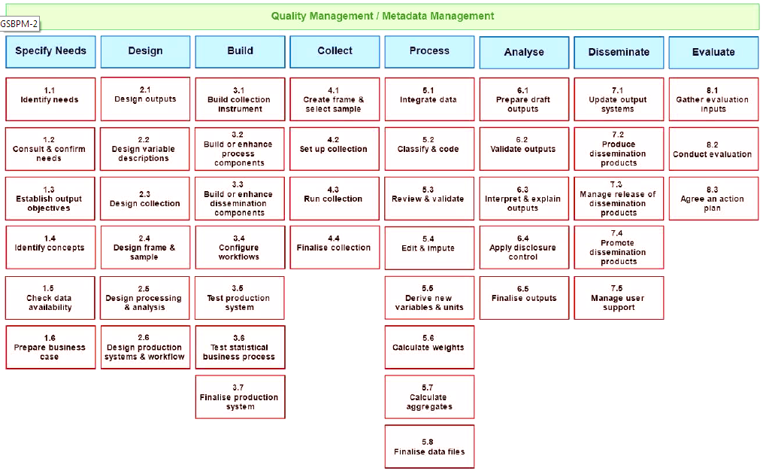
Appendix 2: The GSBPM 5.0

