Slide 1
European Conference on Quality in
Official Statistics Q2014
Development of the Model for Measuring the Satisfaction of Official Statistics Users
Tina Steenvoorden

Slide 2
Introduction
User-oriented approach of NSI‘s
European Statistics Code of Practice
ESS Standard for Quality Reports (ESQRS)
Euro SDMX metadata structure for the exchange of reference metadata (ESMS)
Development of the methodology in this field is slow and the exchange of knowledge is limited

Slide 3
Development of a model
Review of relevant theoretical basis for measuring users’ satisfaction from related fields of research:
national customer satisfaction indices (ACSI)
measuring the quality of services,
measuring satisfaction with websites
measuring satisfaction in the public sector
Model for measuring the satisfaction of official statistics users was defined

Slide 4
Model for Measuring the Satisfaction of Official Statistics Users at SURS
Percieved Quality of Official Statistics Data
Recommendations and Complaints
Percieved Quality of Goods
Assessment of Direct Contact
Overall User Satisfaction
Percieved Quality of Services
Trust
Website Evaluation

Slide 5
User satisfaction survey at SURS
Development of measurment scales, cognitive tests, pilot study
On-line survey
Out of 11 565 invited users, 2 680 took part in the survey. The overall response rate was 23%.
60% female and 40% male users

Slide 6
Main results of the latent variables

Slide 7
Parameter estimates (standardized coefficients)
0,36
Data quality
Trust
0,72
0,14
0,80
0,72
Overall satisfaction
0,67
Direct contact
0,22
0,92
Recommendations/ complaints
0,60
0,05
Website
0,16

Slide 8
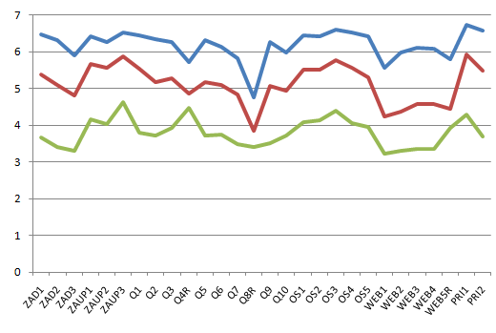
Group comparison
Well-satisfied users (36 %): more frequent users, more experienced users, more often visiting website; more often using data for personal purposes.
Satisfied users (44 %): use data for a longer time, more often using data for study or research purposes.
Less-satisfied users (20 %): use data less often, new/fresh users, visiting website a couple times a year; more often using data for bussiness purposes.

Slide 9
Conclusion
The aggregated results of the survey were published on SURS’s website, along with a special release on the website to inform the users about the results.
The results have been presented at the management board meeting and the meeting of the Statistical Council, and a more detailed analysis is available on the intranet site for all employees.
Based on the results, the main improvement action has been the thorough renovation of SURS’s website that is still under construction.
After the successful implementation of the new website, the survey will be repeated.

