Slide 1
Using GPS To Detect and Prevent Falsification
RJ Marquette
US Census Bureau
rodrick.j.marquette@census.gov

Slide 2
2010 Census Address Canvassing
First operation of the Census
Updates our list of housing units
Handheld computer
Used Global Positioning System (GPS)
Relative coordinates
Dependent quality control – acceptance sampling

Slide 3
Curbstoning Clusters
Clusters of GPS coordinates at:
Single houses
Coffee shops
One spot along the road
19,500 assignments had at least one

Slide 4
Ideal Example Green – GPS; White – Manual
All map spots are fictitious

Slide 5
Curbstoning Cluster Example Green – GPS; White – Manual
All map spots are fictitious

Slide 6
Curbstoning Cluster Example Green – GPS; White – Manual
All map spots are fictitious

Slide 7
Defining Curbstoning Clusters
Definition: Six or more housing units in 25 foot/7.6 meters radius
Difficult to compute - duplicates
Analysis: Squares of about 40 ft/12.2 m
6 or more units in a square or adjacent squares counted as a curbstoning cluster
Excluded multi-housing unit structures

Slide 8
Compared to Dependent Quality Control
Assignments with curbstoning clusters more likely to fail DQC:
13.7% versus an overall 8.4% DQC failure rate
Assignments with “long strands”:
14.6% of assignments with long strands failed DQC

Slide 9
Long Strand Example Green – GPS; White – Manual
All map spots are fictitious

Slide 10
Comparing Curbstoning Clusters and Long Strands
Overlap: 0.81%
Detect different assignments
15.7% of assignments with both failed DQC
Pursue both methods for the 2020 Census
Improve interviewing too

Slide 11
2020 Census Plans
Field operations use smartphones and tablets with GPS
Use GPS in two ways:
Detection
Prevention

Slide 12
Detection
Flag assignments with large strand lengths for further review
Working on methods to detect curbstoning clusters quickly
May be affected by Prevention steps

Slide 13
Good Faith Error Example
All map spots are fictitious

Slide 14
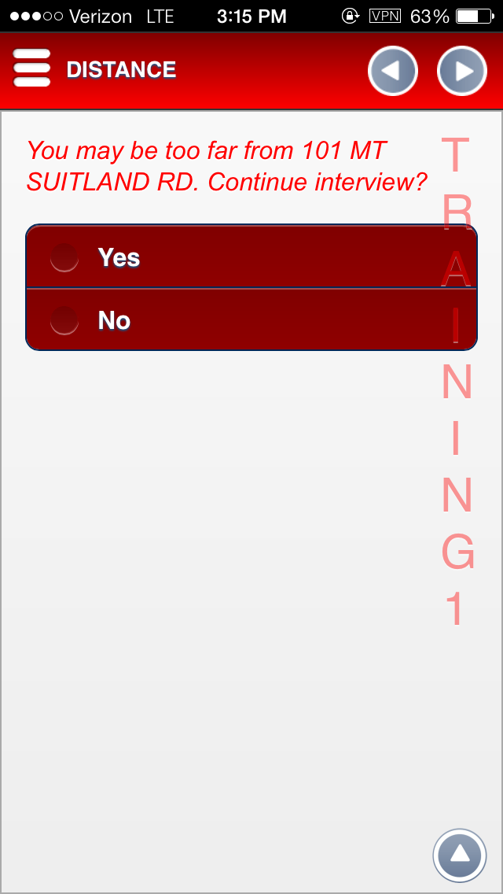
Prevention
Warn the user if they are “too far” from the housing unit
User can override
Warn user if they place 6th housing unit within given radius

Slide 15
Limitations
Hardware GPS accuracy may not meet Census standards
Need to test for this purpose
GPS has some error
May only be able to detect large discrepancies

Slide 16
To Do
Find a way to detect curbstoning clusters in the field
Refine strand length rules
Urban versus rural
Avoid too many false warnings
Test using multi-housing unit structures

Slide 17
Thanks!
RJ Marquette
US Census Bureau
rodrick.j.marquette@census.gov

