Slide 1
Whom are we talking about?
Exclusion, noncoverage and nonresponse in social statistics
(and social surveys)
Ineke Stoop

Slide 2
Whom are we talking about?

Slide 3
Whom are we talking about?
People living in The Netherlands

Slide 4
Whom are we talking about?
Non-citizens
People living in The Netherlands

Slide 5
Whom are we talking about?
Non-citizens
People living in The Netherlands
Age limits

Slide 6
Whom are we talking about?
Non-citizens
People living in The Netherlands
Age limits
Non-residential households

Slide 7
Whom are we talking about?
Non-citizens
People living in The Netherlands
Age limits
Non-residential households
Abroad longer period

Slide 8
Whom are we talking about?
Non-citizens
People living in The Netherlands
Language problems
Age limits
Non-residential households
Abroad longer period

Slide 9
Whom are we talking about?
Non-citizens
People living in The Netherlands
Age limits
No landline phone
Language problems
Non-residential households
Abroad longer period

Slide 10
Whom are we talking about?
Non-citizens
People living in The Netherlands
Age limits
No landline phone
Language problems
No internet
Non-residential households
Health problems

Slide 11
Whom are we talking about?
Non-citizens
People living in The Netherlands
Age limits
No landline phone
Language problems
No internet
Not in population register
Non-residential households
Abroad longer period

Slide 12
Whom are we talking about?
Non-citizens
People living in The Netherlands
Age limits
No landline phone
Language problems
No-go area
No internet
Not in population register
Non-residential households
Abroad longer period

Slide 13
Whom are we talking about?
Non-citizens
People living in The Netherlands
Age limits
No landline phone
Language problems
Noncontact
No-go area
No internet
Not in population register
Non-residential households
Abroad longer period

Slide 14
Whom are we talking about?
Non-citizens
People living in The Netherlands
Age limits
No landline phone
Language problems
Noncontact
No-go area
Mentally or physically unable
No internet
Not in population register
Non-residential households
Abroad longer period

Slide 15
Whom are we talking about?
Non-citizens
People living in The Netherlands
Age limits
No landline phone
Language problems
Noncontact
Refusal
No-go area
Mentally or physically unable
No internet
Not in population register
Non-residential households
Abroad longer period

Slide 16
Whom are we talking about?
Non-citizens
People living in The Netherlands
Conduct an interview
Age limits
No landline phone
Language problems
Noncontact
Refusal
Mentally or physically unable
No internet
Not in population register
Non-residential households
Abroad longer period

Slide 17
Content
What do we want?
Allow all members of the target population to participate in our survey
Do we know what is happening?
Exclusion mechanisms
Availability of information on survey data collection process
What can we do?
Better documention
Become more inclusive

Slide 18
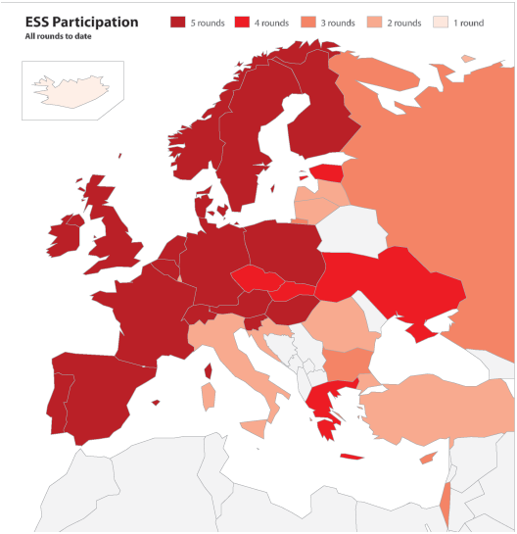
Aims ESS
To monitor and interpret public attitudes and values within Europe and to investigate how they interact with Europe’s changing institutions
To advance and consolidate improved methods of cross-national survey measurement in Europe and beyond

Slide 19
ESS top data user countries (>100) (March 2014) (N=68,204)

Slide 20
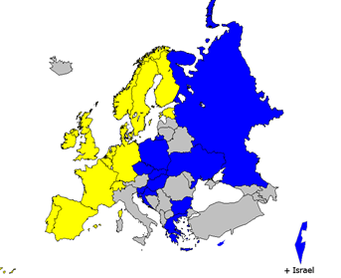
Strategy European Social Survey
Face-to-face interviewing
CAPI/PAPI
Random sampling
Different sampling frames
High coverage
Translation +5% language minorities
But
Exclusion non-residential population
Exclusion far away areas (Caribbean islands)
Nonresponse
High target response rates: 70%
Specification of efforts, guidelines
CAPI
PAPI

Slide 21
Response rates ESS (selection all rounds)

Slide 22
Exclusion, noncoverage, nonresponse, cultural bias
Different sampling frames
Homeless
Illegal aliens
Opt-out register
Small language minority groups
No on-the-fly translation
Non-residential population
No upper age limit, but exclusion senior housing facilities
Cross-national differences
Not able due to mental or physical incapability
Survey mode
Cultural background
How important is it that immigrants have a Christian background?

Slide 23
Response outcomes European Social Survey, R5
Report on quality assessment of contact data files in Round 5: Final report 27 countries
Hideko Matsuo and Geert Loosveldt
Working paper Centre for Sociological Research (CeSO) Survey Methodology CeSO/SM/2013-3

Slide 28
Comparison official statistics
Health surveys, LFS, EU-SILC
Methodological information hard to find
Comparable response rates, effective sample size?
(EU-SILC 2010): “The effective sample size is not included in the following table due to a lack of comparability among the methodologies used by countries for computing the design effect”.

Slide 29
Response outcomes EU SILC 2010
2010 COMPARATIVE EU INTERMEDIATE QUALITY REPORT Version 3 – October 2012

Slide 30
Undercoverage LFS
People living in new dwellings
Recent immigrants
People without a fixed phone (LU, CH)
Students in student halls
People in non-private households
Homeless people and other people without registered residence (e.g. people living in huts, caravans) (DE).
Hard-to-access groups are characterized either by extremely bad traffic conditions to get to their place or by collective reluctance – usually within a small community – towards being interviewed (HU).
Population living in collective households or in dwellings outside the borders of built areas is not covered (EL).
New dwellings underrepresented in the sample, also population living in collective (institutional) households staying/or planning to stay in this places for over a year, homeless people and other people without registered residence (e.g. people living in huts, caravans) are out of the frame, emigrants staying abroad for more than one year (PL).
Substitution (IT)
In many cases no or little information provided
Eurostat, Quality report of the LFS 2012

Slide 31
Exclusion mechanisms
Outdated or incomplete sampling frames
Exclusion particular groups
Non-private households
Far away, no-go areas
Difficult
Nonparticipation
Not able for mental or physical reasons
Language problems
Survey mode
Functional illiteracy

Slide 32
Do we know what is happening
Not really
Non-standardised information
Unavailable information
Many groups drop out for different reason
Effect on statistics
The very elderly in the LFS
The illiterate in the LFS
The very elderly in health surveys

Slide 33
Precision and bias
Comparing groups
Specific survey

Slide 34
1. General population
Complete population
Unemployment
Health
Political efficacy
Social participation
Survey problem
No identification necessary, as long as they take part
Precision: dependent on group size
Bias: Survey participation related to output variable (through subgroup membership)

Slide 35
2. General population: subgroups
Distinctions
Socio-demographic groups, deviant groups, analysis
Survey problems
In surveys, registrations
Have to be identified
Comparing groups
Standardised design

Slide 36
3. Specific group
Target groups
Specific topics
Adapted questionnaire
Survey problems
Sampling frame
Cooperation
Language
Culture
Measurement issues

Slide 37
Paying more efforts to make it possible that everybody can participate

Slide 38
Cons Pros
Efforts to include groups that are not going to respond
Questionnaire not relevant
Costs
Small effect on final results
Responsibility respondent
Completeness
Data quality
Cross-national comparability
Reporting on small subgroups
Fairness
Responsibility statistician, researcher

Slide 39
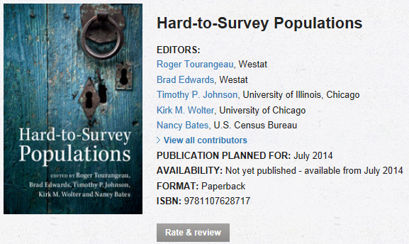
Thank you for your attention
i.stoop@scp.nl

