Slide 1
Quality aspects of rounding statistical results
Jörgen Svensson
Process Owner
Q2014 Vienna

Slide 2
Rounding statistical results
Rounding: computed values ​​are not reported exactly but are replaced by approximations to a given number of significant digits, i.e. with trailing zeroes or fewer decimals
Rounding is used for
convenience in presentation and use
indication of a lack of accuracy in computed numbers
Rounding is usually avoided in intermediate calculations

Slide 3
Reasons for rounding
Uncertainty: not all digits provide meaningful information
Unrounded values would give a misleading impression of precision and thus over-interpretation
Presentation needs to be lucid
To prevent disclosure of exact values

Slide 4
Reasons against rounding
Statistics used by knowledgeable users
Results needed for further calcu-lations
Rounding error would give too much uncertainty
Uncertainty is covered by reporting sampling errors
Results need to be (almost) additive

Slide 5
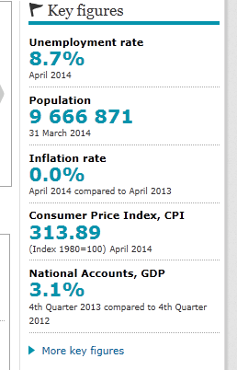
Should we round this figure?

Slide 6
Simple rounding of a single value
Rounding to the nearest integer of a given step
Tiebreaking rule for values half-way between:
Rule A, round half to even: 7.5→8; 8.5→8
Rule B, round half away from zero: 7.5→8; 8.5→9
Standard instruction (Statistics Sweden)
Normally let the choice between rule A and rule B follow what is practically convenient with the IT tools used. Rule A shall be preferred when there are specific requirements that no deliberately distorting tendency may even be liable to be suspected. This may be the case for example for statistics that affect disburse­ments.

Slide 7
Controlled rounding of a set of values
Rounding so that certain conditions are met: consistency in a table
Used when explicit preference for additivity
Shall be done with minimum overall impact
Otherwise a note:
Totals may differ slightly due to rounding.

Slide 8
An example of controlled rounding
 | Group A | Group B | Group C | Total
Region 1 | 10 | 10 | 10 | 30
Region 2 | 5 | 20 | 5 | 30
Region 3 | 15 | 0 | 15 | 30
Total | 30 | 30 | 30 | 90
 | Group A | Group B | Group C | Total
Region 1 | 11,11 | 11,11 | 11,11 | 33,33
Region 2 | 5,55 | 22,22 | 5,55 | 33,33
Region 3 | 16,67 | 0 | 16,67 | 33,33
Total | 33,33 | 33,33 | 33,33 | 100
 | Group A | Group B | Group C | Total
Region 1 | 11 | 11 | 11 | 33
Region 2 | 6 | 22 | 5 | 33
Region 3 | 17 | 0 | 17 | 34
Total | 34 | 33 | 33 | 100

Slide 9
Some conclusions
Rounding is an issue of conventions and quality communication
Rounding is essential for user perception and interpretation
Rounding may send a message
Rounding shall be done with care!

