Slide 1
Enabling a national road and street database in population statistics
Pasi Piela
pasi.piela@stat.fi
Q2014 Vienna Conference

Slide 2
Accessibility applications
Commuting distances
  General annual update for the Social Statistics Data Warehouse
Commuting time
  Enriching with traffic sensor data
Other applications
  Emergency 24/7 accessibility
  Elementary school accessibility

Slide 3
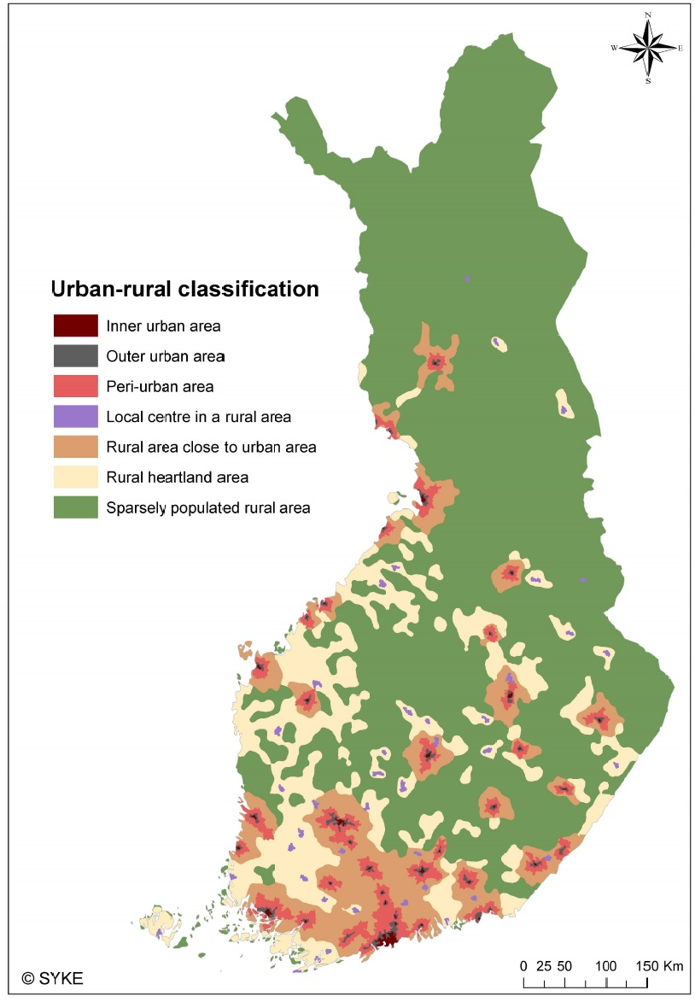
Data and contextual issues 1/2
Digiroad, National Road Database of Finnish Transport Agency
  accurate data on the location of all roads and streets in Finland
Social Statistics Data Warehouse of StatFi
  Dwelling coordinates and work place coordinates (2 years lag) along with a variety of demographic features.
  Coordinate coverage for the ”workplace” was 91.2% of all employed inhabitants in 2011.
New detailed Urban-rural classification by Finnish Environment Institute SYKE

Slide 4
Data and contextual issues 2/2
Traffic sensor detection data of FTA
  Currently 437 stations (vehicle detection loops) giving information for speed, direction, length and class of a passing vehicle. Target here: speed of passenger cars excluding heavy vehicles.
  Open data services available as well (Digitraffic)

Slide 5
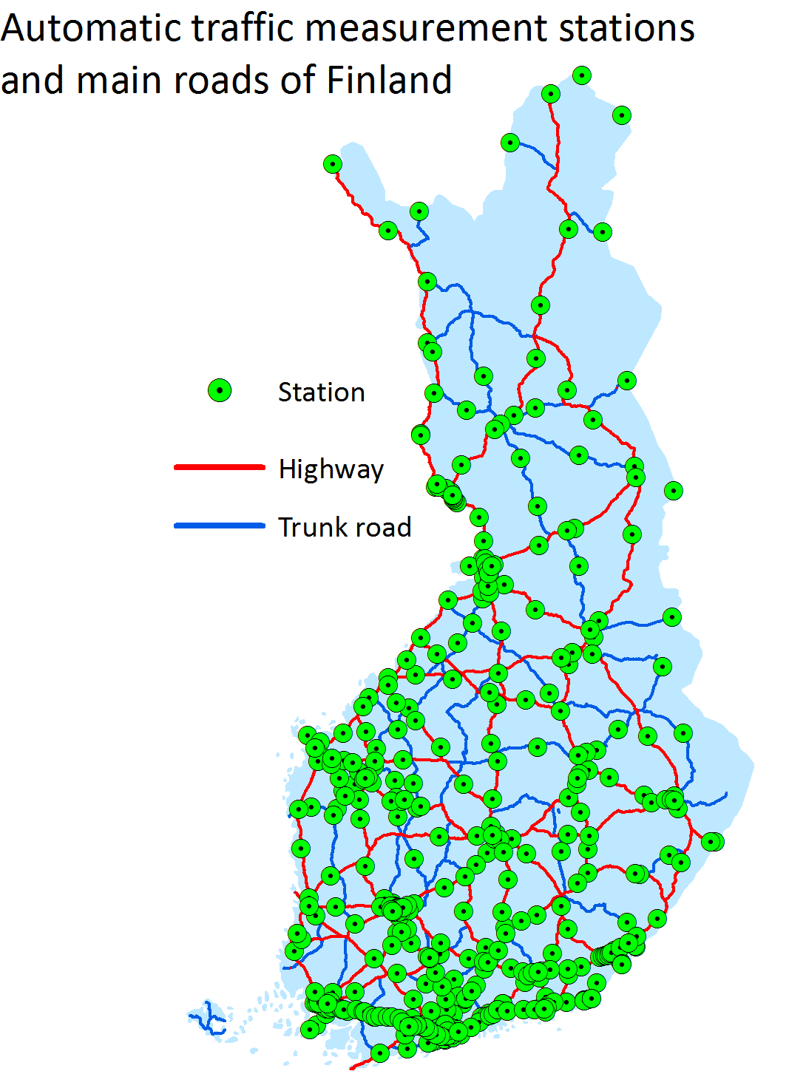

Slide 6
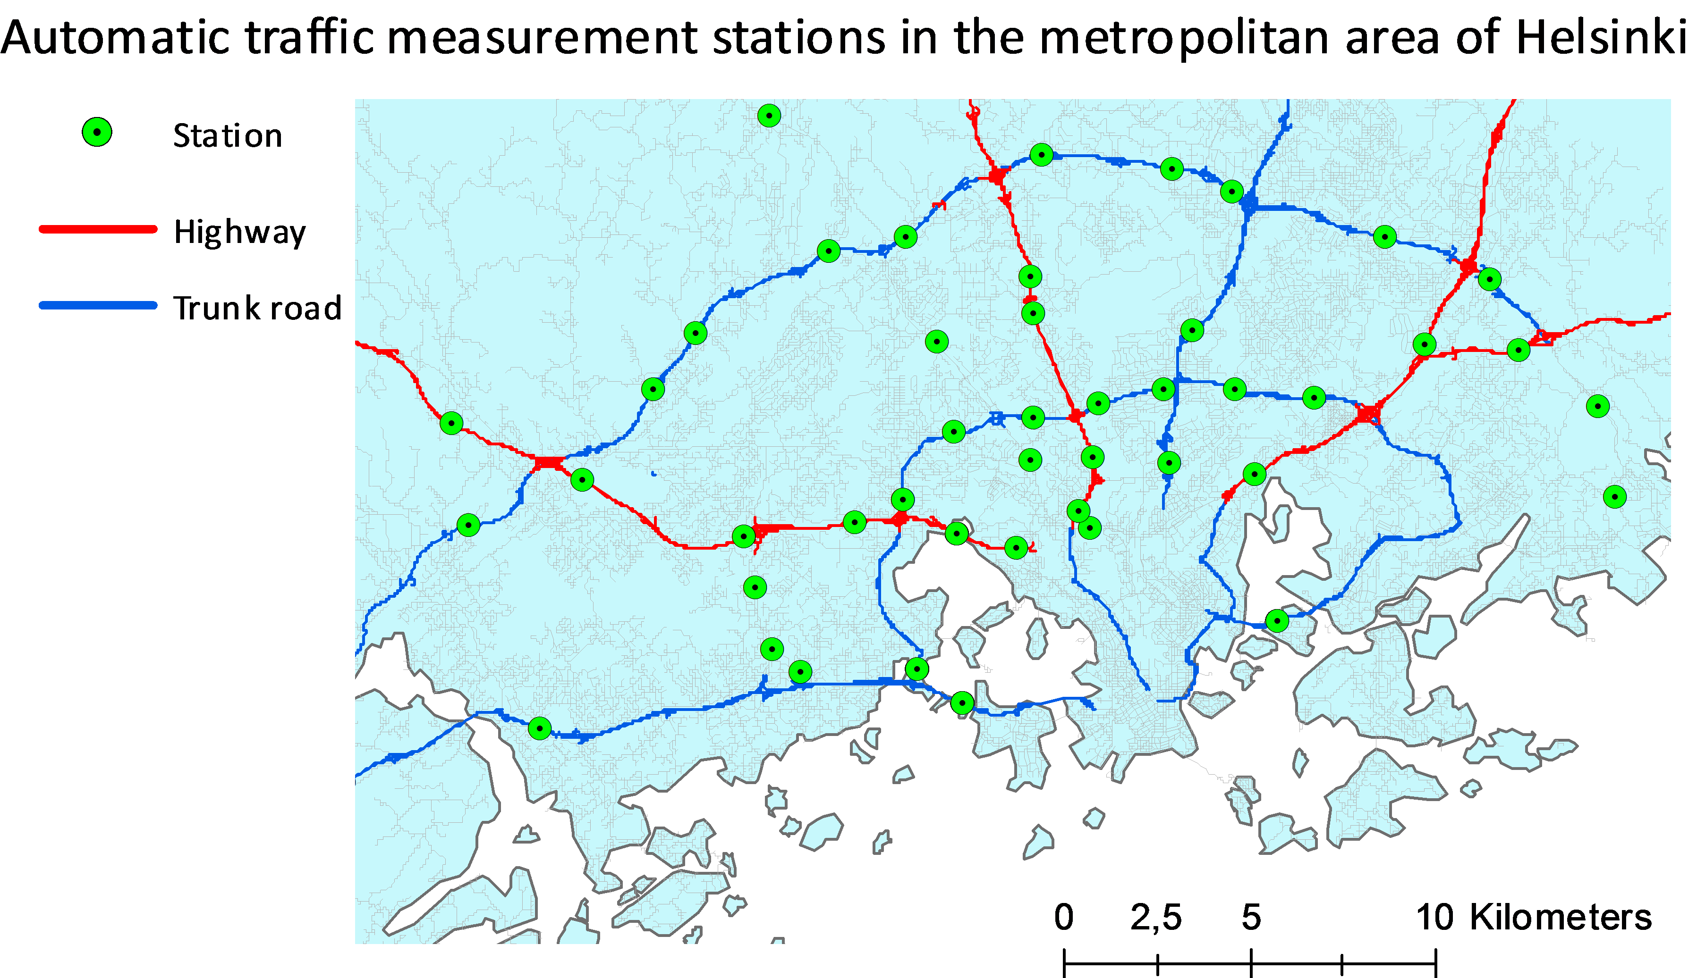

Slide 7
Travel-time model
  Traffic sensor data for a 4 weeks winter period: Mon-Fri 13 Jan – 7 Feb for both directions separately between 7:00 and 8:00 only (busiest morning traffic hour).
  generalised sensor data is compared to the winter time speed limit of the corresponding road element (avg length 188 meters). The lowest speed is taken.
  The speed of all the other roads is estimated by using a specific road functional classification (14 classes, strict computational speeds). The speed classes are between 20 and 95 km/h.
    The algorithm uses hierarchical routing moving a car away from a slow street when possible.

Slide 8
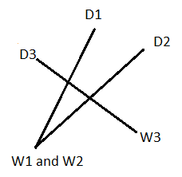
Pairwise computing of commuting times and distances 1/2
2.1 million coordinate pairs i: ((x_{id}, y_{id}), (x_{iw}, y_{iw}))
Computational complexity is high
  ”takes several weeks”
ESRI ArcGIS® and Python™
  number of available licenses is not high
  Network Analyst Route Solver
    Documentation is not satisfactory but it works: common Dijkstra’s algorithm
    with hierarchical routing (6-class functional classification: Class I main road, Class II main road, Regional road etc.)
    impedance attribute is the travel time (of a smallest road element); accumulation attribute is the length of a route.

Slide 9
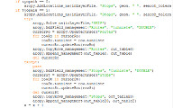



Pairwise computing of commuting distances 2/2
The solution: 45,000 pairs of points (90,000 datarows) for one program run. 3 parallel runs per one standard computer. For 2 computers (2 licenses): 270,000 distances in about 3 days.

Slide 10
Commuting statistics
Type | Median | Mean | Q1 | Q3 | QCD
Linear (km) | 6.10 | 13.43 | 2.08 | 15.40 | 0.76
Route (km) | 8.91 | 17.04 | 3.13 | 20.40 | 0.73
Time (min.) | 11.72 | 16.83 | 5.67 | 21.13 | 0.58
Based on the travel time optimisation.
Q1 = 25th percentile, Q3 = 75th percentile
The means are of 0 – 200 km distances
Deviation measure here:
  QCD = (Q3 – Q1) / (Q3 + Q1)
  Quartile coefficient of dispersion

Slide 11
Commuting distance for populations of the subregions (LAU 1)
Optimised by drive time.

Slide 12
Commuting time for populations of the sub-regions (LAU 1)

Slide 13
Commuting time by the Urban-rural classification
Populations in Inner-urban areas (left) and in Rural areas close to urban areas (right) by the sub-regions.

Slide 14
Average speed for commuting distances 10-15 km
Populations in Rural heartland areas:

Slide 15
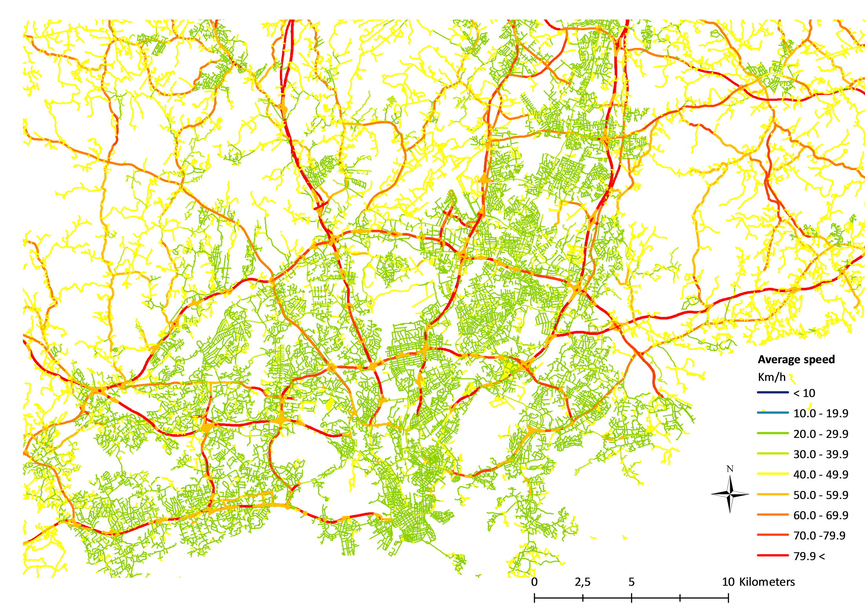

Slide 16
Further research and conclusions
Many accessibility challenges are related to rush hour traffic. The estimation of the commuting travel time becomes much more complex than the general 24/7 emergency accessibility. Big data helps.
The extensive and detailed national road network has been proven useful in population statistics and will be seen as part of the social statistics data warehouse based applications in forthcoming years.
Danke schön!
pasi.piela@stat.fi

Slide 17
Other application examples
24/7 Emergency Accessibility
  Population aggregated to 1 km x 1 km grids
  Speed limits for each traffic element
Elementary School Accessibility
  Population aggregated to 250 m x 250 m grids
  Pedestrian districts allowed, non-hierarchical

Slide 18
Relative 30 minutes drive time coverage by age groups
Hospital Dist. | 1 – 15 | 16 - 64 | 65+ | All
All | 0.896 | 0.894 | 0.846 | 0.885
Min, Kainuu | 0.591 | 0.581 | 0.519 | 0.570
Max, Helsinki | 0.991 | 0.991 | 0.986 | 0.991

Slide 19
