Slide 1
Effect of cross validation in online questionnaires - on subsequent data editing
Improving data quality in business surveys for National Statistics
Hanne-Pernille Stax & Peter Tibert Stoltze, Statistics Denmark

Slide 2
Outline
Development of online questionnaires for business surveys at Statistics Denmark: 2008-2014
Online validation – why and how?
Case 1: Transportation of goods by lorry
Case 2: Vacant positions
Conclusion and perspectives

Slide 3
Online questionnaires for business surveys in Statistics Denmark
110 business surveys per year (yearly, quarterly, monthly)
450.000 forms submitted per year
85+ % digital submission
Implementation of online validation 2008 >
Wave 1: Digital copy of paper questionnaire
Wave 2: Digital questionnaires with internal edit checks
Wave 3: Digital questionnaires with cross validation:
Online comparison btw. keyed data
and pre-known data about individual unit

Slide 4
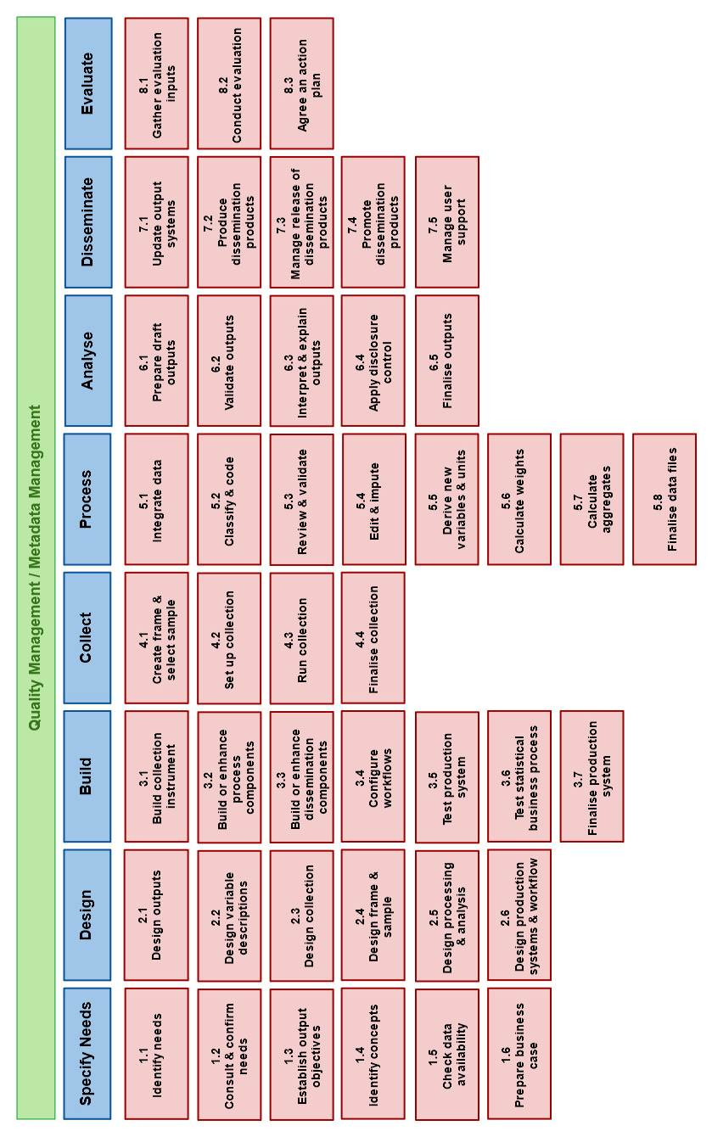
GSBPM

Slide 5
Online edit checks – why?
Conventional process:
Q1
R1
Edit
Q2
R2
Submit
Re-contact
Integrated edit checks:
Q1
R1
Q2
R2
Submit Valid data
Check, Edit/Confirm
Check, Edit/Confirm
Instant feed back - if data violates edit rules
R can review, edit, confirm or explain - before submission
Reduce risk of error and subsequent error-upon-error
Reduce need for data editing and re-contact
Improve data quality
Reduce respondent burden
More effective process

Slide 6
Online edit checks – how?
Simple edit checks on single values
Missing *, type (number), scope (0-100), pattern...
Complex edit checks
Auto calculation, routing, cross validation
Hard stops or responsive assisting guidance
Form & level NOT guided by documented effect, but:
Technological capability
Respondent expectation
Methodological presumptions

Slide 7
Case 1: Transportation of goods by lorry
Data:
Report all trips for specific truck in specific week:
Length of each trip + goods type and weight
For control (post collection editing)
Km driven in total
Start and end point of each trip - area code

Slide 8
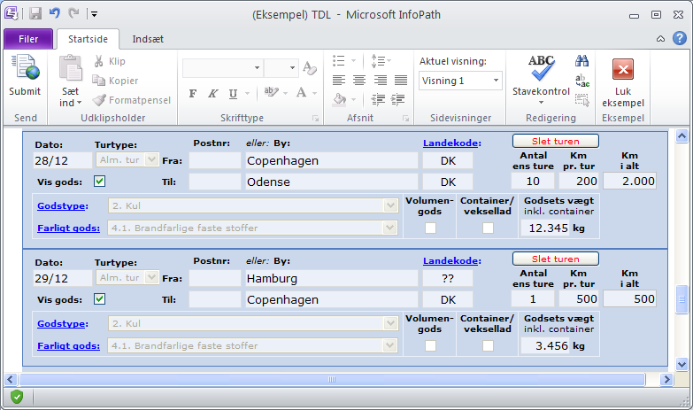
Case 1: Issues (Goods by Lorry)
Data quality is poor:
Trips are not linked > Empty trips are missing
Reported length of trips is unreliable
Sum of trips ≈ 2 x km driven in total
Trip 1:
From Copenhagen
To Odense
Trip 2:
From Hamburg
To Copenhagen

Slide 9
Case 1: Online validation (Goods by Lorry)
Responsive soft assisting functionality
Facilitate internal cross comparison
Auto-transfer of values (km in total)
Auto-sum of trips (running tally)
Auto link of trips

Slide 10
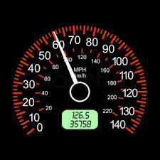
Case 1: Control question (Goods by Lorry)
In total how many kilometers in week?
Calculated from km counter values – at start
Total

Slide 11
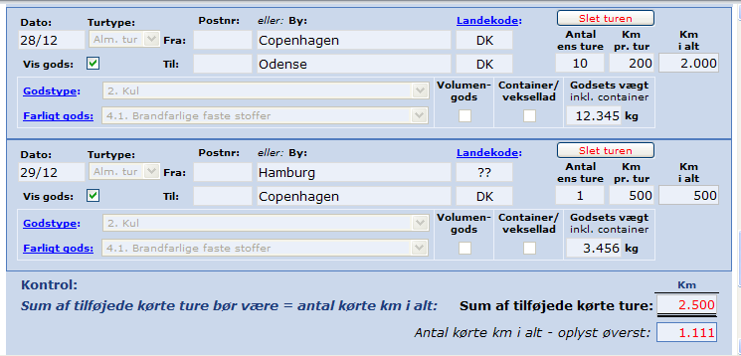
Case 1: Cross validation (Goods by Lorry)
Sum of trips
Transfer & display Total km - for reference
Colour format if Sum exceeds Total.
Sum
Total

Slide 12
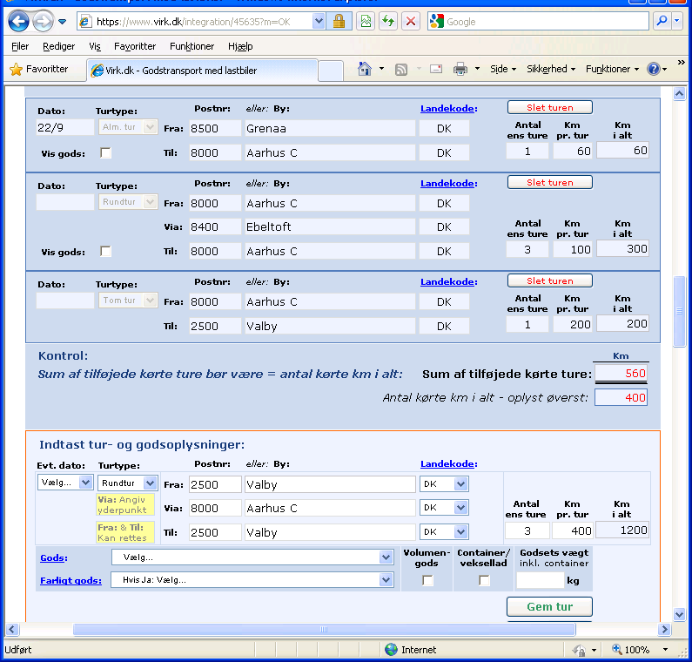
Case 1: Auto fill (Goods by Lorry)
Auto-link of trips:
Auto-transfer of end place of preceeding trip to starting place of following trip.

Slide 13
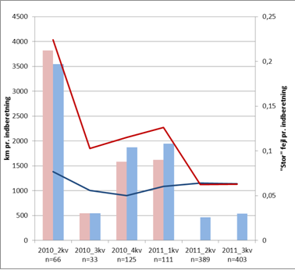
Case 1: Effect (Goods by Lorry)
Trips are linked
Empty trips included
Low span btw. Sum of trips and Total km
No series break in Total km pr week.
Re-design .

Slide 14
Case 2: Vacant positions
Data: Report for specific unit at specific date
Number of vacant positions at unit
Number of employees at unit
Issues:
Edit check AFTER data collection indicate that report is frequently NOT for selected work unit,
but for - larger - legal unit.

Slide 15
Case 2: Cross validation (Vacant positions)
Known number of employees for unit
is prefilled to questionnaire for each unit:
Source 1: Reported in survey 1 year back
Source 2: Business register
OBS: The two values may differ
> NOT displayed (hidden prefill)
Warning is shown if entered value differs too much from both prefilled values (> double / + 50)
OBS: Wide margin copies form post collection editing

Slide 16
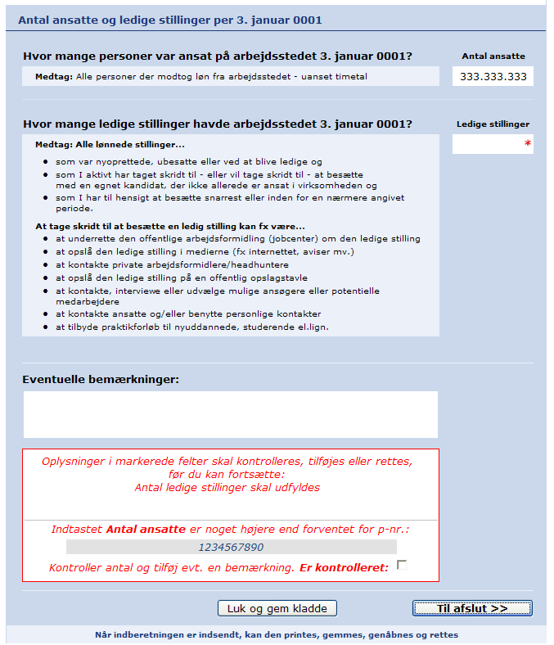
Case 2: Cross validation (Vacant positions)
Number of employees at work unit (control variable)
Number of vacant positions
at work unit (core variable)
Hidden unit prefill: Number of employees
- from previous survey
- from business register
Warning if entered value differs too much from unit prefill values (wrong unit??)
Number of employees
at work unit “xyz” seems high.
Please correct
or explain and confirm.

Slide 17
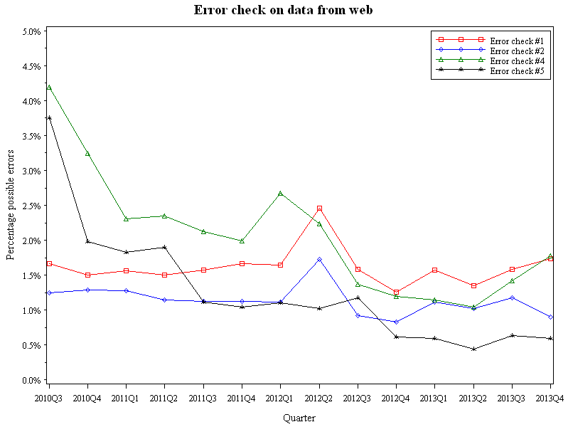
Case 2: Effect (Vacant positions)
Number of errors generally decrease over time.
No grand effect of cross validation. Too coarse?

Slide 18
Case 2: Effect (Vacant positions)
Some errors are less frequent in data from web questionnaires than in data entered via telephone

Slide 19
Challenges and perspectives
Form and level of online validation is largely guided by technical capability & methodological presumption.
Respondents expect online edit checks
Need to balance interruption and assistance
NSI Statisticians think data editing AFTER data collection (GSBPM)
Need to rethink process and generate qualified input - early
Optimized edit checks require follow up analysis
Need to document errors and effect on data quality

Slide 20
Thank you
Hanne-Pernille Stax, hps@dst.dk
Peter Tibert Stoltze, psl@dst.dk

