Slide 1
„Benefits from geocoding information collected in statistical surveys” POLAND
Amelia Wardzińska-Sharif
Programming and Coordination of Statistical Survey Department
Central Statistical Office of Poland
Q2014, 2-5 June 2014 Vienna

Slide 2
GIS Technology
In 2010 Census Round a combination of data coming from administrative sources and registers containing spatial data was used for the first time.
administrative sources
registers containing spatial data
2010 Census Round
2

Slide 3
Base for x,y - GEOCODING
Territorial Identification Registry (System TERYT) provides location data of all statistical units as the address-point of a related building
Location of buildings is specified using geographical x,y coordinates, giving the exact location of each building and make possibility to linking microdata from several registers.
3

Slide 4
Address point identification system
4
Notes:
4

Slide 5
Spatial
address point Identification system
5
Notes:
5

Slide 6
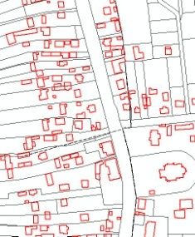
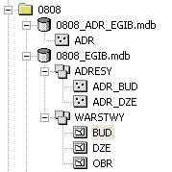
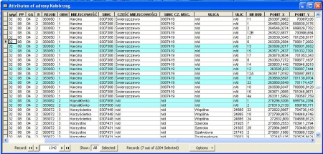
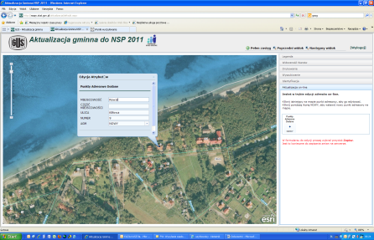
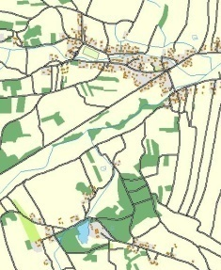
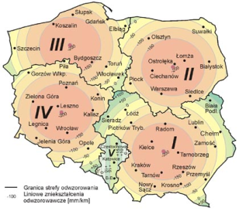
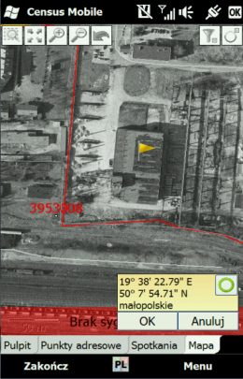
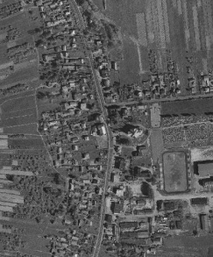
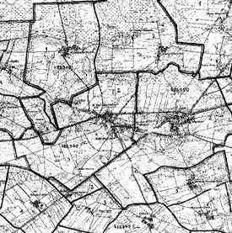
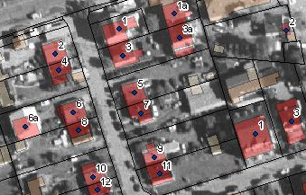
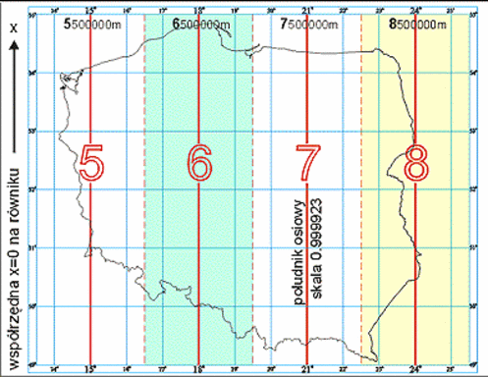
Work schedule
January 2009 – December 2009
January 2010 – May 2010
Censuses 2010 and 2011
continuously since 2011
reference material collection
reference material processing
address point update
address point database update
(gmina update, pre-census field check, census survey)
6

Slide 7
Spatial data compiled in the statistics today
Statistical adress points
Statistical distribution boundaries
statistical regions
address points for residential buildings
enumeration areas
7
Notes:
Omówienie tego co mamy w chwili obecnej w statystyce- wprowadzenie do tematu jak udało się do tego dojść i dzięki komu ☺

Slide 8
projects
GEOSTAT 1A
GEOSTAT 1B (on a voluntary basis)
GEOSTAT 1C (in progress)
„Merging statistics and geospatial information in Member States”

Slide 9
GEOSTAT 1A

Slide 10
GENERAL AND SPECIFIC OBJECTIVES
Geospatial analysis with use of data:
other geospatial datasets possessed by CSO
collected during National Population and Housing Census 2011
„Merging statistics and geospatial information in Member States”
For census purposes a statistical address point database with locations of all dwellings in Poland has been created.
The database is to be expanded with enterprises locations.

Slide 11
GENERAL AND SPECIFIC OBJECTIVES
Creating spatial address points database for enterprises in the test area.
Analysis of different methods of demographic data visualization in various divisions, such as stat. regions, census enumeration areas, cadastral units, 1 km grid
Commuting survey 2011 (based on the Population and Housing Census) result analysis, using GIS tools.
Analysis of spatial data from Topographic Database usability for creation of statistical indicators describing the state of planning. Defining methodology for visualizing these indicators on maps.
„Merging statistics and geospatial information in Member States”
13

Slide 12
ACHIEVEMENTS
Database with enterprises coordinates for 100% of the population for which it was possible to identify the address
perfect for the visualisation of many phenomena related to the place of work
12

Slide 13
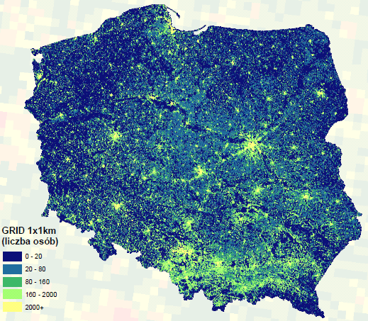
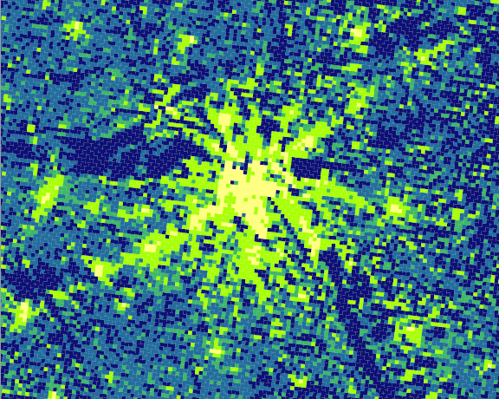
demographic data in 1 km grid
(persons)
13

Slide 14
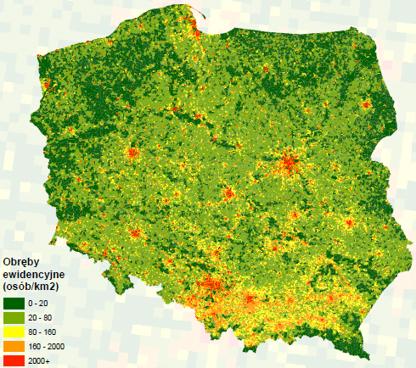
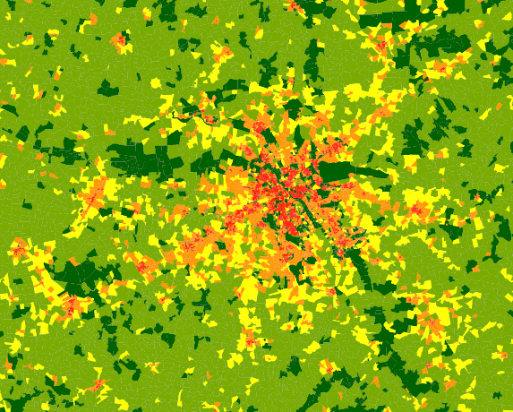
demographic data in cadastral units
Cadastral units
(persons/km²)
14

Slide 15
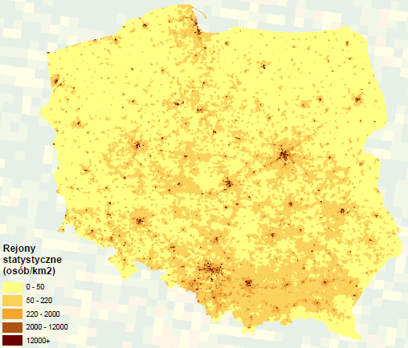
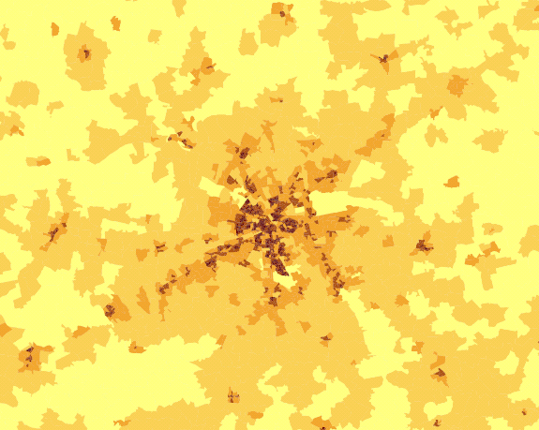
demographic data in statistical regions
Statistical regions
(persons/km²)
15

Slide 16
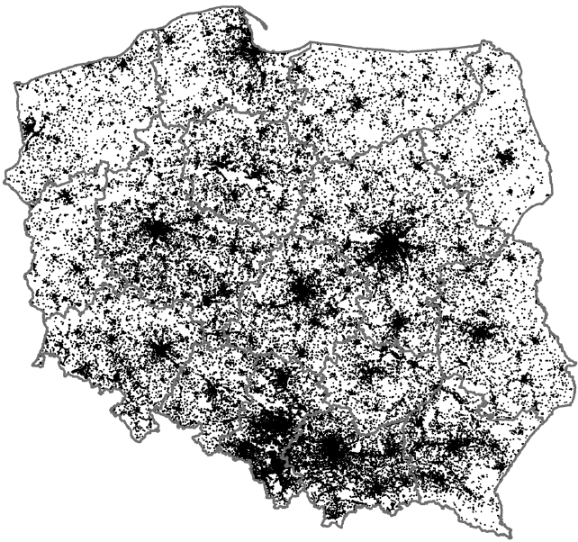
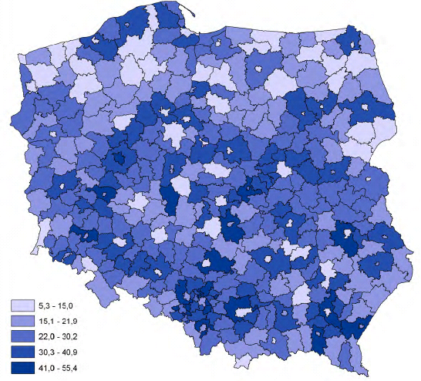
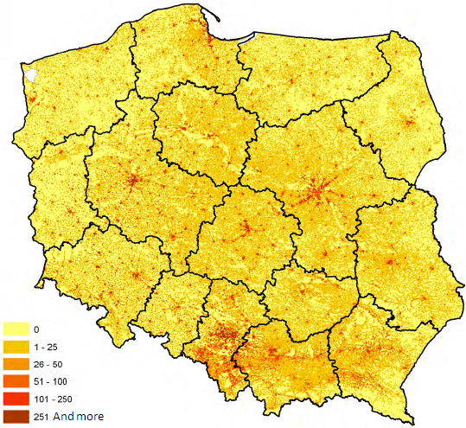
%
persons
16

Slide 17
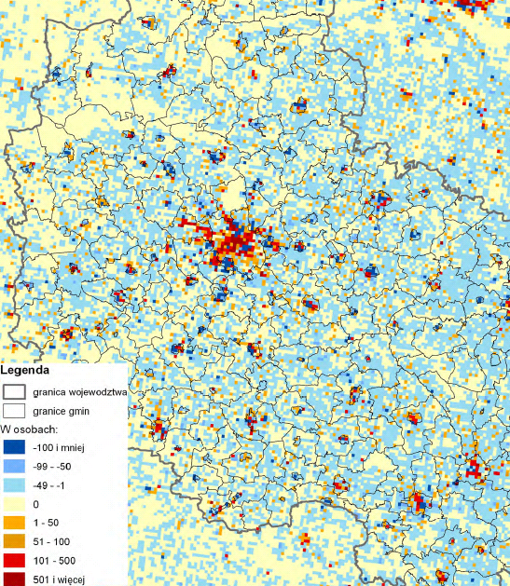
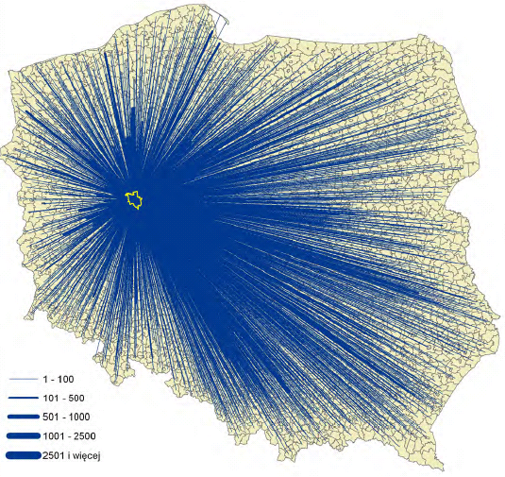
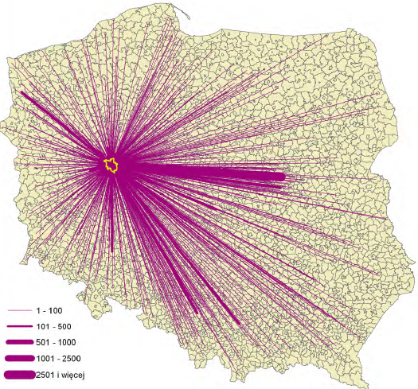
17

Slide 18
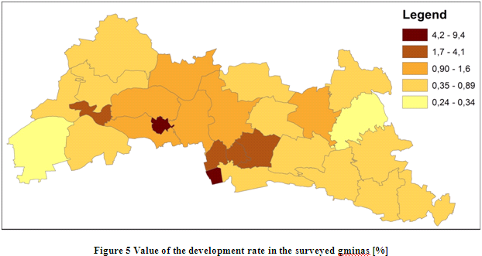
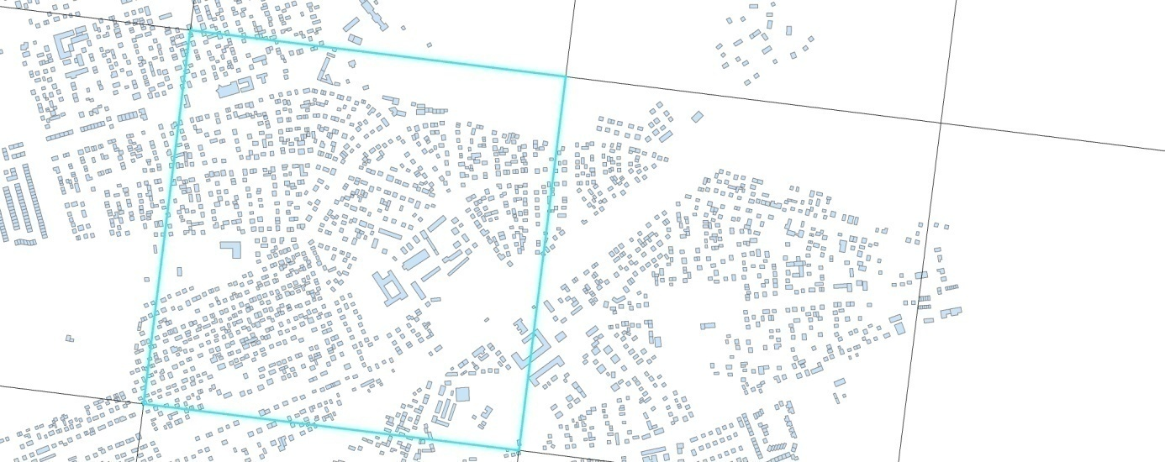
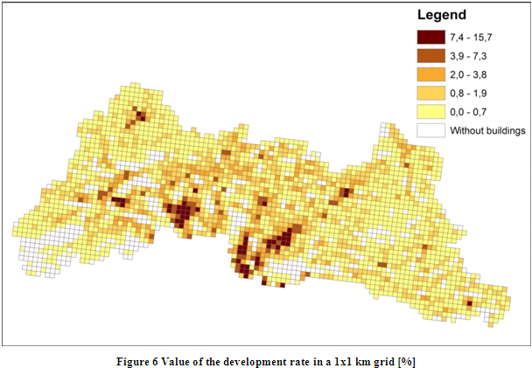
development rate
18

Slide 19
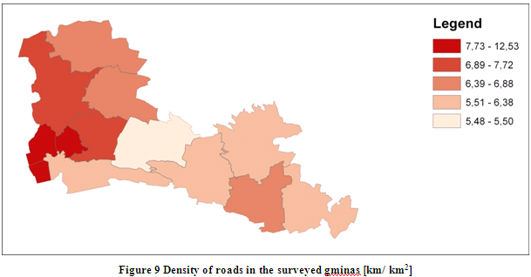
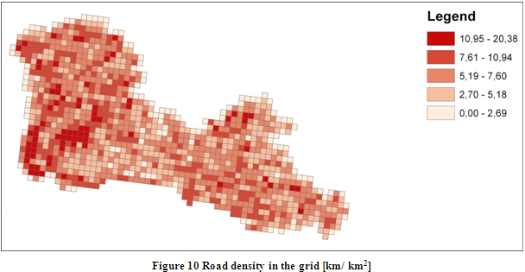
Density of roads
19

Slide 20
GEO.STAT.GOV.PL
START: JULY 2013
Agricultural Census 2010 results:
Choropleth maps
Cartodiagrams
Local Data Bank

Slide 21
Geostatistics Portal functionality
PORTAL GEOSTATYSTYCZNY
Geovisualization of censuses results
Publication of spatial data produced within statistics
Publication of INSPIRE services for two spatial data themes
statistical units
population distribution (demography)
Advanced spatial analysis on microdata
Agricultural Census 2010
statistical regions
National Population and Housing Census 2011
for authorized internal users (in the public statistics)
census enumeration areas

Slide 22
Geovisualization of censuses results
Agricultural Census 2010
location of the agricultural holding
location of its user
National Population and Housing Census 2011
Location of the dwelling
Census data with spatial reference to:
Census data with spatial reference to:
Region (NUTS1)
Województwo (NUTS2)
Podregion (NUTS3)
Powiat (LAU1)
Gmina (LAU2)

Slide 23
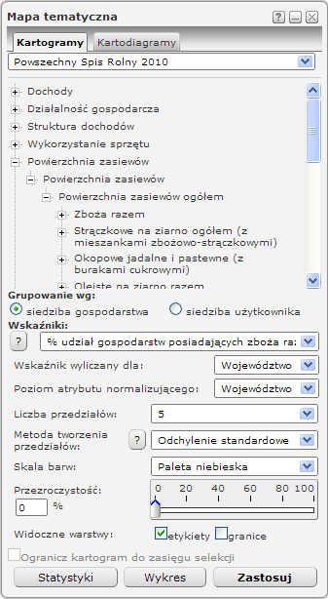
User defined parameters
THEMATIC PHENOMENA
INDICATORS
AGGREGATION LEVEL
NUMBER OF CLASSES
CLASS CALCULATION METHOD
COLOUR SCALE
TRANSPARENCY
VISIBLE LAYERS
GROUPING

Slide 24
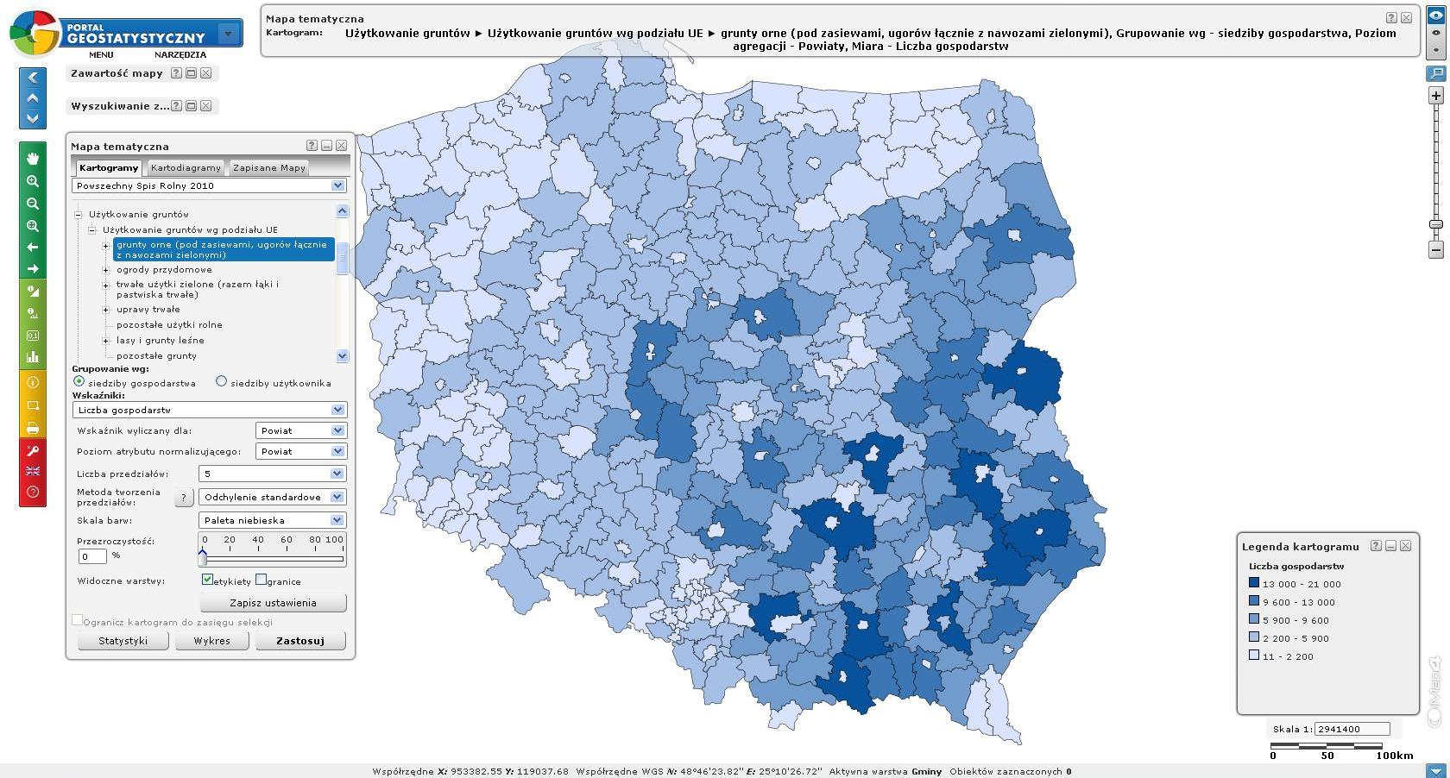
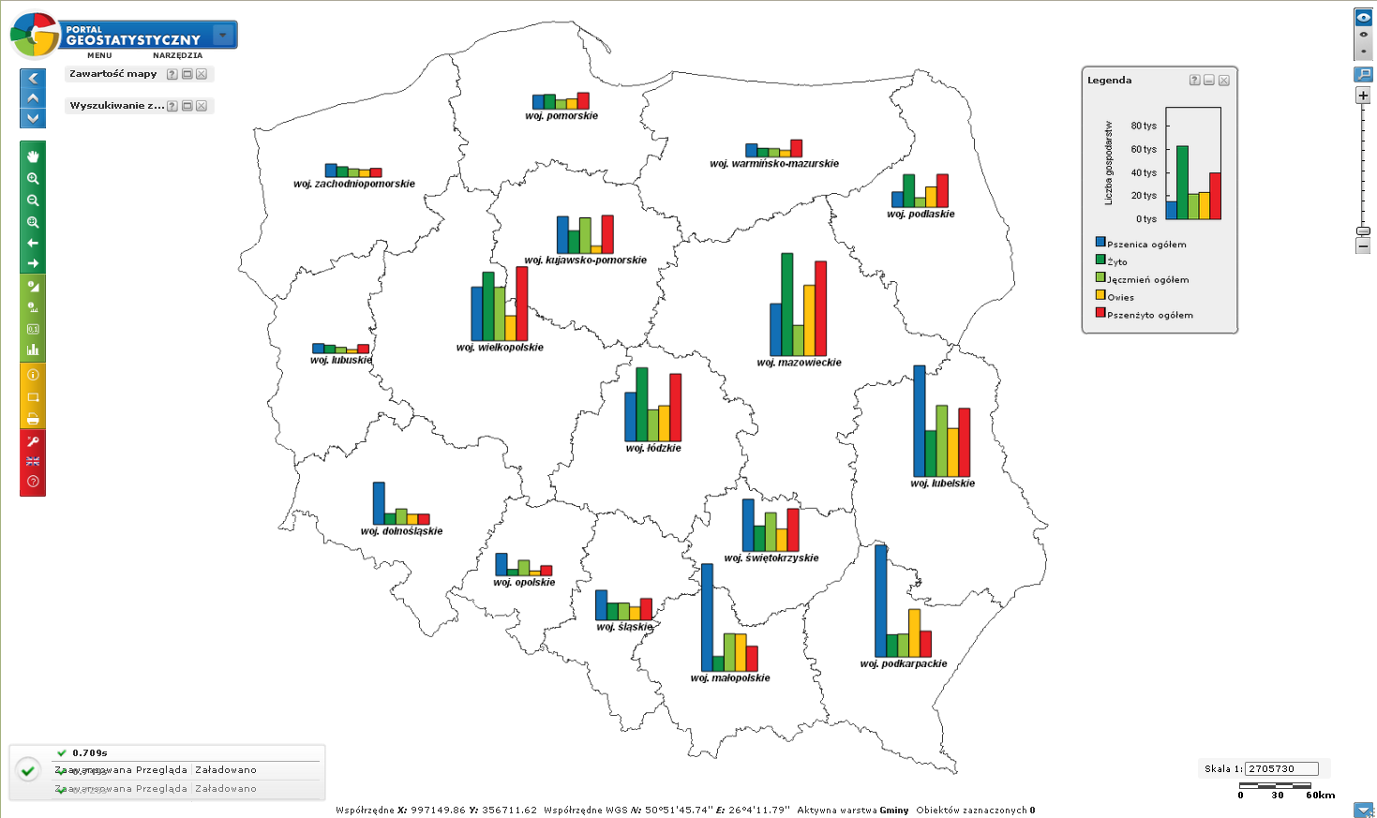

Slide 25
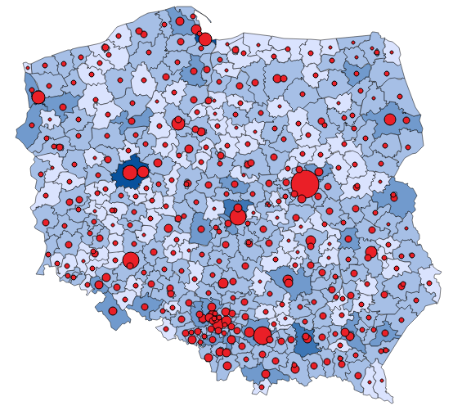
CSO in INSPIRE
President of the CSO is a leading authority on two themes of spatial data in Annex III of the INSPIRE Directive:
statistical units
SU
population distribution (demography)
PD

Slide 26
Individual data dynamic inquiries

Slide 27
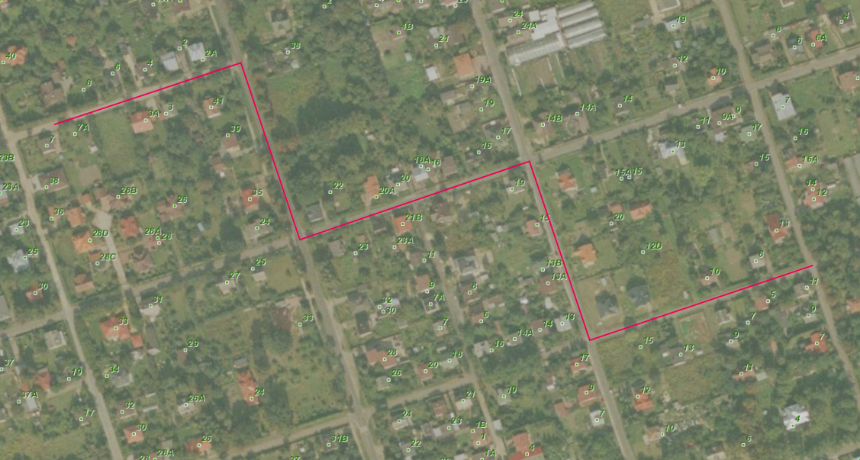
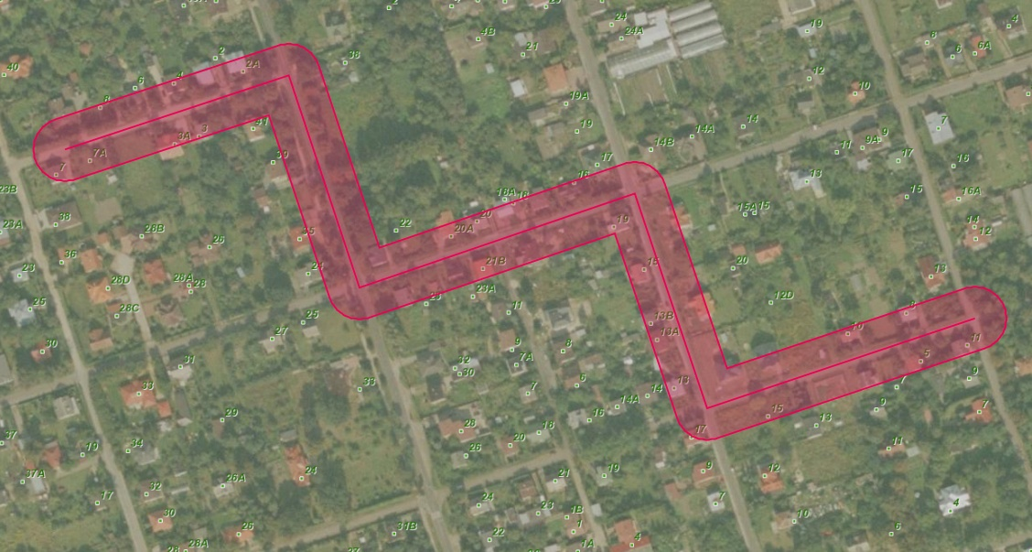
Buffering the line

Slide 28
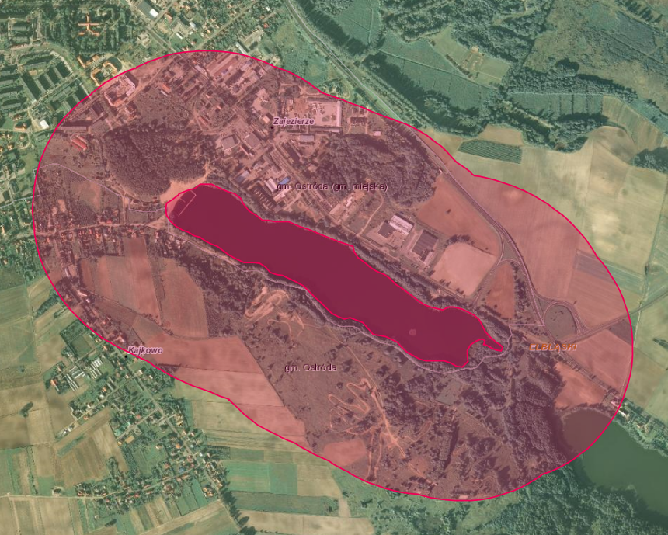
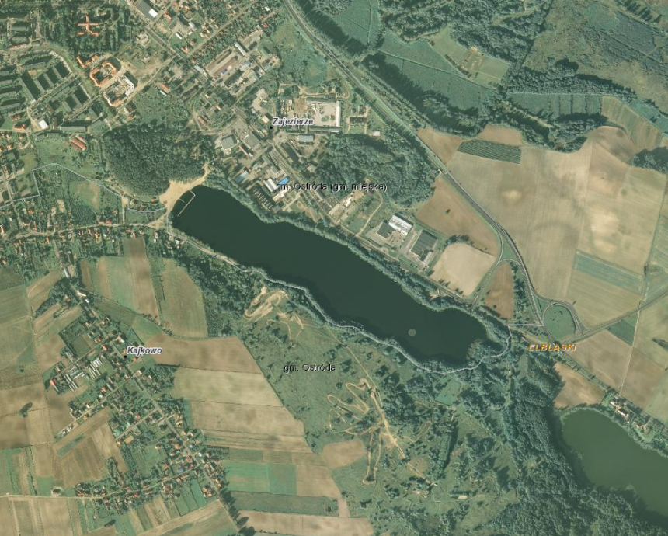
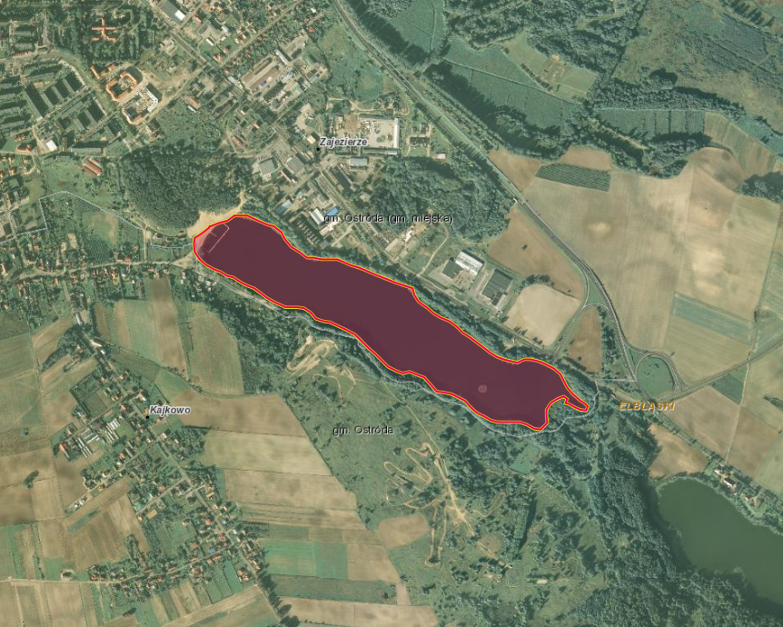
Buffering the polygon
28

Slide 29
Summing Up
georeferencing statistics started in 2009
georeferenced address data base for all residential addresses was established
georeferenced database are manifold, both for data preparation as well as for the dissemination of results
Geostatistics Portal
European Projects - broadening horizons

Slide 30
Thank You For Your Attention
Amelia Wardzińska-Sharif
Programming and Coordination of Statistical Survey Department
Central Statistical Office of Poland
Q2014, 2-5 June 2014 Vienna

