Slide 1
Improving the quality of European monthly unemployment statistics
Nicola Massarelli, Eurostat
Q2014 - European Conference on
Quality in Official Statistics
Vienna, 3-5 June 2014

Slide 2
KEY WORDS
UNEMPLOYMENT RATES
TIME SERIES
QUALITY FRAMEWORK
Notes:
ASSESSING QUALITY AND COMPARING ESTIMATION METHODS

Slide 3
Main features
ILO unemployment rates and levels
Total, plus age and gender breakdown
NSA, SA, TREND
Monthly, quarterly, yearly
T+30 days
EU28, EA18, MS
Levels, M-M and Y-Y changes

Slide 4
Current production
Ownership: about 50-50 Eurostat-MS
3 main methods for unadjusted series
  Pure monthly LFS
  3 month rolling quarters of LFS data
  Temporal disaggregation
  (Quarterly LFS + monthly administrative data)
  Publication of adjusted series: SA, but trends for 4 countries

Slide 5
How temporal disaggregation works
Bulgaria, number of male unemployed aged 25-74, NSA (thousands)

Slide 6
Quality concerns
Volatility
Revisions
Turning points identification
Timeliness
Notes:
Explain why each of these concerns are potential issues
MS have different attitudes towards what is acceptable quality.
Main worry of NSIs: keep their reputation vis-à-vis:
Media
Institutional users
Academy
…

Slide 7
Developing a quality framework
Goal:
  Provide acceptance criteria
  Compare series
Structure:
  Define appropriate indicators for each quality dimension
  Synthetic indicator vs. scoreboard
  Acceptance thresholds

Slide 8
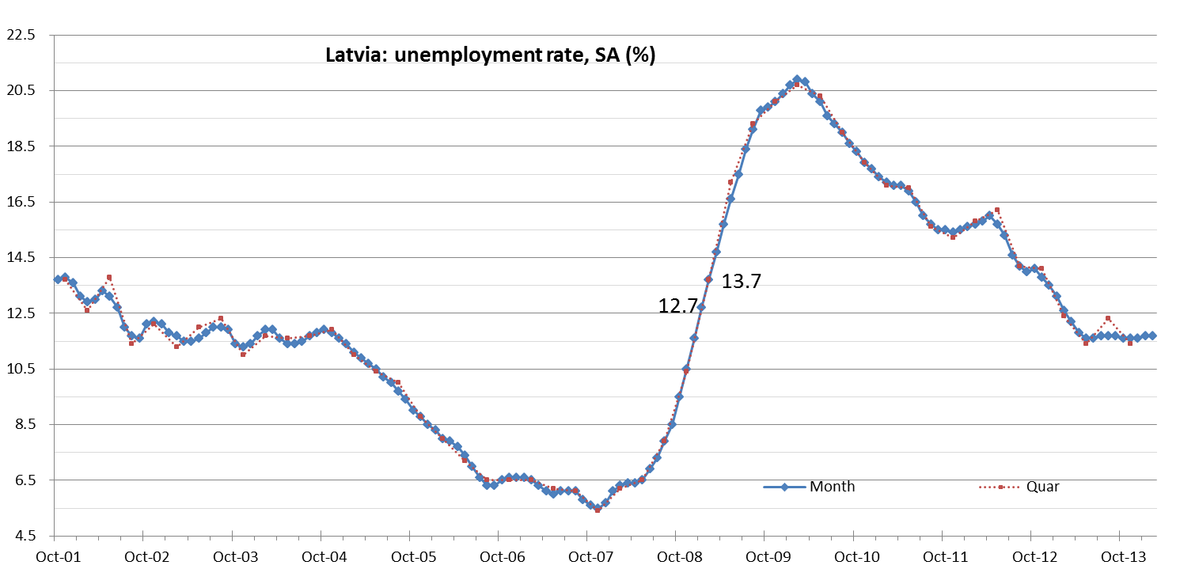
Volatility: big foot effect

Slide 9
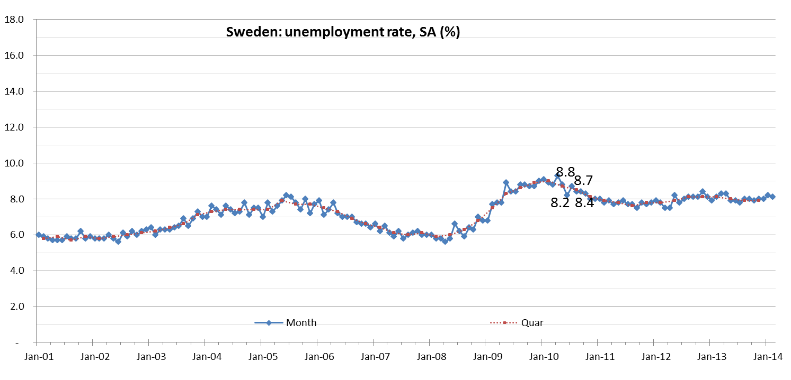
Volatility: pitching & roller coaster effects

Slide 10
Measuring volatility
Big foot effect: STDev of M-M and Q-Q changes
  Thresholds: 0.25 / 0.63
Pitching effect:% sign inversions
  Threshold: 20%
Roller coaster effect: % double large inversions
  Large: ≥0.2 p.p. for M, ≥ 0.3 p.p. for Q
  Threshold: 0%

Slide 11
Measuring revisions
Focus on last data point (headline)
Average absolute revision of the level
Max absolute revision of the level
STDev revision M-M change
% sign inconsistency of M-M changes
Which thresholds?

Slide 12
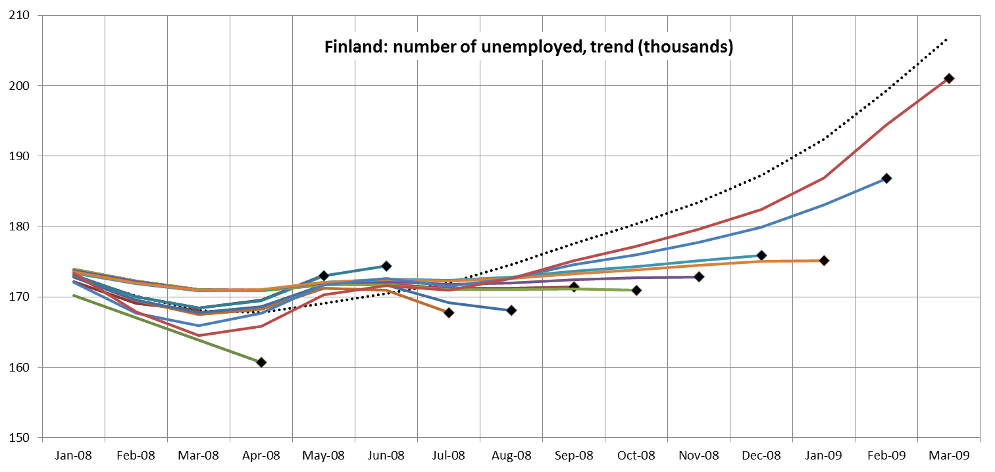
Turning point identification

Slide 13
Unemployment rate: delay in the identification of turning points (monthly vintages)

Slide 14
Summary: no perfect approach

Slide 15
How to discriminate?
Do we focus on the right quality concerns?
Synthetic indicator or scoreboard?
Which indicators?
Which thresholds for acceptance?
Which weights for indicators and quality dimensions?

Slide 16
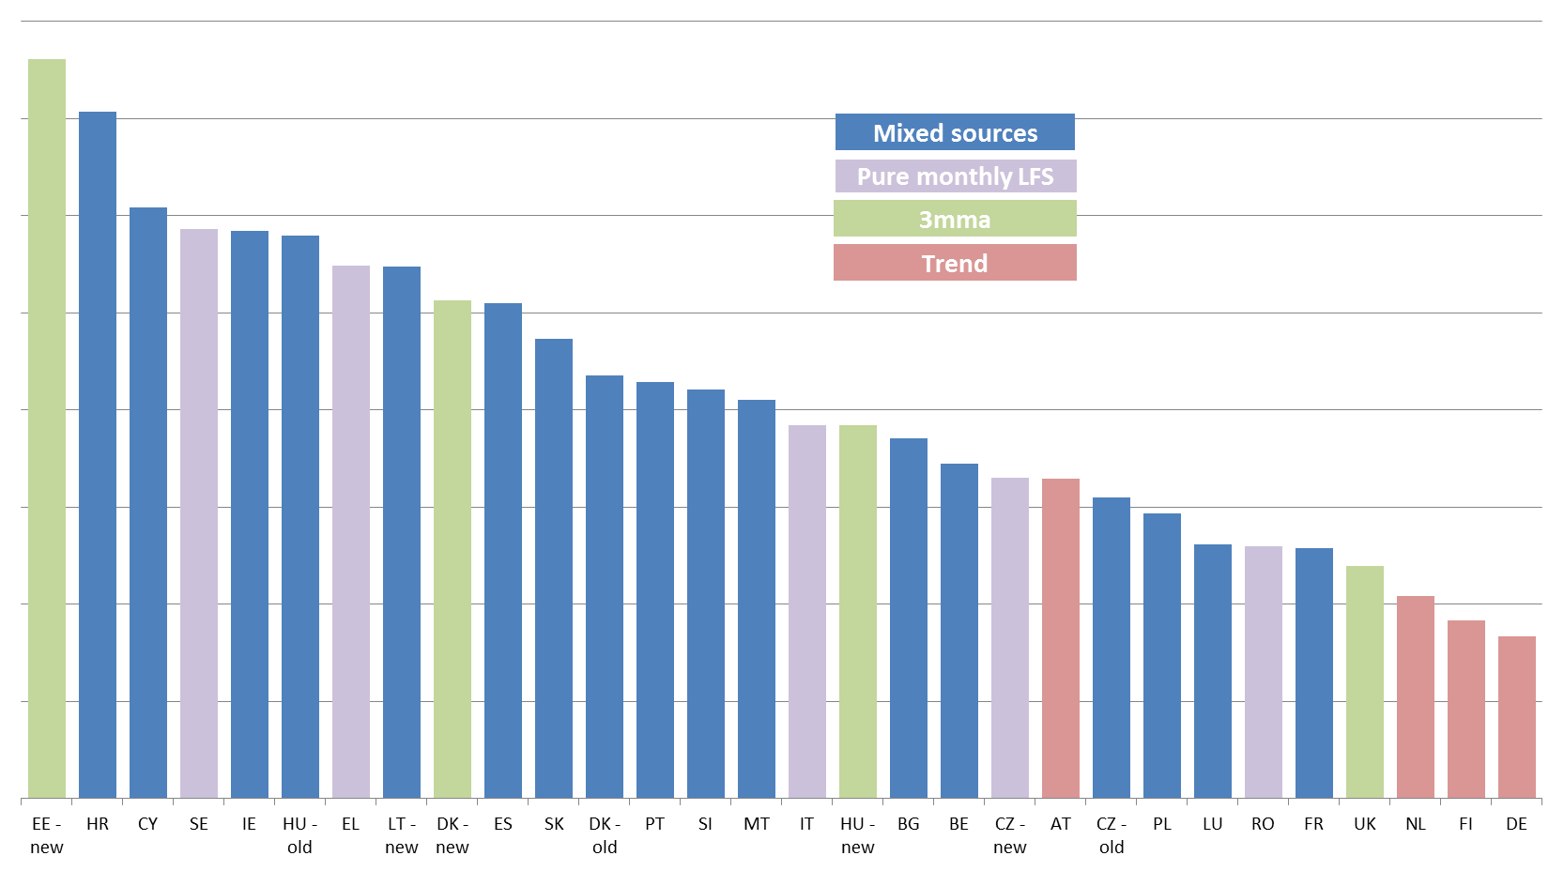
Possible synthetic indicator:
RMSE volatility + revisions
Notes:
Issues:
which indicators for volatility and revisions?
How to take into account other quality dimensions (turning points and timeliness)?

Slide 17
THANK YOU FOR YOUR ATTENTION AND YOUR FEEDBACK
nicola.massarelli@ec.europa.eu

