Slide 1
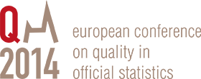

Continuous improvement and
Lean thinking in Statistics Norway
Anne Sundvoll, Director
Department of data collection and methods
asu@ssb.no
Grete Olsen, Senior Adviser and Lean facilitator
Division for Corporate governance, Statistics Norway
gol@ssb.no

Slide 2
About Lean thinking
Culture and management for continuous improvement
Based on other quality systems, like TQM, Six Sigma etc.
Add costumer value
Focus on processes
Involving staff
Reduce waste – work smarter
Useful tools

Slide 3
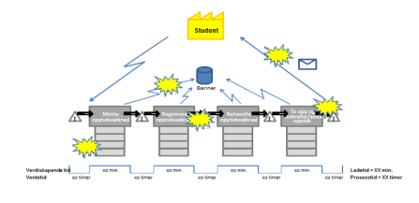
Introduction phase
Value stream mapping
Pilot reviews
Training facilitators
Involving staff
Transvers processes
Lessons learned
Involving middle management
Build culture
Emphasize implementation of changes and follow up

Slide 4
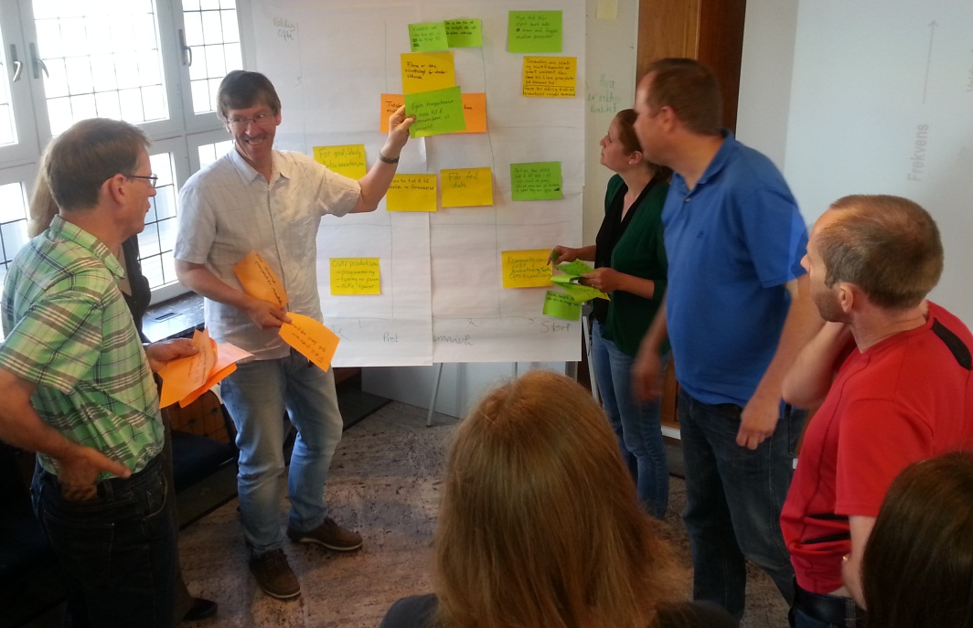
Education of facilitators and process reviews
8 internal facilitators educated
Training on 5 transvers processes
Implementation of changes included in project
Lessons learned
Management
  Top management in front
  Middle management is the key,
  commitment
Build culture

Slide 5
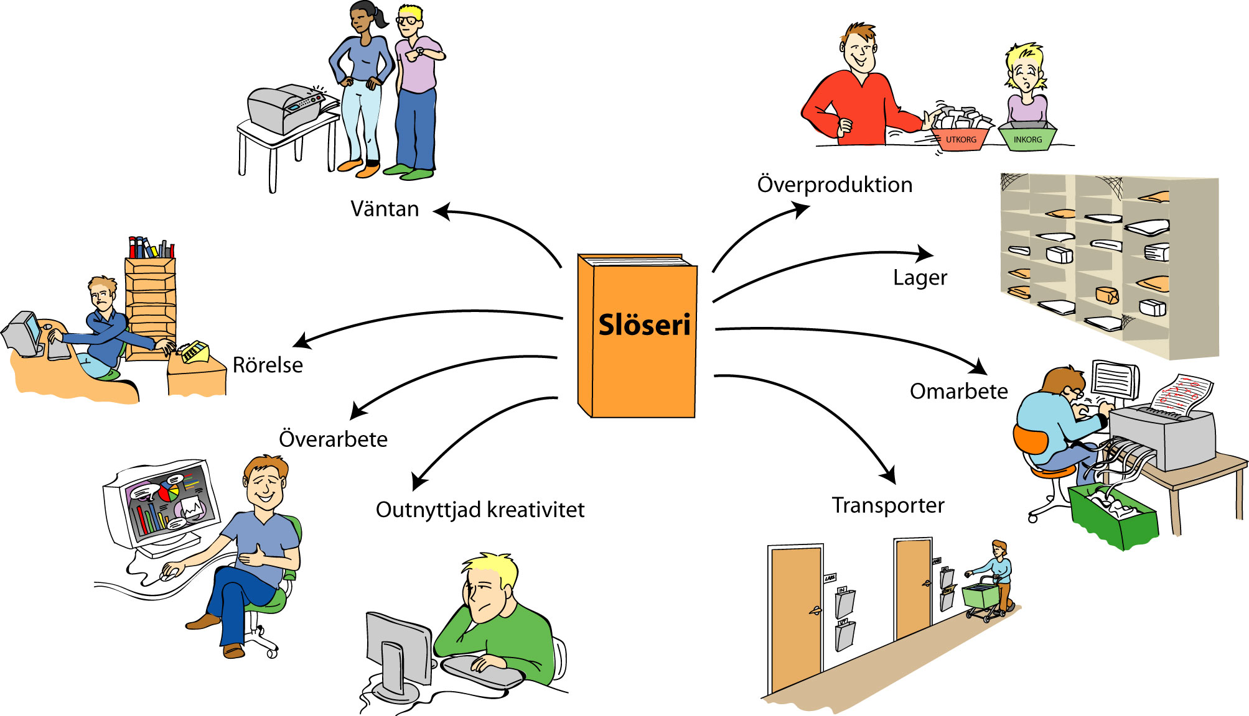
Lean – reducing waste is central
Overproduction
Waiting
Stock
Waste
(MUDA)
Cumbersome movements
Correct
Resources not used
Creativity not used
Transport

Slide 6
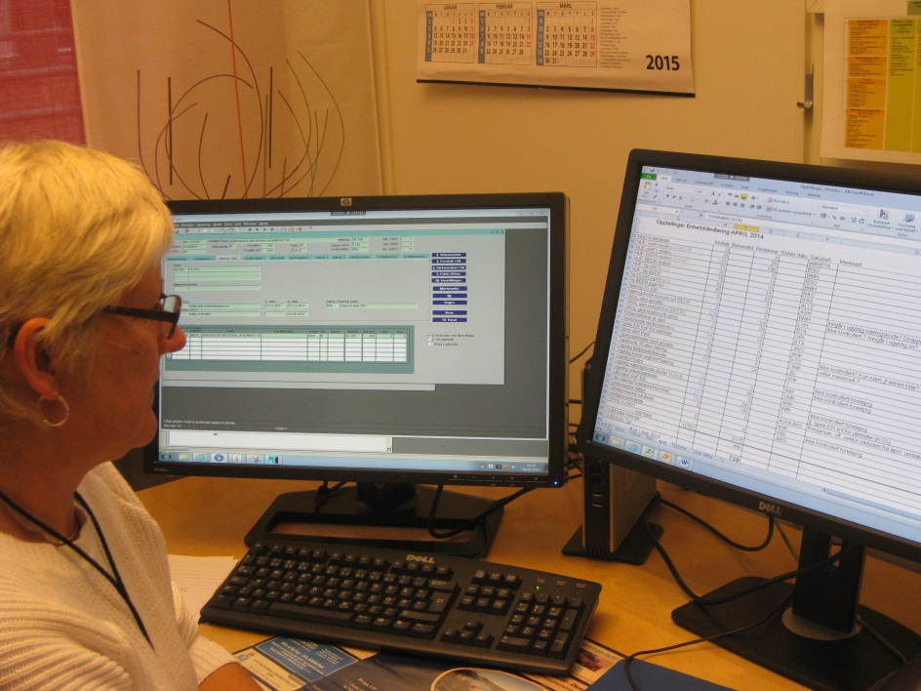
Reduce cumbersome movements and stock
Case 1: Efficient maintenance of the business register
Introducing additional and larger screens
Electronic work-flow
Standard routines
Focus on measurement

Slide 7
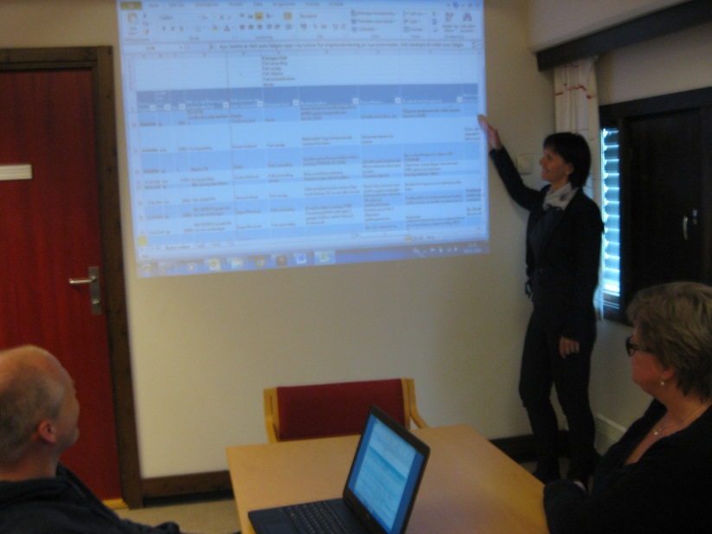
Reduce corrections and waiting
Case 2: Improving data collection specifications
Highlight and analyse mistakes
Improve routines
Training of staff
Active use of the PDCA-wheel

Slide 8
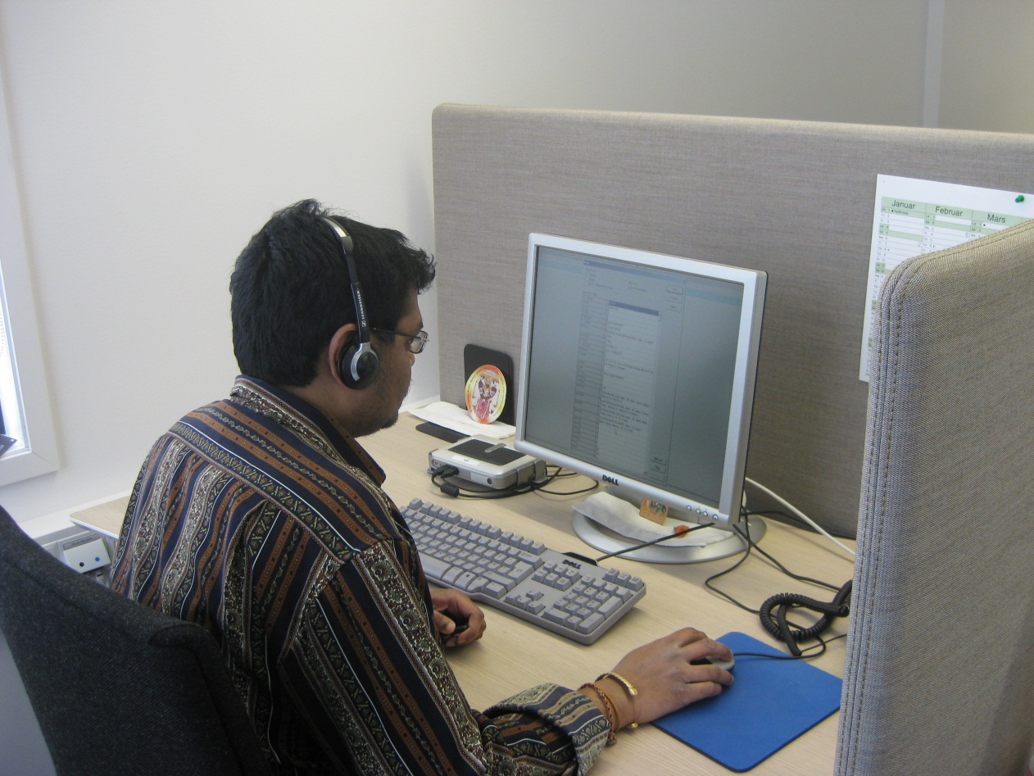
Reduce overproduction
Case 3: Tracking respondents in sample surveys
Targeted routines replaces low-coordinated activities

Slide 9
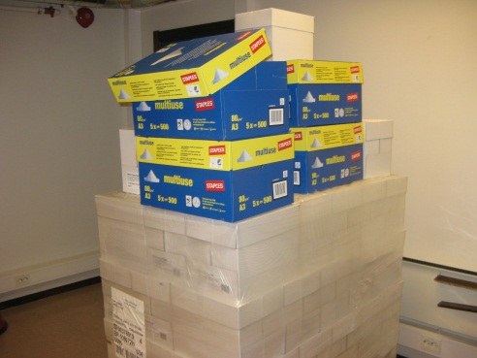
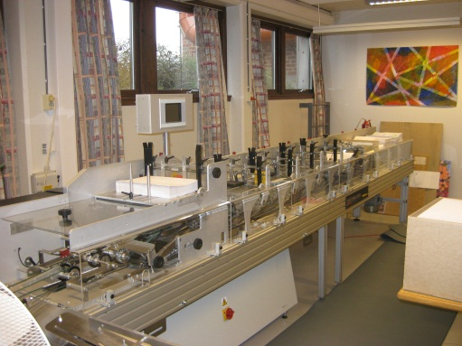
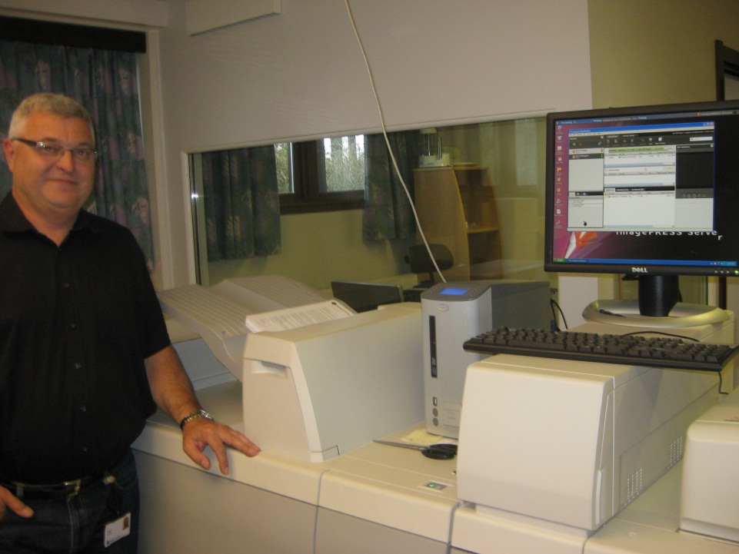
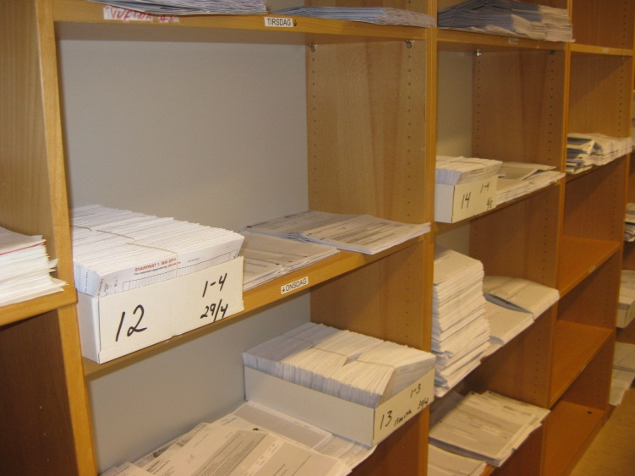
Reduce transport
Case 4: Digital communication in data collection
From paper to electronic questionnaires
From paper based - to digital communication

Slide 10
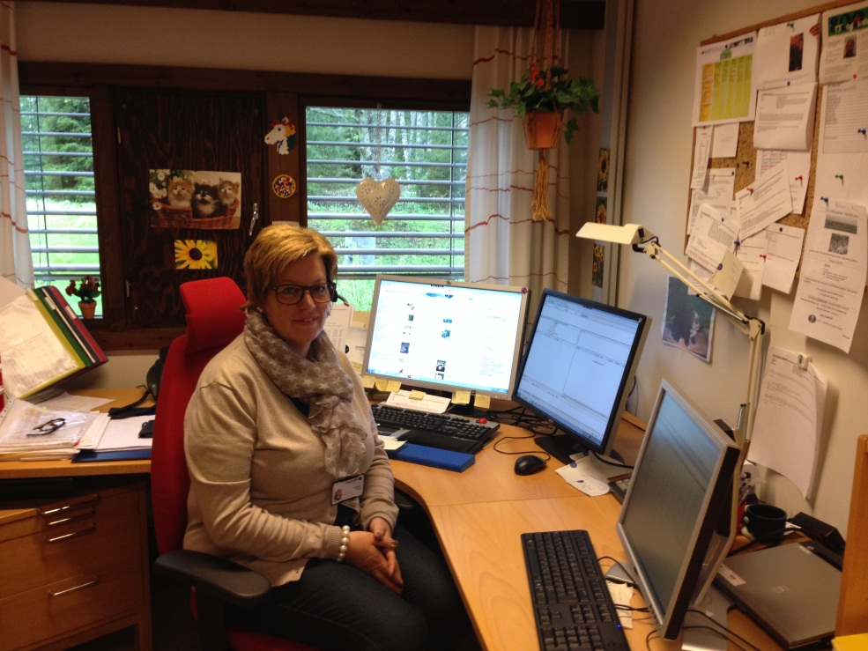
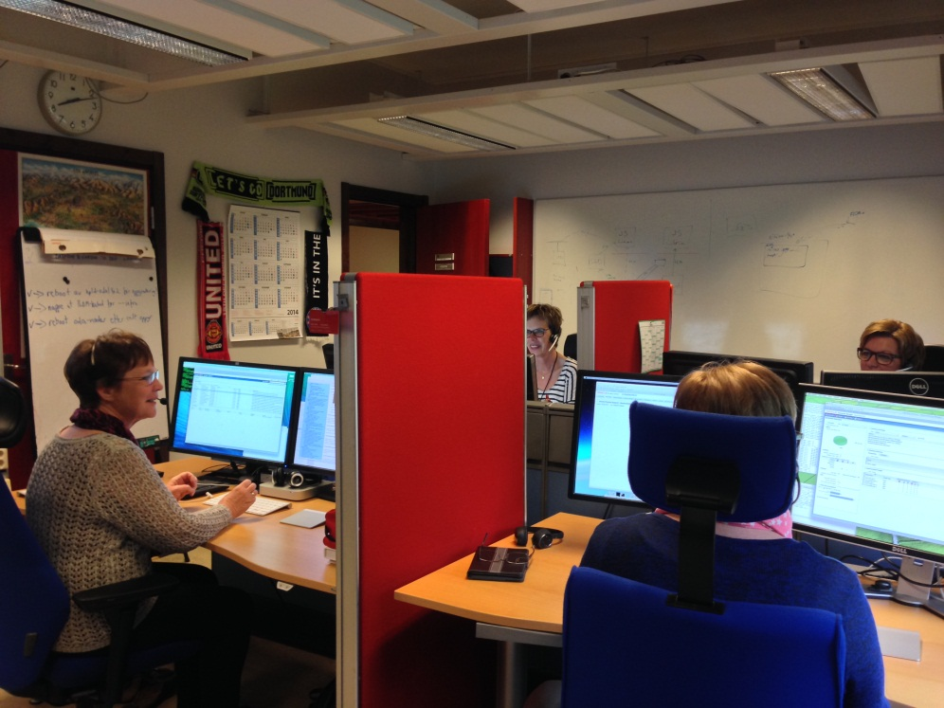
Increase capacity utilization and creative thinking
Case 5: Respondent support service
From cell office to landscape
Solving problems, from telephone to multi-mode approach

Slide 11
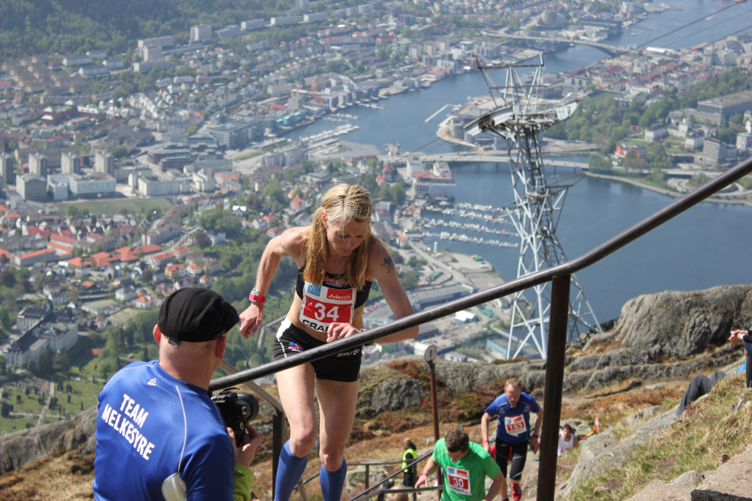
The way forward, we follow the same path
Involving, preparing and training
  management and middle management
Reviews in all departments by
  summer 2015
Transverse processes
External consultants
Internal facilitators, educate more
Project manager for Lean reporting to Director General
Build culture for continuous improvement
It’s okay to fail as long as you learn a lesson !

