Slide 1
Measuring data quality by the use of a routine re-interview module Experiences from the Norwegian European Social Survey Øyvin Kleven and Frode Berglund Statistics Norway – Division for Data Collection Methods
European Conference on Quality in Official Statistics (Q2014)
2-5 June, 2014. Schönbrunn Palace Centre, Vienna, Austria

Slide 2
A purpose of official statistics is to produce estimates of unknown values of quantifiable characteristics of a target population. Estimates are not equal to the true values because of variability … and bias (p:32)

Slide 3
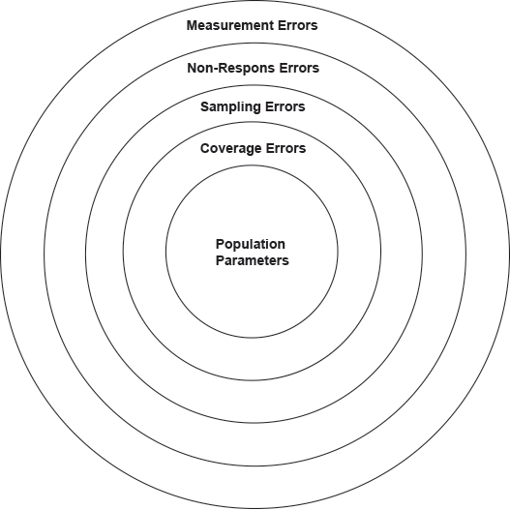
The relationship of sources of survey errors (Alwin 2007)

Slide 4
Measurement errors
Measurement errors are errors that occur during data collection and cause the recorded values of variables to be different from the “true ones”
Their causes are commonly categorized by:
Survey instrument: the form, questionnaire or measuring device used for data collection may lead to the recording of wrong values
Respondent: respondents may, consciously or unconsciously, give erroneous data;
Interviewer: interviewers may influence the answers given by respondents.
Measurement errors can be systematic or random

Slide 5
Validity and reliability
The concept of validity refers to the extent to which the measurement accomplishes the purpose for which it is intended.
Reliability is about the consistency of the measurement
Low reliability indicates that responses are more or less arbitrary, and then the measure can not be valid. Reliability is a necessary condition for the validity of a measure.

Slide 6
Some methods and techniques for assessing measurement errors in surveys (Based on Biemer and Lyberg 2003:261)

Slide 7
Measuring reliability by re-interviews
Reinterviews can be used to asses’ reliability with the following assumptions:
(1) There are no changes in the underlying construct between the two interviews.
(2) All the important aspects of the measurement protocol remain the same. The essential survey conditions remains the same.
(3) There is no impact of the first measurement on the second responses, e.g. there are no memory effects. (Groves et al 2009:282).

Slide 8
Express reliability by raw data
Before looking at the data, decide acceptable changes in responses based on knowledge about the subject, i.e. not just applying a technical method
cross tabulate the two measures
investigate the structure of distribution in the table
calculate the raw agreement rate
calculate acceptable agreement rates

Slide 9
The re-interviewing design in The European Social Survey

Slide 10
Re-interview for self-placement along the left and right scale

Slide 11
t1: In politics people sometimes talk of “left” and “right”. Using this card, where would you place yourself on this scale, where 0 means the left and 10 means the right? / t2 In politics people sometimes talk of “left” and “right”. Where would you place yourself on this scale? Please tick one box.
“Acceptable
agreement rate”: 97 percent
Raw agreement rate: 63 percent

Slide 12
Re-interviewing design for satisfaction with government

Slide 13
t1 Please answer using this card, where 0 means extremely dissatisfied and 10 means extremely satisfied. Now thinking about the Norwegian government, how satisfied are you with the way it is doing its job? / t2 Please indicate to what extent you agree or disagree with the statements below. ‘I am satisfied with the way the government is doing its job.’ Please tick one box.
“Acceptable
agreement rate”: 92 percent
Raw
agreement rate:
43 percent

Slide 14
Some problems with re-interviewing
Increased costs
Increased response burden
It is not possible to be 100% sure that we will capture “the true” reliability, validity and bias with only two measures
There will always be some factors that we don’t control
context effects
interviewer effects
memory effects
etc

Slide 15
Conclusion/summary
Re-interviewing should bridge between qualitative testing methods and quantitative measures of questionnaire quality
Re- interviews can reveal problems in single questions, but it can also reveal that some problems detected in the cognitive labs are not real problems in survey statistics
Key variables in official statistics can be tested more extensively by re-interviewing
Raw agreement indices are important descriptive statistics
They have unique common-sense value
An easy way to say something about reliability i.e data quality

Slide 16
Thank you for your attention!
Øyvin Kleven: kle@ssb.no
Frode Berglund: fbe@ssb.no

