Slide 1
Improved input data quality from administrative sources though the use of quality indicators
Q2014 – Vienna, 3rd June 2014
Coen Hendriks (hen@ssb.no)
Acknowledgement: Many thanks to Anders Haglund, Johan Åmberg, Grete Smerud and Jan Furseth from the Division for Statistical Populations at Statistics Norway for valuable collaboration while developing the quality indicators and reports, and for useful comments on this paper. They are not responsible for the content of the paper.

Slide 2
Managing statistical populations
Three administrative baseregisters and the statistical versions
The Central Coordinating Register for Legal Units (LU) - The Register for Businesses and Enterprises
Cadaster - The statistical Cadaster
Central Population Register (CPR) - The Statistical Population Register
Daily updates, integrated data in a common database
Other sources are integrated, new sources are being added
New information, new units, better coverage, more (actual) addresses, better contact information
Purpose: provide quality assured and updated registers with quality indicators, which cover all statistical populations

Slide 3
Quality indicators from Blue–ets WP 4
The group leaders determined which units to measure for quality and operationalized the indicators
CPR: registered person, family and residential address
Cadastre: address, building, land property and functional unit in a building (dwelling)
LU: legal entities and LKAU
The quality indicators where reviewed and coordinated
Programming in SAS
Counted up all the positive indicators (P)
Reporting (Q)

Slide 4
The indicator file
 | Ind₁ | Ind₂ | Ind₃ | Ind₄ | Ind₅ | Ind₆ | Ind₇ | Ind.. | Ind_{N} | Sum
Unit₁ | 1 | 1 | 0 | 1 | 0 | 0 | 1 | .. | .. | 4
Unit₂ | 0 | 0 | 0 | 0 | 0 | 0 | 0 | .. | .. | 0
Unit₃ | 0 | 0 | 0 | 0 | 0 | 0 | 1 | .. | .. | 1
Unit₄ | 0 | 0 | 0 | 0 | 0 | 0 | 0 | .. | .. | 0
Unit₅ | 0 | 1 | 0 | 1 | 0 | 0 | 1 | .. | .. | 3
Unit₆ | 0 | 0 | 0 | 0 | 0 | 0 | 1 | .. | .. | 1
Unit.. | .. | .. | .. | .. | .. | .. | .. | .. | .. | ..
Unit_{M} | .. | .. | .. | .. | .. | .. | .. | .. | .. | ..
Sum | 1 | 2 | 0 | 2 | 0 | 0 | 4 | .. | .. | P
Number of positive indicators: P=$\sum_{i=1}^{M}{ \sum_{j=1}^{N}{xij}}$
A general quality indicator: Q = (P/(N*M))*1000
Extracts: Indicators with many occurrences (e.g. Ind₇) Units with many positive indicators (e.g. Unit₁)

Slide 5
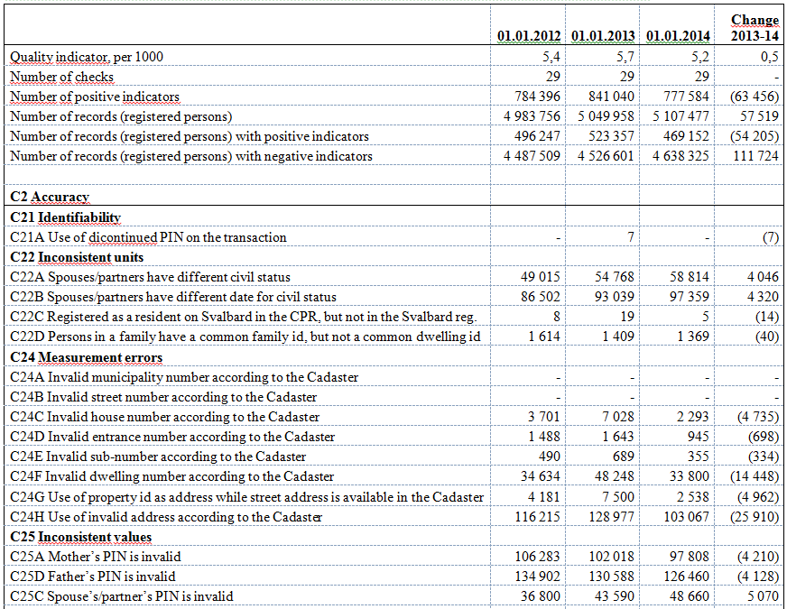
Quality report for registered persons in the CPR, 2012-2014

Slide 6
The practical cooperation with the data owners (registerred persons in the CPR)
Municipalities with highest values of Q, the major cities and Norway, 1.1. 2014
Municipality |  | Records checked | P - positive indicators | Records without positive indicators | Q - general quality indicator
1849 | Hamarøy | 1 819 | 1 244 | 1 154 | 24 ‰
0817 | Drangedal | 4 132 | 1 561 | 3 302 | 13 ‰
1854 | Ballangen | 2 587 | 976 | 1 880 | 13 ‰
1857 | Værøy | 777 | 288 | 613 | 13 ‰
1874 | Moskenes | 1 108 | 394 | 882 | 12 ‰
2018 | Måsøy | 1 244 | 450 | 1 014 | 12 ‰
1514 | Sande | 2 632 | 872 | 2 258 | 11 ‰
1835 | Træna | 489 | 163 | 388 | 11 ‰
1840 | Saltdal | 4 691 | 1 458 | 1 940 | 11 ‰
1850 | Tysfjord | 2 004 | 623 | 1 617 | 11 ‰
1851 | Lødingen | 2 246 | 735 | 1 855 | 11 ‰
2014 | Loppa | 1 027 | 318 | 843 | 11 ‰
0301 | Oslo | 634 249 | 135 547 | 556 138 | 7 ‰
1201 | Bergen | 271 854 | 46 889 | 245 024 | 6 ‰
1103 | Stavanger | 130 755 | 17 357 | 121 071 | 5 ‰
1601 | Trondheim | 182 122 | 22 166 | 169 173 | 4 ‰
 | Norway | 5 107 477 | 777 584 | 4 638 325 | 5 ‰
Analysis shows:
- many inconsistent values (PIN of mother, father and/or spouce/partner is invalid)
- many measurement errors (missing dwelling number, invalid address)
- trouble in the county of Nordland (18xx)
Suspicious units are transferred to the CPR

Slide 7
Other examples of analysis
What kind of positive indicators are found for newly registered persons?
Measurement errors (missing dwelling number, invalid addresses)
Dubious objects (too many registerred persons in a dwelling)
Refer to Appendix, tabel 3
Why do previously registered persons show an increase in the number of positive indicators?
Inconsistent units and values due to immigration
Measurement errors (missing dwelling number, invalid addresses)
Refer to Appendix, tabel 4

Slide 8
The principles for the practical cooperation with the data owners
Positive indicators are identified within a source:
SN complain on the quality of the deliverables
SN return individual based information with positive indicators
Positive indicators are found by matching to another source:
SN give feedback at aggregate level – main rule
Assuming a data processing agreement: We can supply individual data with positive indicators
The data owner has the legal authority to use the second source
The data owner has a copy of the other source available

Slide 9
Quality across registers
SN has a long record of matching sources for quality control and improvement
The approach works: «Improved quality» in the Cadastre gives «fewer mistakes» in the CPR
Indicators for quality across registers need to be developed. We are just starting
A cluster with employees in an enterprise without business (LKAU) in reasonable distance, might indicate under coverage in the Business Register (missing LKAU)

Slide 10
Final remarks
There is a difference between good quality data from registers and good quality register based statistics
Statistical inference
Definition errors – changes in the register due to political decisions

