Slide 1
Administrative data a dangerous gold mine in official statistics
Anton Färnström
anton.farnstrom@bra.se
The Swedish National Council for Crime Prevention
2014-06-03

Slide 2
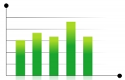
Administrative data
Administrative authority
Statistical producer
The public
Data is not collected by the statistical producer
Data is generated for other purposes than statistics

Slide 3
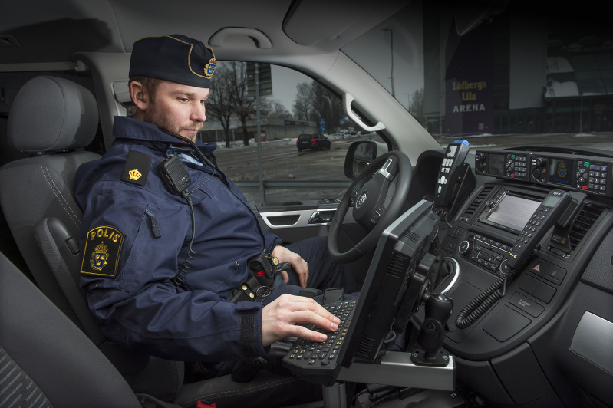
Swedish crime statistics
The Police decision codes:
Code 1: No investigation lead
Code 2: Nu result from investigation
…
Code 13: Free-text
…

Slide 4
Swedish crime statistics
Cleared offences in 2011

Slide 5
Swedish crime statistics
Cleared offences in 2011

Slide 6
Swedish crime statistics
Cleared offences

Slide 7
Swedish crime statistics
Cleared offences in 2011

Slide 8
Swedish crime statistics
Cleared offences in 2011

Slide 9
Swedish crime statistics
Cleared offences in 2011

Slide 10
Swedish crime statistics
Other findings:
Different opinions on how to use the codes
Needs of registering personnel conflicting with statistical purpose
Vague classification
Insufficient instructions

Slide 11
Swedish crime statistics
Main results:
Coding errors have resulted in large flaws in the downstream statistics
The level of detail used in the statistics was not adapted to the quality of the raw data
Results were similar to a previous quality study regarding reported offences

Slide 12
Quality in register-based statistics
Not enough to monitor indata in regular controls
Not enough with close collaboration
More in-depth quality controls are needed

Slide 13
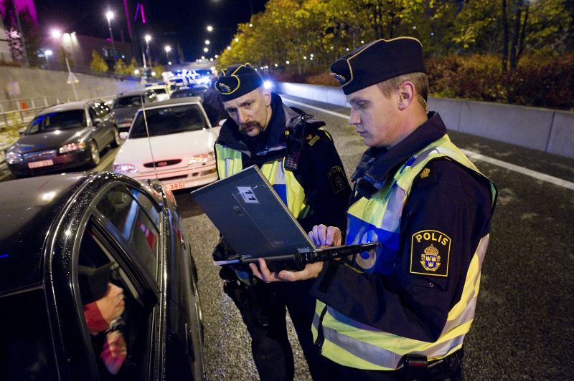
A simple model for assesing quality
Management related indicators
Operations related indicators

Slide 14
Swedish crime statistics
Quality indicators – management
The quality of the classifications
The quality of the registration instructions
Routines to inform the statistical producer on changes
Common work groups with the statistical producer
Quality indicators – operations
Variations between administrative units
Variations over time
Special attention to free-text options
Differing interpretations among registering personnel

Slide 15
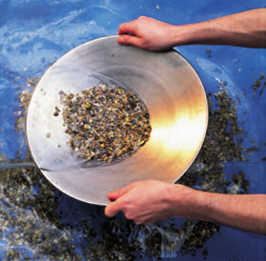

Slide 16
Thank you!
anton.farnstrom@bra.se

