Slide 1
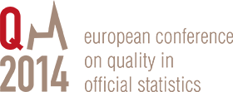
Centralize Data Collection
Does it worth?
Paulo Saraiva dos Santos
Almiro Moreira
3 June 2014
Vienna, Austria

Slide 2
Centralize Data Collection
Does it worth?
Statistics Portugal started in 2004 an integrated and process driven approach to reengineer its production, improving the efficiency and flexibility;
A central data collection department was created, covering all business and social surveys;
The benefits were substantial, especially on innovation and quality improvement;
This presentation describes a historical view of this journey and lists the results achieved;
It also offers some general guidance to evaluate if centralize data collection is a good choice for the production in a National Statistical Office.

Slide 3
Data Collection Centralization
National Statistical Offices (NSO) with a high level of dependence on surveys have their data collection (DC) activities between one of the most resource consumer functions;
Centralize DC activities is one of the options;
Benefits and disadvantages need to be consider.

Slide 4
Degrees of centralization
Not a geographical dimension:
Data collection is centralized when all, or most of the collect and process GSBPM phases are assured by a single organizational unit, no matter if the resources are geographically centralized or not;
It is very common that data collection activities are conducted by individual survey units, using a “silo mode” approach;
But there are many examples where the data collection activities have been progressively centralized, like Australian Bureau of Statistics, Statistics Canada, and Statistics Portugal.

Slide 5
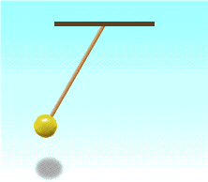
Centralize or Decentralize?
It’s like a pendulum movement, depending on the context
Finance constrains
Technology
Territorial organization and integration of the State
Human resources availability and skills
Increased expectations and requirements from the users
Flexibility
Extended capabilities amongst staff
Harmonization
Centralized
Decentralized

Slide 6
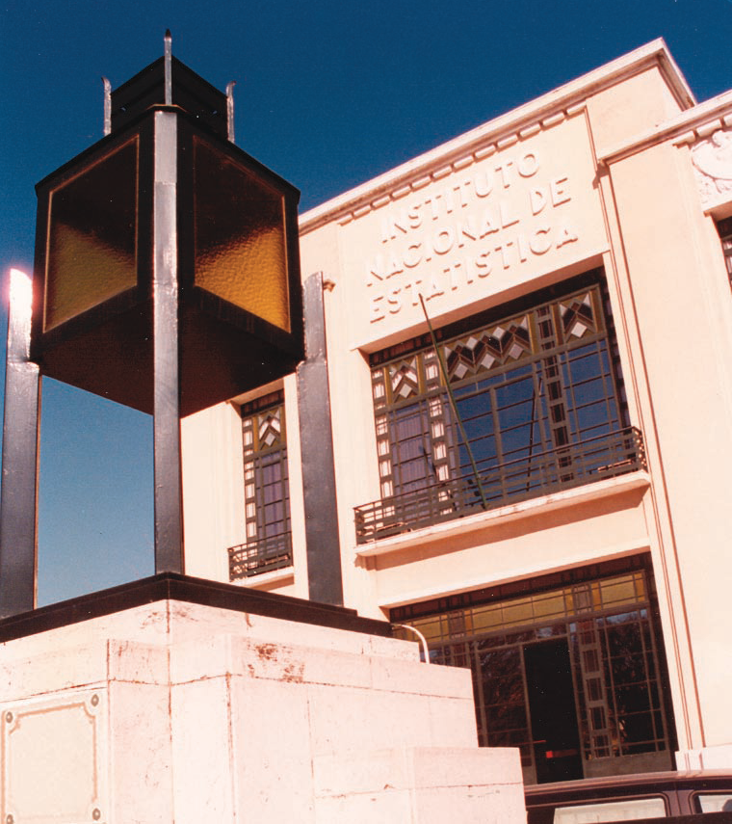
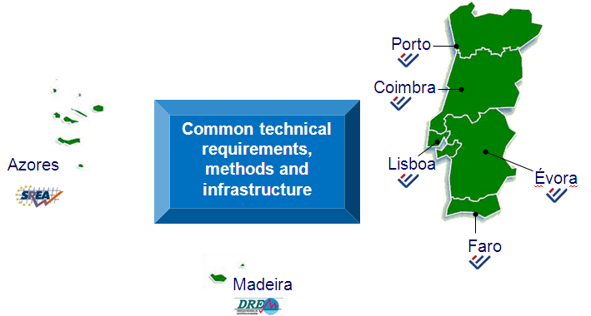
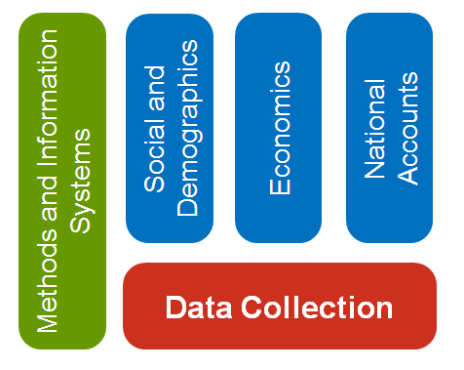
Data Collection centralization at Statistics Portugal

Slide 7
A survey oriented organization
Survey’s data collection:
40% budget & 30% human resources.
Survey Data Collection is a core function
Survey
Oriented

Slide 8
Before 2004: decentralized
Non-integrated organization:
numerous parallel processes, domain by domain, place by place.
Data collection were conducted by:
Subject matter departments and,
Regional directorates.

Slide 9
Organizational context
Timeline before 2003
Headquarters & Regional Directorates;
Regional Directorates:
Firstly acting as dissemination and data collection center for the region (NUTS II);
Gradually assumed an active role in production and regional studies;
Its organization and resources have increased fast.
From 1990, more younger employees with higher educational levels in the regions than in Lisbon;
A strong limitation to reorganize the office.

Slide 10
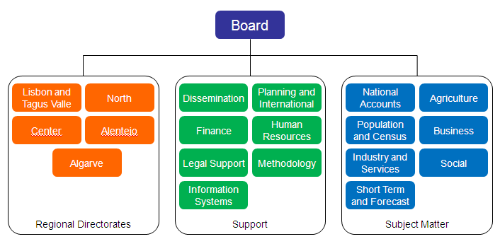
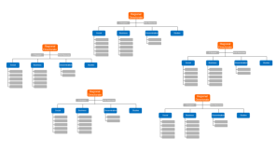
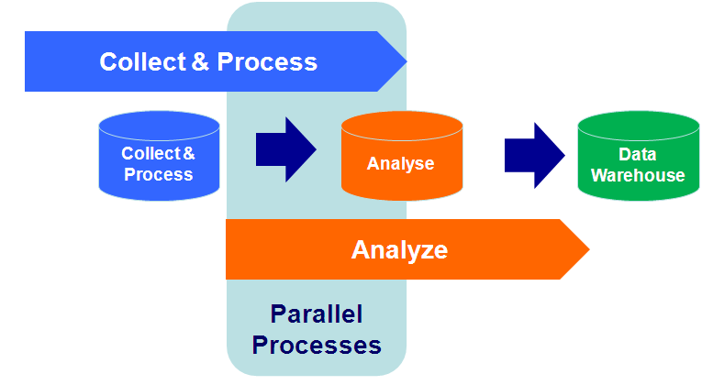
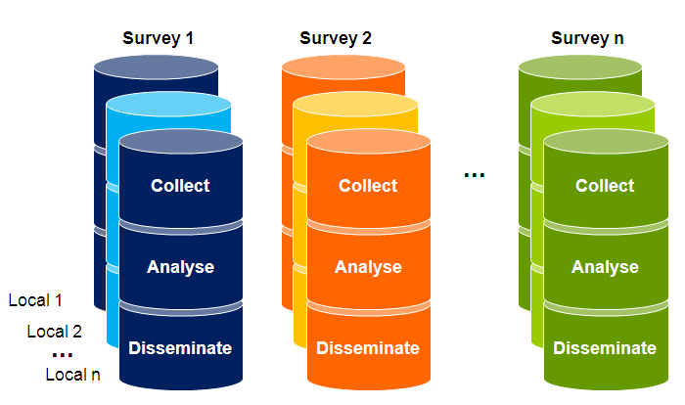
The Challenge
From: complex, inefficient and not flexible.
Need to be reorganized
To: simple and integrated

Slide 11
Data Collection
A Data Collection department assures the collection, processing and analysis of collected data, covering all business and social surveys;
HR → 200 workers + 350 freelance interviewers
81 surveys and 700 occurrences
66 business (self-completed)
15 by interview (CAPI and CATI).
125.000 companies (*) (99% SME);
70.000 dwellings(*);
30.000 farms.
Annual figures
Notes:
The Data Collection Department assures mainly the phases of collection, processing and analysis of collected microdata, covering all business and social surveys.
These are our average annual figures:
We are 200 workers and 350 freelance interviewers.
Business surveys involve around 125.000 different companies.
In 2011, 66 business surveys were carried out, and 640.000 self-completed questionnaires were collected.

Slide 12
Data Collection activites
GSBPM phases and sub-processes:
Collect
4.1 Create frame & select sample
4.2 Set up collection
4.3 Run collection
4.4 Finalise collection
Process
5.1 Integrate data
5.2 Classify & code
5.3 Review & validate
5.4 Edit & impute
5.5 Derive new variables & units
5.6 Calculate weights
5.7 Calculate aggregates
5.8 Finalise data files

Slide 13
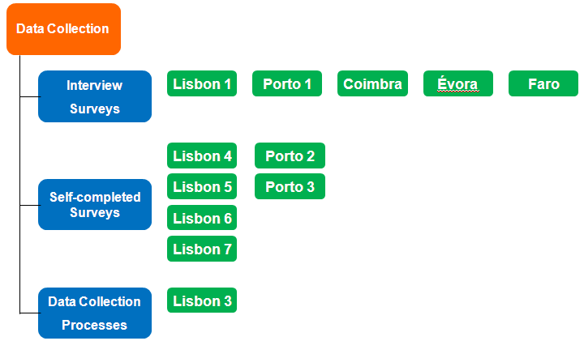
Data Collection Department
Organization by Unit
Business surveys:
By project or statistical operation;
National management of each project;
Social surveys:
Sections work with the same projects;
Share same methods, procedures and tools.
Data collection processes;
Promote the modernization of methods, processes, and tools to support the data collection activities;
Centralized management of CATI surveys.
Countrywide presence

Slide 14
Management within DC
Decentralized managed but centrally controlled;
One overall budget distributed through each management level;
Individual autonomy with responsibility;
Objective-oriented:
HR: matrix management;

Slide 15
Planning Cycle
After the Annual Activity Plan;
Evaluate of HR needed;
Project distribution between the teams;
Some HR are shared between units;
Prepare SLA proposals
to subject mater departments.

Slide 16
Field workforce management
Freelance interviewers to social and agricultural surveys, as well as price collection;
Interviewers have annual contracts and their payment is according to the results;
Interviewers can assure CAPI, CATI and price collection;
CATI interviewers work at home;
A central team assures technical support.

Slide 17
Relationship between
DC & Subject Matter
One major issue at the beginning;
There were a negative perception of the DC tasks → considered as “a low profile work …”
Conversely, subject matter statisticians were very “data collection oriented”;
But expectations were always high!
“You have to do better than me (when I was responsible for DC) …”
Solution: Service Level Agreements (SLA) to manage expectations and to build trust.

Slide 18
Service Level Agreements
DC & Subject Matter
SLA are project specific;
Two main components:
Basic level → included in the methodology of the survey;
Variable level → negotiated.
SLA essentially contains operational indicators, its measures, goals and intervals of acceptance and to overcome;
Has indicators continually measured.

Slide 19
Integrated Production System
From the early stages of the reorganization it was clear to the Data Collection team that the benefits of the centralization would only succeed if supported by an integrated production system.
Survey Management
Business
Agriculture
Social

Slide 20
Strong interdependence
(without interference …)
Data Collection
Subject Matter
Notes:
Gestão do Respondente
Repositório único de Respondentes (Aderentes/Contactos)
Actualização dinâmica e partilhada da informação
Criação de regras

Slide 21
Electronic questionnaires
There were a significant improvement of the electronic data collection for business surveys;
In July 2005: Internet service WebInq
offering an easy and secure alternative to businesses to provide the survey data through electronic self-completed questionnaires.
Nowadays, all business surveys have a webform and more than 85% of the business questionnaires are collected electronically.

Slide 22
Automated Data Collection
New wave of innovation (business surveys);
Using automated data collection, a data provider can collect data in their own information systems, generating a XML file and submitting it to Statistics Portugal pushing a single button, and avoiding manual filling in into a web form;
Data providers save time and resources, reducing their reporting burden.
Statistics Portugal benefits from improved data quality and faster response time.

Slide 23
Improved communication with data providers
A centralized and integrated production system is a key element to improve the relationship with respondents;
As long as the data collection processes occurs, paradata is automatically collected, offering an extensive knowledge of the data providers and respondents.
Nowadays, it is easy to answer some questions like:
what are the surveys that a company or a respondent is involved?
what is their response behavior?
Those questions where near impossible to answer with the former approach.

Slide 24
Data Provider’s survey
To measure consistency of respondent communication.
In 2013 Statistics Portugal carried out this ad hoc survey to data providers, which allowed obtaining a picture of how the obligation to reporting statistics is viewed by the respondents.
With the results was possible to have further information about the Perceived Response Burden and the quality of the data reported, and obtained critical suggestions for the improvement of procedures in data collection.

Slide 25
The way forward
Extend the coverage of WebInq to social surveys
European Health Interview Survey in September
Extend the automated data collection to all business surveys, as an alternative to self-completed webforms
Develop SIGINQ new features, such as the improvement of the analysis of paradata,
Invest in systems to collect regular transactional data, such as supermarket scanner data;
Become an enabler to reduce the survey-dependence of the Portuguese official statistics production.

Slide 26
Lessons Learned & Conclusions (1)
Statistics Portugal had substantive results as well as many opportunities for future modernization and transformation;
The economies of scale and the productivity gains have freed up resources to invest in more innovation and to develop new capabilities;
Having a focused and motivated team is a critical enabler for the innovation, allowing new capabilities (quickly developed).

Slide 27
Lessons Learned & Conclusions (2)
Statistics Portugal has succeeded after the enormous effort to centralize data collection;
There is no single recipe to follow,
but there are some essential ingredients to be considered;
Like any other organization, a NSO needs to continuously understand the context, evaluate the performance (real and perceived) and organize the resources and processes accordingly.

Slide 28
Thank you very much!
Centralize Data Collection
Does it worth?
Paulo Saraiva dos Santos
paulo.saraiva@ine.pt
3 June 2014
Vienna, Austria

