Slide 1
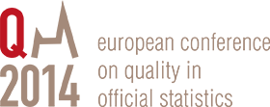
Quality Assessment and Improvement Methods in Statistics – What works?
Hans Viggo Sæbø, Statistics Norway
Quality frameworks
Tools

Slide 2
Quality frameworks
Definitions, principles and model
General quality frameworks with common elements (Total Quality Management, Six Sigma, EFQM, ISO, Lean…)
Frameworks developed for official statistics (European Statistics Code of Practice, UN National Quality Assurance Framework)
Constancy of purpose

Slide 3
Code of Practice is a common European quality framework
Institutional
environment
Statistical
processes
Statistical output
Users
Notes:
3

Slide 4
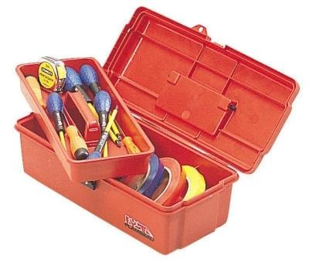
Tools for quality assurance
Quality reports and indicators
Measurements and analyses of process variables
User satisfaction surveys
Self assessments
Reviews/audits
Labelling and certification
Tools can be linked to the business process model where relevant

Slide 5
Quality reports - communicating quality
Structured information for users, based on quality indicators
Information beyond pure quality characteristics
Adapt to user groups
Updating
Indicators have to be used with some care

Slide 6
Tools for quality assurance
Quality reports and indicators
Measurements and analyses of process variables
User satisfaction surveys
Self assessments
Reviews/audits
Labelling and certification

Slide 7
User satisfaction surveys
Different types
Supplement to other user dialogue
Known users are often satisfied
Satisfying current user needs is not enough
Notes:
7

Slide 8
Tools for quality assurance
Quality reports and indicators
Measurements and analyses of process variables
User satisfaction surveys
Self assessments
Reviews/audits
Labelling and certification

Slide 9
Self-assessments
Are often not enough
But can be a good start for a systematic quality work
DESAP
CoP and CAF
Basis for reviews and audits
Notes:
9

Slide 10
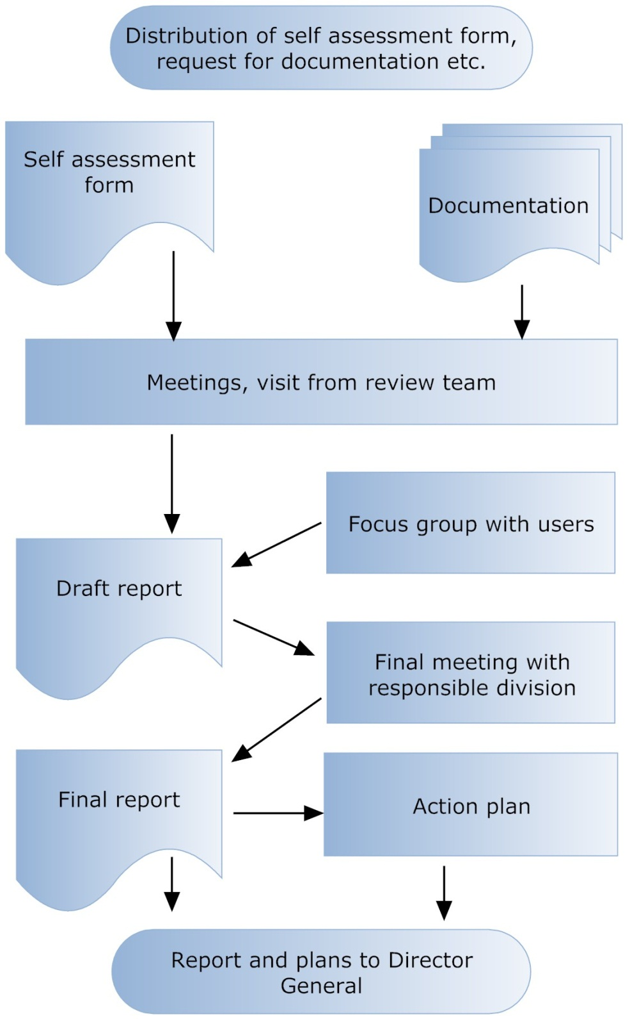
Audits based on Code of practice in Statistics Norway
Team of 4 persons
Self assessment (CoP as basis)
Process mapping (Lean)
Focus groups
Report
Action list
21 statistics or themes 2011 - 2013

Slide 11
Following up is crucial
Assessments and reviews are not enough
Management responsibility
But a central unit can monitor
Type of review actions followed up in Statistics Norway:
Improved user dialogue and dissemination
Documentation
Processes, more standardised solutions
Statistical methods, e.g. macro editing
Legal formalities

Slide 12
Tools for quality assurance
Quality reports and indicators
Measurements and analyses of process variables
User satisfaction surveys
Self assessments
Reviews/audits
Labelling and certification

Slide 13
Labelling and certification
Characteristics of official (and European) statistics:
Common good serving the whole society
Based on quality criteria (CoP)
Not pilots and not analyses
Quality is subject to qualitative judgements
Minimum requirements?
Labelling:
+ Improve trust and quality, prevent misuse
- Bureaucracy, delimitation, will the users care?
Certification
Assessments and reviews are a prerequisite

Slide 14
Concluding remarks
Basis for quality work:
Quality framework: European Statistics Code of Practice
Business Process Model
Organisation
Stepwise procedure
From simple to more advanced tools
Self-assessments are a good start but reviews make a difference
Constancy of purpose
Quality thinking integrated in all activities
Following up is crucial
Quality is more than doing things right – we also have to do the right things

