Slide 1
A Quality Driven Approach to Managing Collection and Analysis
Claude Turmelle, Serge Godbout, Keven Bosa and Fraser Mills Business Survey Methods Division, Statistics Canada
European Conference on Quality in Officials Statistics (Q2014)
Vienna, Austria, June 2-5, 2014

Slide 2
Outline
The Integrated Business Statistics Program (IBSP)
IBSP Active Management Model
Implementation
Empirical Results
Final Remarks

Slide 3
The new IBSP
Statistics Canada recently reviewed its Corporate Business Architecture (CBA) with three main objectives in mind:
Improve efficiency
Enhance overall quality
Increase responsiveness
The Integrated Business Statistics Program (IBSP)
Achieve CBA’s objectives for business surveys
A new business survey infrastructure that will redesign and integrate 120+ business surveys over the next four years, starting in 2014
The newly developed Active Management Model is at the core of the IBSP infrastructure

Slide 4
IBSP Active Management Model
Sampling
Multi-Mode Collection
Automated Processing
Active Management
Rolling Estimates
Editing
Follow-Up
Imputation
Manual Editing
Estimation
Quality Indicators and Impact Scores
Interpretation & Dissemination

Slide 5
IBSP Active Management Model
Quality Indicator (QI)
MSE type, which incorporates Sampling and Imputation Variance, plus a measure of Deviation from predicted values
Impact Score
Impact of a unit on the QI for a given domain estimate
Global Measures
Global QI = Average of QI from all key domains and all key variables of a survey
Global Score = Average of all Impact Scores for a given unit.
0 Imputation Variance + Deviation Large
Reported data close to predicted value
Data imputed from a good model
Data imputed from a poor model
and/or far from the predicted value

Slide 6
IBSP Active Management Model
Strategy is driven by 3 interrelated concepts:
Key Estimates
The combinations of Key Domains (geo*industry) and Key Variables (around 5) to be included in the active management
Importance Factors
Rank the Key Estimates from the most to the least important
Set relative weights of the Key Estimates in the Global Score and Global QI
Generated from historical estimates

Slide 7
IBSP Active Management Model
Strategy is driven by 3 interrelated concepts (cont’d):
Quality Targets
Set the quality objective for each Key Estimate
Targets are set in line with the Importance Factors
For the 1st year, expected CVs coming out of sampling were used as a starting point
Starting with year 2, actual realized QIs will be available as a starting point

Slide 8
Implementation
Collection
One integrated list will be created for all collection follow-up operations
Priority groups will be created from unit scores
Priority 1: top 5% of units with highest score
Priority 2: next 10% of units with highest score
…
Appropriate follow-up action will be based on record status (i.e. appointment, hard refusal, failed collection edit, etc.)
Active collection for a specific survey will stop when
The Global QI has reached a predetermined threshold
AND
The weighted response rate has reached a predetermined minimum

Slide 9
Implementation
Step-by-step top down analysis
Analyse estimates that have reached their quality target
Drill down using unit impact scores to prioritize micro editing
Analyse domains/estimates that are getting close to their target
Look at high impact units in other domains
Analysts will have access to other quality measures as well (e.g. response rates, imputation rates, etc...)

Slide 10
Empirical Study
Parallel run for 46 annual business surveys
40 surveys using paper questionnaires
6 surveys using Web Electronic Questionnaires (EQ)
4 monthly iterations (July, August, September, October)
Focus on Non-Response follow-up (NRFU)

Slide 11
Results
EQ* - Electronic questionnaire

Slide 12
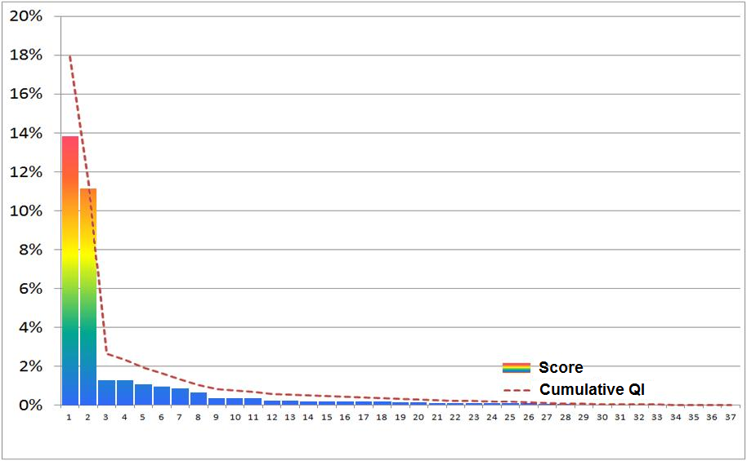
Results
Impact Score
Generally observed situation (first iteration)
Quality Indicator: 17.9% Quality Target: 4.6%
There were 37 units with a Score>0 and 126 units with a Score=0
Target can be reach if and only if units 1 and 2 are resolved
Remaining 35 units have negligible effect on the estimate’s quality
Collection Units

Slide 13
Results
The level of savings depends on:
Collection mode and strategy
Desired level of quality
Choice of the Key Estimates and their relative importance
The launch of Rolling Estimates
Immediately before active collection operations start for Non-Response follow-up
As soon as data is available for Failed Edit follow-up
The frequency of iterations is a compromise between:
Optimality
System capacity
Timeliness of data for Active Management

Slide 14
Final Remarks
It works!
The first few years of the IBSP will be learning years, where the behaviour and performance of the approach will be monitored closely and adjusted where and when necessary.

Slide 15
For more information, ▪ Pour plus d’information,
please contact: veuillez contacter :
Claude Turmelle (613) 951-3327
Claude.Turmelle@StatCan.gc.ca

