Slide 1
Quality Challenges in Modernising Official Business Statistics
Ger Snijkers (Statistics Netherlands)
Gustav Haraldsen (Statistics Norway)
Martin Luppes (Statistics Netherlands)
Piet Daas (Statistics Netherlands)
Johan Erikson (Statistics Sweden)
Li-Chun Zhang (Statistics Norway/University of Southampton)
Q2014: European Conference on Quality in Official Statistics
2 – 5 June 2014, Vienna, Austria

Slide 2
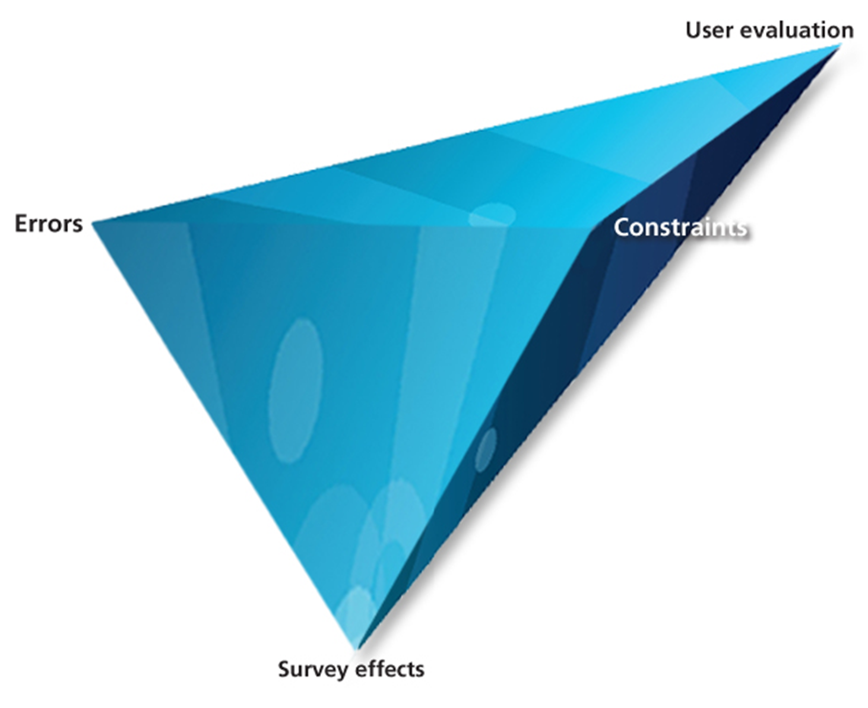
Quality Framework: Quality Diamond
of
outputs
Total survey error sources:
Sampling errors
Non-sampling errors
set by:
Stakeholders
Production process
Business context and response process
Quality effects related to the survey design

Slide 3
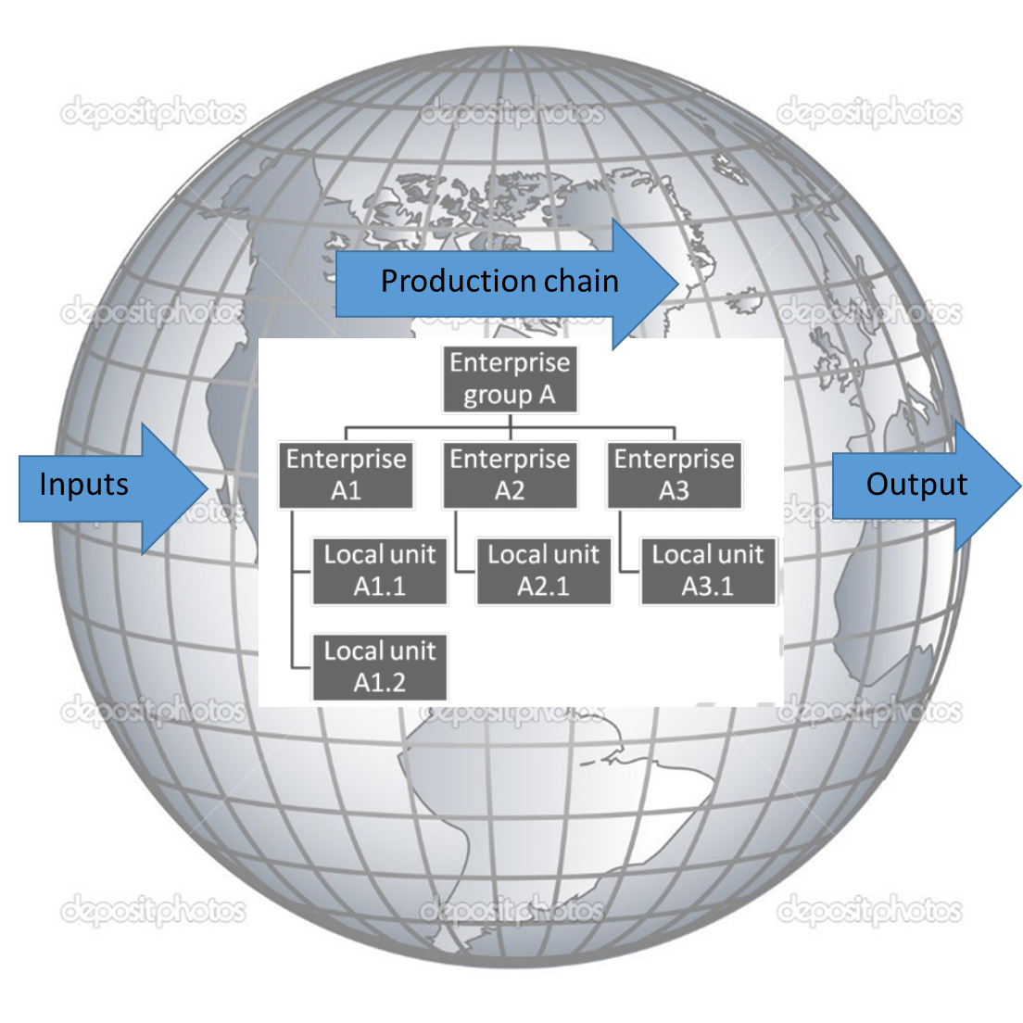
Two fundamental changes
Commercialization of statistics
Globalization
The dynamic structure of Enterprise groups
The origins of inputs and destination of outputs
Business functions across boarders
Measuring Value chains

Slide 4
Two fundamental changes: effects
Commercialization of statistics
Globalization
Different statistics
Sturgeon (2013): “We have a strong sense of changes in the world economy, […] but cannot fully describe the new patterns and structures […], not least because the official statistics at our disposal were created for other purposes and in simpler times!”
The dynamic structure of Enterprise groups
The origins of inputs and destination of outputs
Business functions across boarders
Measuring Value chains

Slide 5
Two fundamental changes: effects
Commercialization of statistics
Globalization
Different statistics
Different ways of producing statistics
Updating multi-source/ mixed-mode strategies:
Using available data
Secondary sources: registers and big data
Modernising survey methodology
The dynamic structure of Enterprise groups
The origins of inputs and destination of outputs
Business functions across boarders
Measuring Value chains

Slide 6
Data sources and (dis)qualities
Globalization
Commercialization
 | Surveys | Admin data | Big data
Data source | Local | Central | Human sourced Process mediated Machine generated
Qualities | Designed Multivariate | Complete Low cost | Timeliness Real time updates
Disqualities | Nonresponse bias Measurement errors Expensive | Validity? Updated? No control | Coverage bias Measurement errors Lean in variables No control

Slide 7
Tentative conclusions
Aimed at updating the multi-source/mixed-mode strategy
Globalization
Commercialization
 | Surveys | Admin data | Big data
Data source | Local | Central | Human sourced Process mediated Machine generated
Starting point: develop new statistical indicators and statistical system at country and European level (e.g. FRIBS)
Data warehousing of already available data
Integration of these data, including business and household data
Study new sources within the context of the new statistical system; use the qualities of each source in a blended approach
Use surveys to collect additional information about the Value Chains
Modernise business surveys: tailor sample units and measurement instruments to the business production process
Qualities | Designed Multivariate | Complete Low cost | Timeliness Real time updates
Disqualities | Nonresponse bias Measurement errors Expensive | Validity? Updated? No control | Coverage bias Measurement errors Lean in variables No control

Slide 8
Tentative conclusions
Aimed at updating the multi-source/mixed-mode strategy
Globalization
Commercialization
 | Surveys | Admin data | Big data
Data source | Local | Central | Human sourced Process mediated Machine generated
Groves (2013):
“We are living in exciting times: it is up to us to build a new paradigm for official statistics. We have work to do!”
Qualities | Designed Multivariate | Complete Low cost | Timeliness Real time updates
Disqualities | Nonresponse bias Measurement errors Expensive | Validity? Updated? No control | Coverage bias Measurement errors Lean in variables No control

