Slide 1
Consistency of Concepts and Applied Methods in Business Statistics
Improving Consistency in the ESS: Target Populations, Frames, Reference Periods, Classifications and their Applications
presented by Boris Lorenc
Q2014, Vienna, 3rd June 2014

Slide 2
Content
Approaches to evaluating inconsistencies
Definition
Top-down (framework) and bottom-up (inventory) approaches
Inventory
Methodology
Main results
Proposals
Structure and areas
Example
Principles

Slide 3
Content
Part 1: Approaches to evaluating inconsistencies

Slide 4
Consistency: the concept
Definition
Consistency means agreement in a set of concepts (their referents), as reflected in complete metadata, pertaining to two or more produced statistics that leads to the statistics being coherent and comparable.
Different types of consistency can be defined:
1. horizontal - consistency of produced statistics between two or more statistical domains in a participating country or between two or more statistical domains on the EU level,
2. vertical - consistency of produced statistics within the same statistical domain between participating countries, or their joint consistency with the corresponding statistics produced on the EU level,
Knowledge of the metadata is needed
Relates to the other quality dimensions
relevance, accuracy and reliability, timeliness, coherence, accessibility
user input needed

Slide 5
Approaches to evaluating inconsistencies
Top-down
From a framework
Bottom-up
From observed issues, e.g. through inventory, that indicate need for improvement of consistency
Perhaps optimal to work from both perspectives, planning so that their respective actions and results converge

Slide 6
Components of a framework
Context
‘Vision 2020’: from stovepipes to integrated systems for production of statistics
Current European initiatives: FRIBS, ESBR, .....
Similar processes on country level (NZ, AU, NL, CA,...)
Integration of statistical production processes
Some general characteristics:
dedicated efforts through extended periods (5-7... years)
integrated data storage
BR central
appropriate mixes of survey and administrative data
integrated production, based on a common set of data
user input in development of systems (within and outside the agency)
lessons learned, backtracking...
Consistency one among several quality components, all assessed against cost too

Slide 7
Content
Part 2: Inventory

Slide 8
Inventory: Questionnaire responses
Questionnaires covered: Coverage of target populations, Extensions of coverage, Sampling frames, Reference periods, Breakdowns, and Size classes (some of the areas asked of only statistical domains) (vide Deliverables 2.6 and 3.6 of WP2)
Sent to the Business Register (BR) and 19 subject-matter domains of business statistics (SDs) in 31 EU and EFTA countries (not in every country to all)
Field period: March-May 2013
High response rate: 27 BR responses and in total 466 SD responses received and taken into the analysis (vide Deliverables 2.7 and 3.7 of WP2)

Slide 9
Inventory: Introduction
Major thematic areas
A. Target populations and frame coverage
B. Business register maintenance
C. Relations between business register and the subject-matter domains of business statistics
D. Temporal aspects
E. Reference periods
F. Sampling methods and sample coordination
G. Classifications
H. Breakdowns
I. Size classes

Slide 10
Inventory: Frame coverage
Undercoverage
Restrictions in administrative sources which feed into BR or other sampling frames, the “threshold” issue (businesses with specific properties, e.g. in specific employment size or turnover value intervals, etc, do not enter into administrative sources)
Restrictions “by design” (e.g. certain NACE activities left out, due to conflicts of regulations or due to established practices in the participating countries)
Temporal restrictions, part I: non-representation of newly established units (in a large country, a separate study indicated an undercoverage in statistics produced by a SD of 22% due to this reason)
Temporal restrictions, part II: dynamically changing properties of businesses registered with a time lag on the frame
Undercoverage of market activities due to insufficient clarity of the concepts used, that is, inability to distinguish between market and non-market activities

Slide 11
Inventory: Frame coverage (cont’d)
Overcoverage
Due to continued existence of units that have ceased with their activity
Due to lag in update of business properties, which would exclude them from target population (e.g. have decreased their turnover to below a certain value)
Due to inability to distinguish between market and non-market activities
Trade-offs involved
Administrative data may be advantageous to data quality, process quality or production economy, but disadvantageous to timeliness if they are only available relatively late

Slide 12
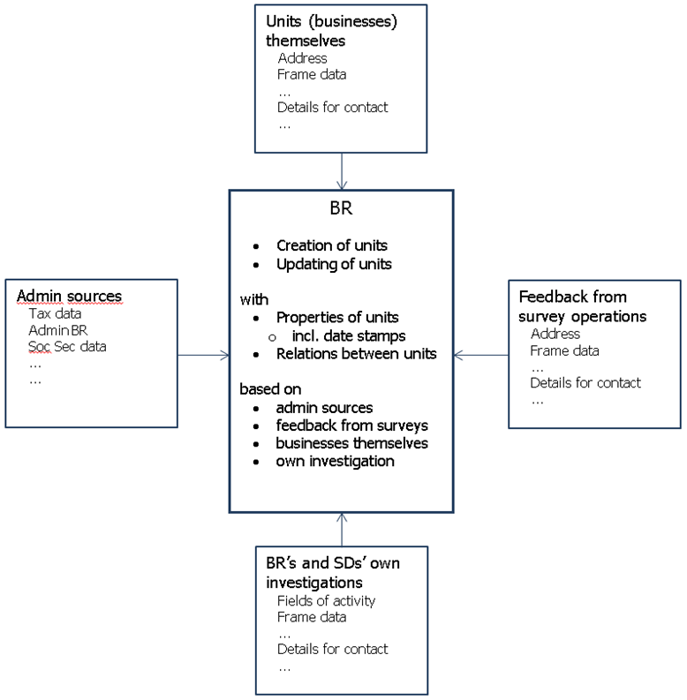
Inventory: Business Register maintenance
Considerable variation in BR practices of maintenance and update
externally available sources of information
internal sources and practices
Methods to assign values of register variables
Coding of units for: NACE, employment, employees, turnover, institutional sector codes
Metadata: existence and management
‘Frozen’ vs. ‘live’ frames

Slide 13
Inventory: Relations between BR and SDs
Use of the BR by SDs hampered by
Prohibited access of SDs external to NSIs to BR due to national legislations
Lack of sufficient quality (completeness) of the BR: timeliness (a time lag leading to both undercoverage and overcoverage) and coverage (of activities, size classes, etc)
Target populations of some SDs not identifiable in the BR (e.g. records of transactions, R&D activities)
Perceived unsuitability of the BR to be used as a frame for conducting censuses
Use of ‘frozen’ vs. ‘live’ frames
Unclear basis for decision
How is consistency addressed when ‘live’
Updates from BR to SDs after sample selection
Practices vary largely
Feedback from SDs to the BR
Practices vary largely
Methodology almost completely missing; differing practices can have effects on produced statistics (accuracy, etc)

Slide 14
Inventory: Temporal aspects
A: not specifically covered, but indications of considerable variation
B: a time leg of mostly up to 3 months; updates of the BR mostly annual
Considerable delay before update
C: Frozen frames most often created annually, but also more frequently
Current within a year or month; timeliness of BR seen as high
D: occurs throughout the year, but more often around the new year (November – February)
Due to freshness of frozen BR

Slide 15
Inventory: Reference periods
Focused on reporting periods for accounting that in businesses are differing from the calendar year
Varies between the countries from a couple of per cents to almost a quarter of the businesses
Rule often applied that reported data are assigned to the calendar year in which the reporting period ends
Can lead to some estimation issues, especially so if recent change is to be estimated
Better adjustment methods needed, but not trivial to develop

Slide 16
Inventory: Sampling - methods and coordination
Sampling coordination may improve consistency
Common reference periods
Common auxiliary information
Current situation (from the inventory): “same time”
Integrate same/different periodicity/-ies?

Slide 17
Content
Part 3: Proposals

Slide 18
Proposals
Set of proposals with the goals towards:
Strengthening business register’s role in statistics production (1-10)
Achieving consistent NACE coverage, breakdowns and size classes (11-16)
Strengthening methodology for achieving consistency (17-24)
Developing integrated systems for economic statistics production (25-28)
Vary from broad to more specific
To be treated as a whole

Slide 19
Strengthening business register’s role in statistics production
1
Identify and implement actions leading to BR becoming the backbone of integrated statistics production.
Rationale:
This proposal is central for a consistent system of integrated economic statistics

Slide 20
Strengthening business register’s role in statistics production
2-5
Work out a methodology for a BR’s set-up and maintenance, including relations between the BR and the subject-matter domains of business statistics.
Develop detailed guidelines for application of NACE coding for the BR purposes
Develop and implement methods to assess gaps in coverage in the BR
Develop manual(s) to support implementation of standards developed by Proposal 2 – Proposal 4.

Slide 21
Principles
Consistency to be optimised, rather than maximised
Consistency best achieved “by design”
Consistency improved by making BR the backbone of business and economic statistics production
The concept might be influenced by changes in data landscape
Improving consistency well aligned with increased standardisation and automatic processing

Slide 22
http://www.cros-portal.eu/content/public-documents
Boris Lorenc
boris.lorenc@scb.se
Thank you…

