Slide 1
Improved Modal Split Indicators for transport statistics based on an effective distance matrix
Ekkehard PETRI, Boryana MILUSHEVA & Oliver HEIDEN, Eurostat

Slide 2
Policy relevance
2011 Transport White Paper:
  a shift of 30% of road freight transport over 300 km to other modes such as rail or waterborne transport by 2030, and more than 50% by 2050

Slide 3
The Statistics
  Total Transport Performance of the five main transport modes (road, rail, iww, air and maritime) in tkm, following the principle of 'territoriality'
  Data broken down in distance classes of above/below 300km

Slide 4
The problem - statistical reporting
Transport performance per Member State
  compiled per country of registration of the vehicle
Transport performance per journey
  only origin and destination (NUTS3) of each journey

Slide 5
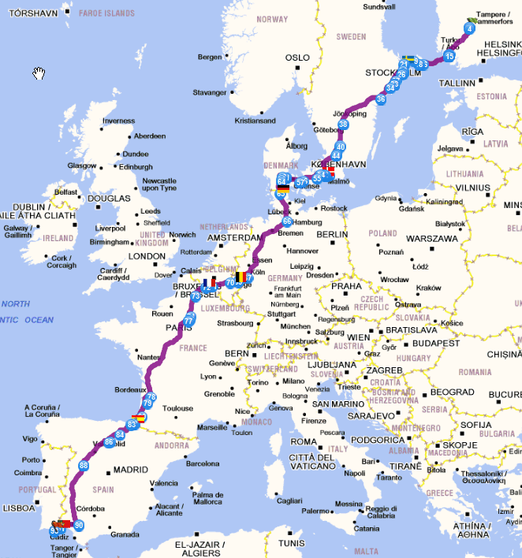
Vehicle perspective "Origin of the haulier principle"
Journey between FI197 and PT150
Total distance 4458 km
Haulier FI ->4458 km to FI
Haulier PT -> 4458 km to PT
Haulier PL -> 4458 km to PL
©ViaMichelin

Slide 6
Journey based statistics on transport performance
REPORTING COUNTRY | REGION OF LOADING | REGION OF UNLOADING | TONNE-KM in 1000 TKM
XX | YY111 | XX111 | 688.886.305
XX | XX113 | YY111 | 96.563.141
CC | YY111 | XX213 | 7.627.632
ZZ | ZZ220 | XX111 | 96.798

Slide 7
The solution -territorialisation
FI 179km
SE 727km
DK 308km
DE 666km
BE 179km
FR 1073km
ES 595km
PT 605km
Other 256km
©ViaMichelin

Slide 8
Proportional territorialisation
1000 km
Country A
Country B
Country C
Country D
100km
100km
700km
100km
X TKM
10%
10%
70%
10%

Slide 9
ILSE distance matrix

Slide 10
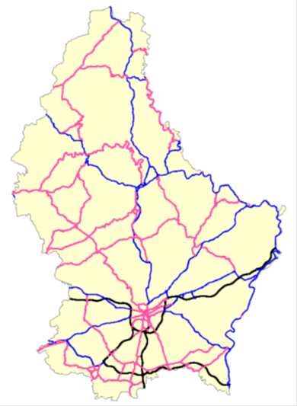
Quality issues of the existing ILSE matrix

Slide 11
The new ILSE matrix
Road network TomTom™
Routing software pgRouting in a PostgreSQL/PostGIS database
NUTS and country boundaries from EuroGeographics©
Origin and destination are defined by the most populated settlement
1 782 607 paths (EU28, EFTA, CC origin destination pairs)
FROM;TO;TOTAL_DISTANCE;AT;BE;BG;CH;CZ;DE;DK;EE;ES;FI;FR;GB;GR;HR;HU;IE;IT;LI;LT;LU;LV;ME;MK;MT;NL;NO;PL;PT;RO;SE;SI;SK;TR;
"ITI17";"SI017";679,36;;;;;;;;;;;;;;121,23;;;482,75;;;;;;;;;;;;;;75,39;;;
"ITI17";"SI018";528,94;;;;;;;;;;;;;;;;;459,97;;;;;;;;;;;;;;68,97;;;
"ITI17";"SI02";565,08;;;;;;;;;;;;;;;;;459,97;;;;;;;;;;;;;;105,11;;;
"ITI17";"SI021";565,08;;;;;;;;;;;;;;;;;459,97;;;;;;;;;;;;;;105,11;;;
"ITI17";"SI022";595;;;;;;;;;;;;;;;;;459,97;;;;;;;;;;;;;;135,02;;;

Slide 12
More detail

Slide 13
Fastest path

Slide 14
Benchmarking of the new matrix
Distances are systematically longer
Distances are more similar to route finder results
BUT
Sometimes significant shifts of territorial shares

Slide 15
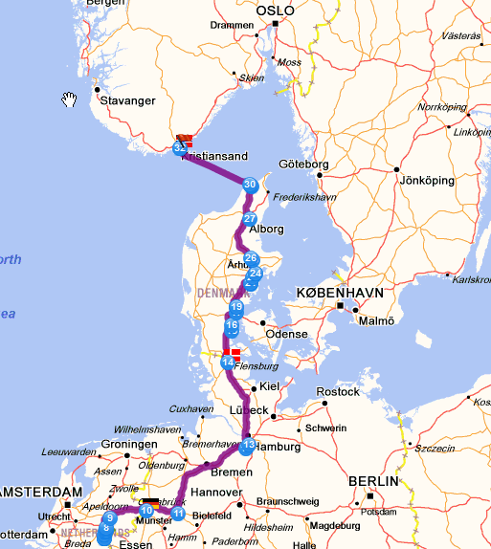
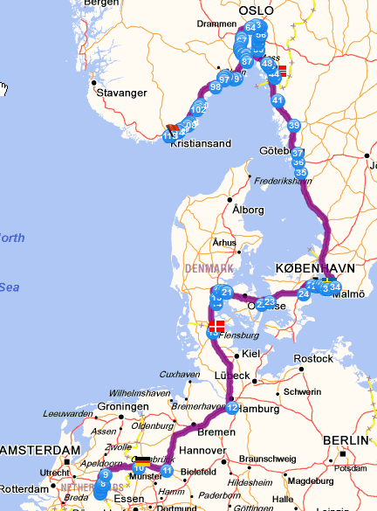
Changes between matrices
©ViaMichelin

Slide 16
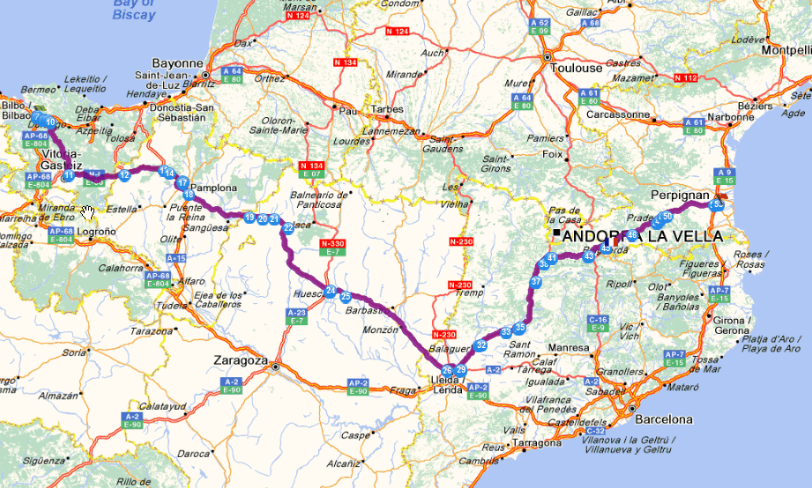
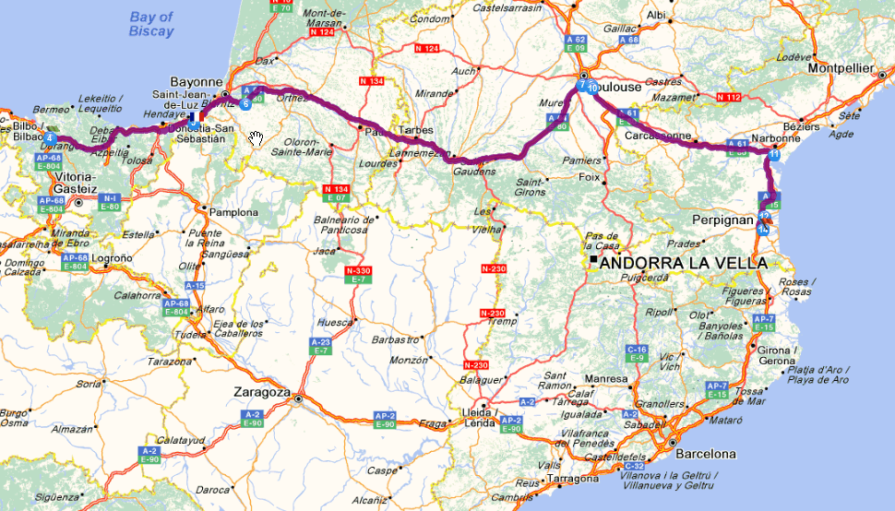
©ViaMichelin

Slide 17
Impact on Modal Split Indicator time series
MSI time series exists since 2008
New matrix first applied to 2011 data
Results for 2011 data indicated a break in time series
Recalculation back in time until 2008 using the new matrix
Significant changes in territorialised road freight transport performance between old and new matrix
  -28% (CZ 2008, 2010) to +28% (BG, 2008)

Slide 18
Benefits (and costs) of the new matrix
Accuracy and reliability 
Relevance 
Reduced burden on respondents 
Coherence and comparability ☹

Slide 19
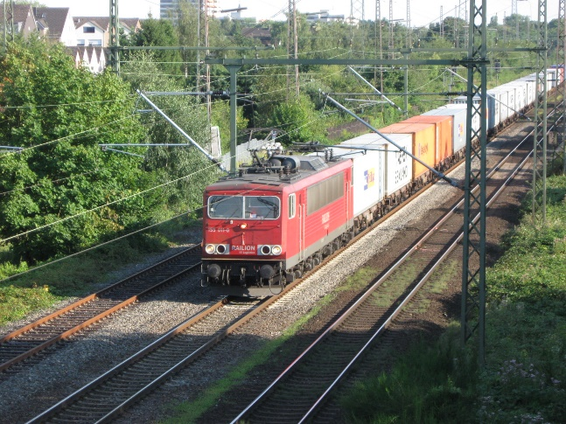
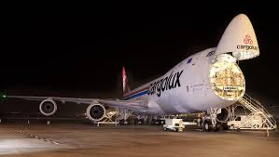
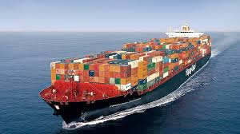
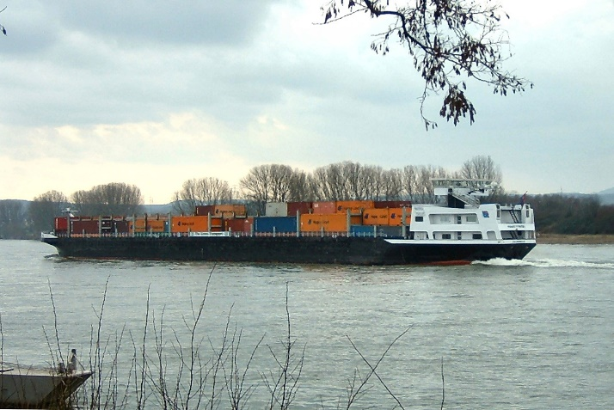
Similar matrices for all other transport modes

Slide 20

EFGS conference
22 – 24 October in Krakow, organised by Statistics Poland
http://geo.stat.gov.pl/efgs

Slide 21
Further information
Ekkehard.petri@ec.europa.eu
http://epp.eurostat.ec.europa.eu/statistics_explained/index.php/Freight_transport_statistics_-_modal_split

