Slide 1

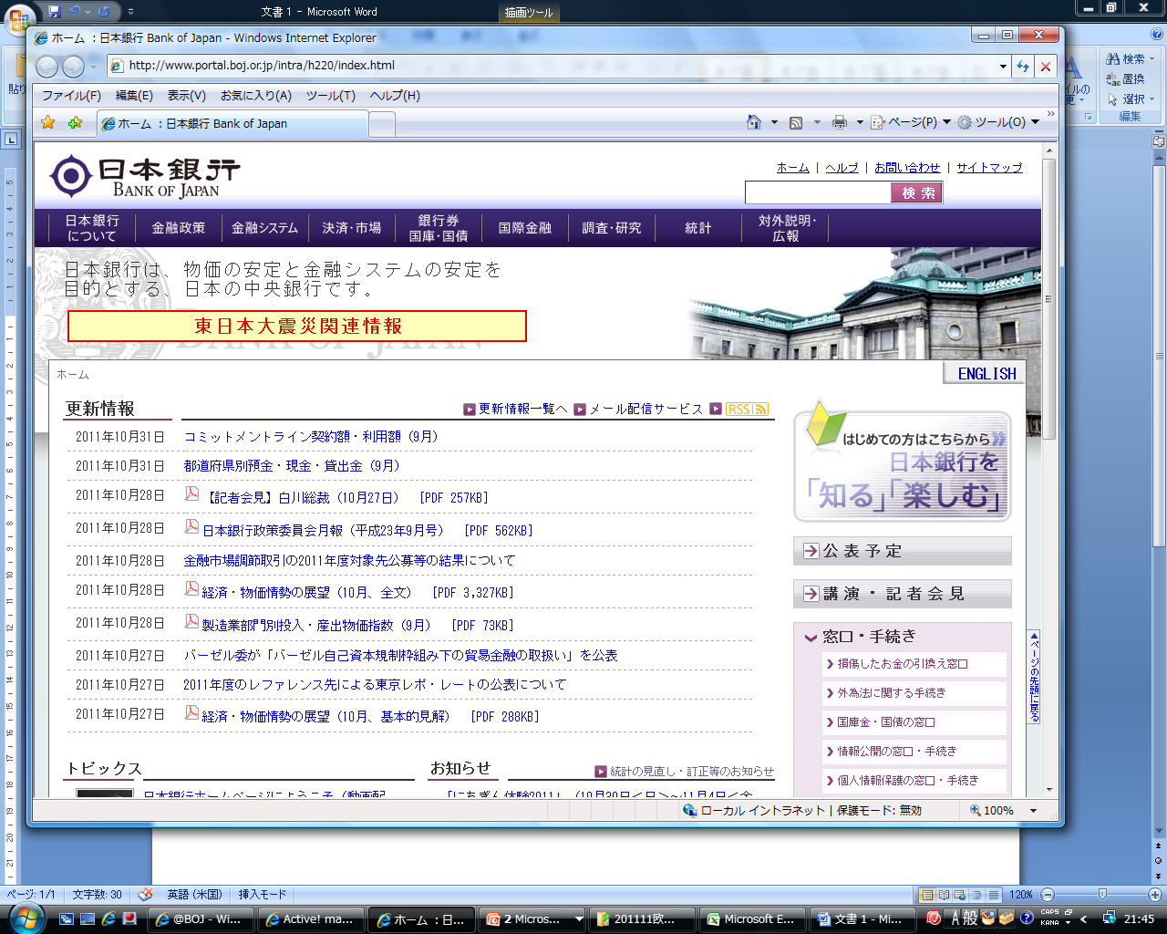
Quality Management of Statistics at the Bank of Japan
European Conference on Quality in Official Statistics
3 June 2014
Kuniko Moriya
Research and Statistics Department
Bank of Japan
kuniko.moriya@boj.or.jp

Slide 2
Outline
Principles and Framework for Quality Management of Statistics at the Bank of Japan (BOJ)
･ “The Basic Principles for the Compilation, Release, and
Development of Statistics” (hereafter “Basic Principles”)
･ The risk control self-assessment system (hereafter “CSA”)
Application of Basic Principles in the case of the Short-term Economic Survey of Enterprises in Japan (hereafter “Tankan”)
Comparison of Quality Management between BOJ Statistics and European Statistics
Remaining Issues and the Way Forward

Slide 3
1. Principles and Framework for Quality Management of Statistics at the BOJ
Basic Principles
･ Consist of 7 categories (see the next slide) published in 2009
･ Basic Principles are compiled according to the full revision of the
Statistics Act, and the “Master Plan Concerning the Development
of Official Statistics” to ensure the quality of compilation, release,
and development of statistics

Slide 4
1. Principles and Framework for Quality Management of Statistics at the BOJ (cont’d)
Categories of Basic Principles

Slide 5
1. Principles and Framework for Quality Management of Statistics at the BOJ (cont’d)
CSA
･ Control self-assessment system to daily operations at
the BOJ introduced in 2007
･ Conducted every 2 or 3 years. Review carefully all daily
operations, find the risks in the daily operations. The risks
found are examined and judged as to how much they are
already controlled and how much risks still remain
･ The results are for internal use only. The risks that remain
are continued to be observed. The measures for their solution
are taken until the next CSA. In the Next CSA, the same
processes are carried out. Through such “PDCA” cycles,
the BOJ continues to realize risk reduction and the
improvement of the quality of statistics

Slide 6
2. Application of Basic Principles in the case of Tankan
A brief explanation of Tankan
･ Tankan is a statistical survey conducted by the BOJ in accordance
with the Current Statistics Act
･ Originally, started to publish in 1957
･ Consists of 4 categories of survey items:
(a) Judgment Survey
(b) Annual Projections
(C) Inflation Outlook of Enterprises
(d) Number of New Graduates Hired

Slide 7
2. Application of Basic Principles in the case of Tankan (cont’d)
The main workflow until release of Tankan
･ Send the survey forms to sample enterprises (about 10,000)
by mail or online
･ Receive the completed survey forms from sample enterprises
･ Input the data of completed survey forms to the aggregation
system
･ Review the data, and contact respondents for clarification
or confirmation, when necessary
･ Review the data again, and compile them for obtaining
the results to publish

Slide 8
2. Application of Basic Principles in the case of Tankan (cont’d)
Confidentiality control (corresponding to Basic Principle 5)
･ The survey results prior to release and the figures of individual
enterprises of the Tankan are strictly controlled
･ The work area of the section compiling Tankan is physically
separated from other sections. The staff members other
than Tankan section are not allowed to enter
･ Paper based materials are kept locked, and electronic based
materials are protected by password on access
･ Nobody is allowed access to the survey before finalizing the results
on the day of release, and even during the release date, the
numbers of people in charge of handling the materials prior to
release is limited

Slide 9
2. Application of Basic Principles in the case of Tankan (cont’d)
Achievements in advancing publication date
(corresponding to Basic Principles 2, 6)
･ Release date of Tankan has been advanced about one week
earlier since that of August 1996 survey
･ Publication date of paper format publication “The Comprehensive
Data Set” has been advanced about two weeks since that of
March 1999 survey
･ Publication date of electronic format publication “The
Comprehensive Data Set” and the “long-term time series data”
has been advanced one business day since that of December
2000 survey

Slide 10
2. Application of Basic Principles in the case of Tankan (cont’d)
Main points of the March 2014 “Revision of the Tankan survey items” (corresponding to Basic Principles 1 - 4, 6, 7)
(a) Abolition of some survey items
･ Some of items in “Annual Projections” has been abolished
･ All items of “Quarterly Data” has been abolished
(b) Introduction of survey on “Inflation Outlook of Enterprises”
･ A survey on “Inflation Outlook of Enterprises” has been
introduced
(c) Revision of sample enterprises for “Conditions for CP Issuance”
･ Definition of the item “Conditions for CP Issuance” has been
changed

Slide 11
3. Comparison of Quality Management Between BOJ Statistics and European Statistics
Basic Principles vs. COP
Basic Principles
(corresponding to COP 4)
COP
The Bank of Japan Act, Article 5
The Statistics Act, Article 2, 25

Slide 12
3. Comparison of Quality Management Between BOJ Statistics and European Statistics (cont’d)
Basic Principle 4 (roughly corresponding to COP 9) mentions further details compared to COP about the detailed information provision to reporting entities to obtain their cooperation to the statistics survey
Basic Principle 3 (roughly corresponding to COP 6, 15) mentions further details compared to COP about conducting an announcement in advance to invite opinions and comments from a broad range of users and reporting entities, when the BOJ plans substantial revisions of statistics

Slide 13
3. Comparison of Quality Management Between BOJ Statistics and European Statistics (cont’d)
Differences in quality management between BOJ Statistics (with Basic Principles and CSA) and the European Statistics (with COP and Quality Assurance Framework) are apparent in terms of the publication and the frequency of implementation as follows:

Slide 14
4. Remaining Issues and the Way Forward
BOJ will continue to make efforts in improving the quality of statistics
In addition, especially regarding the publication and the frequency of implementation for the quality management of statistics, BOJ would like to learn from the experiences of European statistics, referring to the COP and their Quality Assurance Framework
Thank you!

