Slide 1
Spreading the word: implementing the ES Code of Practice in a decentralised system
Cathy Krüger
Senior Coordinating Officer
Council for Official Statistics
Statistics Sweden

Slide 2
Spreading the word: Code of Practice in a decentralised system
System of official statistics in Sweden
Coordination in a decentralised system
Quality in a decentralised system
Towards a harmonised approach
Conclusions

Slide 3
System of Official Statistics in Sweden
Since 1994, a decentralised system with 27 authorities responsible for statistics

Slide 4
System of Official Statistics in Sweden
Since 1994, a decentralised system with 27 authorities responsible for statistics
“The statistical agencies shall determine the content and scope of statistics within the statistics area(s) for which they are responsible”
Section 2, Official Statistics Ordinance (2001:100)

Slide 5
Coordination in a decentralised system
2002 Council for Official Statistics established
An advisory body, with
“..the task of supporting the agencies…in matters of principle on the availability, quality and usefulness of official statistics,”
Section 8, Ordinance (2007:762) with Directives for Statistics Sweden

Slide 6
Coordination in a decentralised system
2002 Council for Official Statistics established
An advisory body, with
“..the task of supporting the agencies…in matters of principle on the availability, quality and usefulness of official statistics,”
Section 8, Ordinance (2007:762) with Directives for Statistics Sweden

Slide 7
Quality in a decentralised system
”Agencies that are responsible for official statistics shall produce up-to-date descriptions of statistics [which] shall contain a quality declaration….based on the quality concepts and guidelines prepared by Statistics Sweden (MIS 2001:1)”
Statistics Sweden’s regulations for the official release of official statistics (SCB-FS 2002:16)

Slide 8
Quality in a decentralised system
”Soft coordination”:
templates (quality declaration)
recommendations / guidelines
cooperation via a working group of experts

Slide 9
Quality in a decentralised system
Varying statistical producers
Size / resources
Statistics
Sweden
119 official statistics
713 staff
University of
Agricultural Sciences
8 off stat
27 staff
Swedish Pensions
Agency
4 off stat
0,5 staff
Board of Agriculture
30 off stat
20 staff

Slide 10
Quality in a decentralised system
Varying statistical producers
Size / resources
Type of data collection/statistics
Register-based
Total population surveys
Sample surveys
Businesses
Individuals
Local government

Slide 11
Quality in a decentralised system
Varying statistical producers
Size / resources
Type of data collection/statistics
European / official statistics
49%
Official statistics
Statistics regulated by EU

Slide 12
Quality in a decentralised system
European statistics
Quality standard under Reg (EU) 223/2009
Focus on independence, transparency
Relevance, accuracy, timeliness, punctuality, accessibility and clarity, comparability, coherence
Official statistics
Recommendation from Council for Official Statistics
Focus on users’ needs ______
Content, accuracy, timeliness, coherence including comparability, availability and clarity

Slide 13
Towards a harmonised approach
2013 changes in Official Statistics Act (2001:99)
National criteria in line with European critieria
”…the following quality criteria shall apply: relevance…; accuracy…; timeliness…; punctuality…; accessibility and clarity…;comparability…; coherence…”
Section 3a, Official Statistics Act (2001:100)

Slide 14
Towards a harmonised approach
Spreading the word
Working group on methods and quality
Seminars/workshops on aspects of the Code
Guide to implementation from the perspective of a Swedish agency

Slide 15
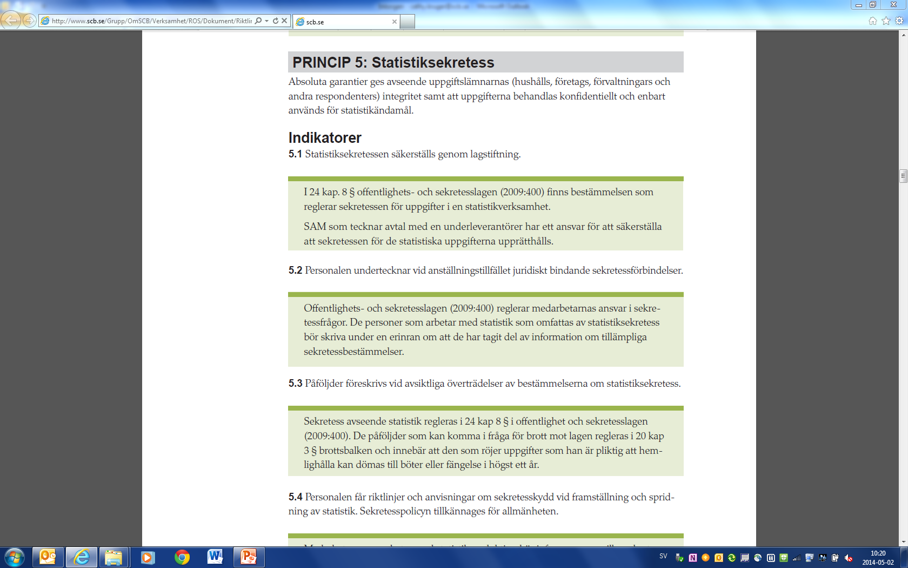

Slide 17
Conclusions
Develop one guideline, incorporating existing national guidelines and European guidelines
Develop quality documentation in line with new critieria
Increase follow-up efforts: self-assessment with constructive feedback and dialogue
Continue with work to ”nationalise” the Code of Practice

