Slide 1
Oversampling and questionnaire effects on precision and coverage of wealth
The new features of the French Wealth Survey wave 2010

Slide 2
Short presentation of the French Wealth Survey
Exists since 1986, a wave conducted every 6 years
Aims at measuring households’ wealth and indebtedness
Fed with the experience accumulated along 20+ years, also with other surveys (in particular the SCF in the US)
In 2010, the French Wealth Survey is included in the Household Finance and Consumption Survey (HFCS)

Slide 3
The new features of the French Wealth Survey 2010
Enlargement of the field and the concept
Oversampling of the wealthy
Questionnaire strategy
Imputation strategy

Slide 4
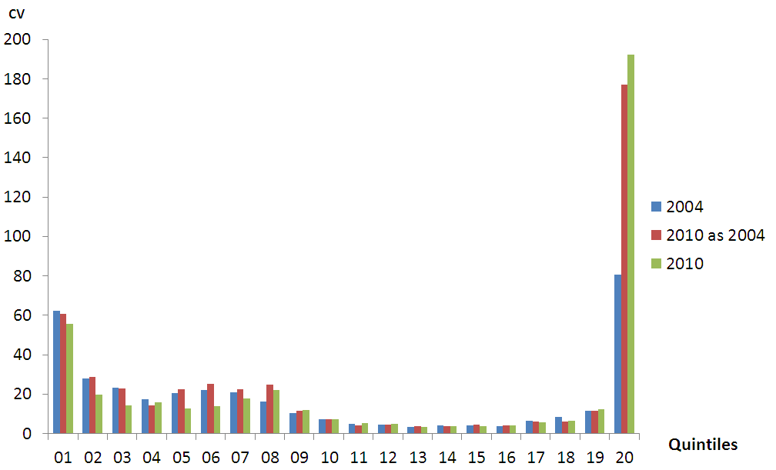
Oversampling of the wealthy

Slide 5
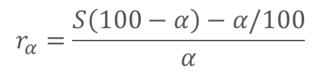
Effectiveness of the oversampling
 | 2004 | 2010
r₁₀ | 37 | 129
r₁ | 37 | 438
$$r_{α}=\frac{S\left(100−α\right)−α/100}{α}$$

Slide 6
Questionnaire strategy
Response | Proportion of the declared financial assets | Share in the global value of financial assets
Amount declared in number | 34.0% | 43.5%
Amount declared in brackets, over EUR 450,000 | 0.4% | 8.7%
EUR 450,000 to 1 million | 55.6% | 26.0%
EUR 1 up to 2 millions | 25.4% | 24.4%
EUR 2 up to 5 millions | 10.8% | 18.5%
EUR 5 up to 10 millions | 2.2% | 14.2%
EUR 10+ millions | 2.6% | 14.7%
DK-DA | 3.4% | 2.2%

Slide 7
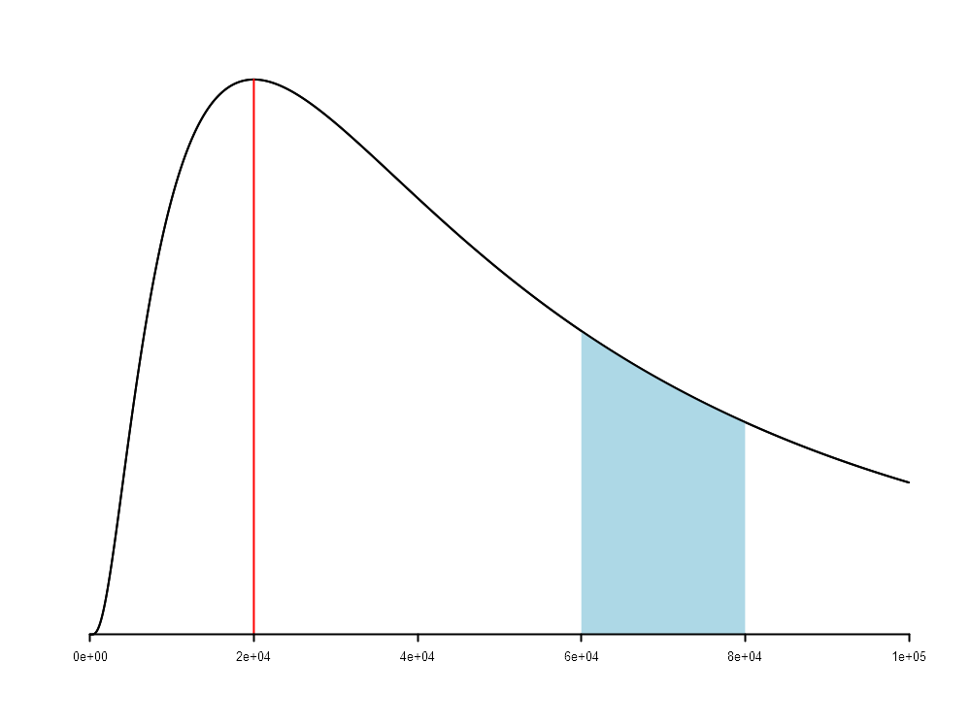
Imputation strategy

Slide 8

Imputation strategy

Slide 9
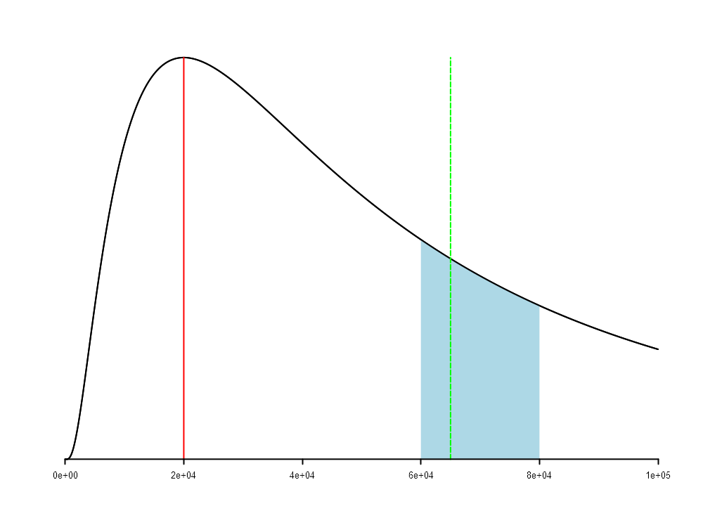
Imputation strategy

Slide 10
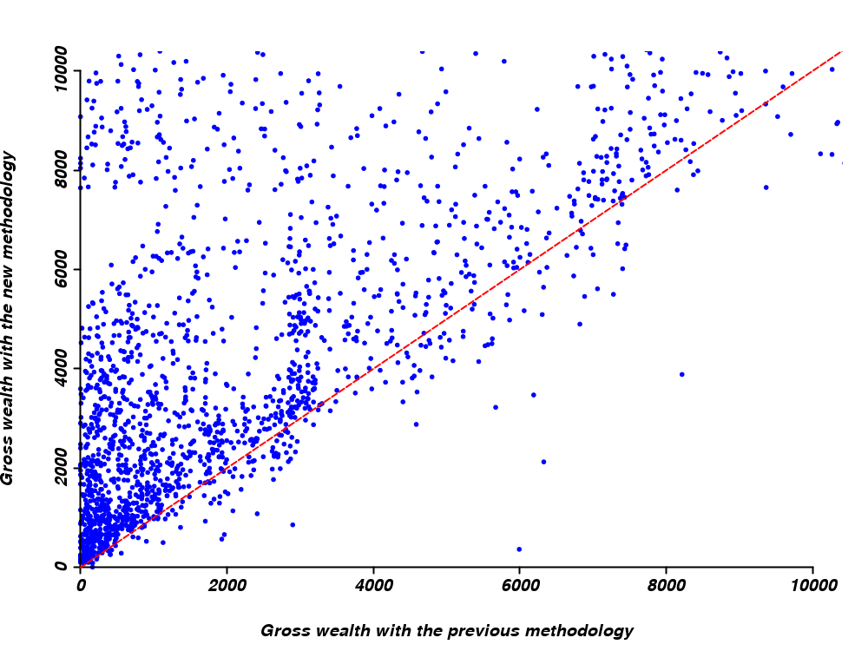
Assessment of the enlargement of the field

Slide 11
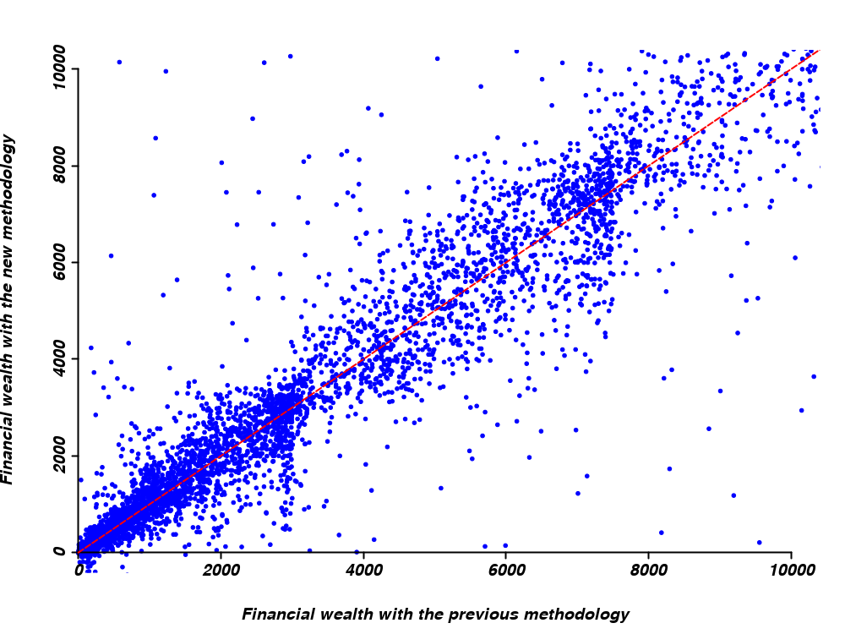
Assessment of the effect of information collection

Slide 12
Assessment of the effect of information collection
Estimators | Gross wealth | Financial wealth | Real estate wealth
Mean | +10% | +10% | +3%
D1 | +215% | -4% | -
D2 | +137% | -2% | -
D3 | +36% | +2% | -
D4 | +6% | 0% | -
D5 | +6% | +1% | +1%
D6 | +8% | +3% | +2%
D7 | +7% | +2% | +3%
D8 | +7% | +4% | +3%
D9 | +7% | +5% | +2%
P99 | +13% | +11% | +3%

Slide 13
Effect of the oversampling – design effect
Estimators | Gross wealth | Real estate assets | Financial wealth
Mean | 0.65 | 0.74 | 0.31
P99 | 0.72 | 0.83 | 0.75
P95 | 1.23 | 1.56 | 1.28
P90 | 1.32 | 1.70 | 1.47
P75 | 1.50 | 1.72 | 1.56
Median | 1.41 | 1.51 | 1.58
P25 | 1.68 | 1.37 | 1.79
P10 | 2.00 | 1.37 | 1.88
P5 | 1.86 | 1.37 | 1.88

Slide 14
Effect of the oversampling - counterfactual
Using the design effects, it is possible to compute how high would have been the precision of a given estimator without oversampling
The idea behind: focus on those strata that contribute mostly to increase the precision of the estimator
This basic method provides a tool to arbitrate between gain of precision and interrogation costs
For example, the variance for the gross wealth mean would have been 48% higher in 2010 without oversampling

Slide 15
Conclusion
Enlargement of the field is a desirable option per se
Oversampling had a positive effect on the precision of the estimates – and probably also on the coverage rate
Both innovations in questionnaire and imputation strategies had a positive effect on the coverage effects and come alongside with the oversampling innovation
Still it is not completely sufficient – but consists of interesting methodologies that can be more or less easily implemented

