Slide 1
More and better
Improvement of official statistics through the Swedish Geodata Cooperation
Jerker MOSTRÖM
Senior Advisor, Regions and Environment Department, Statistics Sweden

Slide 2
The Swed. Geodata Cooperation
Launched in 2011 to fulfil the INSPIRE requirement on data sharing between public authorities
Statistics Sweden participated from start
The agreement is managed by the National Mapping and Cadastre Authority (Lantmäteriet)
Parties in the cooperation are authorities with an information responsibility and municipalities, government agencies and other organizations with official duties

Slide 3
The Swed. Geodata Cooperation
The parties in the cooperation offer each other their spatial data for official use at an annual fee.
The INSPIRE regulation = minimum requirement, the Swedish Geodata Cooperation has a broader scope
One agreement, one annual fee = access to more than 400 geodata products

Slide 4
Before 2011… …and after…..
Public authorities: Geodata acquisition
before 2011 (Example - data exchange and agreements)
Geodata Cooperation Model 2011
One Joint agreement on public datasharing
Organisation h
Organisation a
Organisation g
Organisation b
Organisation f
Joint Agreement
on
Datasharing
Organisation c
Organisation e
Organisation d
Organisation d

Slide 5
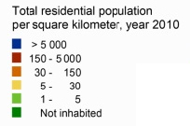

Geodata and geospatial applications at Statistics Sweden
Statistics Sweden’s first population grid application 1988

Slide 6
Geodata and geospatial applications at Statistics Sweden
Long tradition
GI integrated in production in two ways:
  Creation of geospatial products (grids, localities etc)
  Geospatial processing as part of the offcial statistics production chain
Land use statistics most geodata intense
Some 20 products concerning use of land and water, land ownership, urban green areas, designated areas, coastal and urban development etc

Slide 7
More and better
Since 2011, more geodata involved in the production process (all products affected)
Introduction of the Cadastral map - more accurate area estimations and new opportunities
Combination of register data and geodata is the key to improvement

Slide 8
Some examples
Quality improvement: calculation of land and water area in Sweden
Quality improvement: calculation of built-up land by combining administrative sources with the Cadastral map
New statistics: building footprint statistics using Real Property Register

Slide 9
Land and water areas
Cadastral map used for the firs time in 2012
Some 4.2 million real property parcels aggregated to municipalities
Combined with water bodies
All data in scale 1:10 000
Result: Land area of Sweden “shrinked” with some 3,000 square kilometres or 0.7 percent

Slide 10
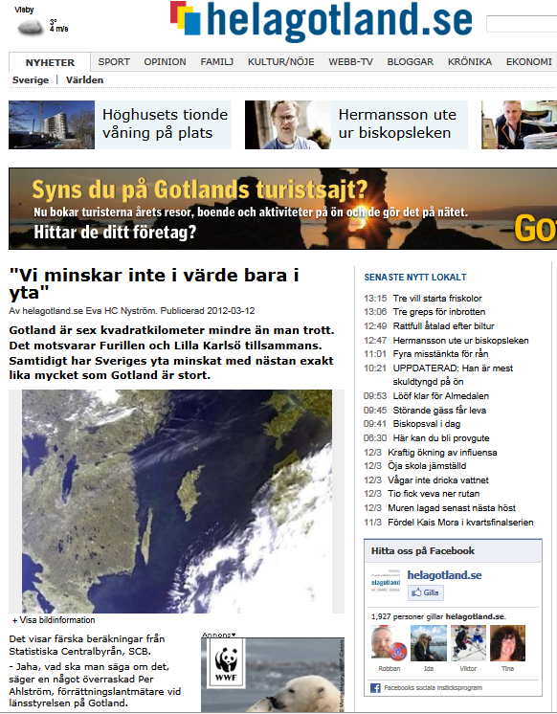
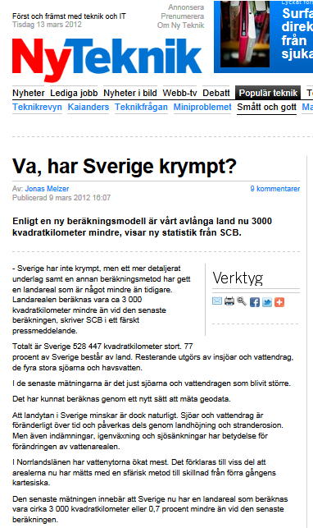
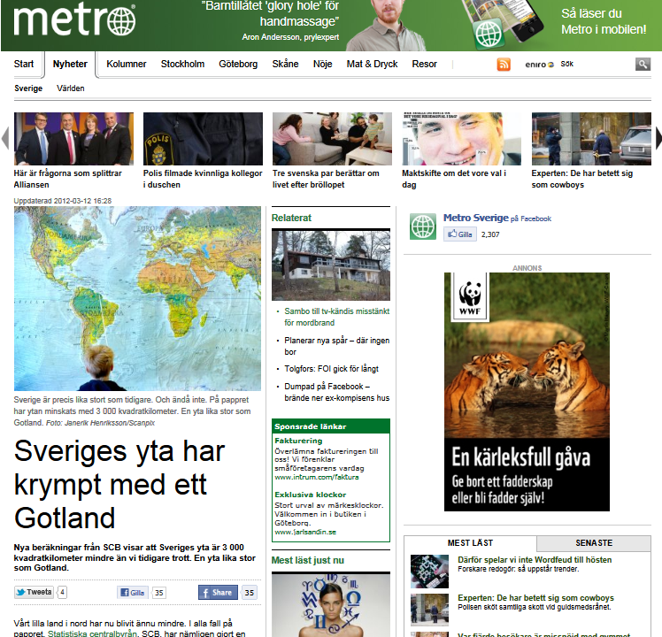

Slide 11
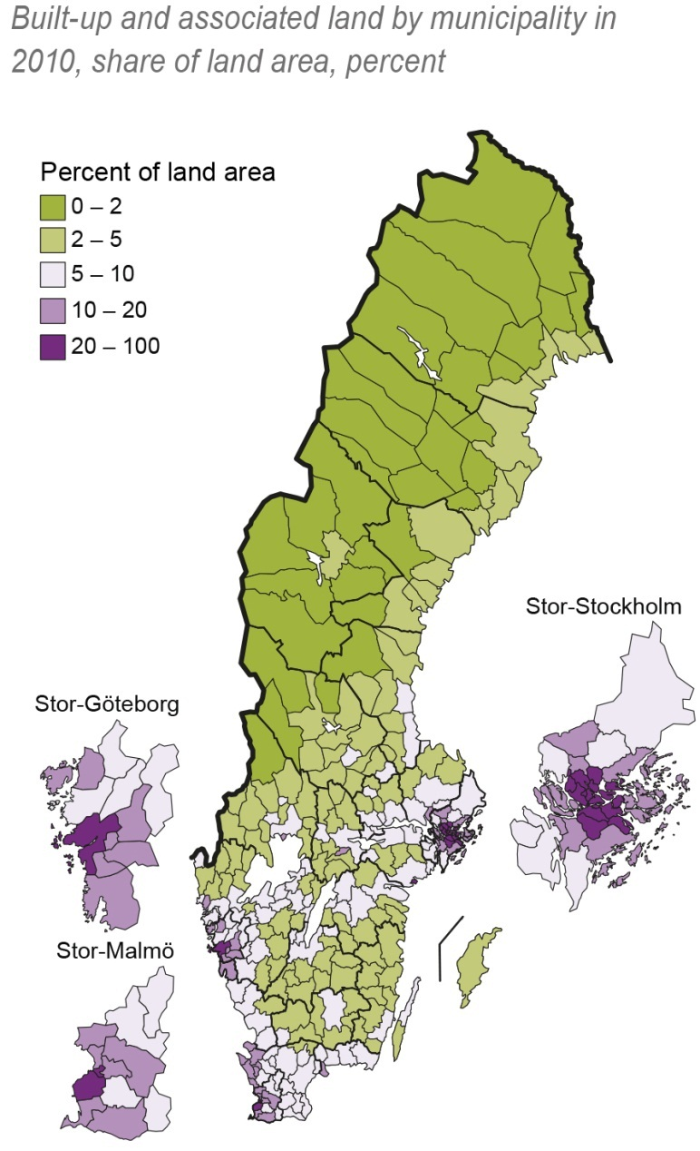
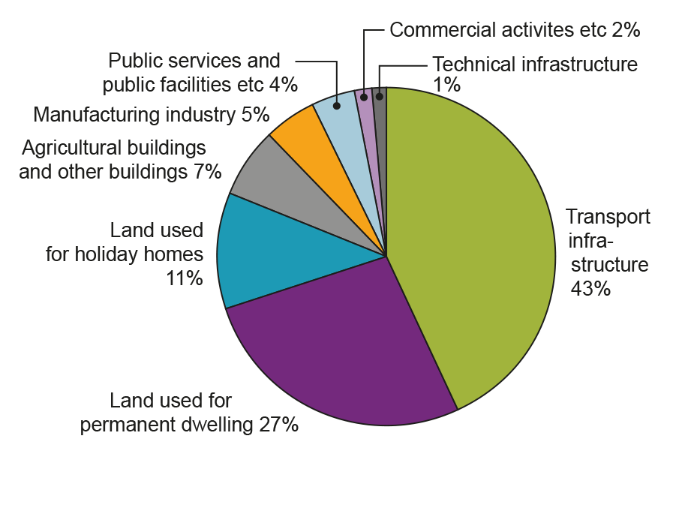
Built-up land
Part of the product ”Land Use in Sweden”
8 categories of built-up land
Some categories reduced due to better methodology

Slide 12
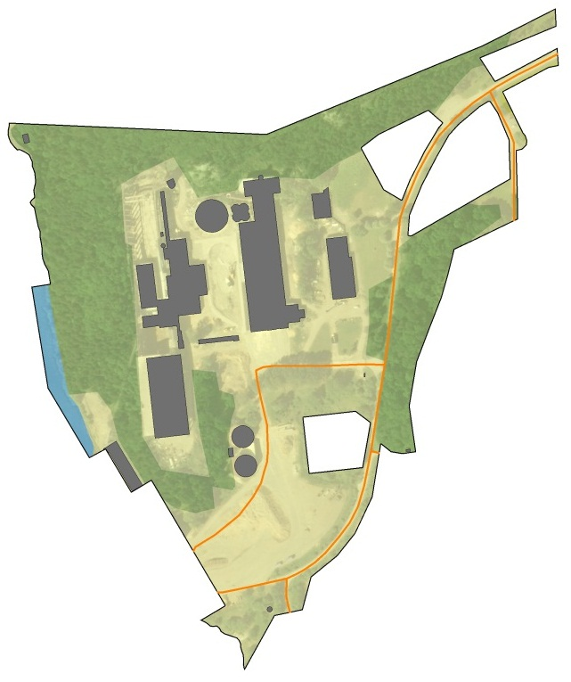
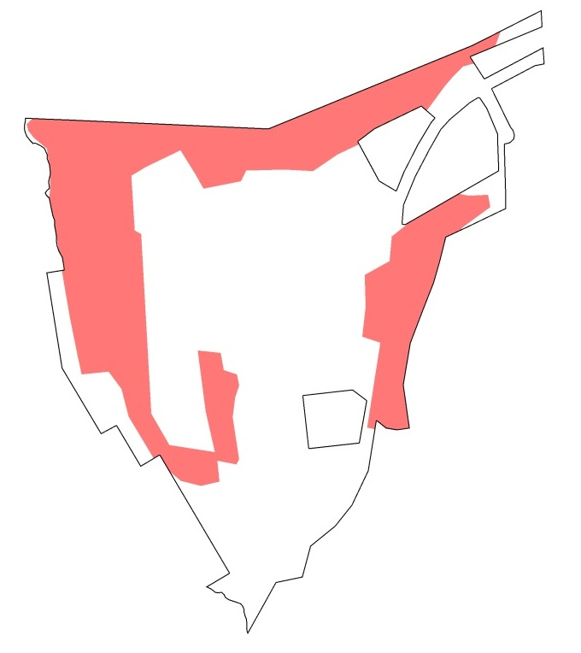
Before 2011
After 2011
Type: Industry
Owner: Company
Land area: 200.000 m²
Built-up land: 200.000 m²?
Type: Industry
Owner: Company
Land area: 200.000 m²
Built-up land:
200.000 m² – 78.000 m²=
122.000 m²
Register data
Improved figure: 122.000 m²
X, Y Coordinates
Geospatial data
Land area: 200.000 m² - Forested area: 78 000 m²

Slide 13
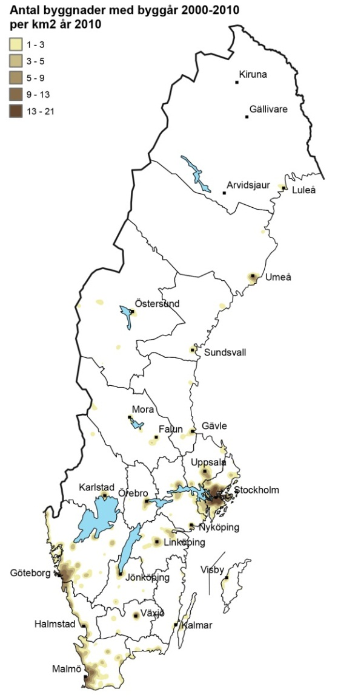
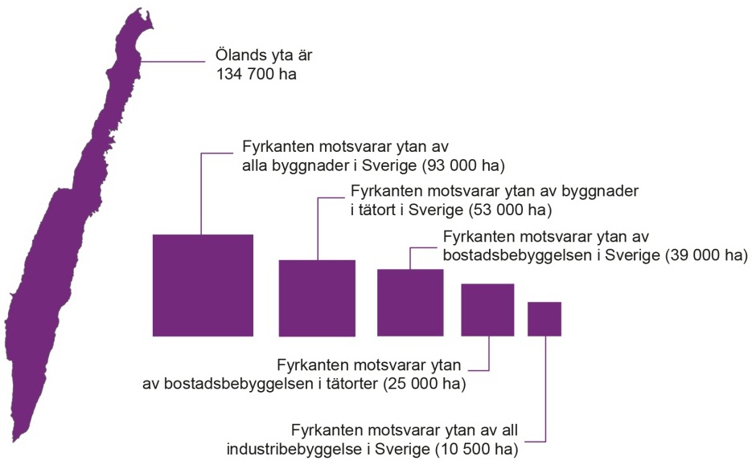
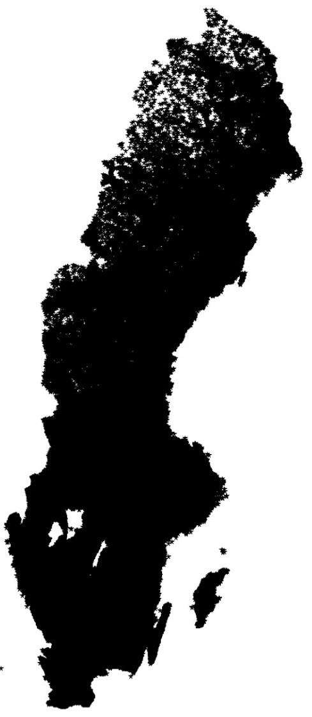
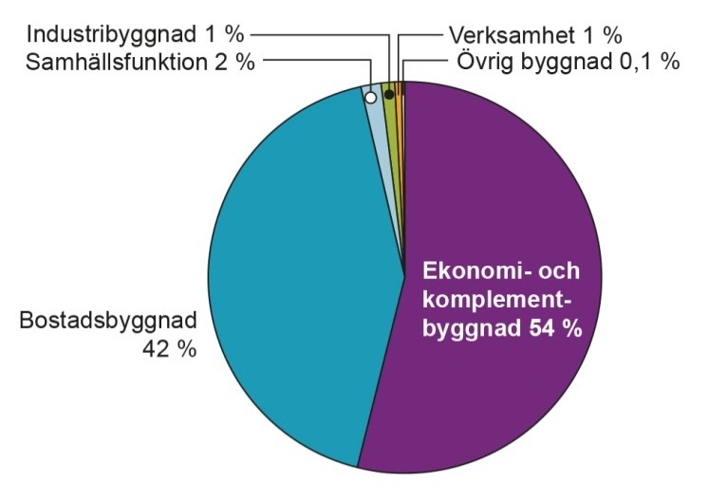
Building footprints
7.2 million buildings

Slide 14
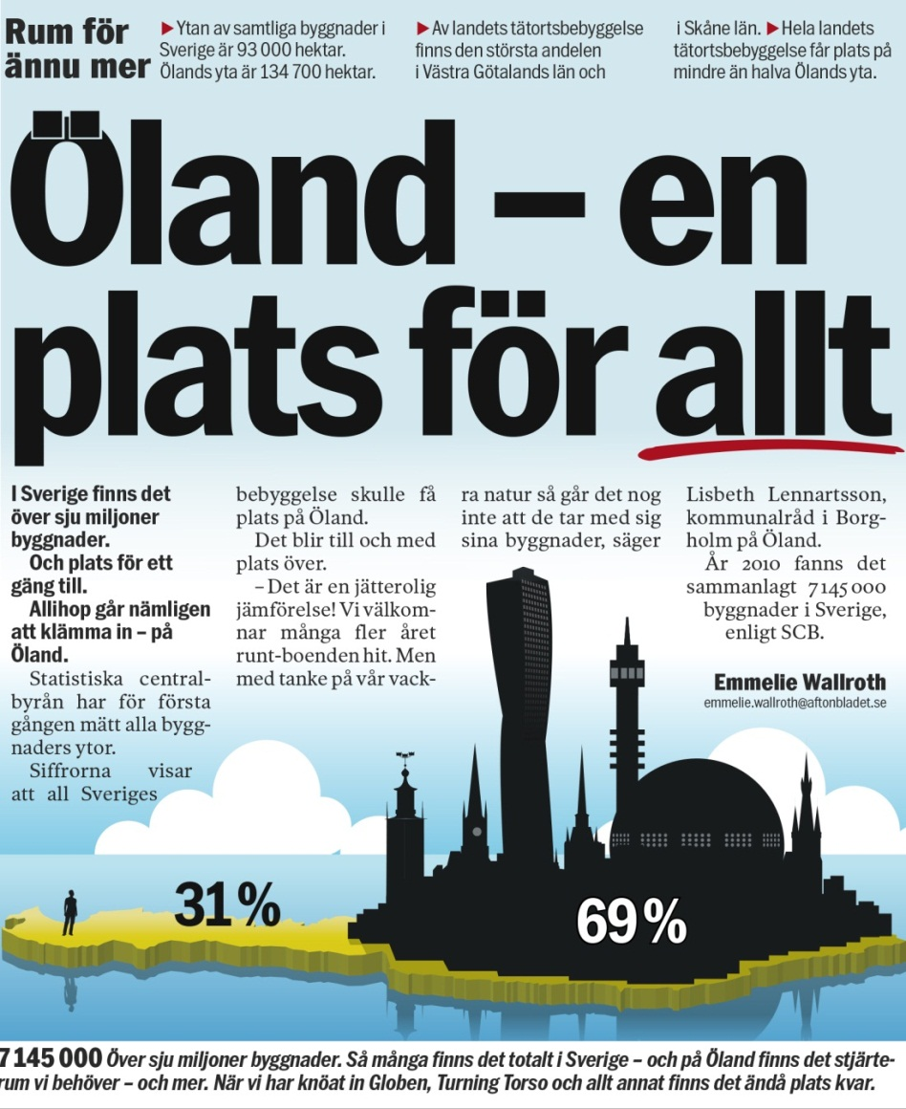
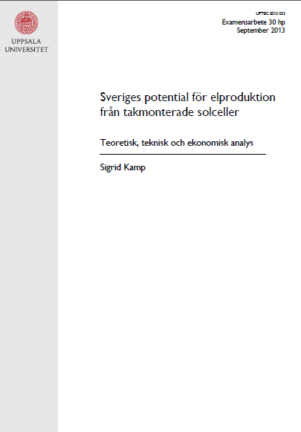
Masters Thesis:
Potential for energy production
from roof mounted solar panels

Slide 15
Some challenges
The more geospatial information used from external producers – the harder to control data (quality, accuracy, coverage, definitions etc)
Metadata for ”map products” – usually not fulfil requirements for statistics production
Close dialogue with producers important. Get to know them and their data!
Technical infrastructure – Geospatial activities more demanding than standard plattforms for statistics (hardware, software, storage etc).

Slide 16
Thank you for your attention!
jerker.mostrom@scb.se

