Slide 1
Metadata in the modernization of statistical production at Statistics Canada
Carmen Greenough
June 2, 2014

Slide 2
Introduction
Metadata modernization
Statistical metadata systems
Service oriented approach to metadata integration
Conclusion

Slide 3
Metadata modernization
Corporate metadata strategy
Generic Statistical Information Model (GSIM)
currently used as a conceptual model for classifications;
used as reference model and common vocabulary
Metadata-driven processes
Generic Statistical Business Process Model (GSBPM)
Notes:
Agency-wide initiative: This strategy provides direction for statistical metadata management. It supports the development of a coherent and consistent set of supporting frameworks, standards, services, processes, solutions and other mechanisms for the production, management and maintenance of statistical metadata.
GSIM: The Generic Statistical Information Model (GSIM) is an internationally recognized framework that defines and describes the information associated with the statistical business process. It provides standard names, definitions and other attributes for these information objects. It can be used as a reference model and common vocabulary for all the information related to processes described in the Generic Statistical Business Process Model (GSBPM).
The Statistical Classification object of GSIM is being used as a conceptual common model for classification exchange among corporate metadatabases and is resulting in coherence in how the statistical classifications are structured and managed within the Agency.
Introducing a service oriented approach to metadata integration ensures the reusability by reducing the number of decentralized and specialized systems and processes.
Metadata-driven: All phases of the statistical business process fully integrate and incorporate the creation and use of standardized statistical metadata. Statistical metadata, from survey specification, sample design and edits to products and services, must be captured, managed and used to drive the entire statistical process.

Slide 4
Metadata modernization (cont’d)
Maximize reuse of existing corporate systems
enhancing existing metadata management structures and databases
Enforcing reuse of concepts and classifications
central repository
Notes:
Reuse of systems: Statistics Canada is implementing a service approach based on our Corporate Business Architecture (CBA) principles. One of the goals of these principles is to foster interoperability and reuse by reducing the numbers of decentralized and specialized systems and processes
Reuse of concepts and classifications:

Slide 5
Metadata modernization (cont’d)
Metadata architecture modernization project
Purpose:
- to improve the design, creation, use maintenance of statistical metadata within Statistics Canada;
Filling policy gaps:
- creating a new Policy on statistical metadata management
- revise the Policy on Standards
- revise the Policy on informing users of data quality and methodology
Redesign the corporate metadata repository
Notes:
Policy gaps:
New Policy objectives: design, create, use and manage statistical metadata consistently and coherently across the surveys and statistical programs; and increase the use of statistical metadata to drive and support all phases of the statistical business process.
The two policies are expected to be merged into one to reflect the need for coherence from the creation to the dissemination of metadata. Evolution in metadata management has also shown the need for greater direction and rules in the efficient management of metadata. The ‘how’ I can include in my presentation.
A study is currently under way to identify the various needs for metadata within the Agency. This results of this study will identify how the corporate metadata repository can be enhanced to accommodate new requirements.

Slide 6
Corporate systems
Integrated Metadatabase (IMDB)
Documentation for all surveys and statistical programs
Referential metadata
Statistical variables and classifications
Questionnaires
Standard Concepts and definitions
use of standard names and definitions for populations, statistical units, concepts, variables and classifications in statistical programs
Standard classification systems
Notes:
Documentation for 350 active and just as many inactive surveys; This documentation is meant to describe how subject-matter Divisions have applied the Statistics Canada’s Quality Assurance Framework throughout the survey process. The types of metadata to be documented in the IMDB are mandated by the Policy on informing users on data quality and methodology.
Standard concepts and definitions as mandated by the Policy on standards. A framework has been developed to provide a way of organizing all the statistical units, variables and related classifications disseminated in the Agency that allows it to improve the coherence of the definitions of variables and use of classifications across subject matter areas.
The IMDB is the repository for Standard classification systems such as : NAICS, NOC,

Slide 7
Corporate systems (Cont’d)
Integrated metadatabase (IMDB) cont’d
Structure of the IMDB - based on ISO 11179 Metadata registries and Central metadata repository model (CMR)
History: information objects are versioned for each cycle
Each object has administrative layer
Notes:
The procedural metadata includes documentation that support the following Phases of the Generic Statistical Business Process Model (GSBPM): 1. Specify needs; 2. Design; 3. Build; 6. Analyse; 7. Disseminate;
All metadata are structured the same way across all surveys and statistical programs. This allows for reusability and sharing of the metadata across surveys.
Historical development. Each time any of the objects are versioned, the differences between versions is captured as notes. These notes are compiled to provide a list of the historical developments of the statistical programs.
Admin layer: that documents the source (organization responsible) and allows for registration of each object individually.

Slide 8
Corporate metadata systems
Integrated metadatabase (IMDB) – cont’d
Access survey metadata, classifications and variables
Definitions, data sources and methods
http://www.statcan.gc.ca/concepts/index-eng.htm?MM
Notes:
External users have several entry points to access the metadata from the IMDB. The Definitions, data sources and methods web module on the Statistics Canada web site provides access to web pages for each of the active and inactive surveys (see Figure A.3). Each page contains the procedural metadata, links to definitional metadata as well as access to data tables and other related publications and announcements.
Also included on this web module are standard definitions for variables, statistical units an http://www.statcan.gc.ca/concepts/index-eng.htm?

Slide 9
Corporate metadata systems (cont’d)
Integrated Business Statistics Program (IBSP)
generalized model for producing business statistics
Common Tools – Questionnaire design tool (QDT)
generalized tools and systems for producing social statistics
Notes:
IBSP: includes approximately 250 surveys and administrative-based programs. IBSP make use of and share generic corporate services and systems for collecting, processing, disseminating and storing statistical information.
The IBSP extract standard classifications from the IMDB with the use of a web service; these classifications include North American Industry Classification System (NAICS); and Standards Geography Classification (SGC).
The IBSP also uses web services to load questionnaire content into the IMDB;
Common tools: consists of generalized tools and systems in view of harmonizing the business processes used across social surveys;
One of the tools – QDT uses web services to load questionnaire content into the IMDB.

Slide 10
Corporate metadata systems (cont’d)
New Dissemination Model (NDM)
modernize current methods and framework for coherent dissemination of data to the public;
organization of the Agency’s holdings
better discovery
enhance navigation
Notes:
NDM - current initiative to revise the organization of the Agency's data holdings to enable better discovery and enhanced navigation through the Statistics Canada web site, which is the Agency's primary dissemination vehicle.
Simplified product line; one common output database
The NDM will include links to the classifications using web services; links to the concepts, variables and definitions in the IMDB from the data tables.

Slide 11
Corporate metadata systems (cont’d)
Common output data repository (CODR)
Links to concepts and definitions in IMDB
Links to Classifications in the IMDB
Statistics by variable
Ability to browse through products crosswalk
Notes:
When data tables are created, subject-matter will have the capability to establish linkages from the data to a) the variables and definitions and b) classifications, all contained in the IMDB.
Statistics by variable – users will be able to navigate through the web site using variables and entry point. Navigation results will include the data tables in which the variable is found, the metadata for all the surveys that disseminate the variable, as well as other related products.

Slide 12
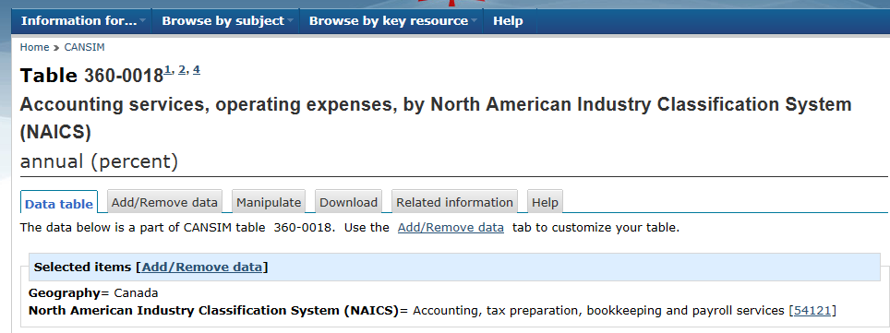
Corporate metadata systems (cont’d)
Notes:
When data tables are created, subject-matter will have the capability to establish linkages from the data to a) the variables and definitions and b) classifications, all contained in the IMDB.
Statistics by variable – users will be able to navigate through the web site using variables and entry point. Navigation results will include the data tables in which the variable is found, the metadata for all the surveys that disseminate the variable, as well as other related products.

Slide 13
Web services
Service oriented approach to metadata integration
Integrating metadata repositories via services
Classification exchange service
Survey and questionnaire metadata exchange services

Slide 14
Conclusion
Metadata driven
Maximize re-use
Reuse of concepts and classifications
Governance
Notes:
Metadata-driven:
Statistical metadata is integral to the statistical business process and drives the process.
1: Statistical business processes use statistical metadata to efficiently generate business outputs: Emphasis is put on the role of statistical metadata which is to support and enable the statistical business process. Priority is given on making key business processes metadata-driven, and focused on the use of standardized statistical metadata to achieve this result.
Goal 2: All phases of the statistical business process fully integrate and incorporate the creation and use of standardized statistical metadata. To enable metadata driven processes and systems, statistical metadata must be created and used as part of these processes, and be embedded in these processes. This can be achieved through the following measures:
1. Create the needed statistical metadata at the appropriate point in the statistical business process, and keep it up to date
2. Generate statistical metadata automatically where appropriate (e.g., to increase efficiency, to increase accuracy); and
3. Establish mechanisms for exchanging the metadata
These measures will lead to more effective and efficient business processes, as well as the increased accuracy of the statistical metadata created and used.
Maximize reuse: An overarching information architecture facilitates sharing, use and re-use of statistical metadata across and throughout the phases of the statistical business process.
An enterprise information architecture establishes the uniform and consistent standards and guidelines that will enable the organization to share and exchange enterprise information.
This includes:
- adopting a framework so that there is a common vocabulary and a common understanding of concepts and the relationships between statistical metadata and other information
- determining the authoritative source of statistical metadata so that that complete and correct information can be used across the organization rather than relying on copies that may or may not be consistent with the authoritative source
- corporately managing the design of statistical metadata so that the needs of all stakeholders are taken into account when metadata is being developed or changed. The degree of coordination required will depend on factors such as the extent to which the statistical metadata is used across processes or systems, the importance of the statistical metadata to the organization (e.g., information of business value or enduring value).
- leveraging work already done by using existing standards and specifications to design and create statistical metadata structures and content wherever possible.
Reuse of concepts and classifications across surveys and statistical programs.

