Slide 1
How to maintain high quality in times of diminishing resources
Anette Hertz, Head of section, Statistics Denmark (ahz@dst.dk)
Karin Blix, Chief adviser, Statistics Denmark (kwb@dst.dk)

Slide 2
Quality management function
Drafted a Quality Policy for the division of External Economy
Focus is on fulfilling our users needs
The Quality Policy consists of 10 principles

Slide 4
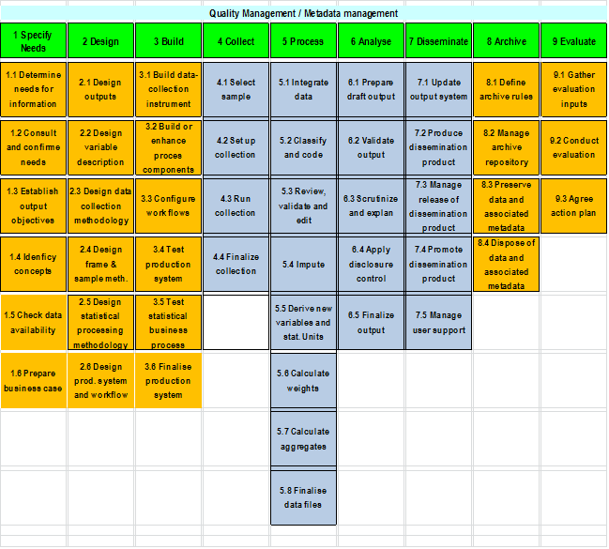
GSBPM – as a frame

Slide 5
GSBPM – as a frame continued
Who is responsible for this process
When is this process running
How do we ensure that the input data are the data needed – how are the data updated?
How do we update changes in rules e.g. EU regulations
What starts/initiates the process
What is the process – which value does the process give?
What comes out of the process – what is done to ensure that this process has been “successful”?

Slide 6
International trade in goods statistics – the big picture
Approximately 35.000 Danish companies report to ITGS (Intrastat account for around 8.000)
On nearly 9.400 different commodity codes
This trade is distributed across 250 countries
The result is nearly 36 million transactions reported each year

Slide 7
Error detection
Resources and amount of incoming data
In 2007 we implemented a score based model
Based on standard unit values the records are given a score, this is influences by how suspicious the record is and what impact the record has on the published figures
Less than 1% of the highest scored records are sent out for validation

Slide 8
The importance of unit values
Standard unit values are at the base for contacting companies to validate
The more accurate the standard unit values are the more likely it is that it is the right probable errors our system detects
Since we validate less than 1% it is important that find the right probable errors
Unfortunately the accuracy of the model has decreased over the years because the unit values gradually has become distorted

Slide 9
What to do?
We have implemented several supplementary measures to improve the standard unit values
The standard unit values must be continually validated
Quality management function has secured
- that responsibility for validation of the standard unit values is assigned
- that the hit rate is continually monitored

