Slide 1
Bringing DESAP self-assessments back into use
Mirko Herzner
Federal Statistical Office, Germany

Slide 2
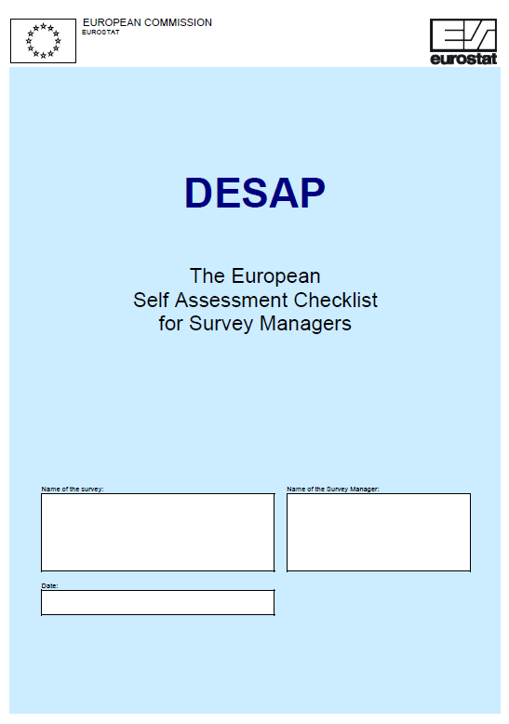
DESAP self-assessments
Self-assessments are an essential part of important quality management systems
DESAP = Checklist for the systematic quality assessment of statistics
Quality criteria of the ESS
Process-oriented
Developed in 2002/03 for statistics that are compiled based on micro data
All important ways of data collection are covered (paper questionnaire, online surveys and the use of administrative data)

Slide 3
Pilot project in Germany
DESAP tested for three surveys
Joint workshops of the FSO and State Statistical Offices
Two-step evaluation
DESAP positively assessed for systematic evaluation of quality, but
Not all relevant aspects covered
Very time consuming

Slide 4
Expansion of assessment questions
Additional question dealing with overall accuracy to include also relevant aspects that are not explicitly covered in the other assessment questions (e.g. accuracy implications of using a cut-off threshold)
Original questionnaire: 15 assessment questions partly referring to
Product quality
Process indicators (e.g. overcoverage)
Integration of six new questions ensuring an output-focused assessment of each of the 15 quality aspects

Slide 5
Example of an assessment question (I)
II/19 Does the frame contain units that do not belong to the target population (overcoverage)? It is recommended to also consider the quality indicator “Overcoverage – rate” when answering the question.
1 – Major overcoverage/Not known
2 – Considerable overcoverage
3 – Some overcoverage
4 – Slight overcoverage
5 – (Nearly) no overcoverage

Slide 6
Example of an assessment question (II)
II/25 How do you appraise the bias caused by overcoverage (see question II/19) in the published results (that is after conducting quality assurance measures)?
1 – Major bias/Not known
2 – Considerable bias
3 – Some bias
4 – Slight bias
5 – (Nearly) no bias

Slide 7
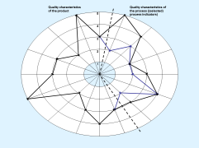
Assessment diagram (original)

Slide 8
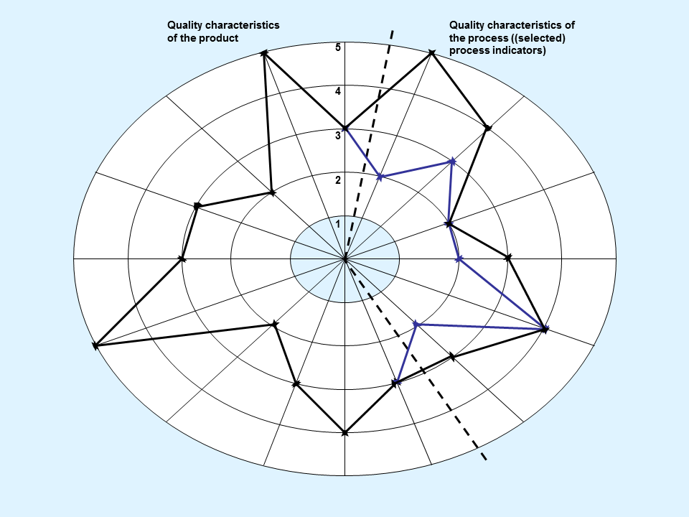
Assessment diagram (advanced)

Slide 9
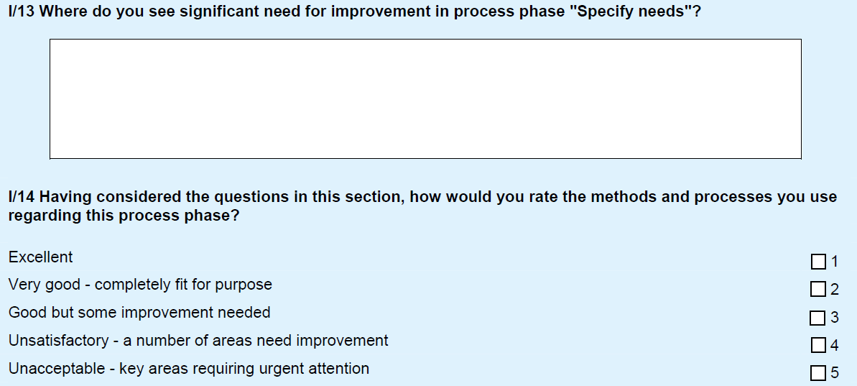
Summary questions for each chapter
Addition of two general questions with identical wording for recording improvement ideas and as a summary assessment per chapter:

Slide 10
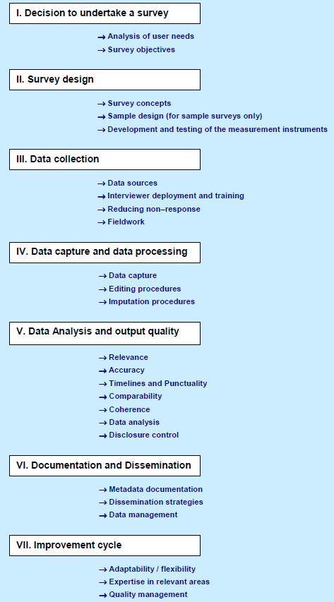
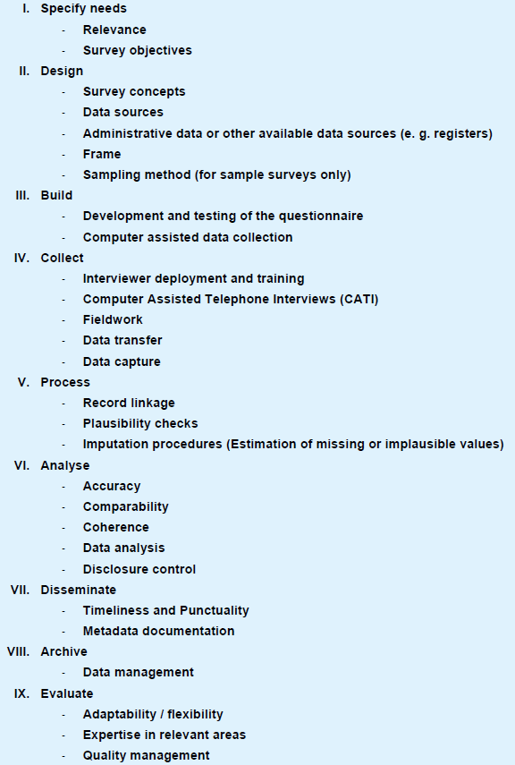
Conversion to GSBPM 4.0

Slide 11
Use of DESAP in Germany
Workshops involving
at least Land Statistical Office of the sponsor state + Destatis for decentralised surveys (participation of three additional Land Statistical Offices recommended)
team consisting of 3-5 people for centralised surveys
Independent conduct of self-assessments
Support by quality managers on demand

Slide 12
Deployment based on pre-defined occasions
Before/after fundamental redevelopment or revision (reprogramming) of production systems *
Request by high-level board *
Before Compliance Visits without specific questionnaire
Before/after substantial employee turnover
On the initiative of the statistics‘ expert meeting
* Mandatory self-assessment

Slide 13
Outlook and further development
Current version of the questionnaire not to be considered final
Further improvements of the questionnaire based on the findings from actual statistical practice
GSBPM 5.0
DESAP might be a valuable starting point also for quality audits
Combining self-assessments and other more objective instruments like quality indicators?

Slide 14
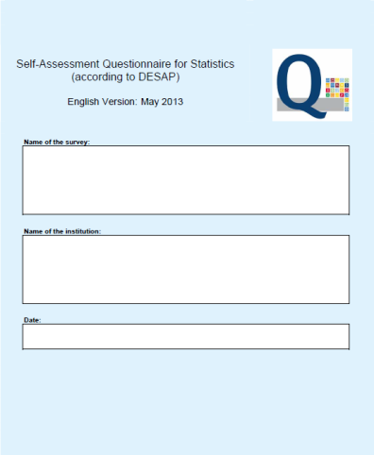
Many thanks for your attention!
Mirko Herzner
Federal Statistical Office Germany, Wiesbaden
Notes:
I thank you for your attention. The floor is open for your questions.

