Slide 1
The ESS.VIP Validation and its implementation in waste statistics
Q2014 – Session 13
4 June 2014
Hartmut Schrör, Eurostat

Slide 2
ESS.VIP Validation
ESS Vision Implementing Project on Common Data Validation Policy
Why?
Lack of co-ordination in validation
Lack of a common validation language
Variety of validation tools
Potential for efficiency gains for Member States and Eurostat

Slide 3
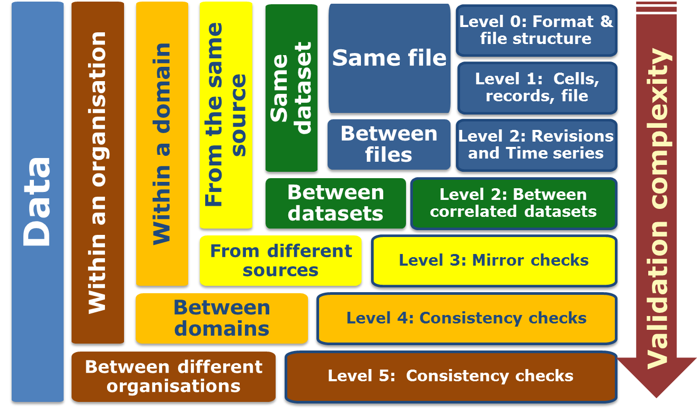
Validation levels

Slide 4
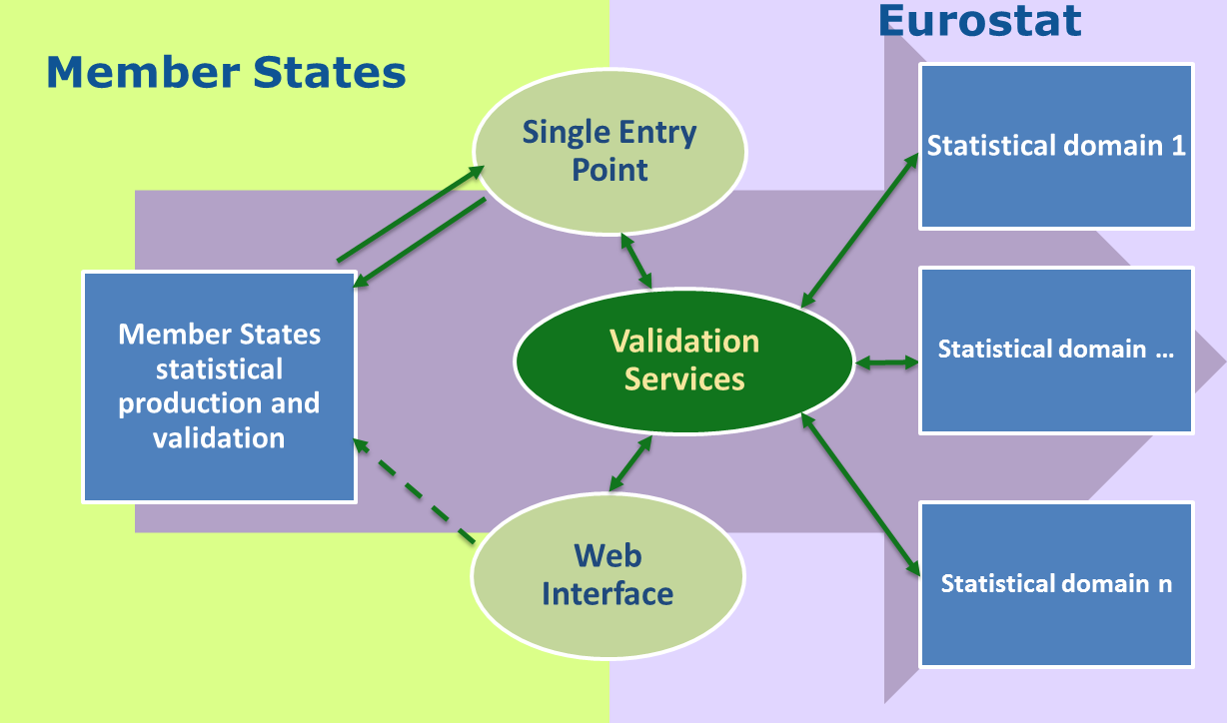
Shared validation system

Slide 5
Validation Syntax - VALS
Example
Description: Validates that the value in the field Country_of_origin is present in the Codelist (dictionary) CL_COUNTRY
validate(match_codelist(INTRASTAT.Country_of_origin, CL_COUNTRY))

Slide 6
ESS.VIP Validation - principles
Horizontal integration (across statistical domains)
Common language for validation rules
Common tools for validation
Vertical integration (along the production chain)
Member States and Eurostat sharing validation rules
Distribution of responsibilities (who, what, when)
"Validation, the sooner the better"

Slide 7
Waste Statistics
waste generation (tonnes)
by source:18 NACE activities + households
by material: 51 waste items
waste management / treatment (tonnes)
by treatment: 5 operations
by material: 51 waste items
waste management facilities (numbers, capacity)
by treatment: 5 operations
by NUTS 2 region

Slide 8
Vertical integration in waste statistics
survey of existing validation procedures in MS
tentative set of standard validation rules
discussion in detail (workshop 9/2013)
stocktaking, usefulness of validation rules
assignment of validation rules to MS / Eurostat
documentation of standard validation rules and their assignment
first application of standard set in 2014 data collection
documentation of results in quality reports

Slide 9
Criteria for standard rules in MS
relevant and applicable in all countries
limited to national level
comparison across countries is Eurostat's task
no use of reference variables
population, employees, value added, etc.
more efficient at Eurostat
no checks of the file formats
use of EDAMIS web forms

Slide 10
Validation in Member States
time series checks
Development of waste generation, treatment
ratio of generation and treatment
implausible waste treatment operations
e.g. incineration of mineral waste
amounts of waste treated vs. treatment capacities

Slide 11
Conclusions
early benefits from vertical integration
systematic reflection / discussion of validation along the production chain
clear assignment of responsibilities
systematic documentation of validation rules and results
future benefits from horizontal integration
standardising the validation rules using VALS
using common tools (shared validation system)
=> saving time and resources both in Member States and at Eurostat

