Slide 1
Quality and aggregation issues in GDP and beyond: insights from the OECD Better Life Initiative
Romina Boarini,
Head of Monitoring Well-Being and Progress
OECD Statistics Directorate

Slide 2
The OECD work on well-being: rationale
Developing better measures of well-being and progress to overcome some of the shortcomings of the GDP
Well-being and progress are high on the statistical and policy agendas of many countries of the world; interest from a variety of stakeholders (academia, NSOs, governments, parliaments, civil society)
Well-being progressively mainstreamed into Post 2015 MDGs and SDGs discussions
Notes:
Shortcomings of GDP include: it ignores non-market components of well-being; includes negative externalities from production; ignores distribution; does not account for depletion of various assets
2

Slide 3
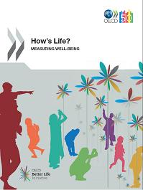
The OECD Better Life Initiative
Your Better Life Index
How’ Life?
Measures, analysis and future statistical agenda on what matters most in people’s life
OECD@50 : Better Policies for Better Lives

Slide 4
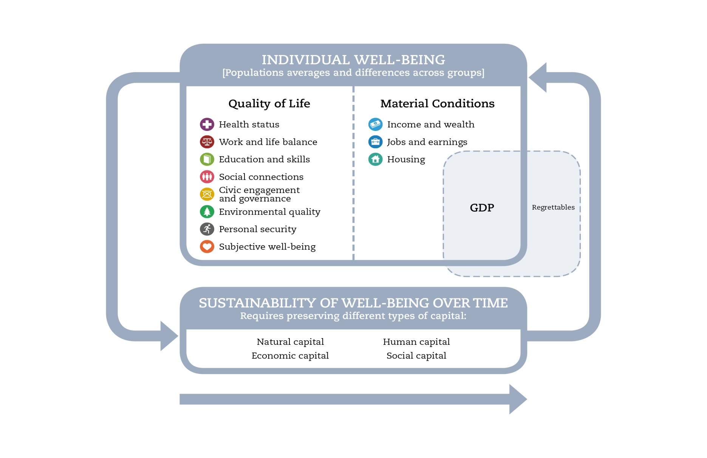
The OECD well-being framework
TODAY
TOMORROW
Notes:
4

Slide 5
Four key features
The OECD well-being framework focuses on:
People rather than the economic system
Outcomes rather than outputs and inputs
Both averages and inequalities
Both objective and subjective aspects

Slide 6
Measurement approach (1)
CHOOSING INDICATORS:
Relevance of indicators
- face-validity: outcome indicators
easily understood, unambiguous interpretation
amenable to policy changes
possibility of disaggregation by population groups
Quality of supporting data
- official and well-established sources; non-official data used as place-holders in a few cases
- comparable/standardized definitions
- maximum country-coverage
recurrent data collection

Slide 7
Measurement Approach (2)
Dashboard with 25 headline indicators and 33 secondary indicators
Not a synthetic index as:
No comparable individual-level information from the same survey for all OECD countries
No first best for setting weights: various works experimenting objective and subjective weights
The OECD should not set weights normatively

Slide 8
Process
First selection by the OECD Secretariat (Statistics Directorate and thematic Directorates: Health, Labour, Education, Environment and Governance)
Consultation with the OECD Committee of Statistics (OECD NSOs+ ISOs) in 2011
Yearly iteration within OECD and with the Committee to make marginal changes to headlines
Indicators improved as better data/metrics become available (the “How’s Life? statistical agenda, e.g. OECD Guidelines of SWB)

Slide 9
Offical and non-official statistics in the Better Life Initiative
Only 4 out of the 25 headline indicators of How’s Life? are from non-official instruments (the Gallup World Poll)
About 1/3 of secondary indicators are based on non-official data
They’re considered “place-holders”
How’s Life? 2015 may replace SWB data from the GWP with data from the official statistics

Slide 10
What about medium/long-term?
Improvements in non-official statistics very slow, particularly those disconnected from the official statistical agenda
Solutions imply:
NSOs to put in place an integrated comprehensive well-being survey, harmonised at international level
ESS to further invest in its non-official surveys, e.g. provide sampling frames, finance larger sample size, harmonise definitions and conventions

Slide 11
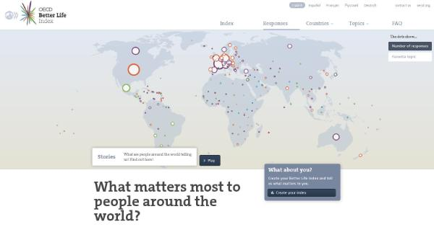
Another example of use of non-official statistics on “beyond GDP”: the Better Life Index
The BLI allows users to express their views on well-being
We just released a dataset with users’ responses (around 60,000)

Slide 12
By reweighing BLI responses, we observe that:
For women a better life means more of:
Community
Health
Work-Life Balance
Civic engagement
Education
For men a better life means more of:
Income
Youth worry about a good start in life but also about being happy and connected
Elderly feel more vulnerable but are also more engaged with society issues

Slide 13
Getting addicted to better lives
People satisfied with their well-being outcomes are also those who value the most these outcomes: this relationship holds for community jobs, education, engagement, health and work-life balance
A notable exception is income: those who value most income are individuals that are the least satisfied with their personal income situation
People living in countries with the highest well-being achievements are also those who value most those achievements
Again income is the notable exception to this rule: people living in higher-income countries tend to rate income as less important
Notes:
New Zealand has one of the lowest level of air pollution and one of the highest level of satisfaction with water quality and Kiwis rate environment as one of their top priority
Denmark and Sweden have the better work-life balance; Danish and Swedes rate work-life balance as a top priority
Canada performs has one of the longest life expectancy and the highest self-reported health status; Canadians give lot of importance to health
United States is the richest OECD country, yet Americans do not consider income as one of their top priority

Slide 14
To aggregate or not to aggregate?
Aggregation is challenging because:
It requires many (possibly ad hoc) assumptions
May imply a loss of information
Dashboards may be challenging too:
Hard to read/understand
Miss the “big picture”, including joint correlation of outcomes
Some special types of synthetic indices may help confront the dashboard versus index dilemma

Slide 15
Different tools for different needs: the example of the Better Life Initiative
How’s Life? dashboard: monitor single components of well-being, particularly useful from a policy perspective
Better Life Index: composite index with weights set by users – advocacy tool
Multidimensional Living Standard Indicator: composite index (theory-based) that helps understanding policy synergies and trade-offs

Slide 16
How to improve on “Beyond GDP” reporting?
A toolkit may help responding to different users and needs
The creation of an integrated harmonised survey would help here as well, to enhance the quality of the synthetic picture

Slide 17
THANK YOU!
romina.boarini@oecd.org
www.oecd.org/measuringprogress
www.oecdbetterlifeindex.org

