Slide 1
On the use of data mining for imputation
Pilar Rey del Castillo, EUROSTAT

Slide 2
Outline
Imputations to solve non-response in surveys; new problems for mass imputations
State of the art: model-based imputations => MI
Introduce data mining methods (for continuous data)
Compare results in a simulation exercise following different criteria
Raise questions on mass imputation (should data mining methods be considered?)
Eurostat

Slide 3
Imputations to solve non-response
Replace each missing-value with an estimate
Current problems in sample surveys
Small area estimation-> provide values for non-sampled units
Statistical matching-> provide joint statistical information based on 2 or more sources
A complete data set providing a basis for consistent analysis?...
Mass imputation as possible solution
Model-based procedures making inferences based on the posterior distribution ⇒ Multiple Imputation (MI) (suited for computing variances)
Eurostat

Slide 4
Multiple Imputation
Imputation
Analysis
Combination
Incomplete
data
Imputed
data
Combined
statistic
Statistics
Eurostat

Slide 5
Simulation exercise
EU-SILC 2009: microdata on income, poverty, social exclusion and living conditions (Spain, Austria)
Wages numerical variable to be imputed; Covariates (15) gender, age, country of birth, marital status, region, degree urbanisation of residential area, economic activity, highest level education, managerial position, occupation, temporary job, part-time job, hours usually worked per week, years education & years in main job
Methods to be compared:
Least Median Squared Error Regressor (LMS)
M5P algorithm (M5P)
Multilayer Perceptron Regressor (MLP)
Radial Basis Function (RBF)
Regression (REG)
Predictive Mean Matching (PMM)
Eurostat

Slide 6
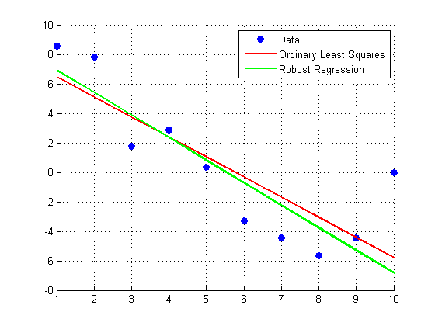
Least Median Squared Error Regressor (LMS)
Outliers affect classical LS linear regression: squared distance accentuates influence of points far away from regression line
More robust: minimise median of squares of differences from regression line
Standard linear regression, solution with smallest median-squared errors
Eurostat

Slide 7
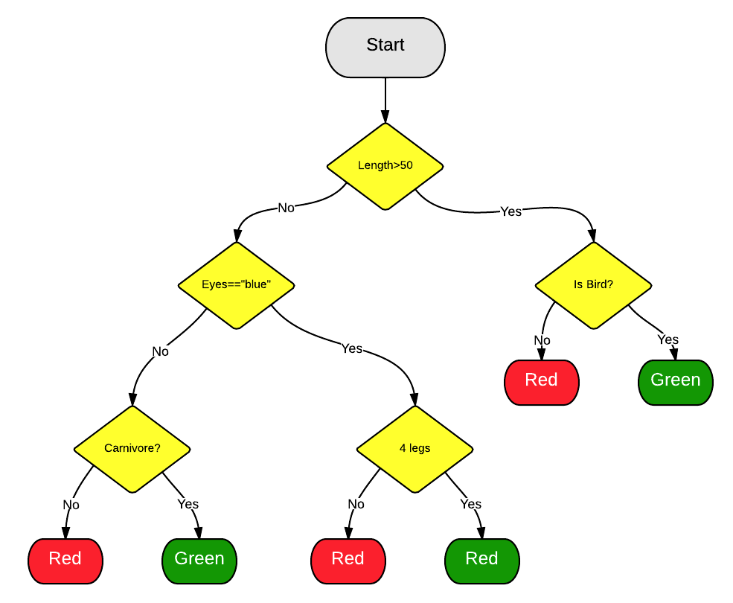
M5P algorithm (M5P)
Decision tree: supervised classifier with uses a tree-like graph or model of decisions and their possible consequences (decision nodes, leaves…)
Model tree: for continuous variables, with a linear regression model at each leaf
Reconstruction of Quinlan's algorithms
Eurostat

Slide 8
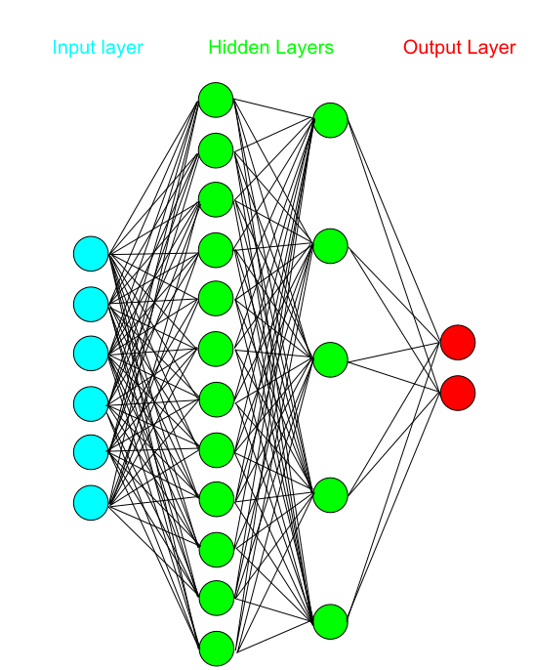
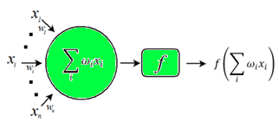
Multilayer Perceptron Regressor (MLP)
Neural networks based on structure of the brain; learning by adjusting connections
MLP
Feed forward network
1 hidden layer
Delta rule as learning algorithm
Δ w_{ij} = -η δE(w_{ij} )/ δw_{ij}
Logistic function as transfer function
f(x) = 1/(1+e^{-x} )
Output layer: 1 node with linear activation
Eurostat

Slide 9
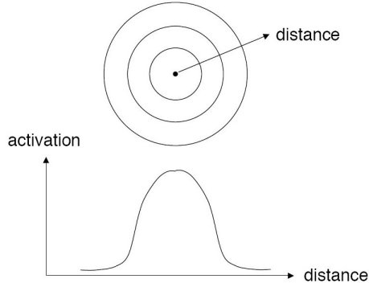
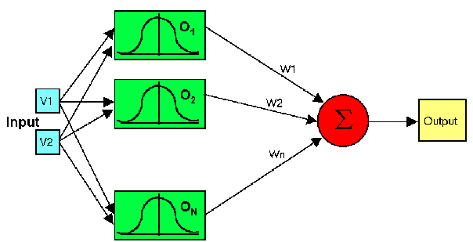
Radial Basis Function (RBF)
Neural network similar to MLP
Differing in way hidden layer performs computations
Activation for an input depends on distance to hidden unit
Parameters to be learnt weights + centres
Eurostat

Slide 10
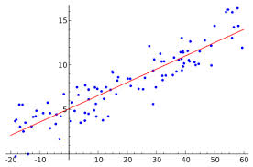
Regression (REG)
Regression forecast for each input of covariate variables from regression estimated using training set
Categorical treated by constructing appropriate dummy variables for each category
Baseline for comparisons
Eurostat

Slide 11
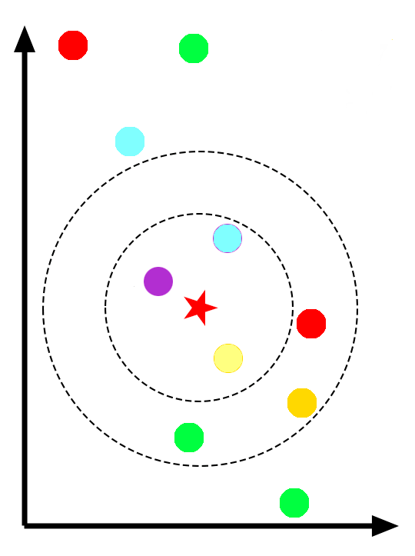
Predictive Mean Matching (PMM)
Similar to regression
For each missing imputes a value randomly chosen from the set of observed values having the closest predicted value to the forecast obtained by the regression model
Identified as providing best imputations
Eurostat

Slide 12
Data mining evaluation criteria
Correlation coefficient
Mean Absolute Error
Root Mean Squared Error
Relative Absolute Error
Root Relative Squared Error
Eurostat

Slide 13
COUNTRY | METHOD | Correlation | MAE | RMSE | RAE | RRSE
ES | LMS | 0.74 | 435.8 | 708.3 | 59.1 | 68.0
ES | M5P | 0.75 | 431.3 | 694.5 | 58.4 | 66.7
ES | MLP | 0.73 | 449.6 | 718.8 | 60.9 | 69.0
ES | PMM | 0.55 | 634.8 | 982.5 | 86.0 | 94.3
ES | RBF | 0.75 | 430.0 | 696.2 | 58.3 | 66.8
ES | REG | 0.73 | 443.8 | 716.9 | 60.1 | 68.8
AT | LMS | 0.53 | 648.5 | 1551.6 | 63.6 | 84.6
AT | M5P | 0.55 | 636.3 | 1529.1 | 62.4 | 83.2
AT | MLP | 0.44 | 751.7 | 1733.7 | 73.7 | 96.1
AT | PMM | 0.33 | 944.5 | 2067.1 | 92.7 | 116.6
AT | RBF | 0.53 | 643.7 | 1543.1 | 63.1 | 84.0
AT | REG | 0.52 | 655.7 | 1561.9 | 64.3 | 85.2
Eurostat

Slide 14
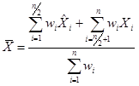
Statistical inference evaluation criteria
Output of mean & other parameters estimates, e. g.
Similarity between original distribution & that with imputed values
, ,
Eurostat

Slide 15
COUNTRY | METHOD | Mean | Mode | Median | STD
ES | ORIGINAL | 1820 | 1400 | 1575 | 10.5
ES | LMS | 1780 | 1400 | 1595 | 8.9
ES | M5P | 1777 | 1400 | 1592 | 9.2
ES | MLP | 1782 | 1400 | 1587 | 9.3
ES | PMM | 1819 | 1305 | 1572 | 10.5
ES | RBF | 1776 | 1400 | 1586 | 9.2
ES | REG | 1775 | 1400 | 1605 | 9.0
AT | ORIGINAL | 2287 | 1800 | 1955 | 27.3
AT | LMS | 2228 | 1915 | 1998 | 21.8
AT | M5P | 2209 | 1915 | 1993 | 21.5
AT | MLP | 2238 | 1915 | 1989 | 23.1
AT | PMM | 2288 | 1500 | 1968 | 25.9
AT | RBF | 2214 | 1915 | 1994 | 21.8
AT | REG | 2205 | 1915 | 1997 | 21.6
Eurostat

Slide 16
Imputation errors for the original Wages variable in one of the simulated files using M5P imputation method
Shrinkage to the mean!!
Eurostat

Slide 17
Country | Method | Hellinger distance | Kolmogorov-Smirnov distance
ES | LMS | 0.050 | 0.031
ES | M5P | 0.043 | 0.028
ES | MLP | 0.036 | 0.023
ES | PMM | 0.015 | 0.009
ES | RBF | 0.041 | 0.027
ES | REG | 0.052 | 0.035
AT | LMS | 0.049 | 0.028
AT | M5P | 0.050 | 0.030
AT | MLP | 0.036 | 0.022
AT | PMM | 0.018 | 0.012
AT | RBF | 0.045 | 0.026
AT | REG | 0.050 | 0.030
Eurostat

Slide 18
Histograms of the Log (wages) variable
Eurostat

Slide 19
But…
When the purpose is obtaining complete files free of missing data…
What happens with the results at a more detailed level of disaggregation? Do the comparative advantages and disadvantages remain?
Eurostat

Slide 20
Example (region of Extremadura in Spain)(1)
METHOD | Correlation | MAE | RMSE | RAE | RRSE
LMS | 0.85 | 317.2 | 489.9 | 54.8 | 57.1
M5P | 0.83 | 313.5 | 489.4 | 54.2 | 57.1
MLP | 0.80 | 337.8 | 521.8 | 58.3 | 60.8
PMM | 0.66 | 504.8 | 731.8 | 87.5 | 86.0
RBF | 0.84 | 314.8 | 480.1 | 54.4 | 56.0
REG | 0.82 | 339.1 | 504.7 | 58.6 | 58.9
Eurostat

Slide 21
Example (region of Extremadura in Spain)(2)
METHOD | Mean | Mode | Median | STD
LMS | 1477 | 1372 | 1348 | 5.7
M5P | 1471 | 1372 | 1337 | 6.0
MLP | 1476 | 1372 | 1340 | 6.1
ORI | 1492 | 1400 | 1317 | 6.8
PMM | 1557 | 1373 | 1374 | 6.9
RBF | 1467 | 1372 | 1323 | 6.0
REG | 1519 | 1372 | 1393 | 5.9
METHOD | Hellinger distance | Kolmogorov-Smirnov distance
LMS | 0.083 | 0.055
M5P | 0.068 | 0.045
MLP | 0.067 | 0.044
PMM | 0.076 | 0.063
RBF | 0.062 | 0.038
REG | 0.088 | 0.086
Eurostat

Slide 22
Thus…
Results at a more detailed level of disaggregation can be reversed…!!!
Eurostat

Slide 23
Final remarks (1)
Data mining procedures provide imputations which reproduce the original individual values sign. better
PMM produces sign. better estimates of means & other statistical parameters for the whole population
Imputations by regression are slightly worse than those of data mining procedures
Eurostat

Slide 24
Final remarks (2)
Paradoxical result: Given an original distribution
one imputed-population has more similar individual values
another imputed-population has more similar distribution parameters
PMM produces random imputations (from regressions) designed to improve σ estimates: at the cost of closeness to individual values!!
Different possibilities to improve data mining imputations
Might it be worth considering also individual one-to-one likeness when assessing similarities between distributions?
Maybe valid inference in the era of data integration, data matching, small area estimation… should be another thing?
Eurostat

Slide 25
Thanks for your attention !!
Eurostat

Slide 26
"…Judging the quality of missing data procedures by their ability to recreate the individual missing values (according to hit-rate, mean square error, etc.) does not lead to choosing procedures that result in valid inference, which is our objective"
Donald B. Rubin, "Multiple Imputation After 18+ Years", JASA, vol. 91, no. 434, June 1996

