Slide 1
Corporate Solutions to Erroneous Dissemination
Steven S. Klement
U.S. Census Bureau

Slide 2
Agenda
Background
Process
Lessons Learned
Future

Slide 3
Background
The Census Bureau is responsible for releasing thousands of data products every year
Each is an opportunity to supply the data-user with needed information
Each is also a chance to release data with errors
“Census mistakes mean a recount for some.” June 28, 2010, Washington Post
“StatsCan admits five-year inflation mistake.” August 16, 2006, CTV
“Census Bureau backtracks on number of same-sex households.” September 27, 2011 Chicago Tribune
Notes:
In times of shrinking budgets, added scrutiny, and an increasing reliance on data-driven decisions by data consumers, the statistical profession should strive to minimize data release errors.

Slide 4
What is Erroneous Dissemination?
QPS defined erroneous dissemination as an error accessible to entities outside of the Census Bureau
Does not include errors found prior to leaving the Bureau

Slide 5
Erroneous Dissemination
Reduced staffs are trying to do more with less
Inevitably some mistakes are not caught until after release to the public
Mid-level managers do not always understand the implications

Slide 6
Initial Response
Census developed a process to handle erroneous dissemination incidents to:
Inform leadership
Inform the public
Identify and correct the source of the error
Not affix blame to individuals
Track incidents over time

Slide 7
Development of the Process

Slide 8
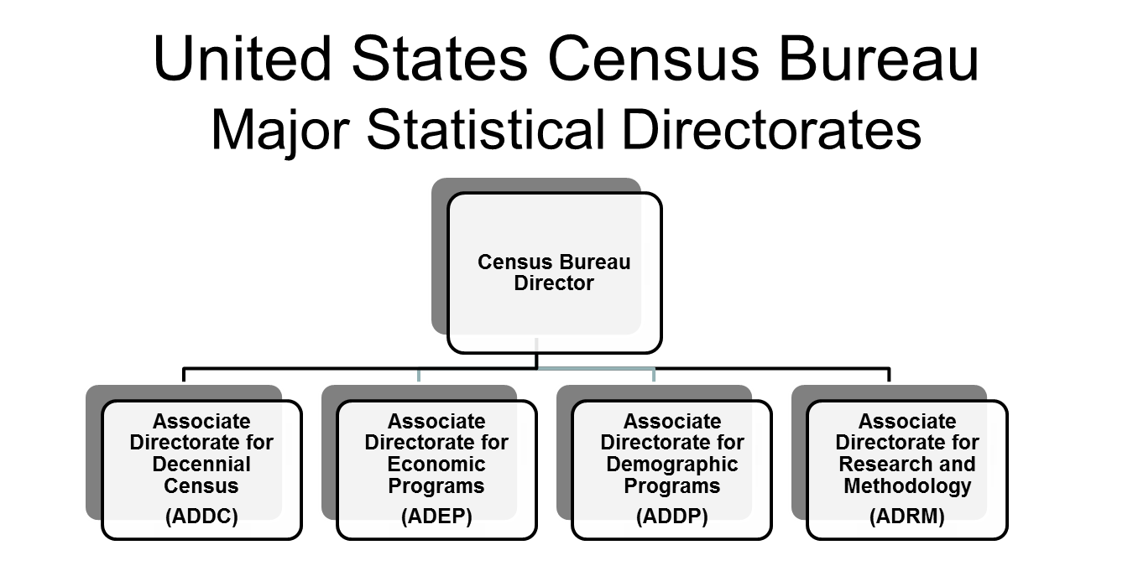
Organization

Slide 9
Developing the Erroneous Dissemination Report
What happened
What caused the issue
What contributed to the issue
What was done to rectify the issue
Follows up actions

Slide 10
Documentation of the Incident (Table A)
17 questions to document the nature of the erroneous dissemination the incident
Description of the incident
What type of error release occurred
When and who reported the incident
Who was notified about the incident
Steps taken to notify the public
Other actions taken

Slide 11
Origin of the Incident (Table B)
Identify the point or failure
Eight categories to classify the error:
Planning/development | Analyzing data/reporting results
Collecting/acquiring data | Releasing information products
Capturing and processing data | Protecting confidentiality
Producing estimates and measures | Other

Slide 12
Factors Associated With the Incident (Table C)
Used to determine all the associated factors that contributed to the incident
A programmer mistypes a line of code
Specification vaguely worded
Not have been properly tested
Supervisor doesn’t check
Adequate quality check not conducted
No individual’s name is listed!

Slide 13
Final Assessment of the Incident (Table D)
Final assessment of the severity of the incident (1-5 scale)
Actions taken to prevent future occurrence
When the actions will be completed
Assess any other vulnerabilities

Slide 14
Preventative Measures (Table E)
Used if Table D leaves open actions
QPS’ responsibility to follow up
Annotate whether the actions are complete
If not complete, document when the next review will take place
Report is complete once all program area actions are complete.

Slide 15
The Reporting Process
Erroneous Data
is released to
the public
Program staff learns of the incident
Program staff completes Table A and sends to QPS
QPS reviews and schedules meeting
Program staff complete Tables B-D, sends to QPS
Tables A-D are reviewed and finalized
Follow up as necessary and complete Table E
Report closed out after all actions performed

Slide 16
Initial Report
Complete the initial report (Table A) when error is reported
Goal is to report within 24 hours
QPS reviews immediately
A meeting is scheduled to discuss the incident - Normally in about two weeks

Slide 17
Meeting to Discuss the Report
Program area completes Tables B-D
Verbal explanation of the incident
Clarifying questions
Correct the report
All parties review again
Some incidents are fixed prior to the meeting
If so, complete Table E and closes out the report
If there are open action, schedule follow-up review

Slide 18
Follow Up
QPS periodically reviews progress
Ensures corrective actions are done
Reviews continue at regular intervals until all actions are complete

Slide 19
Lessons Learned

Slide 20
The Reporting Process
Staff members were unsure of the true intentions of the process
Few reports at first
Reported because the error was too big
QPS has the authority to inquire
Rarely exercised
Want to avoid being the “Dissemination Police”
Once employees realized management’s goal was:
To correct problems
Not to punish staff
…more reports started coming

Slide 21
Corporate Lessons Learned
Many errors unique
About half of errors occur when a long-standing program makes major changes
Manual transfer of data files
Institutional knowledge transfer
Associate Director notification lacking

Slide 22
Future
Share lessons learned
Annual reporting
Developing a database
The long-term goal is that Census
Will have fewer incidents
When necessary, reports are complete and timely done

Slide 23
Questions?
Steven S. Klement
steven.s.klement@census.gov

