Slide 1
Typology of products in Official Statistics
Thomas Burg
Marcus Hudec

Slide 2
Content
Starting Point
Canonical Dimensions for a Typology of Statistical Products
Template
Examples
Impact on Quality Reporting
Conclusions & Next Steps

Slide 3
Content
Starting Point
Canonical Dimensions for a Typology of Statistical Products
Template
Examples
Impact on Quality Reporting
Conclusions

Slide 4
Starting Point
Classical Approach: One-dimensional Type of Statistics
Primary Statistics – Secondary Statistics
Deviation between official statistics and academic statistics
Eurostat handbook on Quality Reports
- Sample Survey
- Census
- Statistical process using administrative sources
- Statistical process involving multiple data sources
- Price or any other economic index processes
- Statistical Compilation

Slide 5
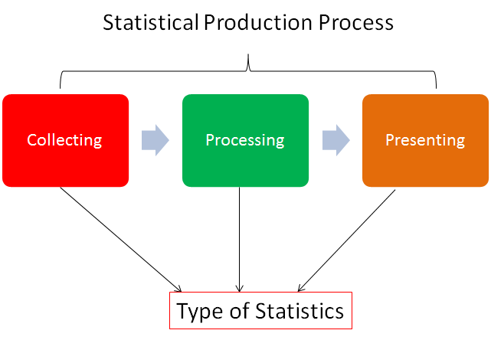
Types of Statistics

Slide 6
Content
Starting Point
Canonical Dimensions for a Typology of Statistical Products
Template
Examples
Impact on Quality Reporting
Conclusions

Slide 7
Canonical Dimensions
Three dimensional approach
Data Collection
Data Processing
Data Presentation ??
Each dimension having its own characterization

Slide 8
Data Collection
Data can be collected having in mind two different purposes:
1. Subject of Statistic 2. Auxiliary Information
Possible data sources for Statistical Products
Survey ⬄ Respondents
Administrative Data⬄ Non-Statistical purpose
Register Data ⬄ Maintained by NSI
Existing Data ⬄ Collected for other product
New Data Sources ⬄ Big Data“

Slide 9
Data Processing (I)
Simple Aggregation(„Normal processing“)
Modell Based Calculations
Accounting
Data Matching

Slide 10
Data Processing (II)
Model Based processing
Can be used for direct calculation but as well at certain product steps aiming to enhance quality
Broad variety but some are typical in official statistics
Weighting of Sampling Schemes
Disaggregation
Index Calculations
Small Area Estimation
Forecasting Methods
Backcasting Methods
Index Calculations
Data Validation Techniques
Statistical Disclosure Control
Flash Estimation
Imputation Techniques

Slide 11
Data Presentation
Classical Statistical Tables
Maps
Indicators
Systems of Accounts
Difficult to assign or rather „not to assign“!

Slide 12
Content
Starting Point
Canonical Dimensions for a Typology of Statistical Products
Template
Examples
Impact on Quality Reporting
Conclusions

Slide 13
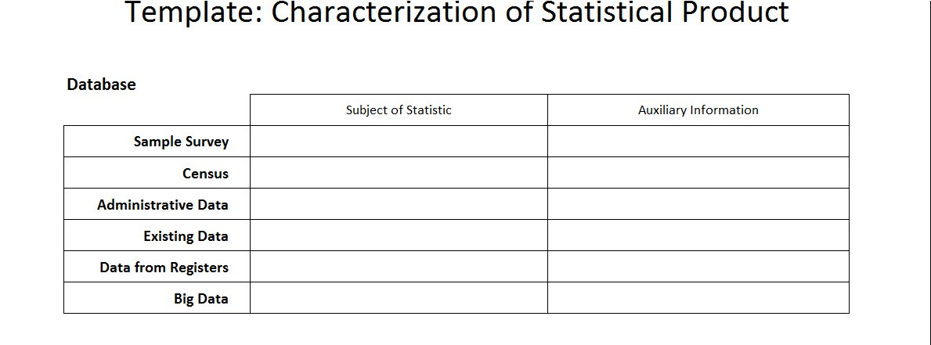
Template (I)

Slide 14
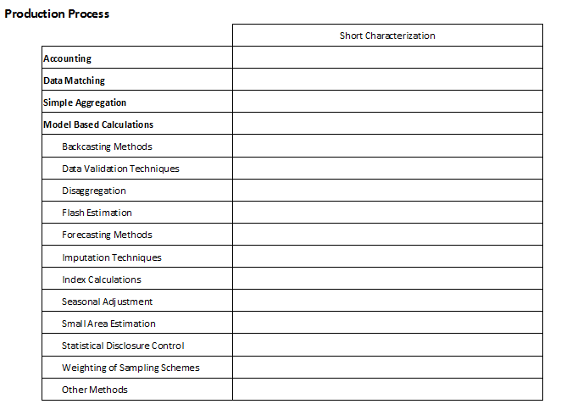
Template (II)

Slide 15
Content
Starting Point
Canonical Dimensions for a Typology of Statistical Products
Template
Examples
Impact on Quality Reporting
Conclusions

Slide 16
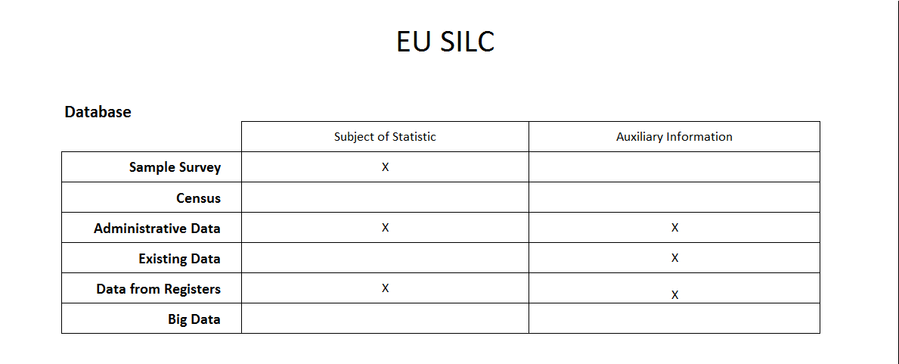
EU SILC (I)

Slide 17
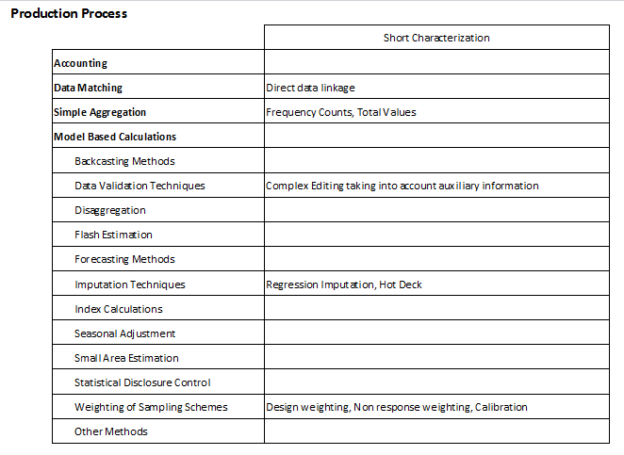
EU SILC (II)

Slide 18
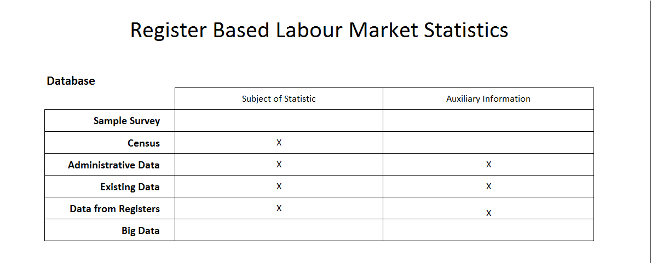
Register Based Labour Market Statistics (I)

Slide 19
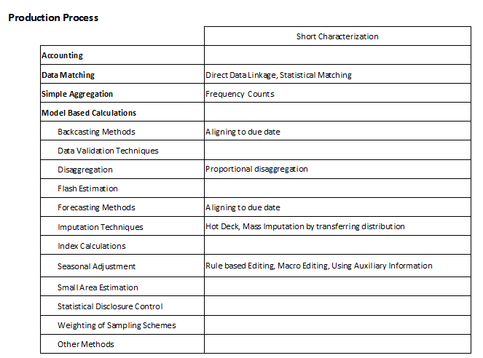
Register Based Labour Market Statistics (II)

Slide 20
Content
Starting Point
Canonical Dimensions for a Typology of Statistical Products
Template
Examples
Impact on Quality Reporting
Conclusions

Slide 21
Impact on Quality Reporting
Set of Metadata relevant for user depends on characteristics of the Statistical Product
All quality dimensions are concerned but first of all
accuracy is a topic.
Certain expectations on quality reporting

Slide 22
Data Sources

Slide 23
Processing
Simple Aggregation | Model Based Processing | Accounting | Data Matching
Availability | Model Diganositcs | Measurement Errors | Matching rates
Completness of Metadata | Goodness of Fit | Top Down vs. Bottom up | Adequcy of Units
 | Description of Methods | Misclassification errors | Homogeneity of underlying concepts
 | Analysis of sensitivity |  | Strength of association

Slide 24
Data Presentation
Contents of Quality report not dependent on characteristics
Accessibility
Clarity
Timeliness
Revisions
Restrictions caused by Statistical disclosure control

Slide 25
Content
Starting Point
Canonical Dimensions for a Typology of Statistical Products
Template
Examples
Impact on Quality Reporting
Conclusions

Slide 26
Main Conclusions
One dimensional approach of assigning a type of statistics is not sufficient
Canonical dimensions can describe the characteristics of a statistical product
Characterization of product has impact on set of metadata and expectations on quality reporting

Slide 27
Next Steps
Sharpening the proposal
Completeness, exact definition etc..
Applying the concept to Standard-Documentation of Statistics Austria

