Slide 1
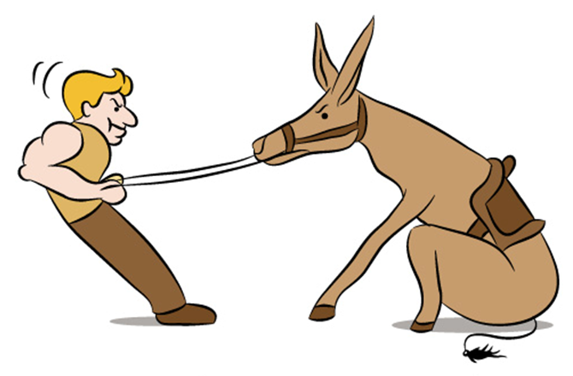
Building strategic partnerships: Improving statistical education and statistical literacy in Ireland
Databank and Dissemination,
Central Statistics Office, Cork, Ireland
Eoin MacCuirc eoin.mccuirc@cso.ie (00 353 21) 453 5504
Notes:
http://caffeinatednightmare.com/blog/wp-content/uploads/2013/10/Stubborn_Donkey.png`

Slide 2
In the beginning… or 2007
Educational outreach fundamental to achieving strategic goals
“To create an educational resource in collaboration with the Dept. of Education and other relevant national and international organisations in order to improve statistical literacy”

Slide 3
Statistical Literacy
Understand and interpret statistical data;
critically evaluate statistical information and data-related arguments;
use the information in context of daily life; and
discuss or communicate one's reactions

Slide 4
Outreach Programme
Primary & Post Primary
CensusAtSchool
John Hooper Medal
Third Level, Government, CPD & Media
The Professional Diploma in Official Statistics for Policy Evaluation
Seminar Series
Cross cohort
Alice Perry Medal – apps4gaps competition

Slide 5
John Hooper Medal
Notes:
A beautiful hand crafted, engraved, silver medal is awarded to each student on the winning team along with individual student and school cash prizes

Slide 6
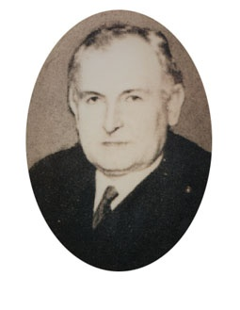
John Hooper (1878 – 1930)
First Director of Statistics for Saorstát Éireann (1923 – 1930)
Education - University Royal University of Ireland, BA, First Class Honours (Mathematics) 1898
Contribution
- Launched first Census of Population and Census of Industrial Production (1926)
- Wrote Statistics Act 1926
- President of the Statistical and Social Inquiry Society of Ireland (SSISI) 1929 - 1930
Notes:
When he died unexpectedly of pneumonia at the age of 51 years.

Slide 7
John Hooper Medal
Launched on
and combined with
Notes:
Very importantly, the John Hooper Medal is an All Island competition

Slide 8
In partnership with

Slide 9
Notes:
The competition accepts posters in Irish and English

Slide 10
Entries & Judging
3 phases - blind
Phase 1 – 2 CSO Statisticians
Phase 2 – 20 CSO staff (statistician and non-statistician)
Phase 3 – Final (6 person external board)
JHM Number of Entries 2011 – 2014
2011: Students Registered 692. Actual Posters 101. 2012: Students Registered 1686. Actual Posters 283. 2013: Students Registered 1281. Actual Posters 253 - agricultural theme
2014: Students Registered 2047. Actual Posters 388.
Notes:
Fiona O'Callaghan (Chairperson) - Central Statistics Office School of Mathematical Sciences - University College Cork Associate Professor of Biomedical Statistics - University of Limerick CALMAST - Waterford Institute of Technology Cork Maths Centre - Cork Institute of Technology
Judges give general feedback, published on the website, on how to improve posters
2011: Students Registered 692. Actual Posters 101. 2012: Students Registered 1686. Actual Posters 283. 2013: Students Registered 1281. Actual Posters 253 - agricultural theme might account for the reduced entries.
2014: Students Registered 2047. Actual Posters 388.
Conversion rate has improved from 15% in 2011 to 20% in 2013

Slide 11
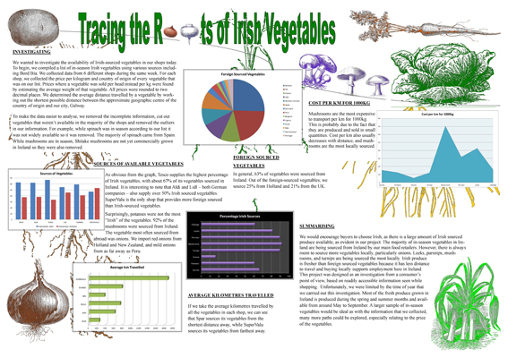
2013 – 1st Place
Aoife Troxel & Sive Neary
Dominican College, Galway

Slide 12
2014 – 1st Place
Liam O’Driscoll & David O’Callaghan
Hamilton High School, Bandon, County Cork

Slide 13
Check out…
http://www.cso.ie/en/newsandevents/youtubevideos/johnhoopermedalforstatistics2013awardsvideo/
http://www.cso.ie/en/studentscorner/johnhoopermedalforstatisticscompetition/

Slide 14
apps4gaps

Slide 17
Partners with

Slide 18
Alice Perry Medal
Alice Perry, (1885-1969)
Alice Perry was born in Galway , Irelandi in 1885. From an engineering family ,Alice graduated with a first class honours degree in Civil Engineering from Queen's College Galway (now NUI, Galway) in 1906. It is understood that she is the first woman to graduate with a degree in engineering in Ireland or Great Britain. It is possible that Alice Perry is the first woman to graduate as an engineer anywhere in the world.
Notes:
http://www.realizedvision.com/ap.php

Slide 19
2014 – 1st Place

Slide 20
2014 – 1st Place

Slide 21
2014 – 1st Place
Best Working App (Student): €1,500 and also judged overall winner of the Alice Perry medal
“Some1LikeMe”
Creators: Jack O’Sullivan, Peter Roe
Teacher: E McNiece
School: Kilkenny College, Castlecomer, Kilkenny
App link: https://play.google.com/store/apps/details?id=com.jackos2500.localstats
Video: https://www.youtube.com/watch?v=r5WsdZGJ4co
Overview: http://vmuss08.deri.ie/apps4gaps/uploads/student-app/soeme1likeme-1397157502/soeme1likeme-overview.pdf
Description: http://vmuss08.deri.ie/apps4gaps/uploads/student-app/soeme1likeme-1397157502/soeme1likeme-description.pdf

Slide 22
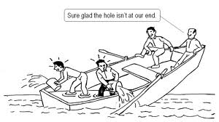
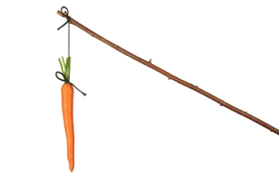
Observations
Notes:
Outreach is core responsibility
Collaboration is absolutely necessary
Think about incentives
Everything online (streamline event management)
Make an event – make it important
Themes may limit numbers, may exclude
Provide feedback from judges (educators) -

Slide 23
Thank You
Questions?

