Slide 1
Quality with variable inputs
Max Booleman
Kees Zeelenberg

Slide 2
Content
The challenge
The process:
Examples outside statistics
Examples inside statistics
Dissemination
Finally
2

Slide 3
The Challenge (1)
Inputs: from full control to no control at all
Primary inputs to secondary inputs to tertiary inputs
Less control over inputs: concepts, quality, timeliness
Tertiary inputs: Big Data: no control at all, even less continuity over time.
3

Slide 4
The Challenge (2)
Produce statistical information which is conceptually consistent and plausible over time with highly variable inputs.
What kinds of processes, organisational requirements and human skills will we need to do this?
4

Slide 5
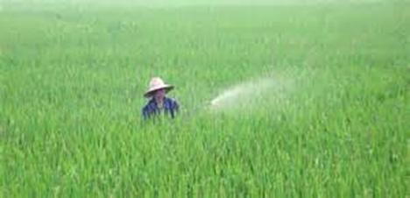
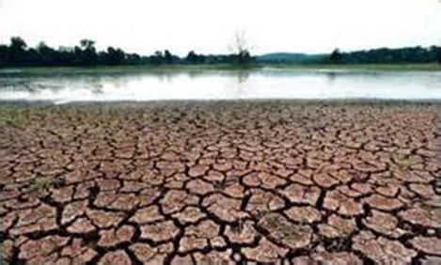
Example 1: the farmer
Predictable inputs: climate, seed variety, seed quality and soil properties.
Less predictable: the weather.
Solutions: green houses, dykes , canals.
Flexible process related to weather conditions:
more human resources
other machinery
artificial rain.
But sometimes crop failure
5
Notes:
A farmer has to deal with predictable and less predictable inputs. Predictable inputs are for instance climate, seed variety, seed quality and soil properties. Less predictable, and certainly in the short term uncontrolled, is the weather. In the medium term the influence of the weather can be controlled by building green houses, constructing dykes or digging canals. The farmer has to adjust his production process to the weather conditions to obtain a profitable amount of good quality crops. Sometimes he will need more human resources, other machinery or artificial rain. But despite his efforts, sometimes his crops will fail.
5

Slide 6
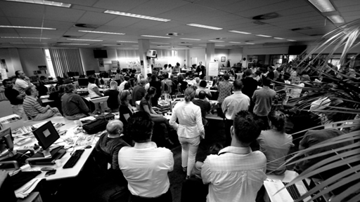
Example 2: the news paper editors
Getting news, deciding how relevant it is, and formulating it understandably for their readers.
The quality of the news and where it emerges are mainly uncontrolled.
Scrum: every morning discuss the work for the coming day.
Professionals: collect, check fact , write
6
Notes:
Another example could be newspaper editors. Their day-to-day work consists of getting news, deciding how relevant it is, and formulating it understandably for their readers. The quality of the news and where it emerges are mainly uncontrolled. The way the work is organized looks like a scrum: every morning they meet to discuss the work for the coming day. Professionals collect the news, do fact checking and convert the news into an article of a certain length, meeting certain quality standards.
6

Slide 7
Example 3: System of National Accounts
Different sources with different quality have to be combined and integrated into a coherent set of indicators.
Sources not completely uncontrolled, but many decisions have to be made in uncertain circumstances
7
Notes:
Different sources with different quality have to be combined and integrated into a coherent set of indicators. Although the sources are certainly not uncontrolled, time and again decisions have to be made in uncertain circumstances
7

Slide 8
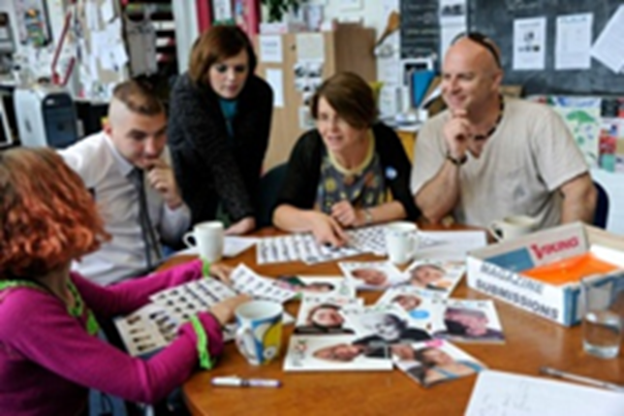
Similarities
Limited scenarios
Professionals with flexible processes
Self supporting groups
Monitor quality during process
Uncontrolled inputs lead to flexibility in tools, costs, efforts.
Self-supporting teams organise themselves on a scrum basis.
GSIM, CSPA will be very important.
8
Notes:
What we see in the example from the previous section is a group of highly flexible and trained professionals who are able to adjust the process at a detailed level. The input and its quality steer the process. During the process, quality is monitored. We also see that there are a limited number of frequently arising scenarios. The weather is wet or dry. The news comes from parliament, news agencies, or has to be gathered by reporters on the spot.
Uncontrolled inputs lead to flexibility in tools, costs, efforts. Self-supporting teams organise themselves on a scrum basis. GSIM will be very important.
There are several forms of flexibility. If interfaces between parts of the process are standardised, as is foreseen in the Generic Statistical Information Model (GSIM) and Common Statistical Production Structure (CSPA), experts could easily switch from one tool to another without bothering about the connections in the production chain. Another way to add flexibility is to adjust the process by setting parameters which also could lead to inclusion or exclusion of tools or parts of tools.
Flexibility also results in more variation in costs and manpower. Self-supporting groups - in which all skills required to run a process are concentrated - is one possible way to organise the work and the office. An example is a scrum: a short meeting every morning to set the targets for that day. Another example is a flex pool of employees: ‘You need a programmer for two days starting tomorrow? Perfect, she’ll be there.’ Or some of the activities could be outsourced to universities, students or temp agencies, especially if the skills they provide are only needed once.
8

Slide 9
Pitfall (1)
Let’s do the same in another way. Or not?
Tourist statistics: use of mobile phones present a broader view on foreign visitors.
In general new techniques and new registrations or sources could lead to proxies, new statistical concepts, which are closer to the potentially already forgotten original target concepts.
9
Notes:
. An example are the Tourists Statistics. New information about the use of mobile phones could present a broader view on foreign visitors. And so, new techniques and new registrations or sources could lead to proxies, new statistical concepts, which are closer to the potentially already forgotten original target concepts. For example: globalisation, common markets, and monetary unions lead to less relevant national and more relevant international figures. Sometimes ‘foreign’ or ‘national’ even seem to become very arbitrary concepts.
9

Slide 10
Pitfall (2)
Our legacy of statistical information is based on past limitations. Do not make the same ‘mistake’ with different inputs or techniques. Start the redesign by exploring the intended use. It could lead to new and more to-the-point concepts or indicators.
10
Notes:
10

Slide 11
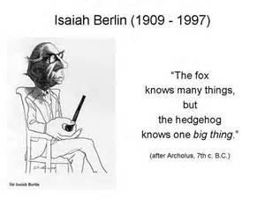
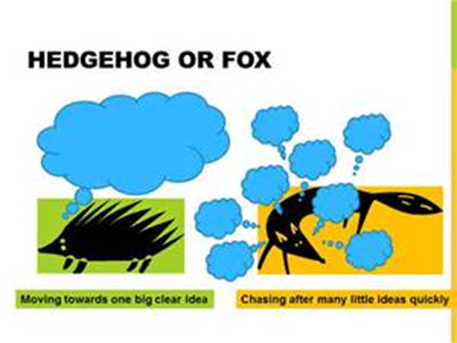
User: fox or hedgehog?
11
Notes:
Remember Tolstoy’s story of the fox and the hedgehog which was used by Nate Silver in The Signal and the Noise. The fox a little bit about a lot of things. The hedgehog knows a lot about a few things. The fox is able to oversee the whole picture, realises the complexity and anticipates better. The hedgehog tends more to use only the information that fits into his own image of reality.
11

Slide 12
User: fox or hedgehog?
Example:
Netherlands facing decline of unemployment figures
good news?
Whole story:
One can only be unemployed if available
Number of jobs: decrease
Number of people increase
12
Notes:
Remember Tolstoy’s story of the fox and the hedgehog which was used by Nate Silver in The Signal and the Noise. The fox a little bit about a lot of things. The hedgehog knows a lot about a few things. The fox is able to oversee the whole picture, realises the complexity and anticipates better. The hedgehog tends more to use only the information that fits into his own image of reality.
12

Slide 13
The fox way
Focus more on changes than on levels.
Show the whole picture. Present integrated pictures and tables to support a holistic view of society. It also makes users less dependent on one - maybe less reliable – indicator
13

Slide 14
The fox way
14

Slide 15
Conclusions
Flexible processes: modules, GSIM, CSPA
Flexible resources: human and financial
Flexible skills
Fox way of presentation
15

Slide 16
Thank you for your attention!
Legacy of statistical information and processes:
We don't make them like that anymore
and it's a good job too!
16

