Slide 1
BES Equitable and Sustainable Well-being in Italy
Fabiola Riccardini - Istat
fabiola.riccardini@istat.it
Q2014 European Conference on Quality in Official Statistics - Vienna, 2-5 June 2014

Slide 2
The BES shared approach
It works through:
a Steering committee of 33 members including representatives from enterprises, trade unions and civil society organizations.
a Scientific commission of 80 members involving high level experts for each domain.
a national survey (45,000 persons interviewed) on the relevance to the Italians of the different aspects of well-being.
an online questionnaire (2,518 respondents) on the validity of the BES framework, the critical and missing issues and the collection of proposals.
a blog collecting analysis, proposals and comments.
the participation of Cnel and Istat’s representatives and experts to several conferences and meetings throughout the country
Q2014 European Conference on Quality in Official Statistics - Vienna, 2-5 June 2014

Slide 3
BES: a complex approach
Annual survey on what is important for wellbeing
(24k households)
Steering Committee
12 Domains
Online survey (2500 people)
and Blog
Discussion
Scientific commission
Meetings in every region
and Blog
134
Indicators
Final report

Slide 4












Key domains for the Italian BES

Slide 5

First Report on Equitable and Sustainable Well-being (BES)
The “Equitable and Sustainable Well-being” is articulate in 12 domains and 134 indicators.
The first report analyze the levels, time trends and distribution of its various components, in order to identify the strengths and weaknesses, as well as particular territorial imbalances or advantaged/disadvantaged social groups.
Q2014 European Conference on Quality in Official Statistics - Vienna, 2-5 June 2014

Slide 6
The tools available in the report and online
For each domain the report analyses the level of well-being and the changes occurred in the period 2004-2011(2).
  Tables at regional level
  Time series graphs
The equity is analyzed by breaking down the indicators at territorial level and, when applicable, by socio-demographic characteristics.
  Ad hoc analysis and graphs.
Trends in well-being (IT, ENG)
Online is available
  the full report (IT)
  the synthesis of the report (IT, ENG)
  The full set of time series tables by region and sex, age and sex
  A platform for the graphical and numerical analysis of the Bes data. http://www.misuredelbenessere.it/index.php?id=49
Q2014 European Conference on Quality in Official Statistics Vienna, 2-5 June 2014

Slide 7
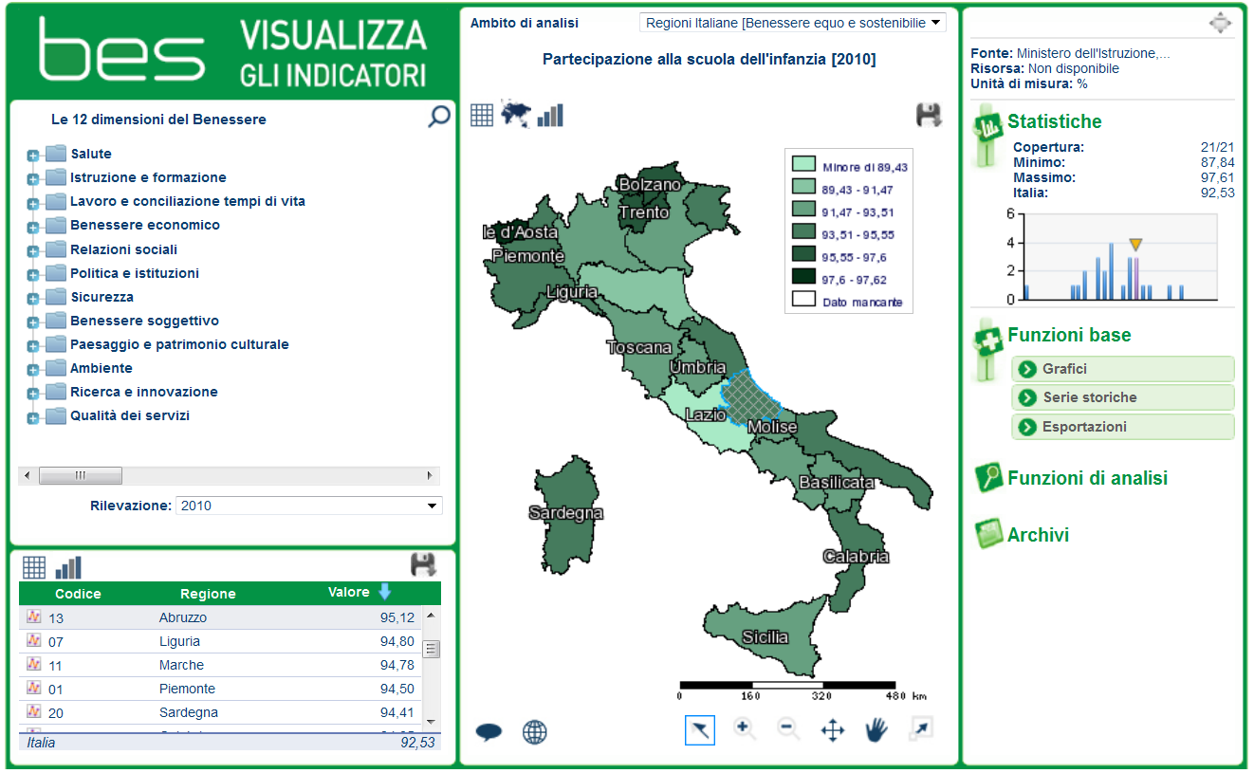
The online platform
Q2014 European Conference on Quality in Official Statistics Vienna, 2-5 June 2014

Slide 8


Q2014 European Conference on Quality in Official Statistics Vienna, 2-5 June 2014

Slide 9


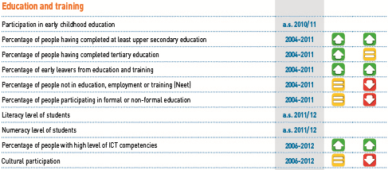
Q2014 European Conference on Quality in Official Statistics Vienna, 2-5 June 2014

Slide 10


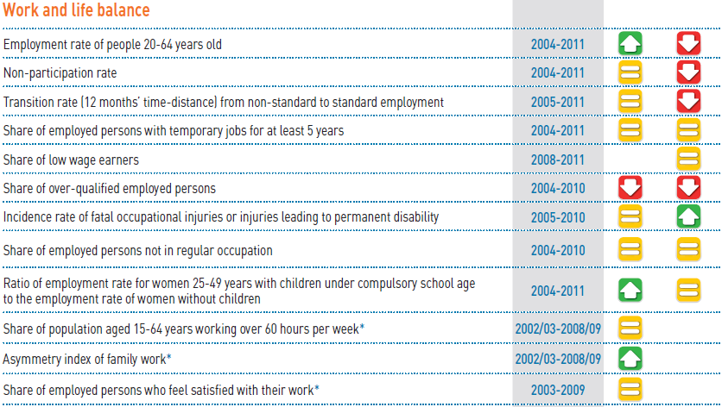
Q2014 European Conference on Quality in Official Statistics Vienna, 2-5 June 2014

Slide 11


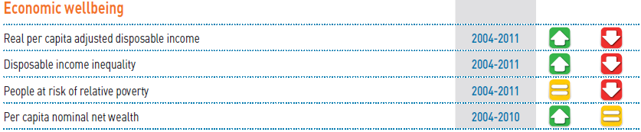
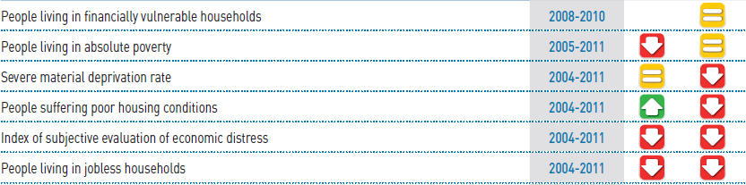
Q2014 European Conference on Quality in Official Statistics Vienna, 2-5 June 2014

Slide 12


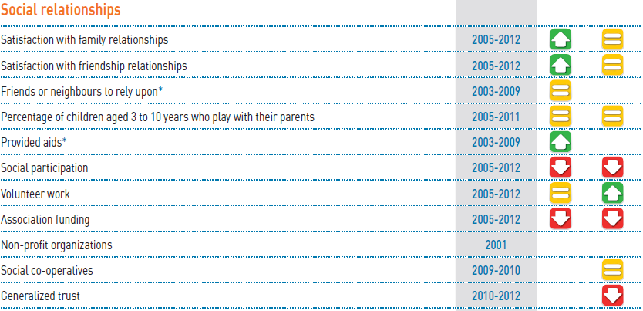
Q2014 European Conference on Quality in Official Statistics Vienna, 2-5 June 2014

Slide 13


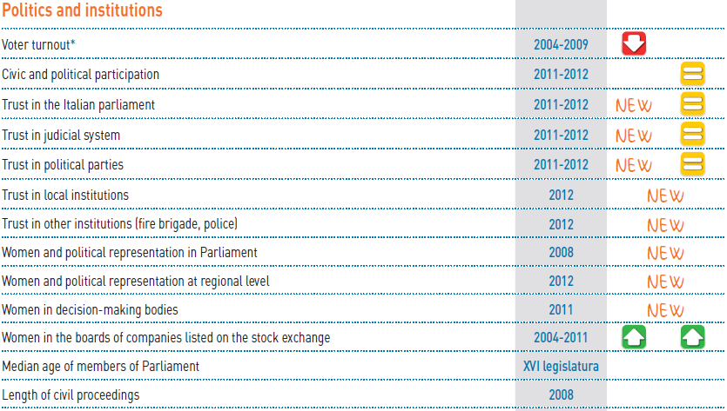
Q2014 European Conference on Quality in Official Statistics Vienna, 2-5 June 2014

Slide 14


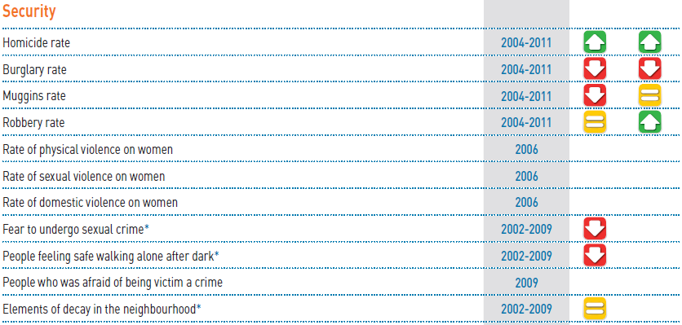
Q2014 European Conference on Quality in Official Statistics Vienna, 2-5 June 2014

Slide 15


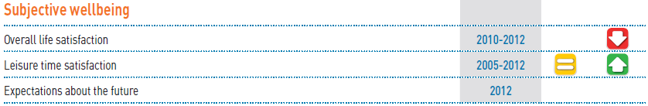
Q2014 European Conference on Quality in Official Statistics Vienna, 2-5 June 2014

Slide 16


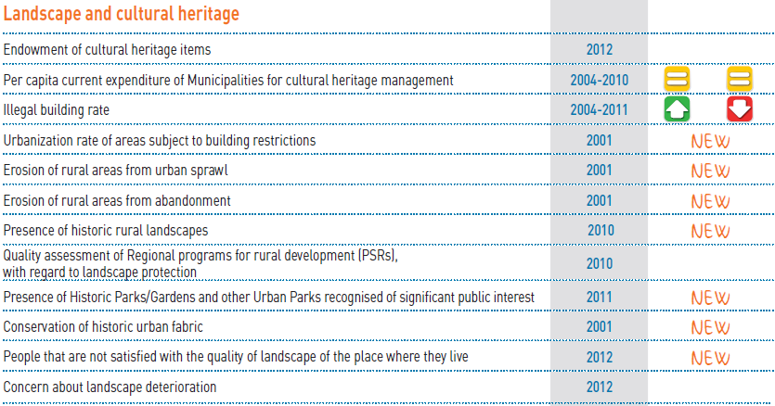
Q2014 European Conference on Quality in Official Statistics Vienna, 2-5 June 2014

Slide 17


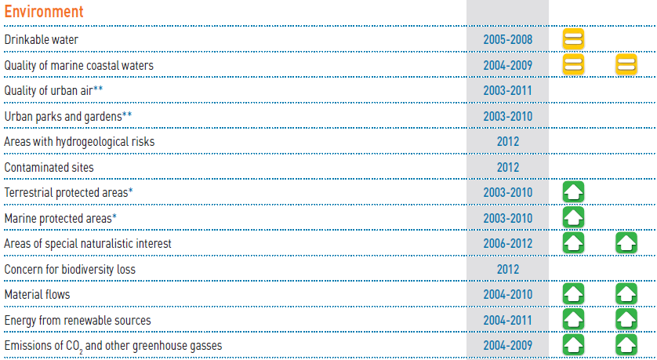
Q2014 European Conference on Quality in Official Statistics Vienna, 2-5 June 2014

Slide 18


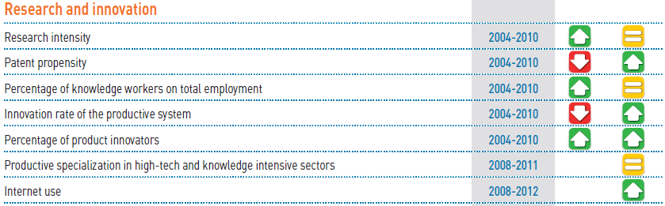
Q2014 European Conference on Quality in Official Statistics Vienna, 2-5 June 2014

Slide 19


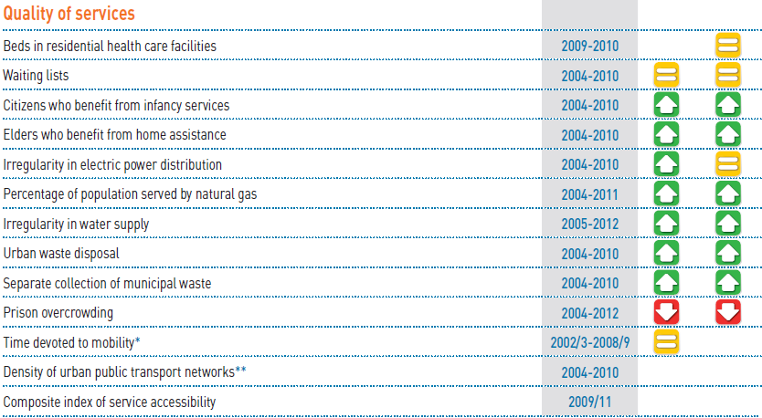
Q2014 European Conference on Quality in Official Statistics Vienna, 2-5 June 2014

Slide 20
- A Second BES Report will be published end of June 2014
- In our DEF (Document of Economic and Financial Planning of Ministry of Economy and Finance) published in May 2014, along with the GDP indicators there is a selection of BES indicators;
At the present

Slide 21
1) composite indicators: experimentations at domain level in order to assess relevance and robustness of different methodologies on restricted groups of indicators;
2) inequalities: measures of distribution among individuals and the breakdown of indicators for different groups (e.g. territories, gender, age, education, income, nationality);
3) sustainability, major challenge for the BES Scientific Commission: select a set of indicators for its assessment will be based around the analysis of the interactions among domains identifying vulnerabilities and resiliencies (combining risk factors analysis, capital approach, capabilities approach) and forecasting models;
4) local level: CNEL and Istat, together with the National Association of Italian Municipalities (ANCI), are exploring the extension of the BES framework at local level through the URBES project. This projects aims at defining a set of well-being indicators for the 15 biggest Italian cities. A first URBES report has been published in June 2013).
Further work

Slide 22
Thank you for your attention

