Slide 1
Quality indicators and quality measurement to foster and enhance cooperation between users and producers

Slide 2
Agenda
Cooperation between users and producers
Quality manuals
Concluding Remarks

Slide 3
1. Cooperation between users and producers
Statistical compilers are always focus on the dimensions of data quality. In fact, the quality dimensions cover all aspects of how statistics meet user needs and their expectations concerning the information disclosed

Slide 4
1. Cooperation between users and producers
Users expect
to obtain reliable data upon which they can base their own decisions
to get timely data, otherwise the data will be useless
to know if statistics will be revised to increase the accuracy and what is the revisions policy followed by the Banco de Portugal
International users
National users
International bodies
EU Member Sates
Market analysts
Central bank
General government
Statistics Portugal
Comercial Banks
Academia
Media
Public

Slide 5
1. Cooperation between users and producers
Statisticians are often accused of speaking their own language and not be fully understood by the media or the general public
So, statisticians need to communicate using accessible language and terminology that are easily recognized by various segments of users

Slide 6
1. Cooperation between users and producers
Some initiatives:
An Interactive Statistics Database on the BP website. This service offers several facilities and options allowing a user-friendly navigation through the statistical information about the Portuguese economy. Users can access a wide range of series comprising these statistics and corresponding metadata and create their own alerts and tables in the Personal Area
System of direct communication between companies and the BP. This service aims to facilitate regular reporting and enhance the quality of elementary information, promoting, simultaneously, a wider use of statistics in particular through the development of feedback information to reporting entities

Slide 7
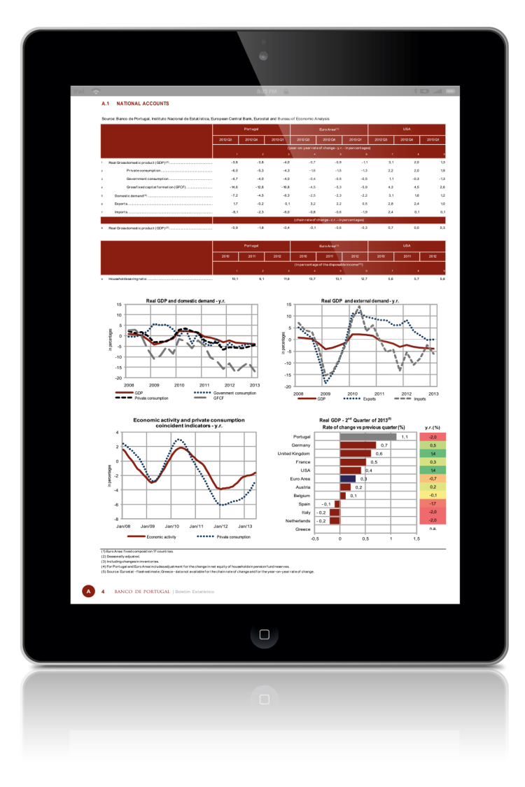
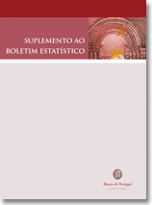
1. Cooperation between users and producers
Some initiatives:
Statistical information is released on a continuous basis on the BP website with the constant concern of statistics disclosing in a clear and comprehensible manner, in tables and graphs to facilitate analysis and enable correct interpretation of results
Several initiatives addressed for the specialized media in the economic area (workshops with journalists), thematic conferences for companies and universities
Publication of quality manuals in line with the principles and indicators of the Public Commitment on European Statistics by the European System of Central Banks

Slide 8
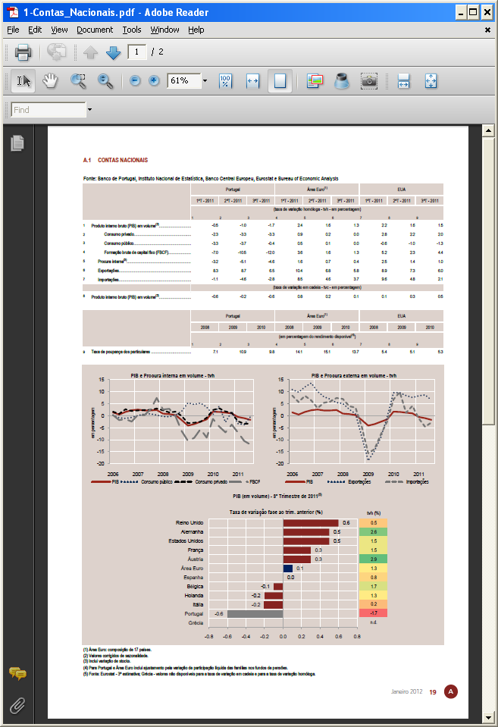
2. Quality manuals
Quality manuals (user’s oriented)
Developed to promote a deeper knowledge and an increased transparency of both, the production processes and the quality control procedures in place. Its goal is to raise understanding of the main procedures and best practices used in the compilation of these statistics, reducing the probability of misunderstandings and helping the users’ understanding of and confidence in BP statistics
Up to now:
Quality management in Banco de Portugal’s statistics (2012)
Quality management in monetary financial institutions’ balance sheet statistics (2013)

Slide 9
2. Quality manuals
Main issues of the quality manuals:
Legal and institutional environment
The institutional environment affects significantly the integrity and credibility of the statistical production. The legal framework for Banco de Portugal statistical production is:
the Organic Law of Banco de Portugal to collect information
the Law on the National Statistical System
the mandate of the ESCB to collect information for the production and dissemination of European statistics
Methodological framework and statistical sources data
The methodological framework for the statistical process follows the internationally accepted standards, guidelines or good practices (the methodological basis of the statistical process, the sources used for the compilation and the collection method are described)

Slide 10
2. Quality manuals
Main issues of the quality manuals:
Quality control procedures
The processes used for the collection, processing and dissemination of statistics and the quality control procedures in place. The statistical quality control in the Statistics Department has two levels:
(i) procedures outside the production cycle
Appointment of contact persons in the reporting institutions and in the Bank
detailed reporting instructions and handbooks are delivered to the reporting institutions
regular meetings and training sessions with the reporting institutions
Quality Assessment Reports
internal working groups to deal with transversal issues
periodic audit operations to the statistical systems conducted by the Bank’s Audit Department or by the Statistical Department (audit operations focused on the analysis of the statistical characteristics of the compilation systems)

Slide 11
2. Quality manuals
Main issues of the quality manuals:
Quality control procedures
(ii) procedures during the production cycle
BPnet - a secure electronic communication system between Banco de Portugal and financial institutions
Corporate Area - a BP website solution of direct communication between companies and Banco de Portugal
specific designed software to facilitate data submission to the Banco de Portugal and allowing the automatic validation of the files received
validation tests are performed on individual and/or aggregated data in the different phases of data processing, and follows mainly three approaches: temporal consistency (analysis of the temporal evolution – month-on-month and year-on-year rates of variation and outliers control), internal consistency (coherence within a set of source data) and external consistency (cross-checking with source data from other sources)
regular statistical production meetings in order to facilitate data sharing discussion and coordination among all staff

Slide 12
2. Quality manuals
Main issues of the quality manuals:
Quality indicators to assess the statistical compilation
This assessment focuses on statistical results, basing the analysis on a series of quality indicators, taking into account their specific nature and critical points in their compilation process. To this end, the Data Quality Assessment Framework’s basic structure (the IMF’s benchmark to assess statistical quality) is used
The results obtained might help compilers to improve the quality of statistics and may help users to understand better the quality of data to anticipate the possible size and direction of forthcoming revisions and to evaluate the impact of using different datasets in their analysis
The assessment analysis is broken down into five levels: statistical analysis measures, revision analysis, internal consistency, external consistency and consistency over time

Slide 13
2. Quality manuals
Main issues of the quality manuals:
Quality indicators to assess the statistical compilation
Statistical analysis measures
To assess whether results for statistics adequately reflect the economic reality, using for that purpose statistical description and analysis measures to assess the quality of statistical calculations
Charts are used to assess the results and to analyze discrepancies and outliers
Revision analysis
To measure the impact of revisions and the degree of confidence that users can place in the early publications of statistics. For this assessment, specific quality indicators are used to compare the first and last versions released (to assess the size/magnitude of such revisions)
Internal consistency
To ensure the internal consistency of statistics by monitoring the residual items and a comparison of flows with stocks in order to monitor price changes, currency fluctuations and other adjustments

Slide 14
2. Quality manuals
Main issues of the quality manuals:
Quality indicators to assess the statistical compilation
External consistency
Comparative analysis procedures are performed using BP’s and similar statistics from other sources, when available (cross-checking statistics for comparable phenomena) and between statistical information and administrative data (accounting data received for supervisory purposes), in order to ensure the overall quality of information disclosed by the Banco de Portugal
Consistency over time
To ensure that there are no series breaks in the released data

Slide 15
3. Concluding Remarks
A key factor in the future success of an organization is its reputation with regard to the quality of its products. Organizations must be dedicated to achieve ongoing improvements in order to meet customer needs as they evolve
In conclusion, it's not enough to have high quality statistical compilation and dissemination systems. It’s also essential to share with users, the knowledge about the production and quality control processes that ensure the compilation of good statistics
Quality manuals are one way to increase the quality of communication for statistical users

Slide 16
THANK YOU FOR YOUR ATTENTION

